Slide 1

Claim 1
Smarter Balanced Sample Items
Grade 3 - Target E
Use place value understanding and properties of operations to perform multi-digit arithmetic.
Questions courtesy of the Smarter Balanced Assessment Consortium Item Specifications – Version 3.0
Slideshow organized by SMc Curriculum – www.ccssmathactivities.com
Notes:
‹#›

Slide 2

#1
Example 1: What is 44 rounded to the nearest ten?
Example 2: What is 456 rounded to the nearest ten?
Example 3: What is 726 rounded to the nearest hundred?

Slide 3

#1 Answer
Rubric:
(1 point each) The student correctly enters the number rounded to the given place.
Answers:
Example 1: 40
Example 2: 460
Example 3: 700
Notes:
‹#›

Slide 4
#2
Example 1: When rounding to the nearest ten, what is the least whole number that rounds to 50?
Example 2: When rounding to the nearest ten, what is the greatest whole number that rounds to 50?
Example 3: When rounding to the nearest hundred, what is the least whole number that rounds to 500?
Notes:
‹#›

Slide 5
#2 Answer
Rubric:
(1 point each) The student correctly enters the least/greatest whole number that rounds to the given number.
Answers:
Example 1: 45
Example 2: 54
Example 3: 450
Notes:
‹#›

Slide 6
#3
Example 1: When rounding to the nearest hundred, what is the greatest whole number that rounds to 500?
Example 2: When rounding to the nearest ten, what is the least whole number that rounds to 520?
Example 3: When rounding to the nearest ten, what is the greatest whole number that rounds to 520?

Slide 7
#3 Answer
Rubric:
(1 point each) The student correctly enters the least/greatest whole number that rounds to the given number.
Answers:
Example 1: 549
Example 2: 515
Example 3: 524

Slide 8
#4
What unknown number makes this equation true?
= 763 + 29
Notes:
‹#›

Slide 9
#4 Answer
Rubric:
(1 point) The student enters the correct difference.
Answer: 792
Notes:
‹#›

Slide 10
#5
What unknown number makes this equation true?
763 – 96 =

Slide 11
#5 Answer
Rubric:
(1 point) The student enters the correct difference.
Answer: 667

Slide 12
#6
Example 1: What unknown number makes this equation true?
763 + 97 = 763 + 100 –
Example 2: What unknown number makes this equation true?
763 + 103 = 763 + 100 +

Slide 13
#6 Answer
Rubric:
(1 point each) The student enters the correct number to make the equation true.
Answers:
Example 1: 3
Example 2: 3

Slide 14
#7
Example 1: What unknown number makes this equation true?
763 + 7 = 700 +
Example 2: What unknown number makes the equation true?
763 + 43 = 800 +

Slide 15
#7 Answer
Rubric:
(1 point each) The student enters the correct number to make the equation true.
Answers:
Example 1: 70
Example 2: 6

Slide 16
#8
Example 1: What unknown number makes this equation true?
763 – 97 = 763 – 100 +
Example 2: What unknown number makes the equation true?
763 – 103 = 763 – 100 –

Slide 17
#8 Answer
Rubric:
(1 point each) The student enters the correct number to make the equation true.
Answers:
Example 1: 3
Example 2: 3

Slide 18
#9
Example 1: What unknown number makes this equation true?
760 – 70 = 760 – 60 –
Example 2: What unknown number makes the equation true?
763 – 43 = 763 – 40 –

Slide 19
#9 Answer
Rubric:
(1 point each) The student enters the correct number to make the equation true.
Answers:
Example 1: 10
Example 2: 3

Slide 20
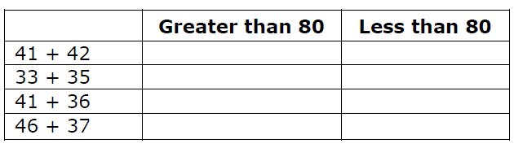
#10
Select whether each sum is greater than 80 or less than 80.

Slide 21

#10 Answer
Rubric:
(1 point) The student enters the correct value for the unknown.
Answer: G; L; L; G

Slide 22
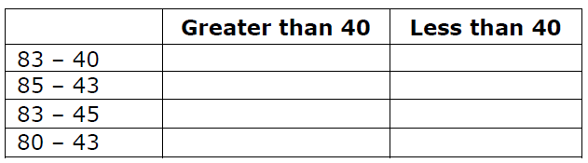
#11
Select whether each sum is greater than 40 or less than 40.

Slide 23
#11 Answer
Rubric:
(1 point) The student enters the correct value for the unknown.
Answer: G; G; L; L

Slide 24
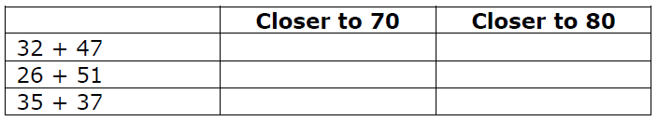
#12
Identify whether each sum is closer to 70 or closer to 80.

Slide 25
#12 Answer
Rubric:
(1 point) The student enters the correct value for the unknown.
Answer: 80; 80; 70

Slide 26
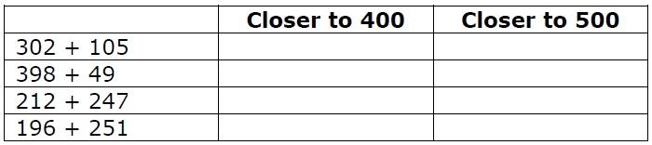
#13
Click the table to show whether each sum is closer to 400 or closer to 500.

Slide 27
#13 Answer
Rubric:
(1 point) The student enters the correct value for the unknown.
Answer: 400; 400; 500; 400

Slide 28
#14
Example 1: What unknown number makes this equation true?
5 x 80 =
Example 2: What unknown number makes the equation true?
3 x = 180
Example 3: What unknown number makes the equation true?
180 = x 3

Slide 29
#14 Answer
Rubric:
(1 point each) The student enters the correct product.
Answers:
Example 1: 400
Example 2: 60
Example 3: 60

Slide 30
#15
Example 4: What unknown number makes this equation true?
60 x = 540
Example 5: What unknown number makes the equation true?
540 = x 60

Slide 31
#15 Answer
Rubric:
(1 point each) The student enters the correct product.
Answers:
Example 4: 9
Example 5: 9

Slide 32
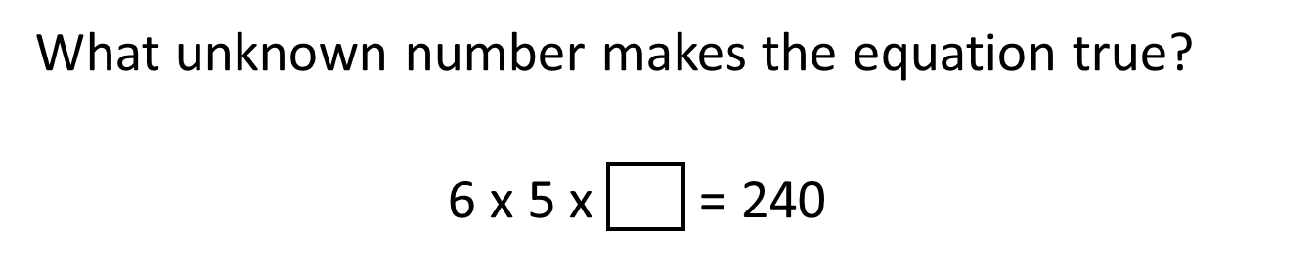
#16

Slide 33
#16 Answer
Rubric:
(1 point) The student enters the correct value for the unknown.
Answer: 8

