Slide 1

Claim 1
Smarter Balanced Sample Items
Grade 3 - Target D
Solve problems involving the four operations, and identify and explain patterns in arithmetic.
Questions courtesy of the Smarter Balanced Assessment Consortium Item Specifications – Version 3.0
Slideshow organized by SMc Curriculum – www.ccssmathactivities.com
Notes:
‹#›

Slide 2

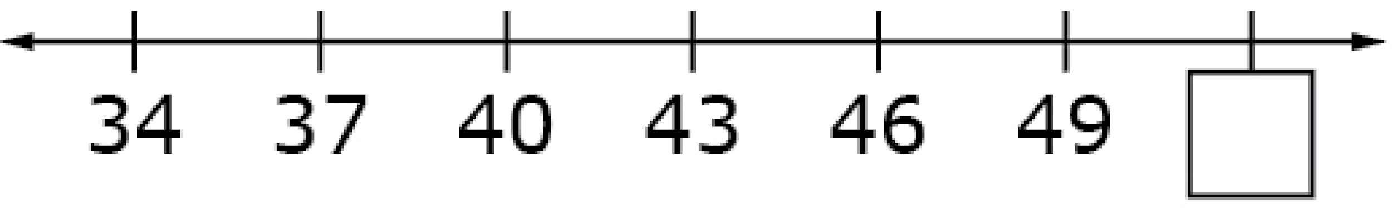
#1
Enter the number that belongs in the box on the number line.

Slide 3

#1 Answer
Rubric:
(1 point) The student enters the correct number for the pattern.
Answer: 52
Notes:
‹#›

Slide 4
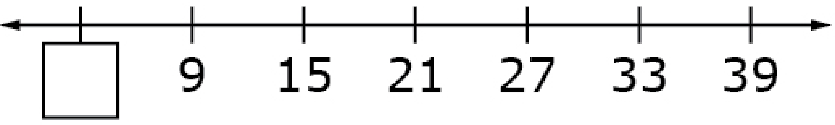
#2
Enter the number that belongs in the box on the number line.
Notes:
‹#›

Slide 5
#2 Answer
Rubric:
(1 point) The student enters the correct number for the pattern.
Answer: 3
Notes:
‹#›

Slide 6
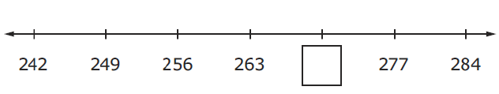
#3
Enter the number that belongs in the box on the number line.

Slide 7
#3 Answer
Rubric:
(1 point) The student enters the correct number for the pattern.
Answer: 270

Slide 8
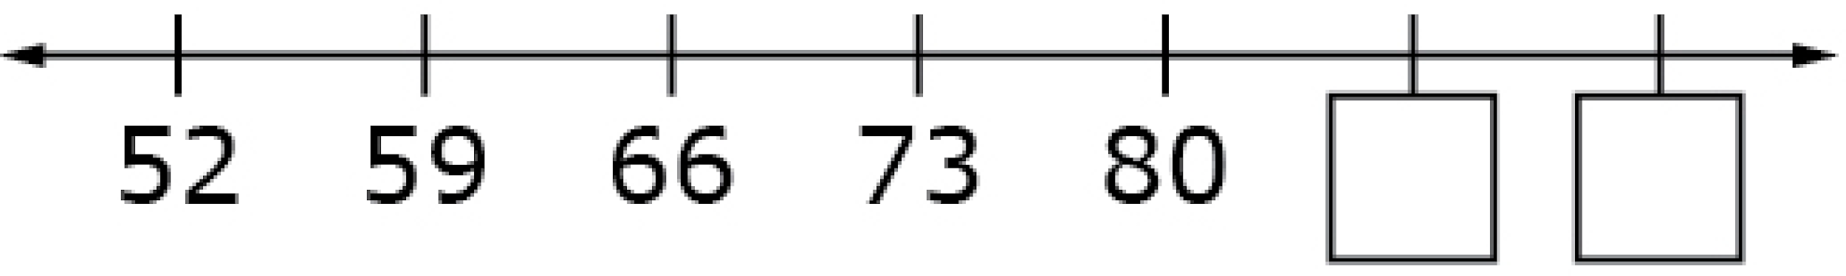
#4
Enter the two numbers that belong in the boxes on the number line.

Slide 9
#4 Answer
Rubric:
(1 point) The student enters the correct numbers for the pattern.
Answers: 87, 94

Slide 10
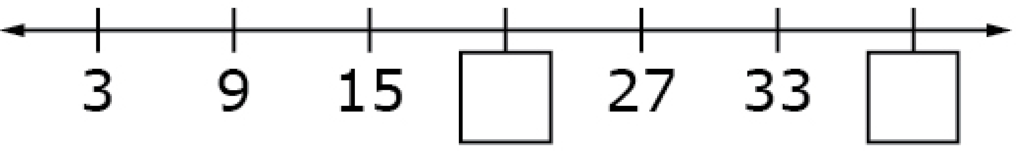
#5
Enter the two numbers that belong in the boxes on the number line.

Slide 11
#5 Answer
Rubric:
(1 point) The student enters the correct numbers for the pattern.
Answers: 21, 39

Slide 12
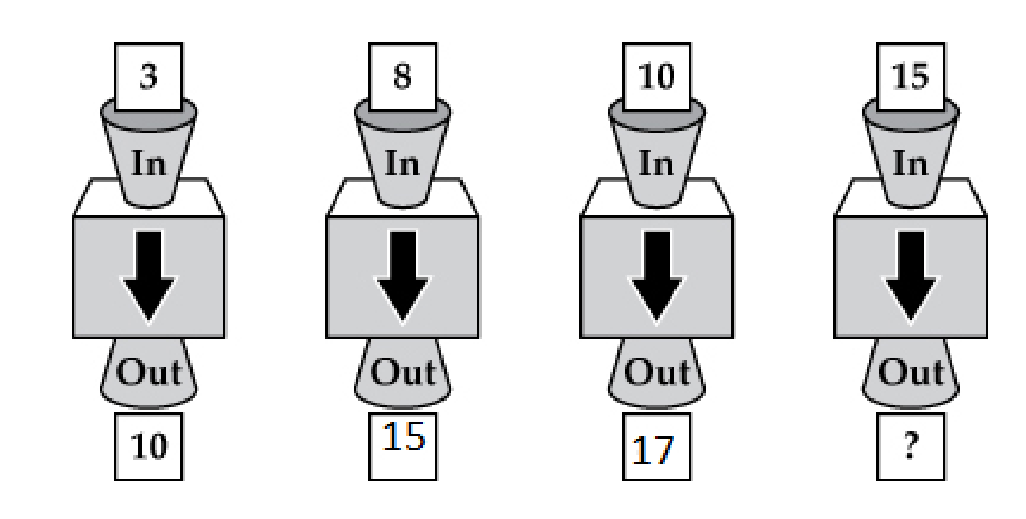
#6
An input/output machine is shown.
The same rule is used for each number that is put in the machine.
Three numbers that came out of the machine are shown.
What number comes out of the machine when 15 is put in?

Slide 13
#6 Answer
Rubric:
(1 point) The student enters the correct number for the pattern.
Answer: 22

Slide 14
#7
Part of a multiplication table is shown.
What number correctly completes the pattern in the table? Enter your answer in the table.
10 |  | 20 | 25
12 | 18 | 24 | 30
14 | 21 | 28 | 35
16 | 24 | 32 | 40

Slide 15
#7 Answer
Rubric:
(1 point) The student enters the correct number in the table.
Answer: 15

Slide 16
#8
Part of a multiplication table is shown.
What two numbers correctly complete the pattern in the table? Enter your answers in the table.
10 |  |  | 25
12 | 18 | 24 | 30
14 | 21 | 28 | 35
16 | 24 | 32 | 40

Slide 17
#8 Answer
Rubric:
(1 point) The student enters the correct numbers in the table.
Answers: 15, 20

Slide 18
#9
Part of a multiplication table is shown.
What three numbers correctly complete the pattern in the table? Enter your answers in the table.
18 | 24 | 30 | 36
21 |  | 35 | 42
24 | 32 |  | 48
27 | 36 | 45

Slide 19
#9 Answer
Rubric:
(1 point) The student enters the correct numbers in the table.
Answers: 28, 40, 54

Slide 20
#10
There are 392 students in Hall Elementary School and 503 students in Jackson Elementary School.
Enter the total number of students in both schools.

Slide 21

#10 Answer
Rubric:
(1 point) The student enters the correct number or equivalent answer.
Answer: 895

Slide 22
#11
There are 425 boys and 510 girls in Franklin Elementary School.
How many more girls than boys are in Franklin Elementary School?

Slide 23
#11 Answer
Rubric:
(1 point) The student enters the correct number or equivalent answer.
Answer: 85

