Slide 1

Claim 1
Smarter Balanced Sample Items
Grade 3 - Target C
Multiply and divide within 100.
Questions courtesy of the Smarter Balanced Assessment Consortium Item Specifications – Version 3.0
Slideshow organized by SMc Curriculum – www.ccssmathactivities.com
Notes:
‹#›

Slide 2

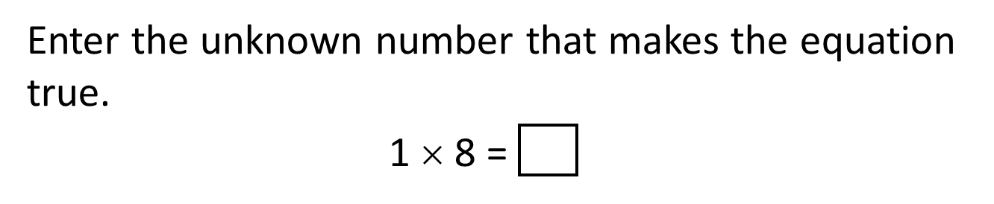
#1

Slide 3

#1 Answer
Rubric:
(1 point) The student enters the correct product.
Answer: 8
Notes:
‹#›

Slide 4
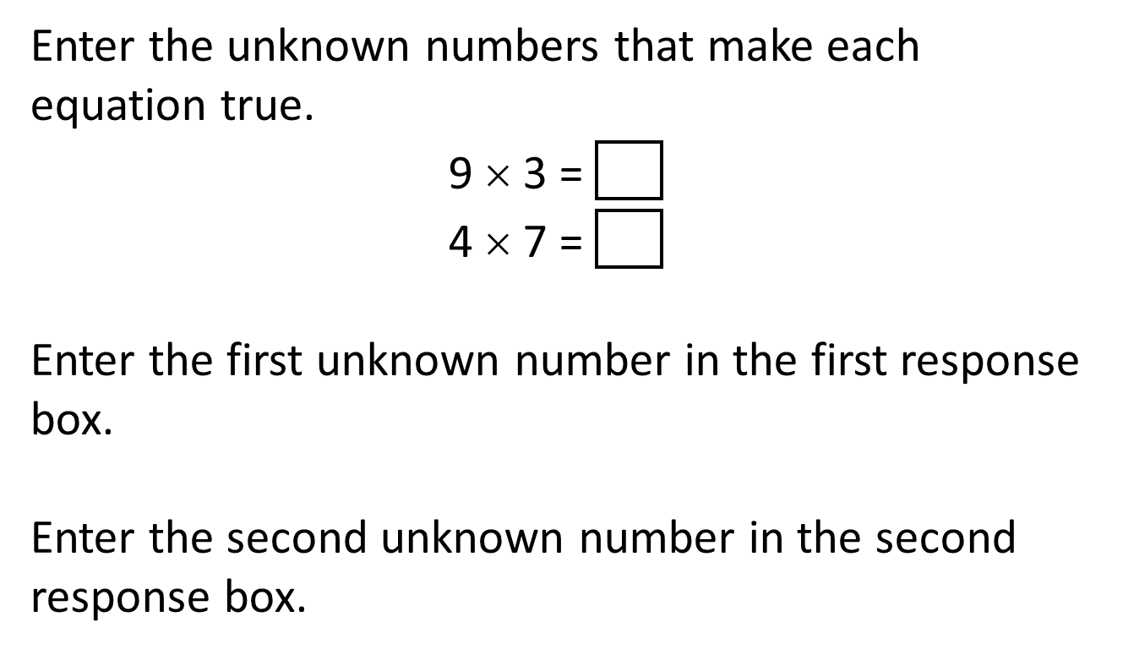
#2
Notes:
‹#›

Slide 5
#2 Answer
Rubric:
(1 point) The student enters the correct products. No partial credit is available for this task model.
Answer: 27, 28
Notes:
‹#›

Slide 6
#3
Select all expressions that equal the given product.
24
6 x 4
7 x 3
9 x 2
3 x 8
4 x 5

Slide 7
#3 Answer
Rubric:
(1 point) The student selects the correct expressions
Answer: A and D

Slide 8
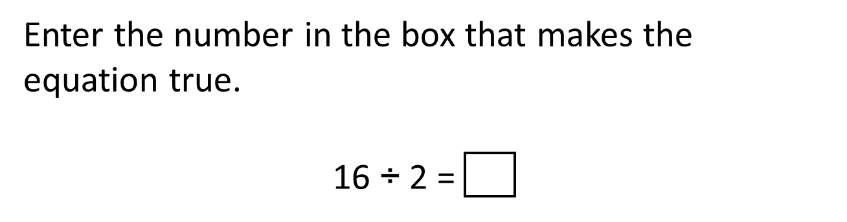
#4
Notes:
‹#›

Slide 9
#4 Answer
Rubric:
(1 point) The student enters the correct quotient.
Answer: 8
Notes:
‹#›

Slide 10
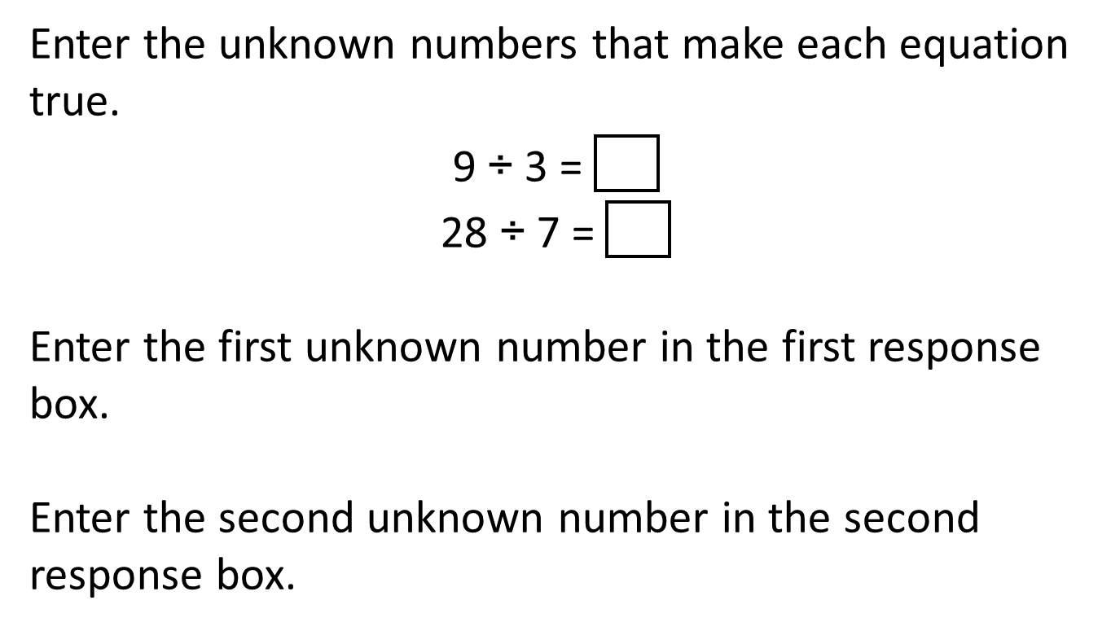
#5

Slide 11
#5 Answer
Rubric:
(1 point) The student enters the correct quotients.
Answer: 3, 4

Slide 12
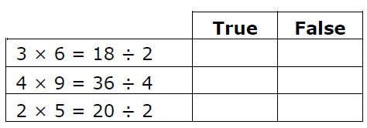
#6
Decide whether each equation is true or false. Click True or False for each equation.

Slide 13
#6 Answer
Rubric:
(1 point) The student answers all three of the equations by correctly identifying each as True or False.
Answer: F; F; T

Slide 14
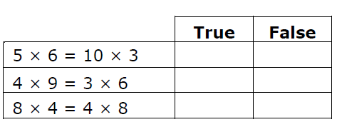
#7
Decide whether each equation is true or false. Click True or False for each equation.

Slide 15
#7 Answer
Rubric:
(1 point) The student answers all three of the equations by correctly identifying each as True or False.
Answer: T; F; T

