Slide 1
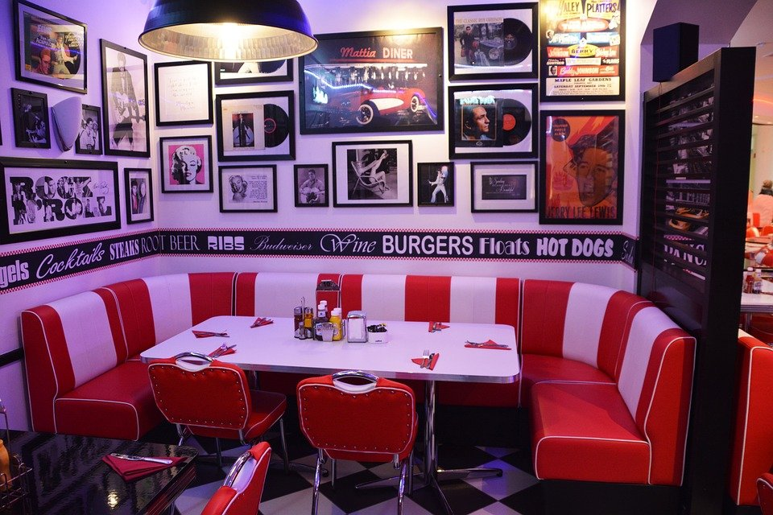
Welcome to the 6th Grade Diner!

Slide 2

Food
Hamburger $6.25
Cheeseburger $7.50
Pizza $10.99
Hotdog $3.55
Drinks
Juice $1.34
Soda $1.50
Milk $1.42
Coffee $1.25
Sides
French Fries $2.25
Chips $1.25
Side Salad $3.25
Desserts
Brownie $3.45
Ice Cream cone $2.43
Cookie $0.95

Slide 3

Selena went to our Diner. She ordered a hotdog and cheeseburger. How much did she spend at lunch?
Price of Hotdog ____________________
Price of Cheeseburger ____________________
+
Notes:
🍐 This is a Pear Deck Drawing Slide
🍐 To edit the type of question, go back to the "Ask Students a Question" in the Pear Deck sidebar.

Slide 4
Selena’s bill came to $12.56. If she paid with $14.75 what would be her change?
–
Notes:
🍐 This is a Pear Deck Drawing Slide
🍐 To edit the type of question, go back to the "Ask Students a Question" in the Pear Deck sidebar.

Slide 5
Brielle and her family went to our diner. They got a ice cream cone, a brownie, and a cookie. How much did they spend on dessert?
Price of an ice cream cone ___________________
Price of a brownie ____________________
Price of a cookie ____________________
+
Notes:
🍐 This is a Pear Deck Drawing Slide
🍐 To edit the type of question, go back to the "Ask Students a Question" in the Pear Deck sidebar.

Slide 6
If Brielle's family paid with $10.00, what would their change be?
–
Notes:
🍐 This is a Pear Deck Drawing Slide
🍐 To edit the type of question, go back to the "Ask Students a Question" in the Pear Deck sidebar.

Slide 7
Haleigh was hungry! She bought a cheeseburger, pizza, and a juice.
Price of cheeseburger ___________________
Price of pizza____________________
Price of a juice ____________________
+
Notes:
🍐 This is a Pear Deck Drawing Slide
🍐 To edit the type of question, go back to the "Ask Students a Question" in the Pear Deck sidebar.

Slide 8
If Haleigh paid with $20, what would her change be?
–
Notes:
🍐 This is a Pear Deck Drawing Slide
🍐 To edit the type of question, go back to the "Ask Students a Question" in the Pear Deck sidebar.

Slide 9
Chris had $9.50 to spend. What are 2 items she could get for lunch and still have some money left over?
Price of item #1 ___________________
Price of item #2 ____________________
+
Notes:
🍐 This is a Pear Deck Drawing Slide
🍐 To edit the type of question, go back to the "Ask Students a Question" in the Pear Deck sidebar.

Slide 10
Jaime, Antonio and Michelle each got an ice cream. How much is it for all 3 ice creams?
Price of 1 ice cream cone ___________________
+
Notes:
🍐 This is a Pear Deck Drawing Slide
🍐 To edit the type of question, go back to the "Ask Students a Question" in the Pear Deck sidebar.

