Slide 1
World war ii-allied powers
by: Taylor Register

Slide 2
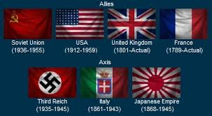

Slide 3
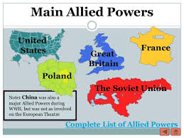
Allied powers
Major Allied Powers: Britain, France, Russia, and the United States
Formed as a defense against the attack of the Axis Powers
Original members were: Great Britain, France, and Poland
  Germany invades Poland, Great Britain and France comes to Poland's aide and declare war on Germany

Slide 4

Russia Becomes an ally
Friends with Germany at the start of WWII
June 22, 1941- Hitler orders a surprise attack on Russia, catching Stalin off guard
  Operation Barbarossa- German invasion of Soviet Union
  Germany wanted Russia’s oil fields, its’ agricultural resources, and to use its’ citizens for manual labor
Causes Russia to flip sides and join the Allies

Slide 5
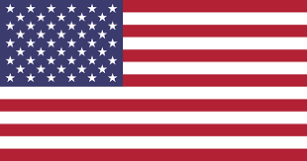
The United states joins the allies
U.S. had hopped to remain neutral throughout WWII
December 7th, 1941- the Imperial Japanese Navy launches a surprise attack on the U.S. Naval base at Pearl Harbor, Hawaii Territory
America officially joins the war a day later on Dec. 8th, 1941- two years into WWII

Slide 6
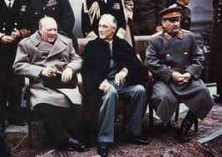
Leaders of the Allied Powers

Slide 7
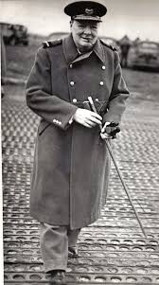
Winston Churchill
Prime Minister of Great Britain during WWII
His country was the last country fighting against the Germans in Europe
Known for his famous speeches to his people when the Germans were air bombing the during the Battle of Britain

Slide 8
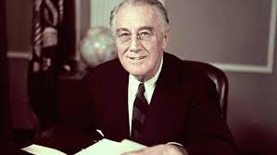
Franklin D. Roosevelt
One of the Greatest U.S. Presidents of all time
Led the United States out of the Great Depression and into WWII

Slide 9
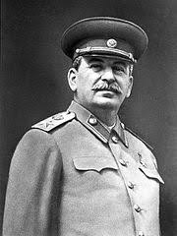
Joseph Stalin
Stalin’s title was General Secretary of the Communist Party
Fought Germany on the Eastern front losing millions and millions of people
He Set up the Eastern Bloc of Soviet led communist states after WWII had ended

Slide 10
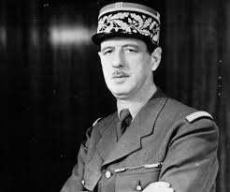
Charles de Gaulle
Leader of the Free French
Commander of the resistance movement against Germany during WWII
Would become President of the 5th Republic of France

Slide 11
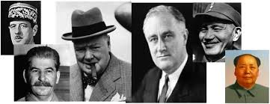
Other allied leaders and generals during wwii

Slide 12
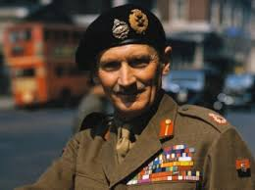
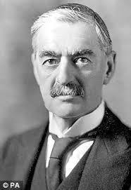
Great Britain
Bernard Montgomery
Neville Chamberlin
General of the British Army
Nickname- “Monty”
Led ground troops during the invasion of Normandy
Prime Minister of Great Britain prior to Winston Churchill
Known for trying to keep peace with Germany by practicing the art of appeasement.

Slide 13
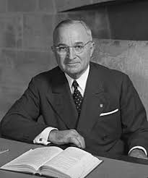
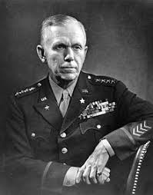
United States
Harry S. Truman
George Marshall
Replaced Roosevelt as President after Roosevelt’s Death
Known for ordering the atomic bombing of 2 Japanese cities
  Nagasaki and Hiroshima
General of the U.S. Army during WWII
Came up with the idea known as the Marshall Plan
  Marshall Plan= European Recovery Program

Slide 14
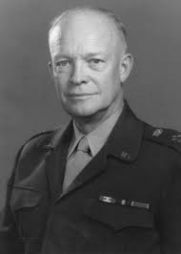
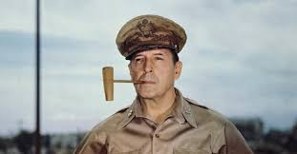
United States
Dwight D. Eisenhower
Douglas MacArthur
Leader of the U.S. army in Europe
AKA- “Ike”
Planned and led the invasion of Normandy
General of the Army in the Pacific fighting the Japanese
Commander of Allied Troops in the Phillippines

Slide 15
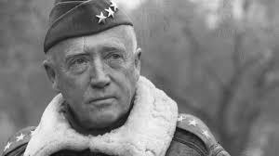
United States
George S. Patton
Important General in North Africa and Europe
Leader of the U.S. Third Army

Slide 16
Chester Nimitz
Omar Bradley
Commander and Chief of Pacific forces for the United States and Allied forces during WWII
Responsible for defending Midway Island and stopping Japanese advancements
Prominent U.S. General in North Africa and Europe during WWII
Led massive air bombardment against the Axis powers at St. Lo

Slide 17
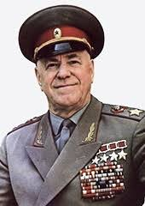
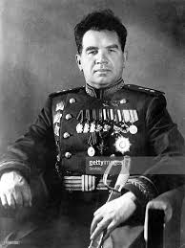
Russia
Georgy Zhukov
Vasily Chuikov
Leader of the Russian Red Army
Led the army that would push the Germans back to Berlin
General of the Russian Army in defending Stalingrad against fierce German attack

Slide 18
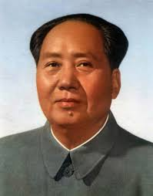
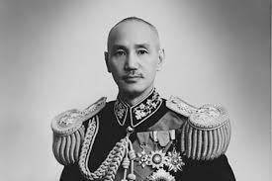
China
Chiang Kai-shek
Mao Zedong
Leader of the Republic of China
Allies with the Chinese Communist Party to fight the Japanese
Flees mainland China after the war to Taiwan
Leader of the Communist Part of China
Allies with Chiang Kai-shek in order to fight the Japanese
Gains control of mainland China after WWII

