Slide 1
Unit 5 Section 8
Fourteen Points and Treaty of Versailles

Slide 2
Wilson’s Take on the War
Before U.S. entry into war, President Wilson had tried to convince both sides to stop fighting
Promoted idea of “peace without victory”
Knew if one side was victorious, the other side would be punished, continuing troubles in Europe
Eventually decided to take Allied side as war continued

Slide 3
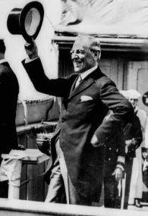
Wilson’s Plan for Peace
Wilson hoped this would be “the war to end all wars”
Plan for peace included ideas to eliminate future conflict
“Fourteen Point Plan”

Slide 4
Fourteen Point Plan
Presented plan to Congress, January 1918.
Ideas to prevent future conflict:
No secret treaties
Freedom of the Seas
Lower tariffs
Arms reduction
End to imperialism
Points 6 – 13 addressed redrawing borders…
14th Point – creation of a League of Nations to keep peace
Hughes explains

Slide 5
Versailles Peace Conference
Britain, France, Italy, United States – “Big Four” meet at Versailles, France
Germany and Russia – left out of negotiations
Other Allies want to punish Germany for war – reject majority of Wilson’s 14 Points
Britain Prime Minister David George had just been re-elected with campaign slogan “Make Germany Pay.”

Slide 6
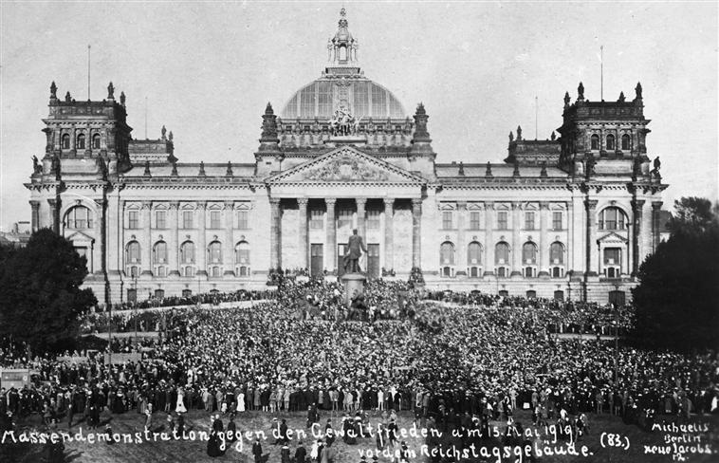
Terms of the Treaty
Creation of 9 new nations including Poland, Czechoslovakia, Yugoslavia, Hungary
Bars Germany from having an army
Forces Germany to pay reparations of $33 billion to Allies
Germany must sign war guilt clause
Takes away German colonies in Pacific
Germans protest the treaty.

Slide 7
Problems with the Treaty
Humiliated Germany
Impossible for Germany to pay reparations
Excluded Russia
Angered Japan
Did not stop imperialism/colonialism
history channel clip

Slide 8
American Opposition
Many Americans think treaty is too harsh
Others worry it does not address questions of imperialism and self determination
Some see it as economic disaster in the making
Main point of opposition – League of Nations
Americans fear that it threatens US ability to stay out of foreign affairs – Sen. Henry Cabot Lodge is most vocal opponent

Slide 9
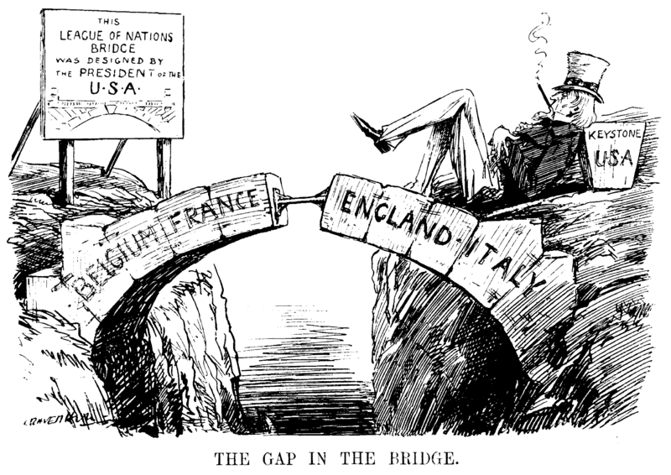
American Opposition
Woodrow Wilson sets out to win approval
Has a debilitating stroke in October, 1919
US fails to ratify Treaty of Versailles – does not join newly formed League of Nations

Slide 10
Domestic Legacy of WWI
American industry grows to unprecedented levels
Movement of hundreds of thousands of African Americans into Northern cities
Intensified Anti-immigrant, Anti-labor feelings
Brought over 1,000,000 women into workforce

