Slide 1
**Monday school holiday
Tuesday → Sick day
Wednesday
October 11th
2023
Period 1, 2, & 4

Slide 2




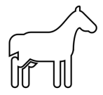





Slide 3
Do Now
Name: __________________
Each symbol represents a number, determine the value of each symbol.
26 = 8 + | – 7 = 13 | 10 = 40
3 + = 8 =
=
=
=
= 2
+ 11 = 20
8
=
=
Do Now
Name: __________________
Each symbol represents a number, determine the value of each symbol.
26 = 8 + | – 7 = 13 | 10 = 40
3 + = 8 =
=
=
=
= 2
+ 11 = 20
8
=
=

Slide 4

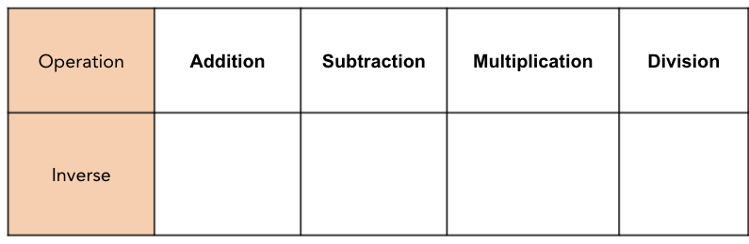
Name_____________________________ Date_____________
Math 1B Classwork 2.4
One Step Equations
What is an Equation?
Equation:
An _______________________ says that two things are ______________.
It will ALWAYS have an equals sign “=”
Variable
A __________________ is a symbol for a
___________________ we don’t know yet.
It is usually a ____________________ like x or y.
26 = 8 + x
How do we solve equations?
The goal of solving an equation is to _______________________ the variable . (Get the variable ______________________ on one side)
We can isolate the variable using _______________________ (opposite) operations. These are operations that “undo” each other or will move a __________________ to the other side of the equal sign.
Examples: If you have this… what's the inverse?
+ 3 the inverse is…
- 5 the inverse is…

Slide 5
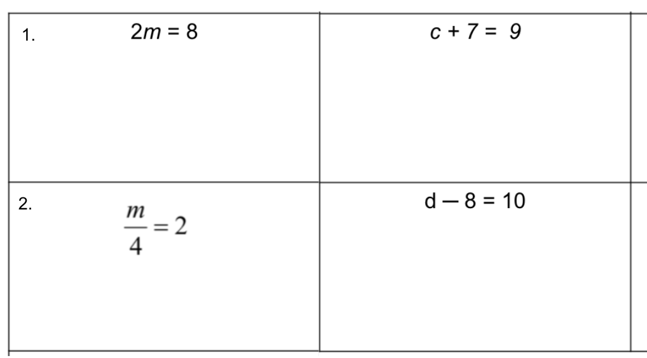
Using Inverse Operations →
The operation is ___________________.
So the inverse operation is ______________.
To get the variable by itself, we must ___________ each side by ______.
The operation is ___________________.
So the inverse operation is ______________.
To get the variable by itself, we must ___________ each side by ______.
3.
The operation is ___________________.
So the inverse operation is ______________.
To get the variable by itself, we must ___________ each side by ______.
4.
The operation is ___________________.
So the inverse operation is ______________.
To get the variable by itself, we must ___________ each side by ______.

Slide 6
Name_____________________________ Date_____________
Math 1B Practice 2.4
Practice Solving One Step Equations
1. | 2. | 3.
4. | 5. | 6.
7. | 8. | 9.

Slide 7
10. | 11. | 12.
13. | 14. | 15.
16. | 17. | 18.

Slide 8
Thursday
October 12th
2023
Period 1, 2, & 4

Slide 9
Do Now
Name: __________________
Solve the following one-step equations.
5 + x = -14 | x - 6 = 17 | 8x = 32
10x = -29 | 34 = -4 + x | -3x = 12
x = 6 3 . | x = 15 7 . | 2 = 4x
Do Now
Name: __________________
Solve the following one-step equations.
5 + x = -14 | x - 6 = 17 | 8x = 32
10x = -29 | 34 = -4 + x | -3x = 12
x = 6 3 . | x = 15 7 . | 2 = 4x

Slide 10
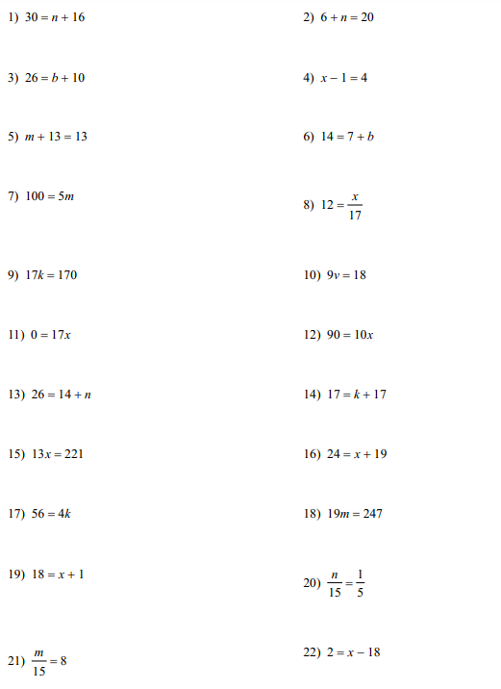
Name: __________________
One Step Equations Practice
Notes:
1st color identify all the addition problems, 2nd subtraction, 3rd multiplication, 4th division

Slide 11
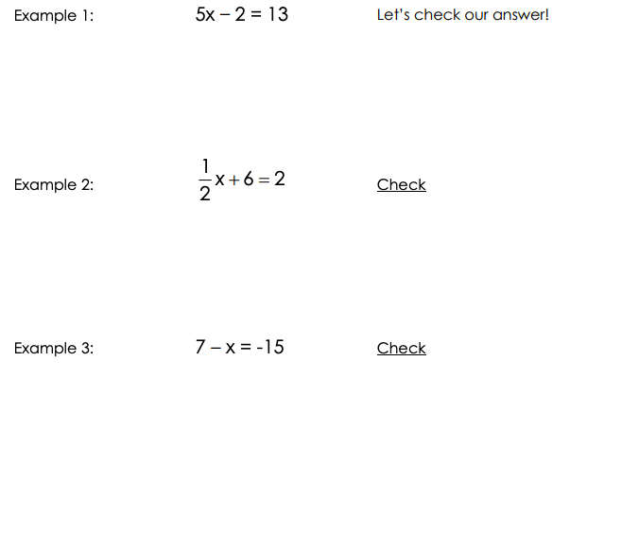

Name_____________________________ Date_____________
Math 1B Classwork 2.5
Multi Step Equations
2-Step Equations
Goal: Get the variable ALONE using inverse operations.
In an equation which has more than one operation, we have to undo the operations in the correct order.
Step 1: Undo addition or subtraction (We move the number without the variable 1st)
Step 2: Undo multiplication or division.
–15 = x – 7
You Try! →
Check

Slide 12



Distribute & Combine Like Terms → REVIEW
Reminder/Example: –4(x + 3) + 2(3x –6)
You Try →
5(3x + 1) – 7(x – 2)
Multi-Step Equations
Step 1: DISTRIBUTE and COMBINE LIKE TERMS on each side of the equation
Step 2: Undo addition or subtraction (We move the number without the variable 1st)
Step 3: Undo multiplication or division.
Example:
You Try →

Slide 13



More Examples…
1. | Check
2. | Check
3. | Check
4. | Check

Slide 14
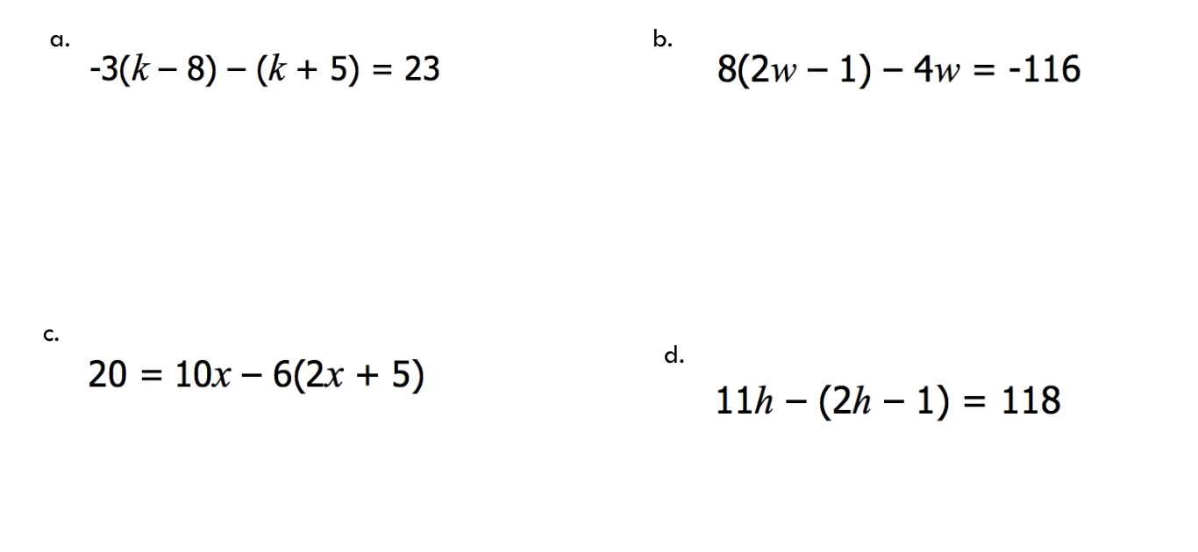
5. | Check
6. | Check
7. | Check
8. | Check

Slide 15
P2 → Assembly 10:30 am
Friday
October 13th
2023
Period 1 & 2
Notes:
Delta math day

Slide 16
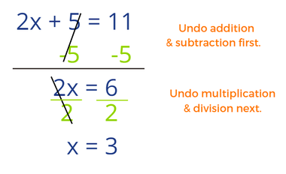
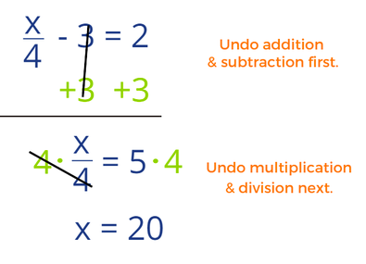
p1
Do Now
Name: __________________
EXAMPLE 1
EXAMPLE 2
Use the examples here to answer the 4 questions on the back
Do Now
Name: __________________
EXAMPLE 1
EXAMPLE 2
Use the examples here to answer the 4 questions on the back

Slide 17
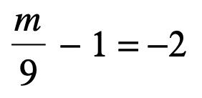

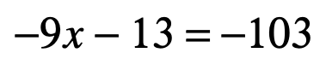

p1
1. | 2.
3. | 4.
1. | 2.
3. | 4.

Slide 18
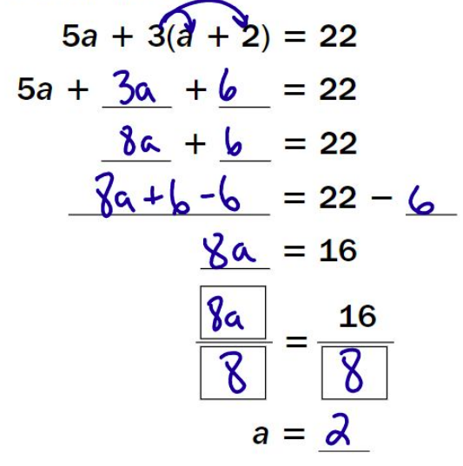

p2
Do Now
Name: __________________
Example 1
Solve:
2(3x - 4) - 3(2x + 1) = 10
Do Now
Name: __________________
Example 1
Solve:
2(3x - 4) - 3(2x + 1) = 10

Slide 19
p1&2
Exit Ticket
Name: __________________
Solve for x.
2(2x + 3) - 3(5x - 2) = 4
Exit Ticket
Name: __________________
Solve for x.
6(2x - 3) - 4(4x + 1) = 22

Slide 20
p1&2
Exit Ticket
Name: __________________
Solve for x.
4(3x - 1) - 2(2x - 4) = 16
Exit Ticket
Name: __________________
Solve for x.
5(3x - 2) - 2(4x + 5) = 8

