Slide 1
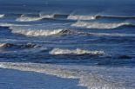
Waves move through oceans.

Slide 2
Videos
Click on this link to watch a video about tides. http://studyjams.scholastic.com/studyjams/jams/science/weather-and-climate/tides.htm
Click on this link to watch a video about waves.
http://studyjams.scholastic.com/studyjams/jams/science/weather-and-climate/waves-and-currents.htm

Slide 3

Waves form in the open ocean.
A wave is an up and down motion along the surface is of a body of water
The size of waves is usually caused by winds
Waves can also be caused by earthquakes, landslides, and underwater volcanic eruptions

Slide 4
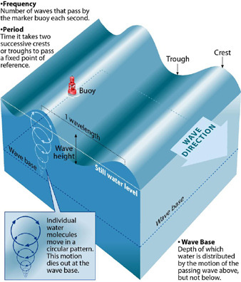
Wave action at the water’s surface
There are four parts to waves:
  Crest: high point of a wave
  Trough: low point of the wave
  Wave height: vertical distance between the top of the crest and bottom of trough
  Wavelength: distance between one wave crest and the next
  Waves move energy, the water stays more or less in the same place.
  Most waves only affect the water near the surface. At a certain depth, the waves no longer affect the water.

Slide 5
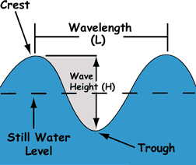

Slide 6
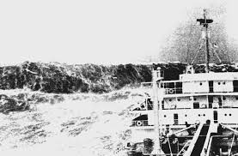
Rogue Waves
Click here to read about rogue waves. http://oceanservice.noaa.gov/facts/roguewaves.html
Rogue waves sound like something straight out of a sailor's tall tale: ominous, mysterious, solitary waves of enormous height crashing down on ships at sea in seemingly calm waters. But as improbable as they might seem, recent st­udies suggest these rogues are more common than anyone previously guessed.
Imagine having an 80-foot wall of water barreling toward you. Actually, that might be too tall an order. It's easy to throw around heights like 50 feet or 90 feet without really grasping how huge a wave of such height would be. Here are some handy comparisons:
  The average room in your house is probably about 8 feet high.
  A typical two-story house is between 20 and 30 feet high.
  The Statue of Liberty is 111 feet tall from her toes to the top of her head, not counting the pedestal or her arm and torch.

Slide 7
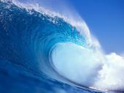
Wave action near the surface
When waves reach the shallow water, they lose speed and the crest eventually falls over the trough. This is when they lose their energy. This is called a BREAKER.
When waves hit the shore and break, the water runs back down the sand into the ocean. This can cause an undertow if the shore is sloped steeply. An undertow is the pull of water as it runs back to the sea. These can be very strong and very dangerous.

Slide 8
Waves cause currents near shore.
Longshore current:
  Moves water parallel to the shore
  Occur where waves meet the land at an angle rather than head-on
  Zig-zag motion moves and along the beach
  http://oceanservice.noaa.gov/education/tutorial_currents/03coastal2.html
  http://gazaa.gccaz.edu/hazardcity/Files/modules/shoreline/FG11_03.jpg
Rip currents:
  Narrow streams of water that break through sandbars and drain rapidly back to sea
  Occur with high winds or waves
  Can be dangerous for swimmers; causes almost 100 deaths in the USA every year
  The best way to escape is to swim parallel to the shore
  http://oceanservice.noaa.gov/facts/ripcurrent.html

Slide 9
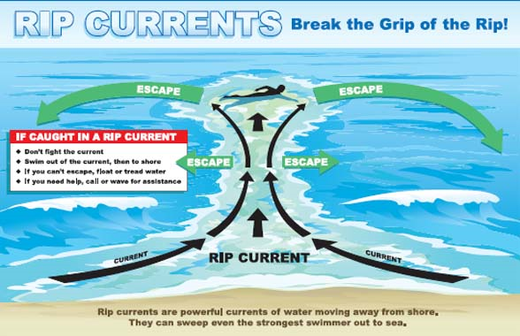

Slide 10
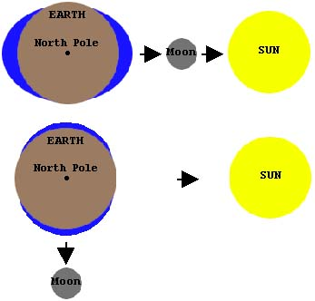
Tides – the periodic rising and falling of the water level of the ocean
2000 years ago, people began to realize that the Sun and the moon had an affect on tides.
The Sun and the Moon have gravity that pull on objects on Earth. Earth’s water bulges on the side facing the Moon. The Moon’s gravity also pulls on Earth itself. Earth gets pulled toward the Moon, leaving a second bulge of water on the side of Earth facing away from the Moon.

Slide 11
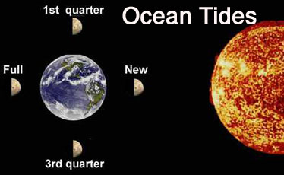
Daily Tides
  The side facing the Moon and the side opposite the Moon will be in high tide. Between the bulges are dips. But as the Earth rotates, different parts of Earth pass through the bulges and dips. Most places have 2 high tides and 2 low tides everyday.
  Tidal range: the difference in height between a high tide and the next low tide
    Steeper shore lines have a higher tidal range
Monthly Tides
  During a full moon and a new moon (when the Earth, Moon and Sun line up) the Moon and Sun pull Earth’s waters in the same direction. An extra high bulge or an extra low dip is called a spring tide.
  During a first and third quarter, the Sun and Moon are not lined up with the Earth and they pull on opposite directions. This causes a smaller bulge and dip called a neap tide.

Slide 12

Tides can be caused to generate electricity.
A tidal dam is built near a coast in the path of tidal waves. When the water flows in during a high tide, the water is trapped behind the gates of a dam so that when the tide is low, the gates open and the water floods out. This flowing water flows out and spins turbines that power electric generators.
These cause much less pollution than any other methods of electricity. These do have some drawbacks because sometimes they do not produce electricity at the appropriate time of day. They also can block the path of fish migrating.

