Slide 1
Transition
Transition Services
Annual Goals
Monitoring

Slide 2
What are Transition Services?
A coordinated set of activities for a child with a disability that:
is designed to be within a results-oriented process, that is focused on improving the academic and functional achievement of the child with a disability to facilitate the child’s movement from school to post-school activities, including postsecondary education, vocational education, integrated employment (including supported employment); continuing and adult education, adult services, independent living, or community participation;

Slide 3
IDEA Transition Services
Are based on the individual child’s needs, taking into account the child’s strengths, preferences, and interests; and
Includes instruction, related services, community experiences, the development of employment and other post-school adult living objectives, and, if appropriate, acquisition of daily living skills and functional vocational evaluation.

Slide 4
Transition Services
Instruction
Related Services
Community Experiences
Employment
Adult Living Skills
Daily Living Skills(if appropriate)
Functional Vocational Evaluation (if appropriate)

Slide 5
Instruction
Instruction as a transition service is a broad range of activities that promotes access to school curriculum, help students gain needed skills and move toward his/her postsecondary goals. Instruction around the acquisition of daily living skills may be needed for some students who need preparation of specific life skills (e.g., self-care, money management, transportation).

Slide 6
Related Services
These are the supports (e.g., psychology, physical therapy, occupational therapy, speech therapy, assistive technology) needed for students to access more integrated work, education, and living environments. Related services within the context of transition services is to help students (and families) determine if related services are needed beyond high school, help identify who or what agency might provide those services, help identify how the student (parent) can access those services and make the connections to needed services prior to the student leaving school.

Slide 7
Community Experiences
Community experiences involve a variety of activities and experiences that are provided outside the school building. A range of career and job domain activities (e.g., job shadowing, internship, work experiences) are used to learn knowledge and skills to meet the requirements of specific occupations or career pathways. For students going onto postsecondary education, activities often involve touring colleges and/or programs offered by various colleges and universities (e.g., summer programs).

Slide 8
Employment
With a major focus on career planning, these services help the student develop, define, refine and finalize his/her postsecondary goals. Assessments, experiences, and planning activities are key to helping students finalize their goals. This area focuses on the development of work-related behaviors, job seeking and keeping skills, career exploration, skill training and actual employment. Volunteer work also provides important skills and experiences that could lead to integrated employment or supported employment. Adult living objectives are those services that include support activities done occasionally such as accessing employment support agencies, registering to vote, filing taxes, renting a home, accessing medical services, filing for insurance, or accessing adult services, college information, Social Security Income (SSI).

Slide 9
Adult Living Skills
Activities and strategies in the area of Adult Living Skills are those that are done occasionally such as registering to vote, filing taxes, obtaining a driver’s license, renting or buying a home, accessing medical services, obtaining and filing for insurance, planning for retirement, and accessing adult services such as Social Security.

Slide 10
Daily Living Skills
Daily living skills are included, "if appropriate" to support student ability to do those activities that most adults do every day (e.g., grooming, preparing meals, budgeting, maintaining a home, paying bills, caring for clothes).

Slide 11
Functional Vocational Evaluation
Functional vocational evaluation is one component of a transition program that is included "if appropriate". This evaluation involves "an assessment process that provides information about job or career interests, aptitudes, and skills. Information may be gathered through situational assessment, observations or formal measures, and should be practical. The IEP team could use this information to refine services outlined in the IEP".

Slide 12
Transition Assessment Data
Will help establish:
The student’s vision for their future (postsecondary goals)
The requirements of the postsecondary location
The transition services needed for a successful post-school transition
The annual goals needed to help get to that postsecondary location
Progress monitoring of the student’s annual goals and long-term goals for adult life

Slide 13
Determining Activities
These questions will help guide the selection of student specific and appropriate transition activities:
What do I need to learn now to live where I want after graduating from high school?
What do I need to learn now to do the job I want after graduating from high school?
What do I need to learn now to be able to succeed in an educational/training program after graduating from high school?
Can these activities be reasonably accomplished within the duration of the IEP?

Slide 14
Group Activity
1. Log into LiveBinder
https://ncdpiecd.inquisiteasp.com/cgi-bin/qwebcorporate.dll?idx=X82FAJ
Password: 2016nctt
2. Go to Tab 6 – Review Transition Services examples of activities
3. Share

Slide 15
Determining Who is Responsible
Responsibility for the activities should be shared
No one entity should be responsible for all of the activities
If an outside agency is assigned responsibility for an activity, a representative from that agency must be invited to the IEP meeting (with prior permission of parent or student who has reached the age of majority)

Slide 16
IDEA Participating Agency Requirements
To the extent appropriate, with the consent of the parents or a child who has reached the age of majority, in implementing the requirements of §300.321(b)(1), the public agency must invite a representative of any participating agency that is likely to be responsible for providing or paying for transition services.
If a purpose of a child’s IEP Team meeting will be the consideration of postsecondary goals for the child and the transition services needed to assist the child in reaching those goals, the LEA, to the extent appropriate, and with consent, must invite a representative of any participating agency that is likely to be responsible for providing or paying for transition services to attend the child’s IEP Team meeting. However, if the participating agency does not attend the meeting, the LEA is no longer required to take other steps to obtain participation of an agency in the planning of any transition services.

Slide 17
Purpose of the IEP Annual Goals linked to the Postsecondary Goals
To establish and define the results-oriented process that is focused on improving the student’s academic and functional achievement
To facilitate the student’s movement from school to post-school activities
To target the most important skills needed in an area/domain that support the student’s postsecondary goals
To structure skill attainment that can be reasonably accomplished within the life of the IEP (one year)

Slide 18
IEP Annual Goals linked to Postsecondary Goals
For each postsecondary goal there must be an annual goal(s) included in the IEP that will assist the student in making progress towards their identified postsecondary goal.

Slide 19
Developing the Secondary Transition IEP Annual Goals
For each Postsecondary Goal and related IEP Annual Goal there must be at least one activity identified in the following areas, that the student can be expected to attain within the life of the IEP:
Instruction Related Service(s)
Community Experience(s)
Development of Employment and Post-School Objectives
Acquisition of Daily Living Skills (if appropriate)
Functional Vocational Evaluation (if appropriate)

Slide 20
Developing the Secondary Transition IEP Annual Goals
Remember: the Transition Services and Secondary Transition IEP Annual Goals should clearly link to and support the Postsecondary Goals

Slide 21
Onslow’s Program Compliance Review 2018

Slide 22
Purpose
Ensure compliance on a five year cycle
Identify and correct areas of noncompliance
Provide technical assistance

Slide 23
Core Components
Student Record Review
Interviews: EC Process
Service Verification
Related Services Verification
LEA Resources
Licensure

Slide 24
Student Record Review
65 records were selected for state review
  -30 student records were reviewed for full program compliance
  -35 student records were reviewed for transition only

Slide 25
Student Sample
The student monitoring sample was collected from the following schools:
Elementary Schools-Summersill Elementary, Jacksonville Elementary
Middle Schools-Jacksonville Commons Middle, Hunters Creek Middle
High Schools-Jacksonville High, White Oak High

Slide 26
Areas of Compliance
Area of Compliance | Percentage | Corrective Action
CNSNT 1, PWN 2a, PWN 2d, PWN 2e, EVAL 4, EVAL 5, EVAL 8, EVAL 9, EL 12, IEP 13, IEP 15b, IEP 15c, IEP 15d, IEP 15e, IEP 19, IEP 20, IEP 21, IEP 24, TRAN 26, TRAN 29, TRAN 30, TRAN 31 | 100% | Criteria Met
PWN 2c, PWN 3, EVAL 6, EL 10, EL 11, IEP 14, IEP 15a, IEP 17, IEP 18, IEP 22, TRAN 27, TRAN 28, TRAN 32 | 80-99% | Individual student corrections
PWN 2b, EVAL 7, IEP 16, IEP 23, TRAN 25 | Below 80 % | LEA corrective actions and individual student corrections

Slide 27
Transition 25
TRAN25 | There are appropriate measurable postsecondary goals addressing education or training, employment, and as needed, independent living. NC 1503-4.1 CFE 300.320 DEC 4a | Yes=The required goals are present, measurable and will occur after high school. No=One or more goals are not present, measurable, and/or do not state what the student will do after high school. | Student Level: Revise the IEP to address measurable postsecondary goals. LEA Level: There must be training of appropriate special education personnel including the LEA representatives on measurable postsecondary goals.

Slide 28
Examples of Non-Compliant areas from The Program Compliance Review

Slide 29

“Would Like to” is Not Measurable

Slide 30
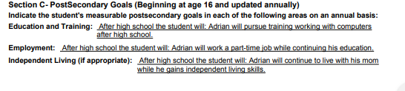
“will pursue” is not measurable

Slide 31
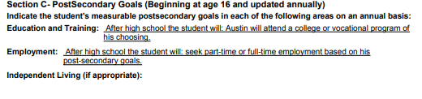
“Will Seek” is not measurable. Avoid using the word “or.”

Slide 32

Goals must be for what will happen after high school

Slide 33
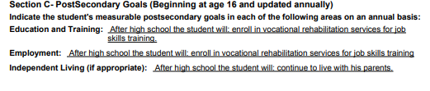
Employment goal is not for employment

Slide 34
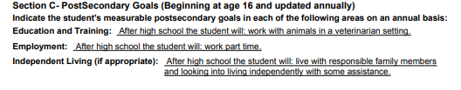
Education and Training goal is for employment

Slide 35
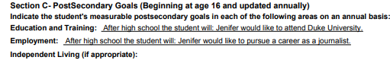
“would like to” is not measurable

Slide 36
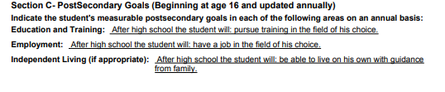
“will pursue” is not measurable. Avoid using “of his choice.”

Slide 37
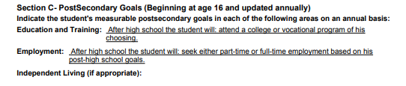
Post secondary goals do not include any targets based on assessments. Avoid “of his choosing” and “will seek.”

Slide 38
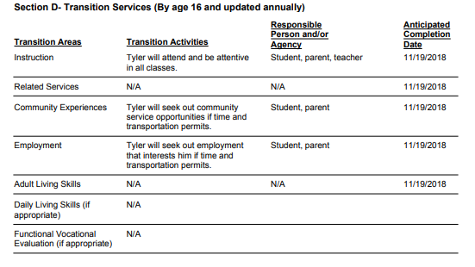
How can you measure “If time and transportation permits”? Too much room for this to not be completed.

Slide 39
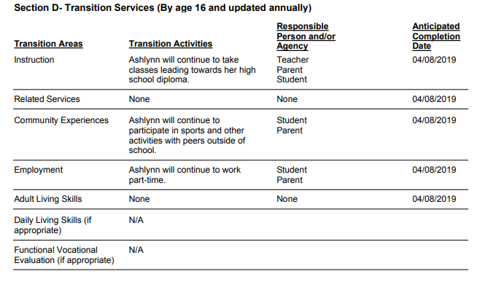
Instruction should not restate the Course of study. What are the activities? Do not indicate “continue.” What are the activities to help make progress towards the postsecondary goal?

Slide 40
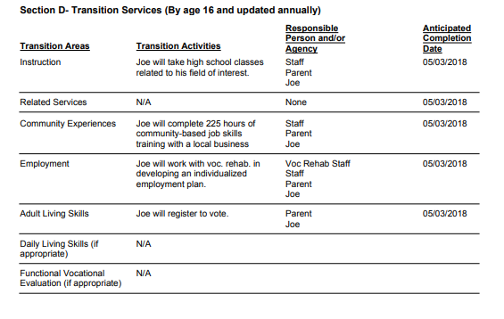
Voc. Rehab. Is responsible for an activity but they were not invited to the meeting

Slide 41
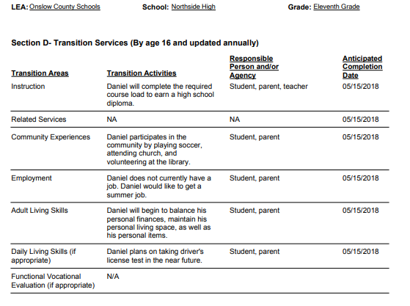
Instruction activity is not accomplishable in the life of the IEP.

Slide 42
QuesTions?

