Slide 1
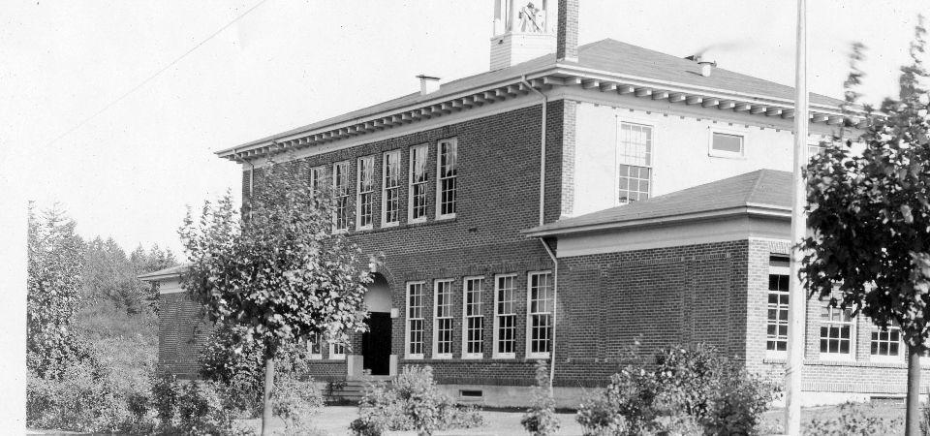
Steilacoom Historical School District
2017-2018
Budget Hearing
July 27, 2017
General Fund, Debt Service Fund, Capital Projects Fund,
ASB Fund, Transportation Vehicle Fund

Slide 2
Summary of Legislative Changes
2017-2018
2.3% COLA including the continuation of the temporary COLA from the 2015-17 biennium
K-3 class size reduced to 17.0 as an allocation only
No K-3 class size compliance for the 2017-18 school year
General Education and Lab Science Materials, Supplies, and Operating Costs (MSOC) allocations are increased by inflation as shown below.
MSOC Category | 2016-2017 | 2017-2018
General Education | $1,223.36 | $1,244.16
Lab Science | $168.05 | $170.91

Slide 3
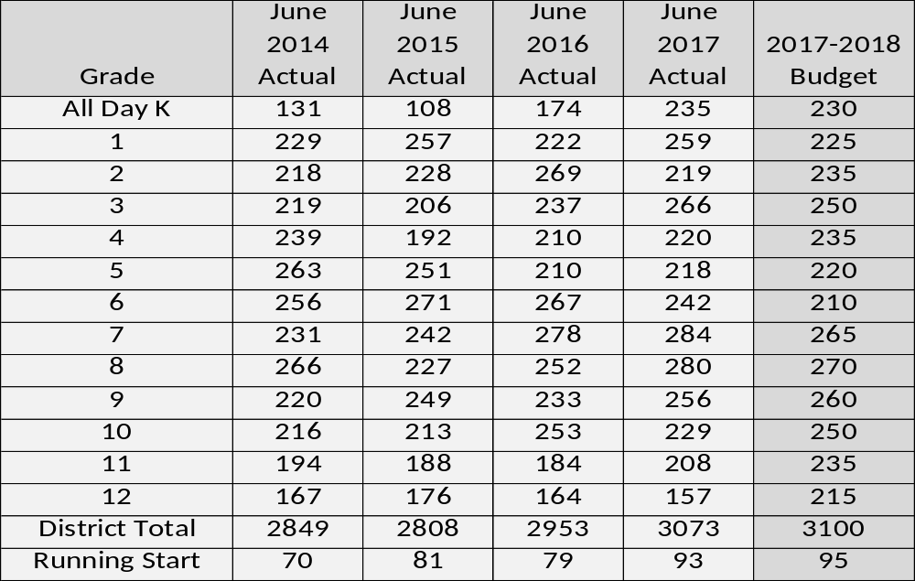
FTE Enrollment

Slide 4
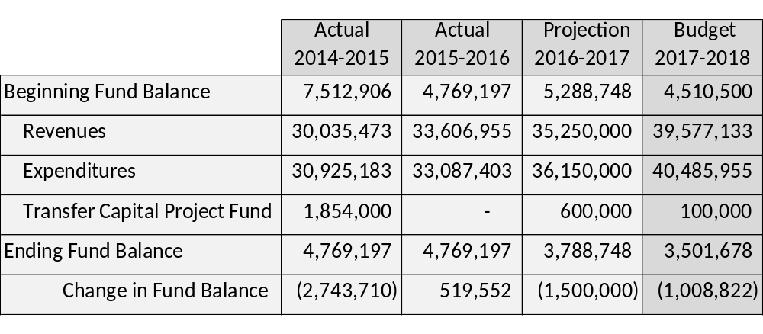
General Fund
Budgeted Ending Fund Balance includes:
Board Policy 6% prior expenditures of 2,169,000
Compensated Absence Pool Reserve of 25,438
Unassigned Fund Balance of 1,307,240

Slide 5
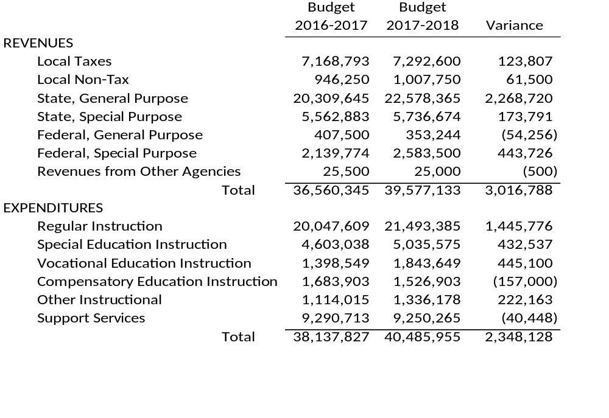
General Fund Budget Comparison

Slide 6
General Fund
Revenues By Source
Revenues from Other Agencies/Financing Sources - $25,000 - .06%
Local Nontax - $1,007,750
2.55%

Slide 7
General Fund
Expenditures By Program
Special Education - $5,035,575 – 12.44%
Support Services
$9,250,265 – 22.85%
Vocational Education - $1,843,649 – 4.55%
Compensatory Education
$1,526,903 - 3.77%
Other Instructional Programs
$1,336,178 – 3.30%
Regular Instruction – Basic Education
$21,493,385 – 53.09%
General Fund Budgeted Expenditures - $40,485,955

Slide 8
General Fund
Expenditures by Object
Purchase Services
$6,841,151 – 16.90%
Travel
$73,928 - .02%
Equipment
$663,000 – 1.63%
Supplies
$3,545,164 -8.76%
Employee Benefits
$8,274,805 – 20.44%
Classified Salaries
$5,030,831 – 12.43%
General Fund Budgeted Expenditures - $40,485,955

Slide 9
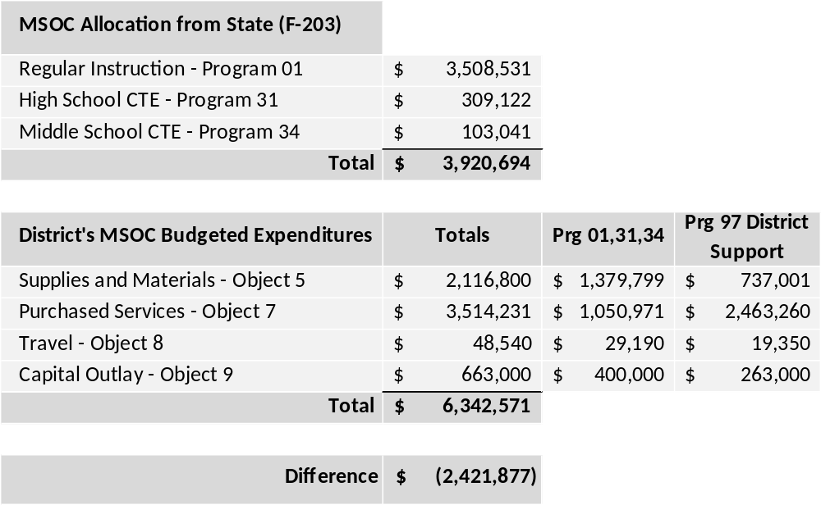
General Fund
Materials, Supplies and Operating Costs

Slide 10
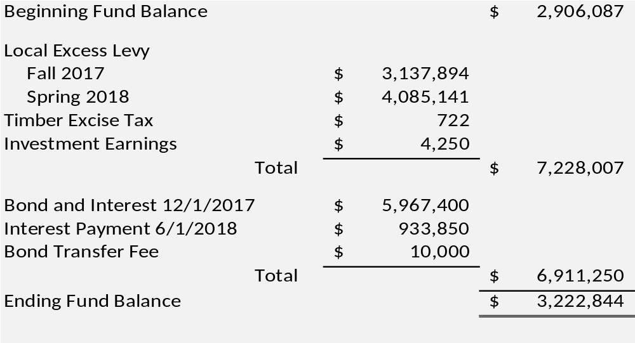
Debt Service Fund
September 1, 2017 outstanding bond debt = $46,960,000

Slide 11
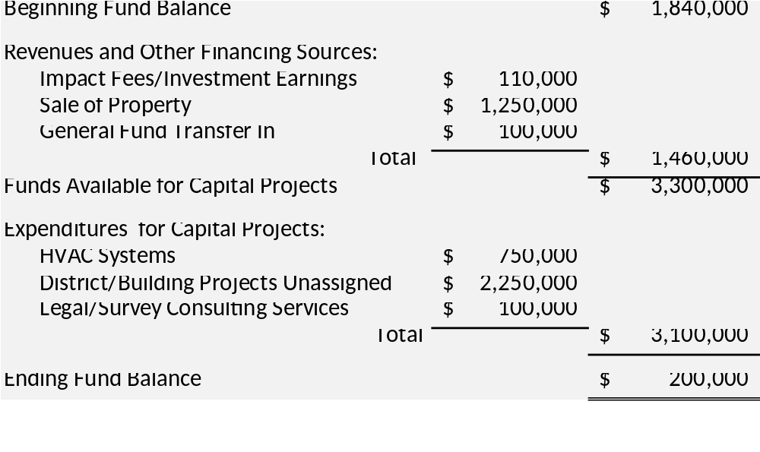
Capital Projects Fund

Slide 12
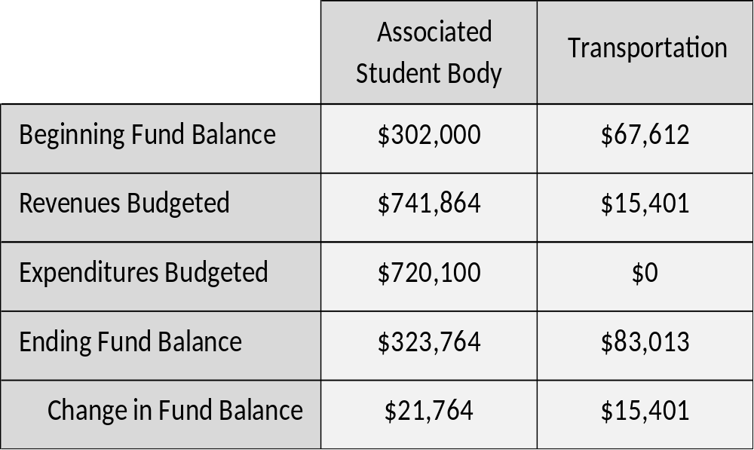
ASB and Transportation Funds

Slide 13
Questions/Comments

