Slide 1
Registration 2017-18
Rising 11th Grade

Slide 2
Counselors
Mrs. Noell - Last Names A – L
Ms. Forrest - Last Names M – Z

Slide 3
Overview
Graduation requirements by diploma
SOL’s and verified credits
Elective options
Select courses
Registration procedures

Slide 4
Diploma Types
Course | Advanced Studies | Standard
English | 4 | 4
Math | 4 | 3
Science | 4 | 3
Social Studies | 4 | 3
Health/PE | 2 | 2
World Language | 3 or 4 | -
Econ & Personal Finance | 1 | 1
Online Course Req | 1 (included in Econ course) | 1 (included in Econ course)
Fine Arts/Career & Tech Ed | 1 | 2 (can be World Lang.)
Industry Credential | - | 1
Electives | 2 or 3 | 4 (2 must be sequential)
TOTAL | 26 | 22

Slide 5

SOLs & Verified Credits
SOL Subject | Advanced Studies (9) | Standard (6)
English - Reading - Writing | 2 | 2
Math - Algebra 1 - Geometry - Algebra 2 | 2 | 1
Social Studies - World Geography - World History 1 - World History 2 - US History | 2 | 1
Science - Earth Science - Biology - Chemistry | 2 | 1
Student Choice | 1 | 1
You are expected to pass ALL of your SOLs!

Slide 6
Elective Options
Out-of-building electives:
JROTC – @ WBHS on A or B day for 2 blocks
BCAT – classes are 2 blocks (A1, B1, or B2)
Virginia Western Regional Academy for Advanced Technology – daily @ VWCC 8:00-10:30
  Mechatronics, Engineering, Pre-Health Program
  Must provide own transportation

Slide 7
BCAT
Auto Service
Building Trades
Computer Info Tech
Cosmetology
Criminal Justice
Culinary Arts
Cyber Security
Early Childhood Education
EMT (must be 16)
Game Design & Programming
Masonry
Motorsports
Networking
Robotics/Mechatronics
Teaching Internship
Welding
Specialty Centers:
  Mass Communication
  Engineering
  Performing Arts
  Visual Arts & Museum Studies
BCAT courses require an application unless students are continuing in a BCAT Program.

Slide 8

RCPS Online
1 FREE RCPS Online course
  If registered during registration window
  EXCEPTION: AP Psychology
Additional Courses: $400 each
Make sure it is a good fit!

Slide 9
Virginia High School League (VHSL)
Athletes MUST be enrolled in and passing a minimum of 5 credit producing courses or their equivalent at any one time for eligibility in ALL Virginia High School League activities.
GHS strongly encourages athletes to register for a minimum of 6 total credits to minimize the possibility of ineligibility.

Slide 10
Registration Process
Fill out Registration Form
Enter Course Requests in Synergy
Counselors review Course Request individually with each student
Student Request Verification (SRV) given to students
  MUST be signed by parent/guardian and returned to school
  Changes can be indicated on the SRV, signed, and returned

Slide 11
Thoughtful Course Selection Process
Students register for courses
The number of students in each course is taken to central office in February
  Decisions are made in February as to what classes are offered and how many classes are offered
Be certain to select courses that you TRULY want (including alternates)!
SRV’s sent home in February for parents to review. No changes after that time.

Slide 12

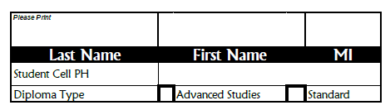
Selecting Courses
USE PENCIL ONLY!!
Jones Sally M.
540-387-6536
✓

Slide 13

Do not work ahead. We will complete form as a group to answer all questions once.

Slide 14
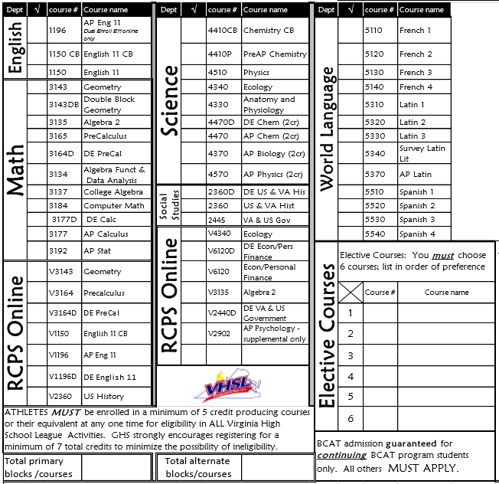
Select core courses
Select electives to equal 8 blocks (ideal schedule)
Select at least 4 alternates in order of preference.
Sign form.
✓
✓
✓
✓
✓
BCAT –Masonry 2
1420 Theater 2
9990 Study Hall
9120 Art 1
8250 Intro to Culinary
9093 Entrepreneurship
8
4

Slide 15
Applications
Dual Enrollment (New or Returning)
  Deadline: April 29
BCAT (students not currently at BCAT)
  Deadline: January 18
Supplemental RCPS Online course(s)
  Must be turned in with $400 check to Glenvar High School
Turn in when you meet with your Counselor!

Slide 16
Exit Strategy
Form Complete?
  8 blocks (ideal schedule)
  Minimum 4 alternates
  Sign form
Separate forms – YELLOW sheet to outside aisle
  Please show white copy to your parents and BRING TO HEALTH & PE 10

