Slide 1

Freshman Foundations
Hickory Ridge High School

Slide 2

Things to know about during your freshman year….

Slide 3

Promotion….
Typically you will receive 1 credit per class
To be promoted to the next grade level….
To be a Sophomore=6 credits
To be a Junior=13 credits
To be a Senior=19 credits
Athletic Eligibility/Driver’s License…..
You must pass 3 out of 4 classes during the previous semester to play a sport and keep your driver’s license/permit

Slide 4

Grading scale….
To pass a class you must receive a 60% or above
Grading Scale:
  90-100%=A
  80-89%=B
  70-79%=C
  60-69%=D
  59 and below=F
  Failed due to attendance=FF

Slide 5

Final Grade Calculation….
1st quarter grade x 3=
2nd quarter grade x3=
Final exam x 2=
Add them together
Divide by 8
=Final grade

Slide 6

Question: who gets promoted?
Anna | Seth
English I - 83 Foundations of Algebra -85 Algebra I - 90 Earth/Env - 89 World History - 82 Health/PE - 95 Foods I- 94 Career Management- 57 | H English I - 55 Geometry - 93 H Earth/Env - 54 H World History - 74 Health/PE - 89 Spanish I - 50 Intro to Broadcasting - 95 Theatre I - 96

Slide 7

Answer….
Anna does because she received 7 out of 8 credits
Seth does not because he received 5 out of 8 credits
Remember: you need 6 credits to be promoted to a Sophomore!

Slide 8

Transcript….
A transcript is a four-year report card that includes EVERY final course grade for EVERY class you take in high school
It also contains…. transcript
  Student Information
  Credit History
  Grade History
  GPA (it is cumulative and is the average of quality points earned)
  Class Rank (a number that tells you where you stand in relation to your peers in your grade level)
  EOC scores
  Attendance

Slide 9
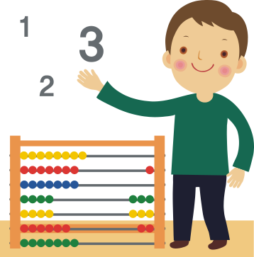
Honors and AP Courses….
Honors= .5 additional quality point
  Regular World History – if you made an 88, you would get a 3.0
  Honors World History – if you made an 88, you would get a 3.5
AP= 1 additional quality point
  AP World History – if you made an 88, you would get a 4.0

Slide 10

Don’t forget about career clusters…
It is required that every student have a career cluster by the time they graduate
A career cluster has 4 classes in a specific area of interest
17 different career clusters:
  Agriculture, Food, and Natural Resources
  Hospitality and Tourism
  Arts, Audio/Video Tech and Communication
  Business Management and Administration
  Science, Tech, Engineering, and Mathematics
  Health Sciences
  Finance
  Human Services
  Transportation, Distribution, and Logistics
  Architecture and Construction
  Marketing
  Fine Arts-Chorus, Drama, Visual Arts, Broadcasting, Band
  World Languages

Slide 11

Attendance….
Attendance is VERY important in high school.
You cannot miss more than 8 days in a class per semester to get the credit.
If you miss more than 8 days, you will have to make up missed time in Saturday School, but that does not guarantee you will receive credit for the course.

Slide 12

Four Main Factors Colleges Use in Determining Acceptance….
GPA
SAT/ACT Scores
Application/extracurricular activities
Discipline Records

Slide 13







GET INVOLVED!
  Watch announcements for school activities, clubs, sports and sporting event information.

Slide 14

Make the best out of your freshman year….
Complete all of you homework every night (you shouldn’t have any zeros!)
If you need help in a class, don’t be afraid to ask your teacher questions (that is what they are there for!)
Attend your teacher’s after school tutoring
Sign up through your counselor to attend peer tutoring on Wednesdays
Get involved with HRHS—clubs, activities, sports
Challenge yourself!

