Slide 1
Fairborn High School Scheduling
2015 – 2016 school year

Slide 2
What Materials Do I Need?
Program of Study Booklet
Instructions for Course Request Form
Course Request Form
Transcript
These materials will be handed out in Homeroom on Feb 6th.
There will be a meeting with your teachers on Feb 10th and 11th.

Slide 3
Required Courses for Graduation
2016 & 2017 .
4 Credits of English (9, 10, 11, and one additional unit)
4 Credits of Math (Algebra, Geometry, and Algebra II or its equivalent and one unit of Advanced Study)
3 Credits of Science (1 Physical, 1 Biological, and one additional unit of Advanced Study)
3 Credits of Social Studies (World Studies, American Studies, and Government)
½ Credit of PE (two courses)
½ Credit of Health
½ Credit of Personal Finance
1 Credit of Business Technology, Fine Arts, or Foreign Language
4 ½ Credits of Electives
Total of 21 credits!
Notes:
In order to graduate from Fairborn High School each student will be required to pass certain courses during their course of studies.
The required credits include:
Four credits of English including English 9, 10, and 11
Four credits of Math including algebra, geometry, and Algebra II or its equivalent
Three credits of Science including one physical and one biological.
Three credits of Social Studies including one credit of World Studies, one credit of American Studies, and a ½ credit of government.
One half credit Physical Education, which is two classes, unless you choice to do the PE Option.
One half credit of health.
One half credit of Career & Finance
One credit of Business Technology, Fine Arts, or Foreign Language
Four and a half credits of electives totaling up to 21 credits.

Slide 4
Requirements for Graduation 2018
Everything on the previous slide +
Take the state-designated end-of-course exams and qualify for one of three standards for graduation as set by ODE.
New: All students take end of course exams:
Algebra I and Geometry or Integrated Math I and II
Physical Science
American History and American Government
English 9 and 10
Students studying Advanced Placement (AP), or taking dual enrollment course in Physical Science, American History or American Government may take assessments aligned to those courses in lieu of end-of-course exams to avoid double testing.

Slide 5
Additional Requirements for Graduation…Standard One
Earn a cumulative passing score on seven end-of-course exams. The
scores will be set by the State Board of Education.
Algebra I and Geometry or Integrated Math I and II
Physical Science
American History and American Government
English 9 and 10

Slide 6
Additional Requirements for Graduation…Standard Two
Earn a “remediation-free” score on a nationally recognized college admission exam such as ACT or SAT. The state of Ohio will pay for all 11th grade students to take the exam free of charge.

Slide 7
Additional Requirements for Graduation…Standard Three
Earn a State Board of Education approved, industry-recognized credential or a state-issued license for practice in a career and achieve a score that demonstrates workforce readiness and employability on a job skills assessment.

Slide 8
Earning Credits
0-4.75 Credits = Freshman
5-9.75 Credits = Sophomore
10-15.75 Credits = Junior
15+ Credits = Senior
Notes:
In order to advance to the next class you need to gain at least 5 credits the previous year, so in order to be a Sophomore you need 5 credits, a Junior you need 10 credits, and a Senior you need 15 credits or more.

Slide 9
Required Classes for Sophomores
English 10 (or English 10 Honors)
American Studies (or American Studies Honors)
Biology (or Chemistry I Honors or General Chemistry if you took Advanced Biology your freshman year)
Geometry (or Advanced Geometry or Algebra 2 or Algebra 2 Honors)
Physical Education (unless you do the PE Option and/or completed both P.E. requirements in your Freshman year)
Notes:
All Sophomores students will take four core subject areas. If you wish to sign up for English 10 Honors, American Studies Honors, Advanced Geometry, Algebra 2 Honors, Chemistry I Honors, your teacher must recommend you. If you want to sign up for one of these classes, mark out the subject on your course request form and write in the class you want. You must also get your teacher signature. English 10 Honors will require summer readings.

Slide 10
Elective Classes for Sophomores
Art (Textiles and Fibers, Ceramics, Drawing, Painting, Sculpture, Digital Imaging, Visual Arts Advanced Study)
Business (Intro to Business, Desktop Publishing, Personal Finance, Intro to PowerPoint and Excel, Accounting I)
Foreign Language (Spanish)
Home Economics (Nutrition and Basic Culinary Skills)
Engineering/GCCC (Tech Action Lab)
Marketing Mgmt/GCCC (Intro to Marketing)
Music (Band or Choir)
Project Lead The Way (Engineering, Biomedical)
AFJROTC (Aerospace Science)
Notes:
These are the elective courses available to sophomores. Some of these are semester classes and some are year long classes. Examples could be a combination of Foreign Language and Music or 4 art classes. The keyboarding class is a prerequisite to some of the other upper level business classes. If you are signing up for a foreign language, you must have a C or better in Language Arts. Tech Action Lab is a prerequisite to the Engineering Technology classes. If you are signing up for Band or Choir you must audition and have teacher approval. Project Lead the Way will be discussed in more detail in a few slides. ROTC is the AF Junior Reserve Officer Training Corp, the program provides citizenship training and an aerospace science program for high school youth. Students are required to wear a uniform once a week and participate in physical fitness training.

Slide 11
Required Classes for Juniors
English 11 (or Language and Composition Honors AP)
Government (or Government Honors AP, Psychology, Sociology, Economics Honors, World Affairs Honors, World History Honors AP, Psychology Honors AP)
Upper Level Science Elective (Earth and Space Science, General Chemistry, Biology 2 Honors AP, Chemistry 2 Honors AP, Conceptual Physics, Physics Honors, Physics 2 Honors AP, Environmental Science Honors AP)
Algebra 2 (or Algebra 2 Honors, Pre Calculus, Pre Calculus Honors, Calculus AB Honors AP, Statistics Honors AP)
Notes:
All Sophomores students will take four core subject areas. If you wish to sign up for English 10 Honors, American Studies Honors, Advanced Geometry, Algebra 2 Honors, Chemistry I Honors, your teacher must recommend you. If you want to sign up for one of these classes, mark out the subject on your course request form and write in the class you want. You must also get your teacher signature. English 10 Honors will require summer readings.

Slide 12
Elective Classes for Juniors
Art (Textiles and Fibers, Ceramics, Drawing, Painting, Sculpture, Digital Imaging)
Business (Desktop Publishing, College Essentials for Juniors, Intro to PowerPoint and Excel, Accounting I, Personal Finance)
Foreign Language (Spanish)
Home Economics (Nutrition and Basic Culinary Skills)
GCCC Satellite (Engineering Tech, Marketing Mgmt)
Music (Band or Choir)
Project Lead The Way (Engineering, Biomedical)
AFJROTC (Aerospace Science)
Newspaper
Yearbook
Health (Human Development, Sports Medicine)
Notes:
These are the elective courses available to juniors. Some of these are semester classes and some are year long classes. Examples could be a combination of Foreign Language and Music or 4 art classes. If you are signing up for a foreign language, you must have a C or better in Language Arts. Tech Action Lab is a prerequisite to the Engineering Technology classes. If you are signing up for Band or Choir you must audition and have teacher approval. Project Lead the Way will be discussed in more detail in a few slides. ROTC is the AF Junior Reserve Officer Training Corp, the program provides citizenship training and an aerospace science program for high school youth. Students are required to wear a uniform once a week and participate in physical fitness training. Newspaper and Yearbook require an application.

Slide 13
Required Classes for Seniors
English 12 (or Literature and Composition Honors AP, Speech, Drama, or Science Fiction)
Government (if you didn’t take it your Junior year, and/or Psychology, Sociology, Economics Honors, World Affairs Honors, World History Honors AP, Psychology Honors AP)
Upper Level Math (Functions, Pre Calculus, Pre Calculus Honors, Calculus AB Honors AP, or Statistics Honors AP)
Electives
Notes:
All Sophomores students will take four core subject areas. If you wish to sign up for English 10 Honors, American Studies Honors, Advanced Geometry, Algebra 2 Honors, Chemistry I Honors, your teacher must recommend you. If you want to sign up for one of these classes, mark out the subject on your course request form and write in the class you want. You must also get your teacher signature. English 10 Honors will require summer readings.

Slide 14
Elective Classes for Seniors
Art (Textiles and Fibers, Ceramics, Drawing, Painting, Sculpture, Digital Imaging)
Business (Desktop Publishing, College Essentials, Intro to PowerPoint and Excel, Personal Finance, Accounting I)
Foreign Language (Spanish)
Home Economics (Nutrition and Basic Culinary Skills)
GCCC Satellite (Engineering Tech, Marketing Mgmt)
Music (Band or Choir)
Project Lead The Way (Engineering, Biomedical)
AFJROTC (Aerospace Science)
Newspaper
Yearbook
Health (Human Development, Sports Medicine)
Notes:
These are the elective courses available to juniors. Some of these are semester classes and some are year long classes. Examples could be a combination of Foreign Language and Music or 4 art classes. If you are signing up for a foreign language, you must have a C or better in Language Arts. Tech Action Lab is a prerequisite to the Engineering Technology classes. If you are signing up for Band or Choir you must audition and have teacher approval. Project Lead the Way will be discussed in more detail in a few slides. ROTC is the AF Junior Reserve Officer Training Corp, the program provides citizenship training and an aerospace science program for high school youth. Students are required to wear a uniform once a week and participate in physical fitness training. Newspaper and Yearbook require an application.

Slide 15
Options for Seniors
College Credit + (formerly Post Secondary Enrollment Option)
College Prep Curriculum/Diploma with Honors (Meet 7 of 8 Criteria)
  4 Units of English
  4 Units of Math
  4 Units of Science
  4 Units of Social Studies
  3 Units of Foreign Language
  1 Unit of Fine Art
  3.5 or above GPA
  27 or higher on ACT

Slide 16
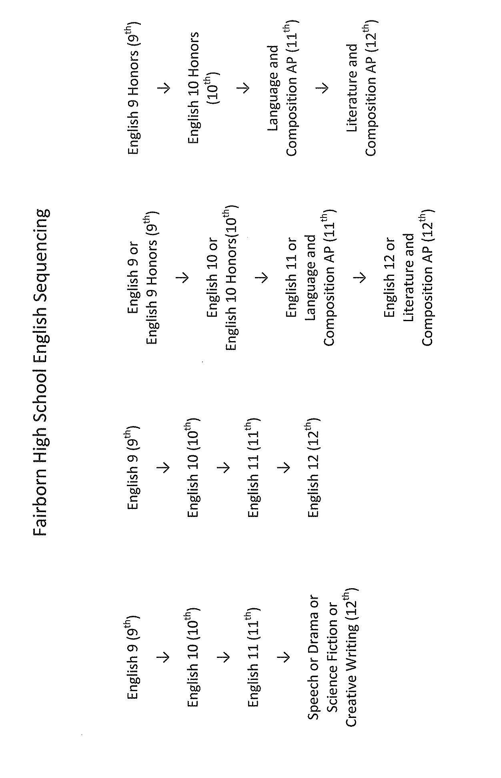
Course Sequencing

Slide 17
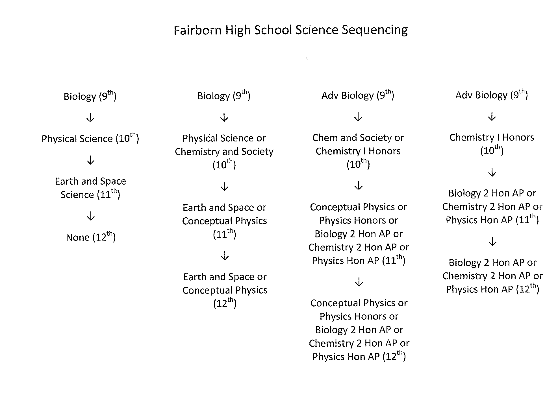
Course Sequencing

Slide 18
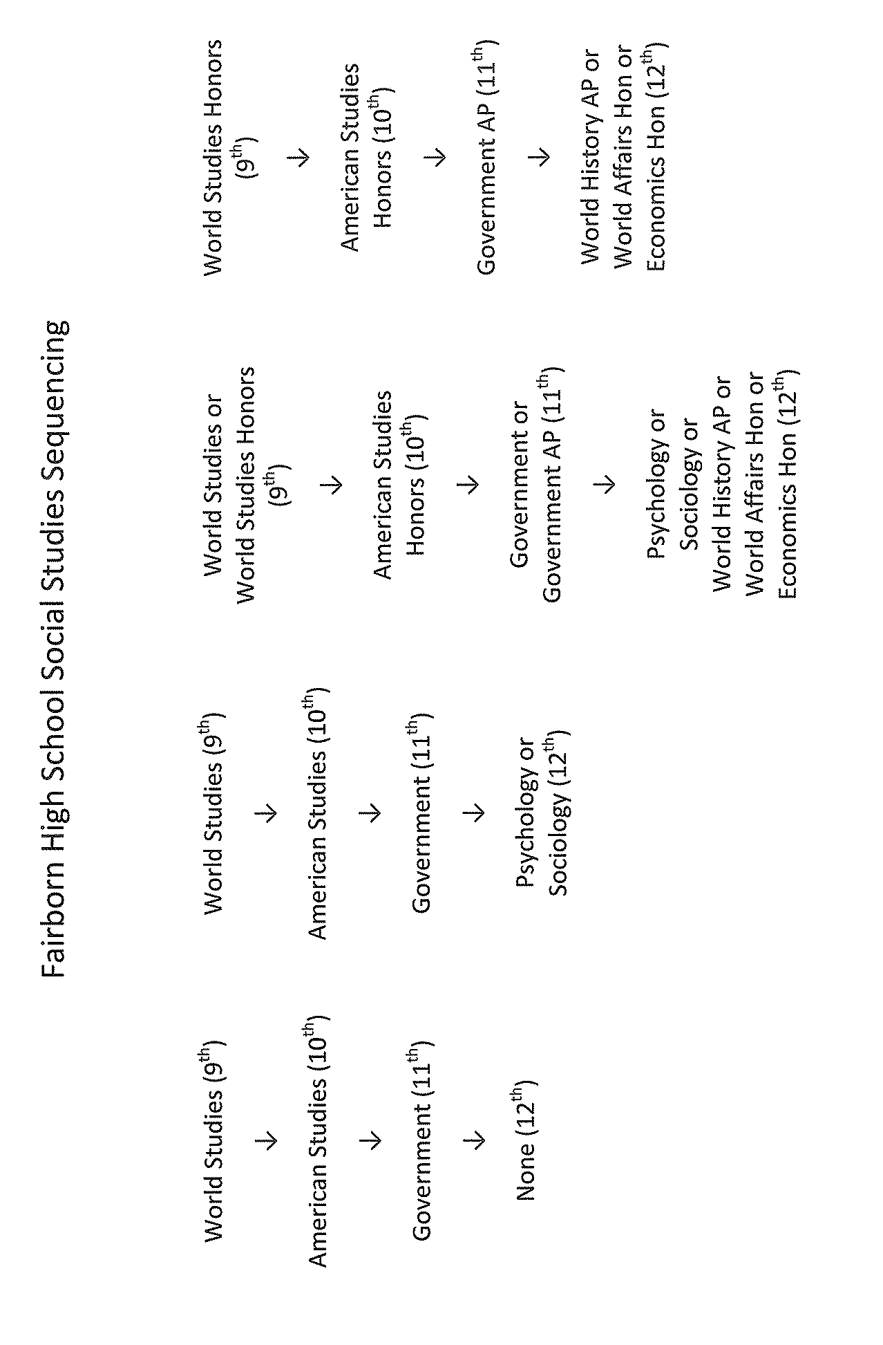
Course Sequencing

Slide 19
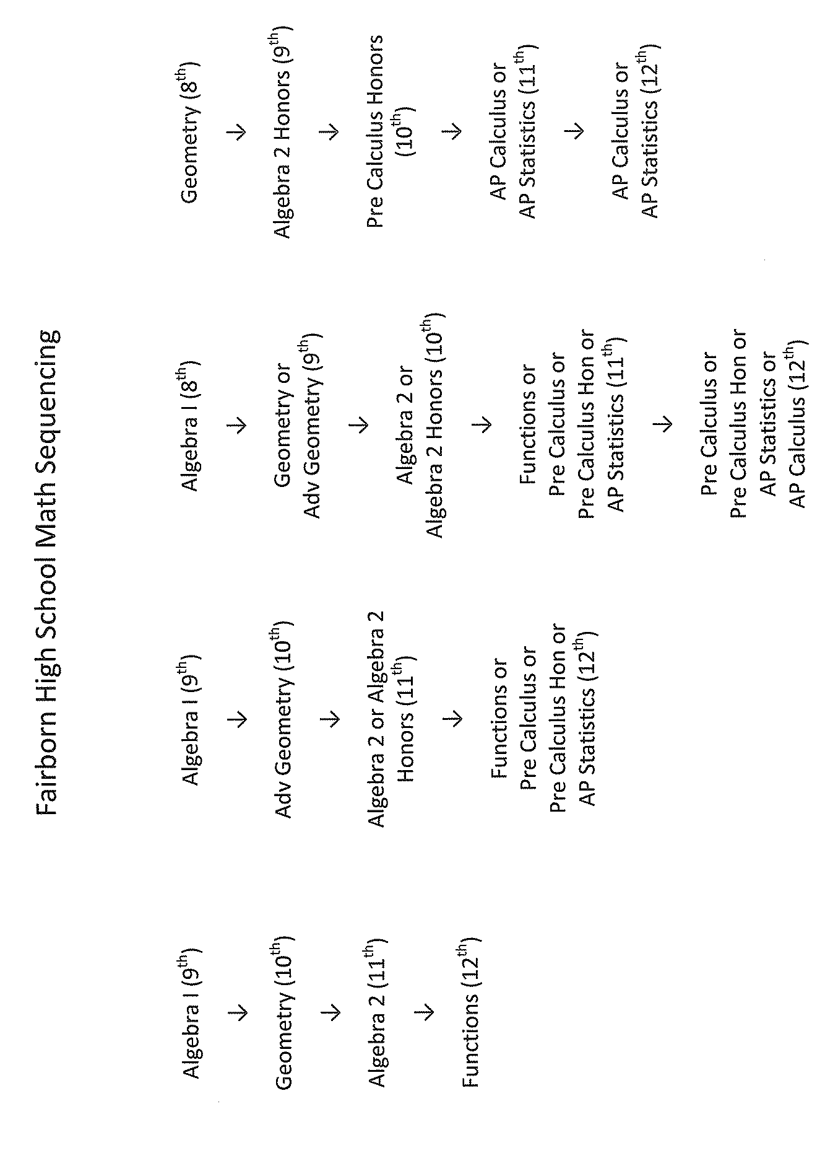
Course Sequencing

Slide 20
Physical Education Option
Students who participate in athletics, marching band and/or color guard will have the option to apply for ¼ credit of P.E.
Students will only be able to receive a ¼ credit of P.E option per school year.
Students must apply for this option at the end of their athletic season (applications will be available in the guidance offices).
Credit will be awarded as Pass/No Credit and will not count towards G.P.A or eligibility.
Notes:
Read slide.

Slide 21
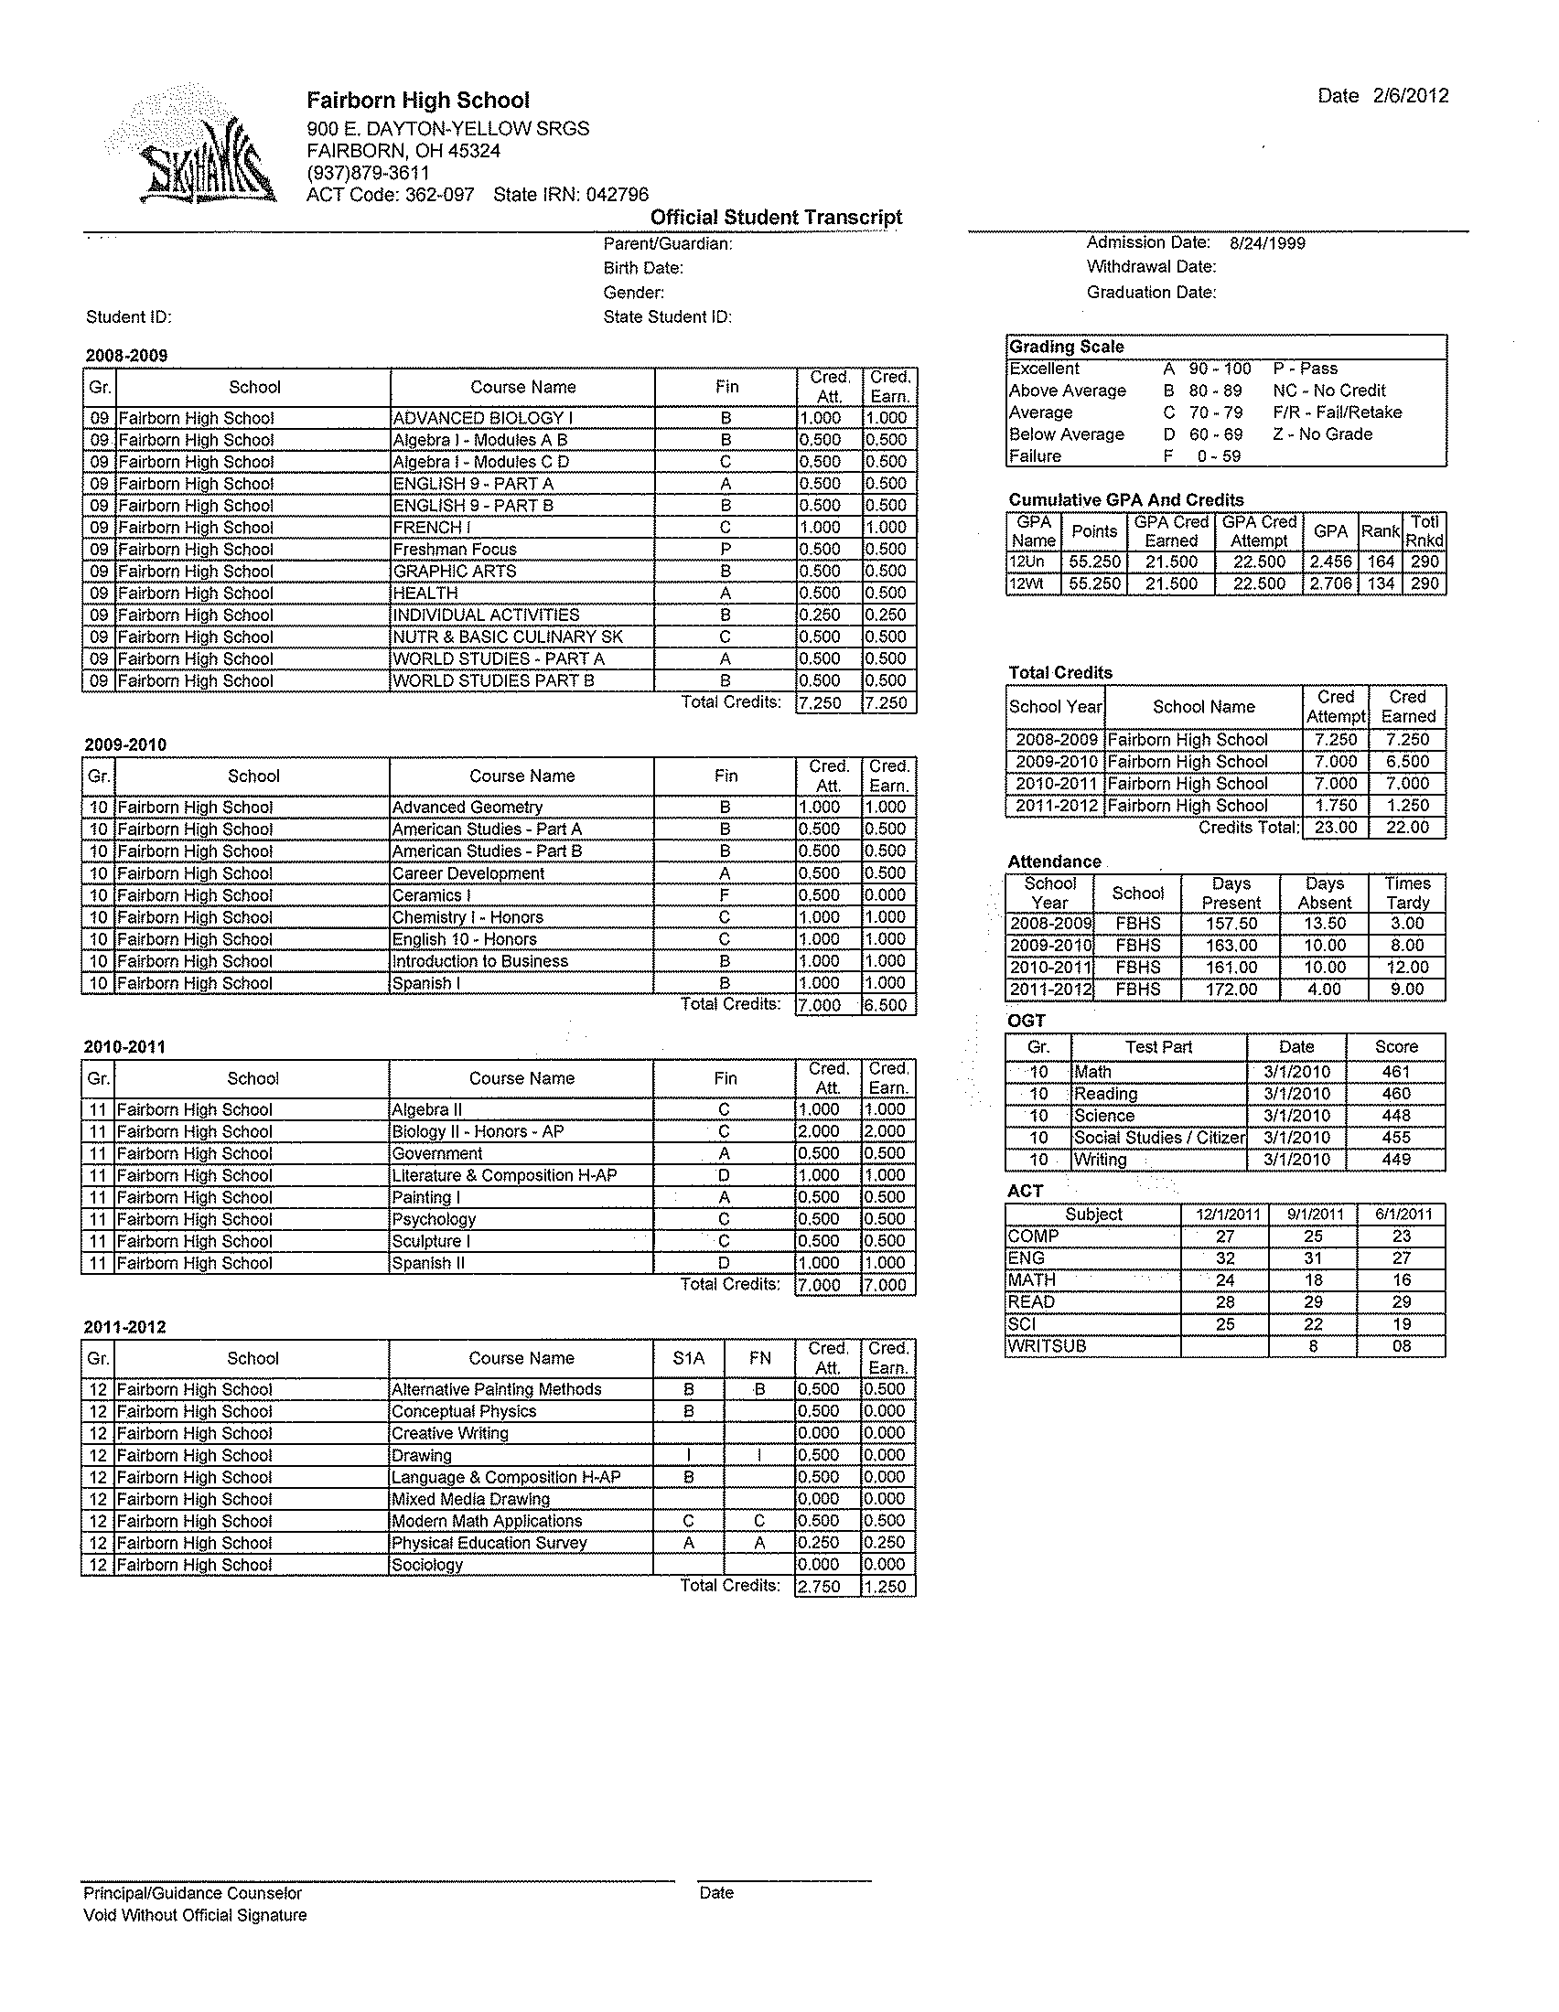

Slide 22
Athletic Eligibility/Honor Roll/Principal’s List
Athletic Eligibility
  You must be passing 5 courses with a 2.0 GPA
(PE does not count as one of the 5)
Honor Roll Criteria
  3.0 Honor Roll
  3.6 Principal’s List
Notes:
For any student wishing to participate in athletics at Fairborn High School you must be passing 5 courses with a 2.0 GPA and Physical Education does not count as one of the five courses.
We recommend NOT taking a study hall because it takes away opportunities for you to earn credits.
To make the honor roll students must have a 3.0 GPA. The principal’s list requires a 3.6. These students are recognized with a certificate and names in the newspaper.

Slide 23
Summer School
Registration forms will be available in the guidance office after spring break
Notes:
For those students interested in taking summer school information sheets and registration forms will be available in the Guidance office in the spring.

Slide 24
Attendance Policy
9 absences per semester
18 total for the year
NO CREDIT will be awarded for students who miss more than the allowed days per class.
  Includes Tardies
  Both excused and unexcused absences count towards the attendance total
If a student skips their final, they will receive NO CREDIT for the class!
Notes:
Students are only allowed to miss 9 days per semester, 18 total for the year. If a student misses more than the allowed days they will receive NO CREDIT for this class. The total absences include tardies. Both excused and unexcused absences count towards the attendance total.
If a student skips their semester exam or final exam, they will receive NO CREDIT for that class.

Slide 25
National Science and Math Institute
Advanced Placement Initiative

Slide 26
Included Classes
AP Chemistry
AP Biology
AP Physics
AP Calculus
AP Language and Composition
AP Literature and Composition
AP Statistics
AP Environmental Science

Slide 27
Benefits to students and staff of FHS
Specialized training for AP teachers
Specialized training for pre-AP teachers
Equipment and supply money
Unlimited access to experts in the field
Review sessions run by AP experts from NMSI
Incentives for students and teachers
  Pay for all sophomores to take PSAT
  50% of AP test paid
  Money paid to students and teachers for passing scores on AP tests

Slide 28
Review
Scheduling Information was handed out on Feb 6th during Homeroom. You will have a meeting/discussions with your teachers on Feb 10th and 11th about your course selections. You will turn in your Course Requests Sheets in 8th period on the 10th or 11th.
If you don’t complete a schedule, one will be completed for you and there will be NO CHANGES.
Take the time to fill out a GOOD schedule, but remember that things could change based on the amount of classes offered and the period it is offered.
Notes:
We thank you very much for your attention up to this point, now let’s review. If you do not turn in a schedule, one will be completed for you and there will be no changes. We want everyone to get the schedule they desire, so please make sure you turn in your schedule sheet and please choose your classes wisely.

Slide 29
Junior Night and CC+ Night
Next Wednesday February 11th
  Junior Information Night @ 6:00
  College Credit + Night @ 7:00

Slide 30
Fairborn Guidance Department
FHS Phone Number 879-3611
Guidance Counselors:
Director of Guidance Brandon Prather bprather@fairborn.k12.oh.us
  A-K Dana Mitchell dmitchell@fairborn.k12.oh.us
  L-Z Christopher Downing cdowning@fairborn.k12.oh.us
  Secretary Terry Oberschlake toberschlake@fairborn.k12.oh.us
Notes:
We thank you very much for your time and attention. Please notice our contact numbers. We can be reached by phone or email. Here is the alphabetical list of the guidance counselors. Direct all concerns to the appropriate counselor.

