Slide 1

Coach Holley

Slide 2
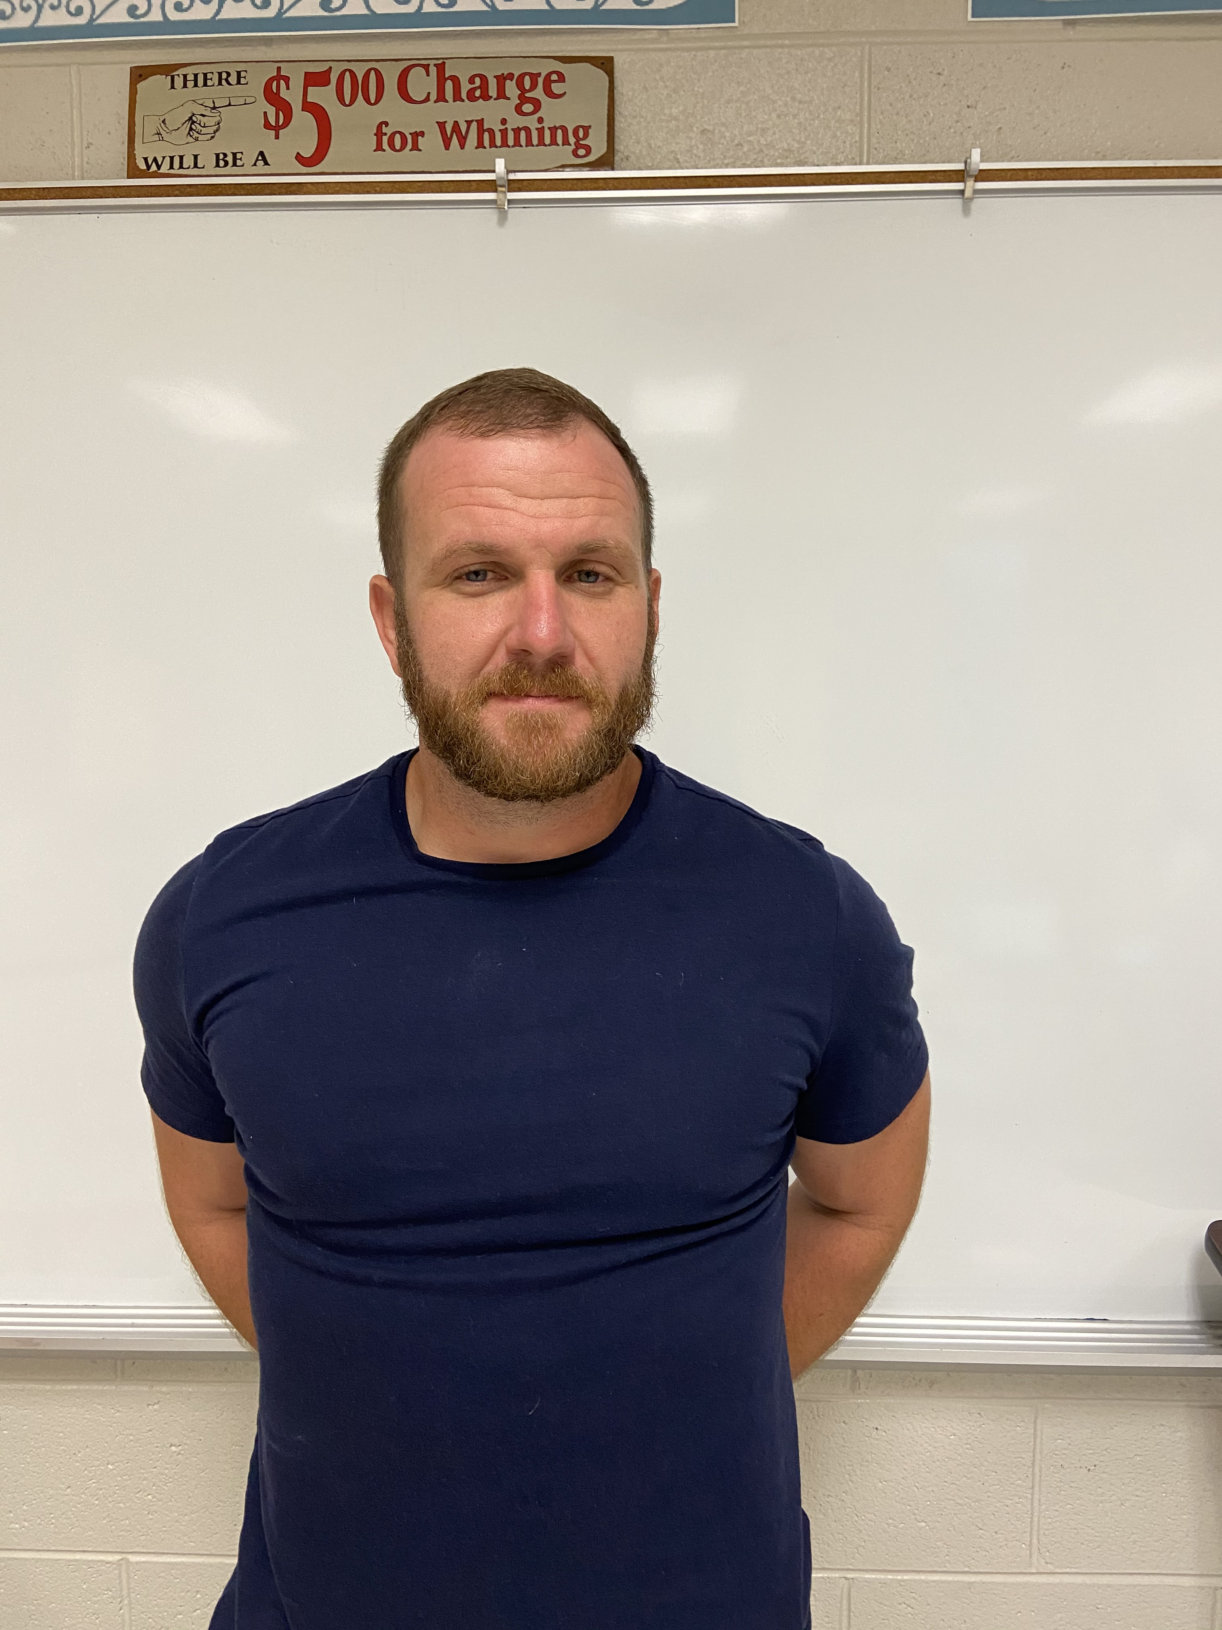
ABOUT ME
Welcome Back Video
https://youtu.be/52PmLl7cRYQ
Education
I attended Athens State where I received a bachelor's of science in Biology and Secondary Education.
Experience
I started my career at Hazel Green High School where I was responsible for teaching Biology and AP Biology. After 7 years I accepted an opportunity at Buckhorn High where I taught AP Environmental Science and ACT prep for 2 years. I spent 1 year at New Hope High School where I taught AP Biology.
Bio
My Name is Jerrett Holley and I am from Hamilton Alabama. I attended Hamilton High School where I participated in Football, Track, and competition weight lifting. I graduated in 2002 and went on attend Bevill State Community College before transferring to Athens State. While at Athens State I met my wife Katie. We have 2 daughters named Ava and Miriam.

Slide 3
SCHEDULE
FALL | SPRING
FOOTBALL | AP ENVIRONMENTAL
BIOLOGY | AP ENVIRONMENTAL
PRE AP BIOLOGY | AP ENVIRONMENTAL
PRE AP BIOLOGY | FOOTBALL

Slide 4
CONTACT INFORMATION
EMAIL: jbholley@madisoncity.k12.al.us
PHONE: 256-216-5313

Slide 5
Virtual classroom expectations:
Always contact me via email or through Schoology.
All assignments have a due date and late work will be penalized.
You are expected to participate and communicate
COVID
The current state of the world is unlike anything we have ever experienced.
With that being said I will work with and try to help you get through this year.

