Slide 1

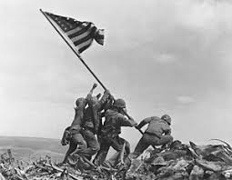
Wiley McKeller

Slide 2
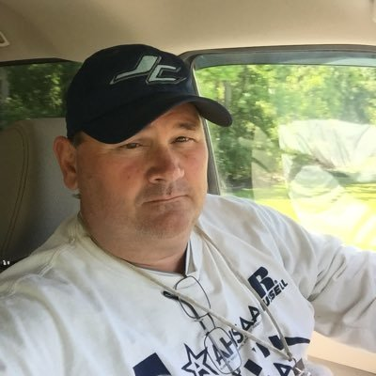
ABOUT ME
I have 22 years in public education
I have a BS from Lamar University
I have a Masters in Edu Leadership from The University of West Alabama
I have been married to Laura McKeller for 22 years and she is a math teacher at Liberty MS
I have 2 kids, Brooks and Kate, who are both Seniors this year at JCHS
I coach Varsity Football and Varsity Golf
I teach US and World History at JCHS
https://youtu.be/P2gkbQk-5YY

Slide 3
SCHEDULE
FALL | SPRING
Varsity Football
US History 1
US History 1
US History 1 | Varsity Golf

Slide 4
CONTACT INFORMATION
EMAIL:
wmmckeller@madisoncity.k12.al.us
PHONE:
205-261-1065
SYLLABUS
https://docs.google.com/document/d/1xbgMmsz3NfikhOMW92UB0pxpW1Qefm6dKZ9Zgt5oX_c/edit?usp=sharing

Slide 5
Virtual Situation
We are all in uncharted waters with virtual school. But, with this difficult situation, there is an opportunity to rise to the occasion and do something special! I have always believed in the phrase, “FIND A WAY”. Together we WILL get through this and make this an outstanding school year!

