Slide 1
Printing instructions for exit tickets
In the File menu, choose Print preview.
Where it says “1 slide without notes”, change to “Handout - 2 slides per page”.
Where it says “Landscape”, change to “Portrait”.
Click “Print” and print only the page you want (2 copies of the same exit ticket on one page.)

Slide 2
This slide intentionally left blank.

Slide 3
Lessons 1,2 exit ticket Name:
Explain how to find Carlos’s height on the Ferris wheel 8.5 seconds after it starts turning at speed.
Notes:
Lesson 1/2

Slide 4
Lessons 1,2 exit ticket Name:
Explain how to find Carlos’s height on the Ferris wheel 8.5 seconds after it starts turning at speed.
Notes:
Lesson 1/2

Slide 5
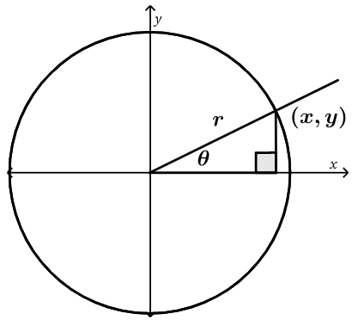
Lesson 3 exit ticket Name:
Find the coordinates of (x, y) if r = 7 and 𝜃 = 34°.
Notes:
Lesson 3

Slide 6
Lesson 3 exit ticket Name:
Find the coordinates of (x, y) if r = 7 and 𝜃 = 34°.
Notes:
Lesson 3

Slide 7
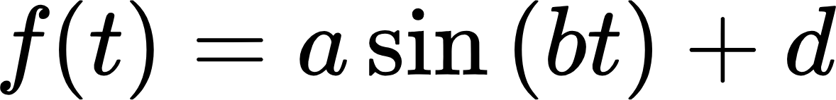
Lesson 4 exit ticket Name:
Let
Explain how a, b, and d affect the graph of the function.
a:
b:
d:
Notes:
Lesson 4

Slide 8
Lesson 4 exit ticket Name:
Let
Explain how a, b, and d affect the graph of the function.
a:
b:
d:
Notes:
Lesson 4

Slide 9
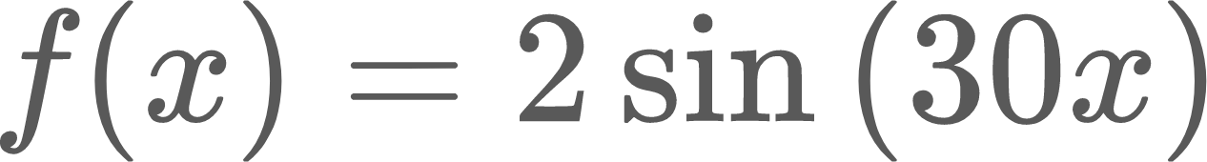
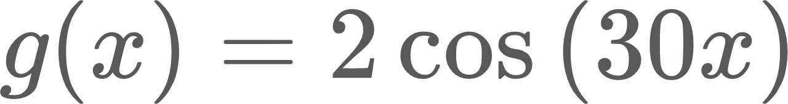
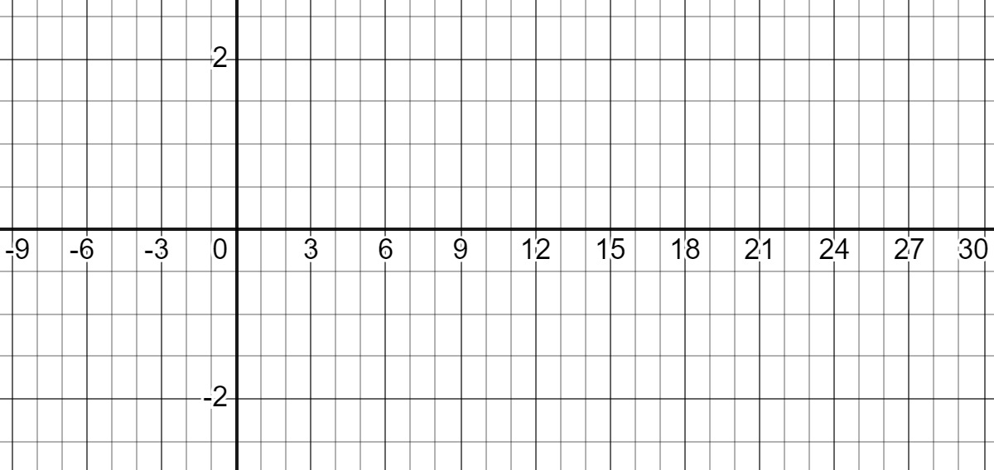
Lesson 5 exit ticket Name:
Carefully graph and on the same grid.
(The angles are in degrees, not radians.)

Slide 10
Lesson 5 exit ticket Name:
Carefully graph and on the same grid.
(The angles are in degrees, not radians.)

Slide 11

Lesson 6 exit ticket Name:
Graph and label the following points in polar coordinates using degrees:
A(4, 60°)
B(7, -60°)
C(-2, 90°)
Notes:
Lesson 6

Slide 12
Lesson 6 exit ticket Name:
Graph and label the following points in polar coordinates using degrees:
A(4, 60°)
B(7, -60°)
C(-2, 90°)
Notes:
Lesson 6

Slide 13
Lesson 7 exit ticket Name:
Find the arc length of a 28° arc on a circle with radius 10 cm.
Notes:
Lesson 7

Slide 14
Lesson 7 exit ticket Name:
Find the arc length of a 28° arc on a circle with radius 10 cm.
Notes:
Lesson 7

Slide 15
Lesson 8 exit ticket Name:
Use special right triangles to find the sine and cosine of 3π/4. CLEARLY show how the special right triangle relates to the angle. Keep exact values (no rounding) and don’t forget to rationalize your denominators!
Notes:
Lesson 8

Slide 16
Lesson 8 exit ticket Name:
Use special right triangles to find the sine and cosine of 3π/4. CLEARLY show how the special right triangle relates to the angle. Keep exact values (no rounding) and don’t forget to rationalize your denominators!
Notes:
Lesson 8

Slide 17
Lesson 9 exit ticket Name:
Use special right triangles to find the sine and cosine of 2π/3. CLEARLY show how the special right triangle relates to the angle. Keep exact values (no rounding) and don’t forget to rationalize your denominators!
Notes:
Lesson 9

Slide 18
Lesson 9 exit ticket Name:
Use special right triangles to find the sine and cosine of 2π/3. CLEARLY show how the special right triangle relates to the angle. Keep exact values (no rounding) and don’t forget to rationalize your denominators!
Notes:
Lesson 9

