Slide 1
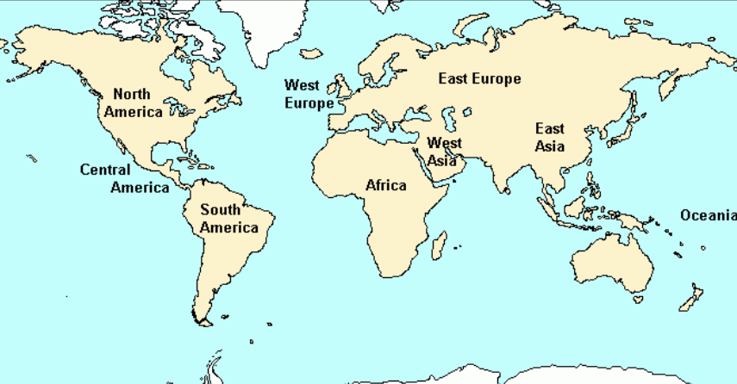
Unit 3: Macroeconomics
By Ms. Lane

Slide 2


Doctors of Macroeconomics
For this unit, you will be a doctor.
Your patient is the economy of the country.
Label the medical conversion chart so you understand your responsibilities as a doctor of economics.
Doctors of Macroeconomics Conversion Chart
Human | Economy
blood | money
Pulse | Gross Domestic Product (GDP)
Medical chart | Business cycle
Medical specialists | Economists
Medicine | Fiscal policy
Symptoms of illness | Unemployment, inflation, deflation, stagflation

Slide 3



What is macroeconomics?
The branch of economics that studies the overall working of a country’s economy including topics such as inflation, unemployment, and economic growth

Slide 4

What is Gross Domestic Product (GDP)?
Dictionary.com
What is the definition of gross?
  The definition is…
What is the meaning of domestic?
  The meaning is…
What is the meaning of product?
  The meaning is…
Draw a picture of each of the following words to create a visual memory
Economics definition: the dollar value of all final goods and services produced within a country’s borders in a given year.

Slide 5

Studying Economics by Country
As a doctor, you will be evaluating economic statistics and human demographics to draw conclusions about the health of some countries.
Watch the video 7 Billion and Counting to draw conclusions from data
Determine whether your assigned countries you are assigned are sick or healthy and prepare a written statement

Slide 6
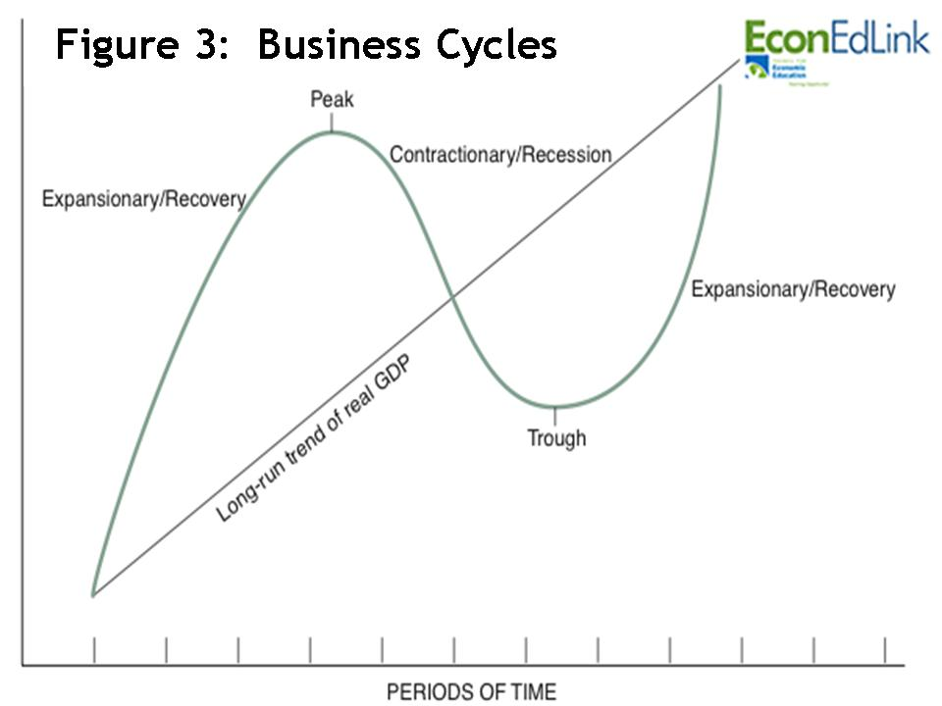
What is the business cycle?
The business cycle is:
  a period of macroeconomic expansion followed by a period of macroeconomic contraction
  Read page 310 and 311 to identify the phases of the business cycle
  Draw and label a graphic of the business cycle
  Describe recession and depression

Slide 7
What factors can shift the business cycle phase?
There are 4 variables that can effect the business cycle. These factors are:
  Business Investment
  Interest rates and credit
  Consumer expectations
  External shocks

Slide 8



Factors that Shift the Business Cycle
Name of Factor | What does this mean? | Positive effect | Negative effect
Business Investment | Investing in new factories & equipment | Increasing investment helps economy expand ☺ | Decreasing investment makes the economy contract ☹
Interest rates and credit | Interest rates The rate of interest that businesses have to pay. Credit The availability of loans to businesses. | Low interest rates makes credit available so businesses and the economy expand ☺ | High interest rates makes credit unavailable so the economy contracts ☹
Consumer Expectations | Consumers have a feeling about the direction of the economy | If consumers think the economy is expanding, they will make more purchases which will help the economy expand. ☺ | If consumers think the economy is contracting, they will save money (not spend) so the economy will contract. ☹
External Shocks | Unexpected events that hurt the economy | There aren’t any positive shocks. | Decrease in oil supplied, spoilage of crops can contract the economy.

Slide 9


Study, Review and Quiz
Go to: http://quizlet.com/_bzoh2 to study for your quiz
  Make sure you complete:
    Learn
    Scatter
    Test
Go to studyisland.com and take the Macroeconomics: GDP & Business Cycles quiz
Complete your AFL for 1b and 2b:
  I can evaluate GDP statistics to explain the health of the economy.
  I can illustrate and explain the business cycle.

Slide 10

Unemployment in the Economy

Slide 11

What are the four types of unemployment?
Frictional-unemployment that occurs when people take time to find a job they desire
Seasonal-unemployment that occurs as a result of changes in harvests, vacations and/or the time of year
Structural-unemployment that occurs when occurs when workers skills do not match the jobs that are available
Cyclical-unemployment that rises during economic downturns and falls when the economy improves

Slide 12

Unemployment Analysis
With your elbow partner, analyze each situation and determine the type of unemployment described in the reading. Complete the data table section entitled: What does it look like?

Slide 13
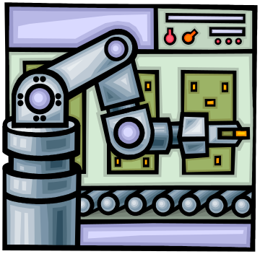
Learn more about Unemployment
Watch the video: Are Robots Hurting Job Growth?
What type of unemployment is discussed in this video?
List the pros and cons of robots in the workplace.
What are robots doing to the US economy?
Predict how people will adapt to the greater use of robots.

Slide 14
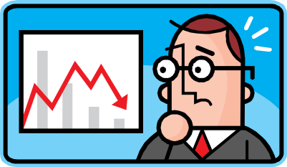
How does high unemployment effect the economy?
The economy is not healthy if the unemployment rate is too high (over 6%)
Loss of income means less consumer spending on goods
Gross Domestic Product (GDP) drops
People who are not working do not pay taxes
Unemployed people get discouraged and stop looking for work (discourage

Slide 15
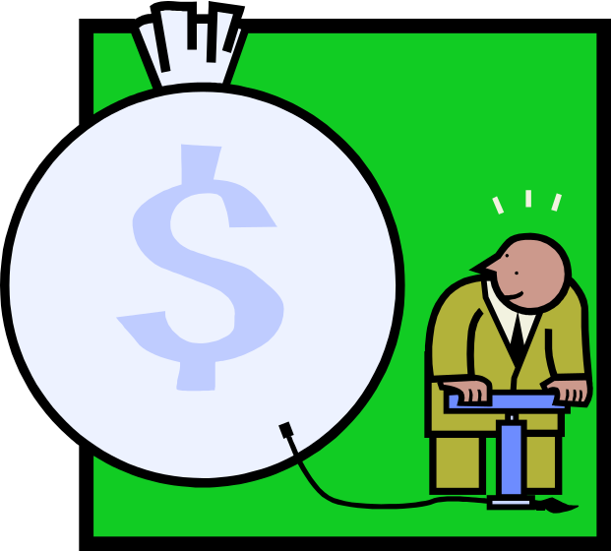
What is Inflation?

Slide 16

Inflation and Purchasing power questions
As a class we will read page 338, 339 and 341 to determine the following:
  What is inflation?
  What is purchasing power?
  What is a price index?
  What is the Consumer Price Index (CPI)
  What is a market basket?
  What causes inflation?
Complete your Cornell notes as we answer these questions. Draw pictures to help you learn each vocabulary word.

Slide 17
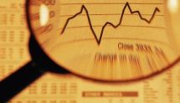

Inflation and Purchasing power answers
Complete your Cornell notes as we answer these questions. Draw pictures to help you remember each vocabulary word
Inflation is a general increase in prices (see figure 13.3)
Purchasing power is the ability to purchase goods and services
A price index is a measurement that shows how the average price of a standard group of goods changes over time. It is used to compare to earlier averages to see how much prices have changed over time.
The Consumer Price Index (CPI) is a price index determined by measuring a standard group of goods meant to represent the “market basket” of a typical urban consumer
A market basket is a representative collection of goods and services (see figure 13.4)
Inflation is caused by:
  Greater demand than supply especially during wartime
  Lower productivity (for example: less vegetables due to drought)

Slide 18

Examining Price Inflation
Complete the price inflation assignment to see how income and prices have changed over the past 70 years.

Slide 19

Study, Review and Quiz
Go to Quizlet: http://quizlet.com/_c7ct2 to study for your quiz
  Make sure you complete:
    Learn
    Scatter
    Test
Go to studyisland.com and take the Unemployment and Inflation quiz
Complete your AFL for 3b, 4b and 5b:
  I can define inflation and how the government can try to control it.
  I can describe how the consumer price index is used to determine inflation.
  I can distinguish between the different types of unemployment and how it affects individuals and the economy.

