Slide 1
writing equations of quadratic equations unit 2 day 5

Slide 2
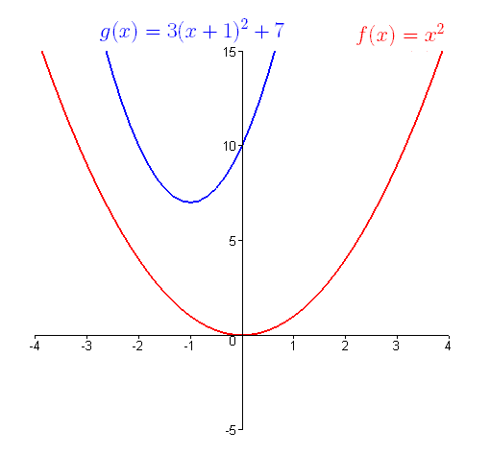
KEY CONTENT:
A-CED.A.2: I can create equations and inequalities in two or more variables to represent relationships between quantities; graph equations on coordinate axes with labels.
F-BF.A.1b: I can write a function that describes a relationship between two quantities. Combine standard function types using arithmetic operations.

Slide 3
Today I will learn how to write a quadratic equation given specific information.

Slide 4
Mini Lesson #1 writing an equation of a quadratic function using a point on the graph and the Vertex
PART A:
Video – Take Notes - (0:00 - 3:50)
https://www.youtube.com/watch?v=BYlWhtgUwJI
PART B:
In the example from the video above, what would the final equation look like if you rewrote it in standard form?

Slide 5
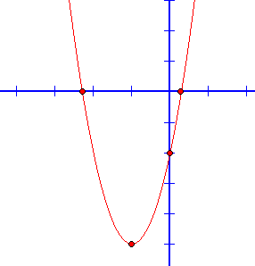
Independent practice u2A5 Example 1
Write an equation of the parabola
in vertex form.

Slide 6
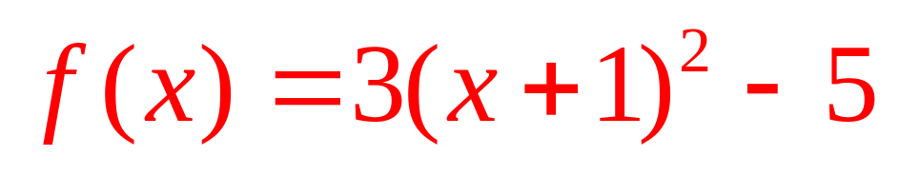
Independent practice u2A5 Example 1
Write an equation of the parabola
in vertex form.

Slide 7
Independent practice u2A5 Example 2
Write an equation of the parabola in vertex form that passes through the point (13, 8) and has a vertex of (3, 2).

Slide 8
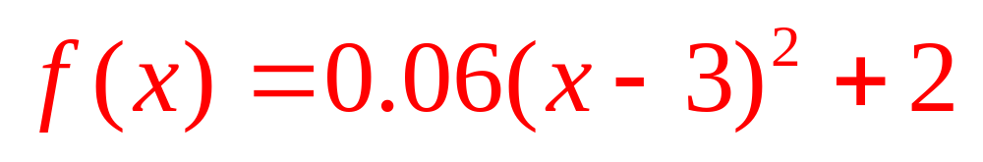
Independent practice u2A5 Example 2
Write an equation of the parabola in vertex form that passes through the point (13, 8) and has a vertex of (3, 2).

Slide 9
Independent practice u2A5 Example 3
Write an equation of the parabola in vertex form that passes through the point (- 7, - 15) and has a vertex of ( - 5, 9).

Slide 10
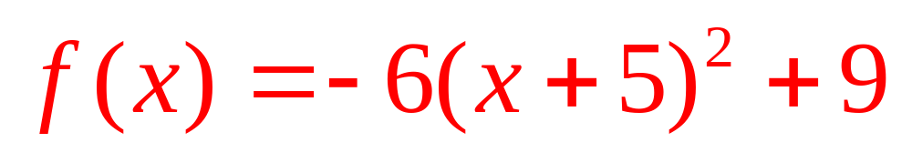
Independent practice u2A5 Example 3
Write an equation of the parabola in vertex form that passes through the point (- 7, - 15) and has a vertex of ( - 5, 9).

Slide 11
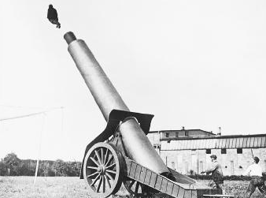
Guided practice u2A5 Example 4
In the picture to the right a performer is being launched from a cannon.
On the next slide the graph shows the parabolic pathway of the performer who is shot out of a cannon, where y is the height (in feet) and x is the horizontal distance traveled (in feet).

Slide 12
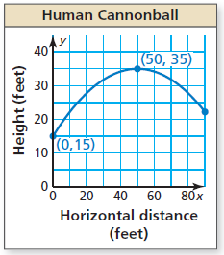
Guided practice u2A5 Example 4
Write an equation of the parabola.

Slide 13
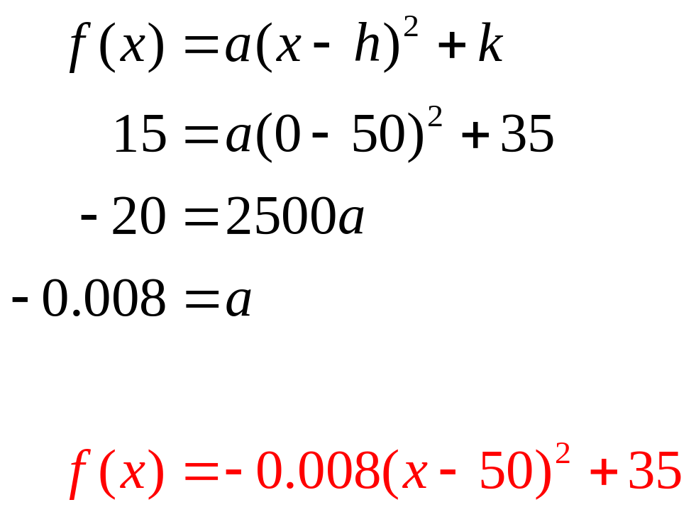
Guided practice u2A5 Example 4
Write an equation of the parabola.

Slide 14
Guided practice u2A5 Example 4
If the performer lands in a net 90 feet from the cannon, what is the height of the net?
Round your answer to the nearest foot.

Slide 15
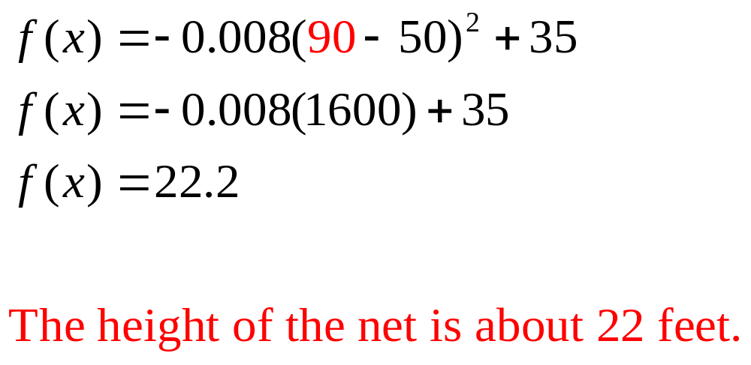
Guided practice u2A5 Example 4
If the performer lands in a net 90 feet from the cannon, what is the height of the net?

Slide 16
independent practice u2A5 Example 5
What would the height of the net be if the vertex of the parabola was
(50, 37.5)?
Round your answer to the nearest foot.

Slide 17
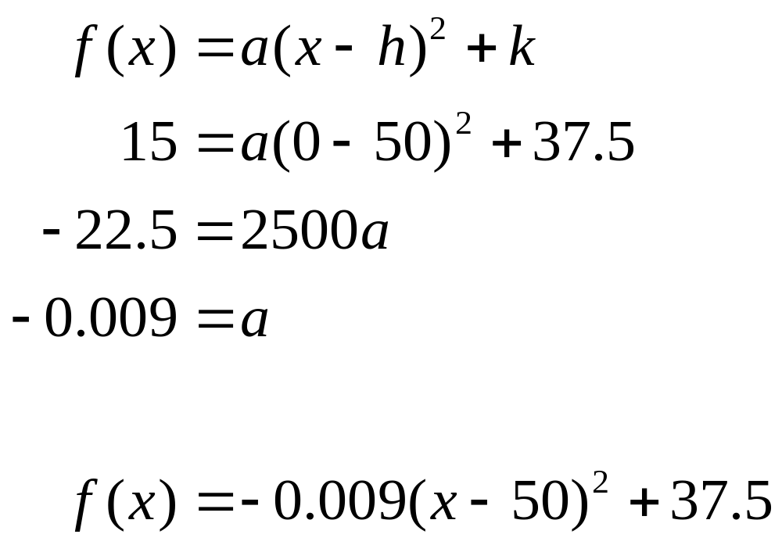
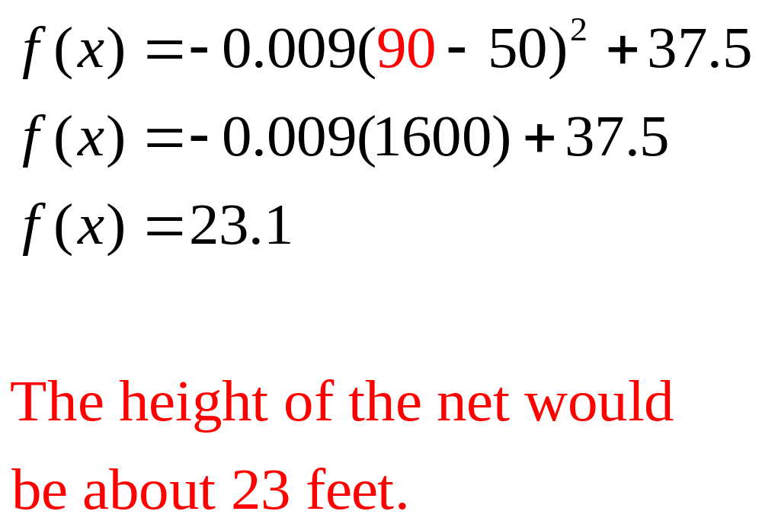
independent practice u2A5 Example 5

Slide 18
independent practice u2A5 Example 5
Identify and interpret the domain and range in this situation.

Slide 19
independent practice u2A5 Example 5
The domain is [0, 90] and represents the horizontal distance, in feet, traveled from the cannon .
The range is [15, 35] and represents the height of the performer, in feet.

Slide 20
Mini Lesson #2 find a quadratic model for a data set using the quadratic regression feature on your calculator.
Take Notes - (0:40 - 6:00)
https://www.youtube.com/watch?v=bGOyuh2QVP8

Slide 21
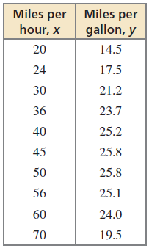
Guided Practice u2A5 Example 8
The table shows fuel efficiencies of a vehicle at different speeds.
Part A: Write a function, in standard form, that models the data. Round the a, b and c values to the nearest thousands.

Slide 22
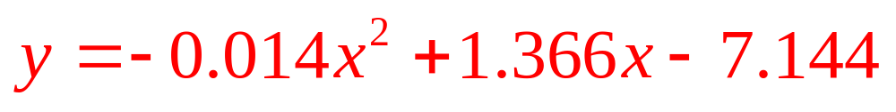
Guided Practice u2A5 Example 8
Part A: Write a function that models the data.
Enter the data in a graphing calculator using two lists and create a scatter plot. Use the quadratic regression feature to generate a best fit quadratic model.

Slide 23
Guided Practice u2A5 Example 8
Part B: Use the exact coefficient values generated by the quadratic regress model to identify the optimal driving speed. If needed, refer back to the steps in the video.
After finding the optimal driving speed, round your final answer to the nearest tenth of a unit.

Slide 24
Guided Practice u2A5 Example 8
The optimal driving speed is the speed at which the mileage per gallon is maximized. Use the maximum feature on your calculator to identify the maximum value on the parabola. At this point you will see the maximum mileage per gallon is about 25.9571 per gallon when driving about 48.4565.
When rounding to the nearest tenth of a unit, the optimal driving speed is approximately 48.5 miles per hour.

Slide 25
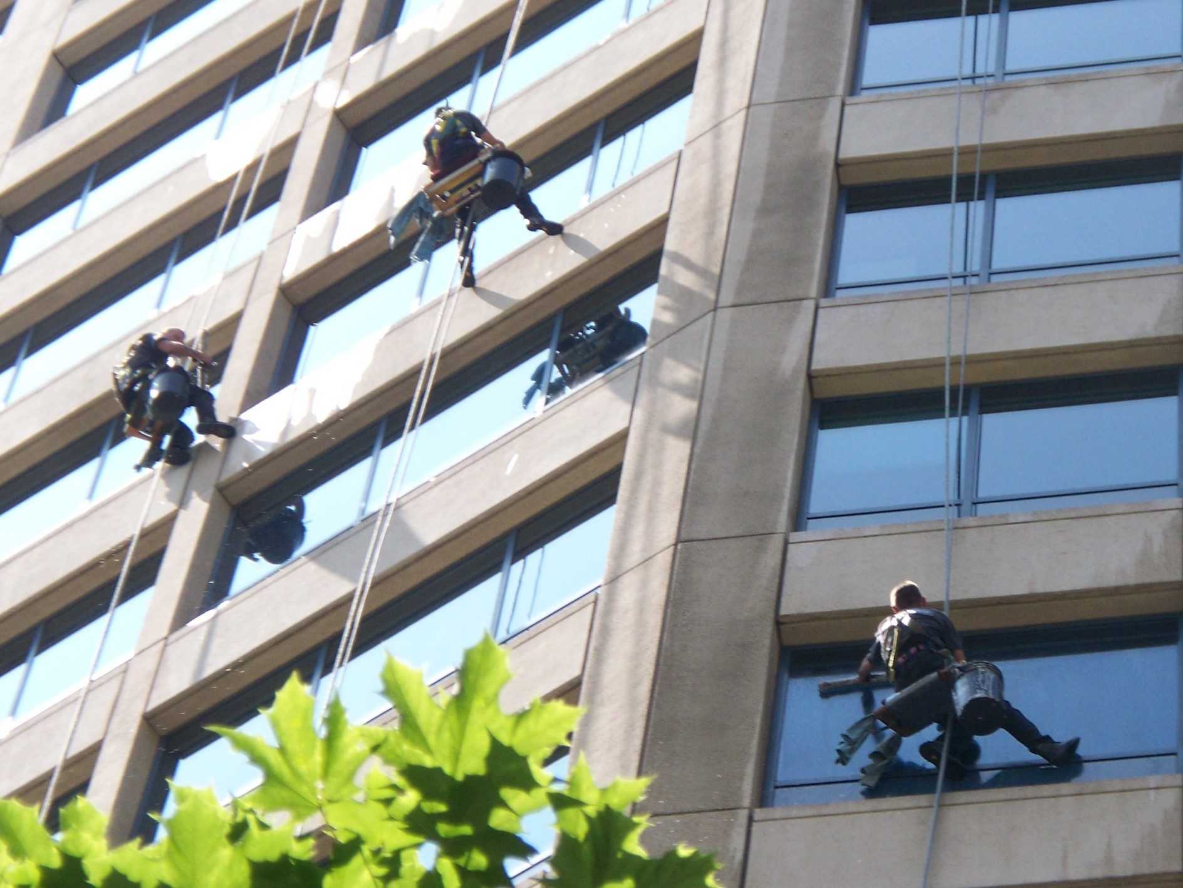

independent Practice u2A5 Example 9
The table below shows the height h (in feet) of a squeegee t seconds after it was dropped by a window cleaner while cleaning a skyscraper.

Slide 26
independent Practice u2A5 Example 9
After using the quadratic regression feature on your calculator to model the data set, predict when the squeegee will hit the ground. Round your answer to the nearest hundredth of a unit.

Slide 27
independent Practice u2A5 Example 9
HINT: To identify the exact point use the zero feature (left bound, right bound, guess) on the graphing calculator .

Slide 28
independent Practice u2A5 Example 9
The squeegee will hit the ground after about 4.18 seconds.

Slide 29
independent Practice u2A5 Example 9
Identify and interpret the domain and range in this situation.

Slide 30
independent Practice u2A5 Example 9
The domain is [0, 4.18] and represents the time the squeegee was in the air.
The range is [0, 280] and represents the height of the squeegee.

Slide 31
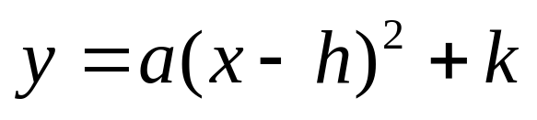
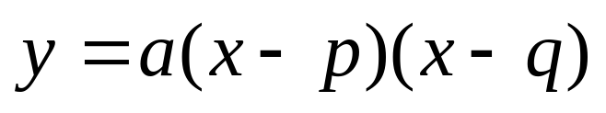
Review Core concepts
Writing Quadratic Equations...
Given a point and the vertex (h,k)
Given a point and the x-intercepts p and q
Given three points Write and solve a
system of three equations
in three variables
Given more than three points Quad Reg

Slide 32
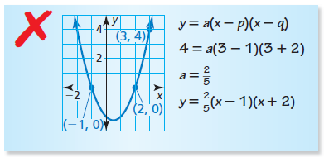
Checking for understanding…
Describe and correct the error in writing an equation of the parabola.

Slide 33
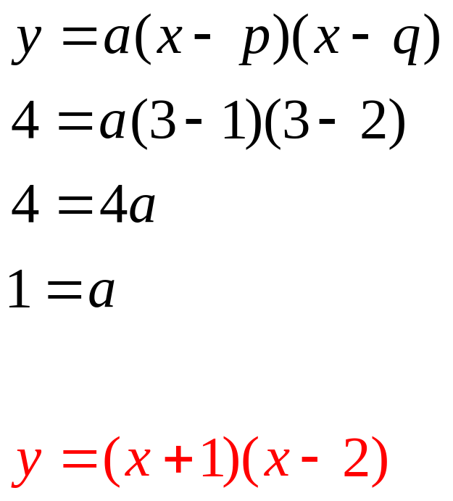
Checking for understanding…
The x-intercepts were substituted incorrectly.

Slide 34
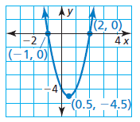
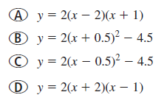
Checking for understanding…
Which of the following equations represents the parabola below?

Slide 35
Checking for understanding…
Which of the following equations represents the parabola below?

Slide 36
Checking for understanding…
How can you write a quadratic function whose graph passes through three known points?

Slide 37
Checking for understanding…
How can you write a quadratic function whose graph passes through three known points?
Substitute the (x, y) values into the standard equation to write a system of three equations with three variables. Then solve the system for a, b, and c using the RREF method.

Slide 38
Checking for understanding…
Is it possible to write the equation of a quadratic function given only two ordered pairs? Explain.

Slide 39
Checking for understanding…
Is it possible to write the equation of a quadratic function given only two ordered pairs? Explain.
It is only possible to write the equation of a quadratic equation given two ordered pairs if one of the ordered pairs is the vertex of the parabola.

Slide 40
Checking for understanding…
How can you write a quadratic function that models data consisting of more than three points?

Slide 41
Checking for understanding…
How can you write a quadratic function that models data consisting of more than three points?
Use the quadratic regression feature on the graphing calculator.

Slide 42
Checking for understanding…
How do you know whether to perform a linear regression or a quadratic regression for a given set of data?

Slide 43
Checking for understanding…
How do you know whether to perform a linear regression or a quadratic regression for a given set of data?
Enter the data into a graphing calculator using two lists and create a scatter plot. The scatter plot will indicate whether the data points are collinear (linear regression) or non-collinear where the data points follows a curve (quadratic regression).

Slide 44
Checking for understanding…
Give four ways to find a quadratic model for a set of data points.

Slide 45
Checking for understanding…
Give four ways to find a quadratic model for a set of data points.
Use the vertex and a point in the vertex form of the equation.
Use the intercepts and a point in the intercept form.
Use quadratic regression on a calculator.
Use the three points and solve the system of equations to find
the coefficients.

