Slide 1
After School Ukulele
MR. Pilz’s Class 2019-2020

Slide 2
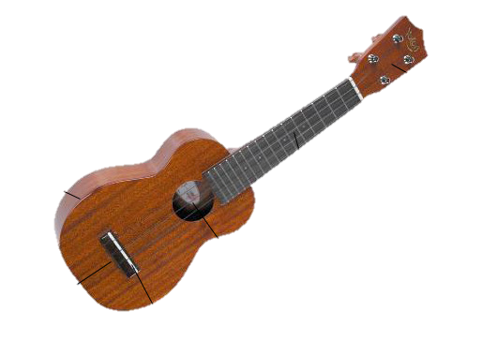
Parts of the Ukulele
Tuners
Frets
Neck
Head
Body
Nut
Soundboard
Soundhole
Bridge

Slide 3
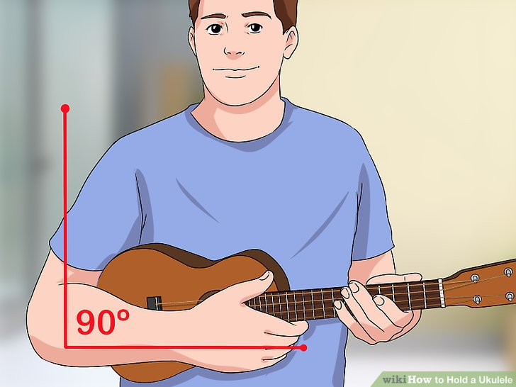
How to Hold the Ukulele
Right arm hugs BODY of ukulele
Left hand grips between NECK and HEAD
Left hand fingers wrap under and around neck
Head of the ukulele should ALWAYS face the instrument wall!!

Slide 4
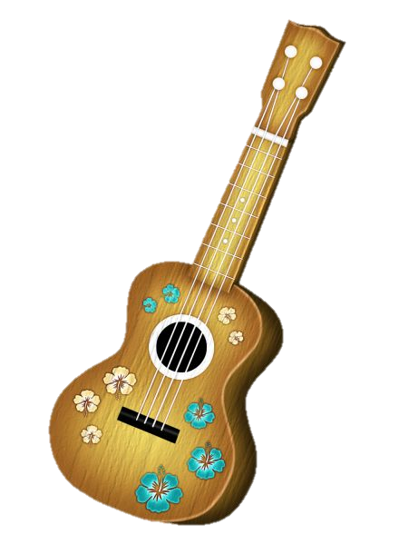
Ukulele Do’s and DONT’s
NEVER touch the tuners
Never pull strings or pluck/strum strings too hard
Be very gentle with your ukulele
Never pick up by the neck
Always hold with both hands

Slide 5
How to Play the Strings?
Plucking
Strumming
One string at a time is played with thumb
Your thumb rests on the string it lands on
All strings are played at the same time with thumb
Take thumb from the top string (My) to the bottom string (fleas) in one swift motion

Slide 6
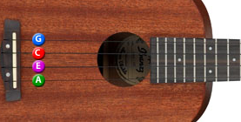
Ukulele Strings
The order of the strings from top to bottom is G, C, E, A
The letter is the name of the note it plays
My Dog Has Fleas
My
Dog
Has
Fleas

Slide 7
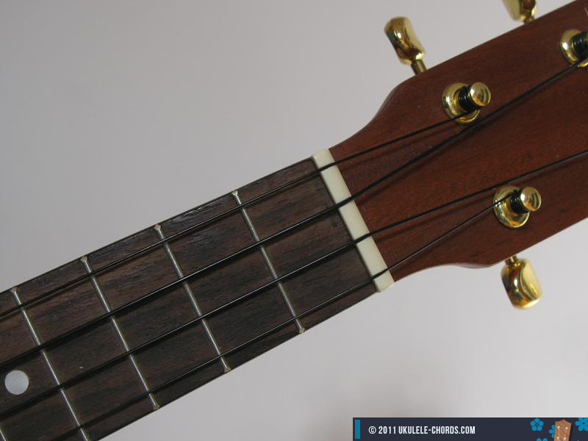
OPEN ( Am7 )
A minor 7 chord (Am7)
No left hand fingers are touching any strings

Slide 8

O
O
O
O
O
O
O
O

Slide 9
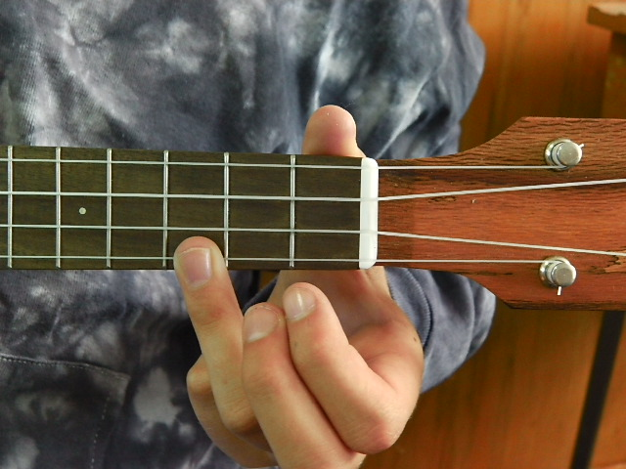
C Major
C Major Chord
Third Finger
Third Fret
Bottom String
3

Slide 10
C
C
C
C
C
C
C
C

Slide 11
C
C
C
C
O
O
O
O
C
C
C
C

Slide 12
C
C
C
C
C
C

Slide 13
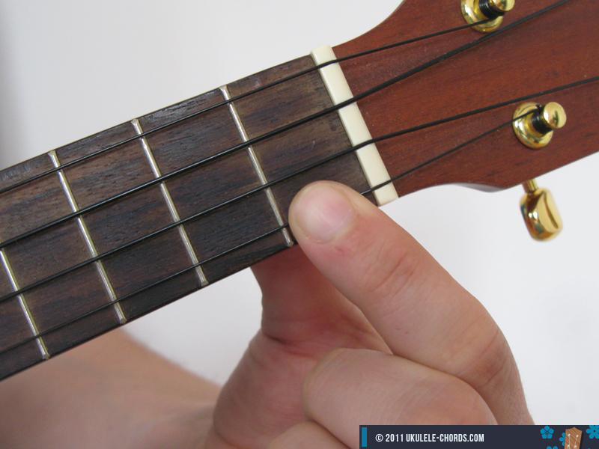
C7
First finger
First Fret
Bottom String
1

Slide 14
C7
C7
C7
C7
C7
C7
C7
C7

Slide 15
C7
C7
C7
C7
C7
C7

Slide 16
C7
C7
C7
C7
C
C
C
C

Slide 17
C7
C7
C7
C7
C
C
C
C
C7
C7
C7
C7

Slide 18
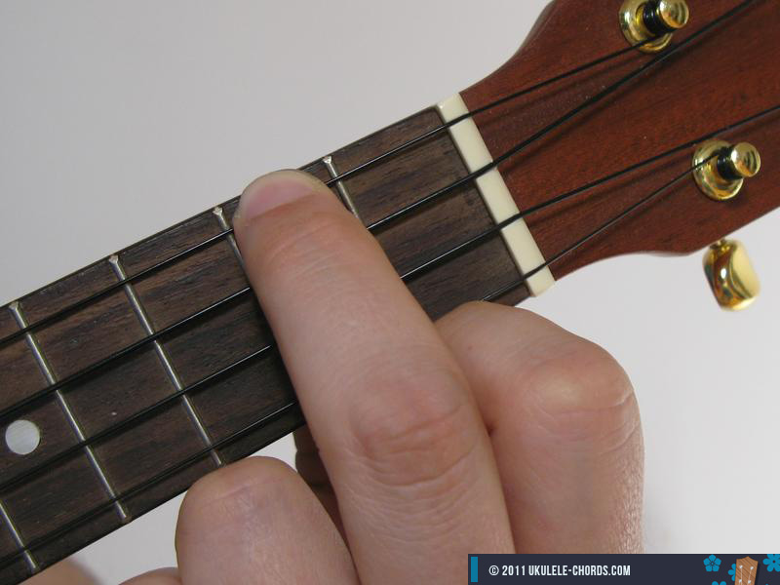
A minor
Second finger
Second Fret
Top String
2

Slide 19
Am
Am
Am
Am
Am
Am
Am
Am

Slide 20
Am
Am
Am
Am
Am
Am

Slide 21
Am
Am
Am
Am
O
O
O
O
Am
Am
Am
Am

Slide 22
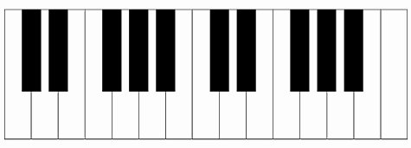
OPEN vs. Am?
Am = 3 different notes
Open (Am7) = 4 different notes: (A, C, E, + G)
1
2
3
4

Slide 23
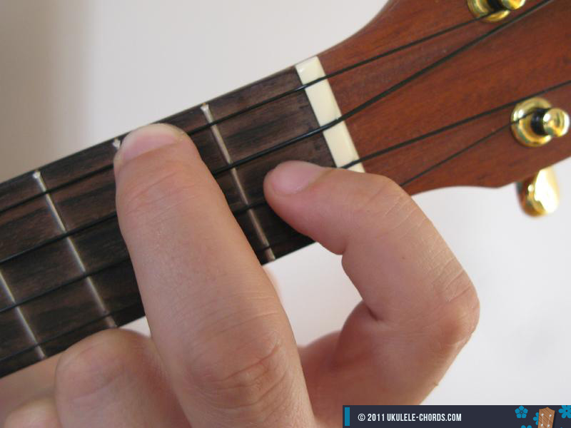
F Major
Second finger
Second Fret
Top String
PLUS
First finger
First fret
Second string
2
1

Slide 24
F
F
F
F
F
F
F
F

Slide 25
F
F
F
F
Am
Am
Am
Am
F
F
F
F

Slide 26
Am
Am
Am
Am
F
F
F
F
Am
Am
Am
Am

Slide 27
F
F
F
F
O
O
O
O
F
F
F
F

Slide 28
You are My Sunshine
C
F

Slide 29
C
C
C
C
C
C
C
C
F
F
F
F

Slide 30
C
C
C
C
F
F
F
F
C
C
C
C

Slide 31
C
C
F
F
C

Slide 32
C
C
C
C
Sun -
shine
/ my
only
C
C
C
C
Sun -
shine
/ you
make me
F
F
F
F
Ha-
ppy
/ when
Skies are

Slide 33
C
C
C
C
grey
/ you’ll
never
F
F
F
F
Know
Dear,
/ how
Much I’ll
C
C
C
C
Love
you
/ so
Please don’t

Slide 34
C
C
F
F
take
/ my
Sun-
Shine a-
C
Way!

Slide 35
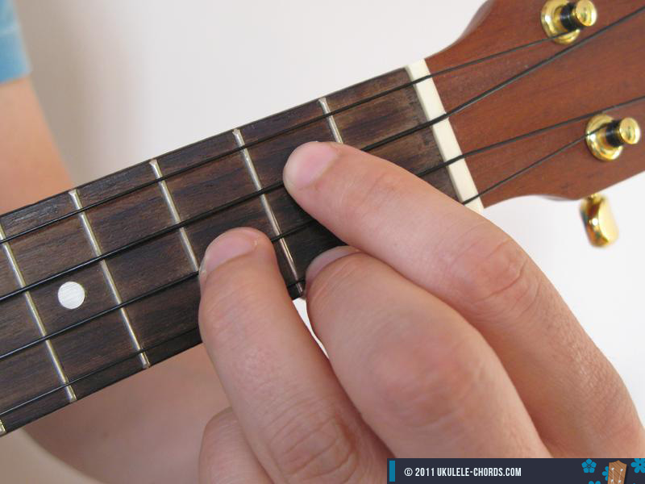
G Major
1 and 2 finger
  Second fret
  1/3 string
3 finger
  3 fret
  String between other fingers
1
(2)
3
2
(1)

Slide 36
G
G
G
G
G
G
G
G

Slide 37
G
G
G
G
O
O
O
O
G
G
G
G

Slide 38
Ukulele Progressions
C
O
Am
C

Slide 40


Slide 44
Ukulele Progressions
C
Am
F
C

Slide 50
Pop Progression
C
G
Am
F

Slide 51
C
G
Am
F

Slide 52
C
G
Am
F

Slide 53
C
G
Am
F

Slide 54
C
G
Am
F

Slide 55
C
G
Am
F

Slide 56
C
G
Am
F

Slide 57

C
G
Am
F

Slide 58
Blues Progression
G
C7
D7
G

Slide 59
G
C7
D7
G

Slide 60
G
C7
D7
G

Slide 61
G
C7
D7
G

Slide 62
G
C7
D7
G

Slide 63
G
C7
D7
G

Slide 64
G
C7
D7
G

Slide 65
G
C7
D7
G

Slide 66
Strumming Patterns

Slide 67
Free Fallin’
C
F
Am
G

Slide 68
C
F
Am
G

Slide 71
C
G
Am
F

Slide 72
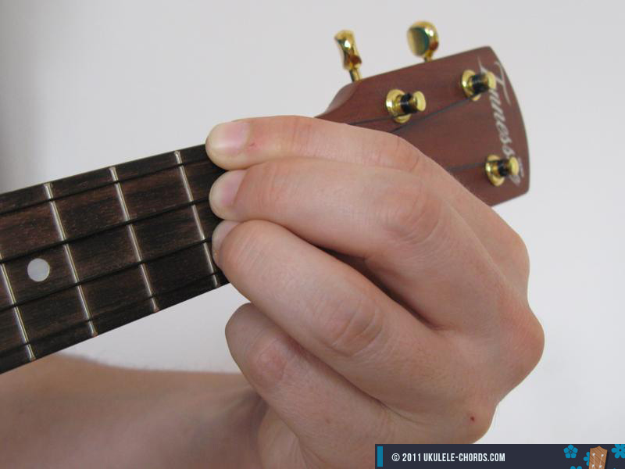
Un Poco Loco
C
G
D

Slide 73
D Major
Fingers 1, 2, and 3
  Second fret
  Top three strings
OR
  Second finger
  Covers top three strings
1
(2)
3
2
(1)

Slide 74
C Major
C Major Chord
Third Finger
Third Fret
Bottom String
3

Slide 75
F Major
Second finger
Second Fret
Top String
PLUS
First finger
First fret
Second string
2
1

Slide 76
G Major
1 and 2 finger
  Second fret
  1/3 string
3 finger
  3 fret
  String between other fingers
1
(2)
3
2
(1)

Slide 77
Chord Progression
D
G
C

Slide 78
Un Poco Loco
What color’s the sky? Mi amor, mi amor?
You tell me that its red, ay mi amor, mi amor.

Slide 79
Un Poco Loco
Where should I put my shoes Mi amor, mi amor?
You say put them on your head, ay mi amor, mi amor.

Slide 80
Un Poco Loco
You make me un poco loco, un poquito loco
The way you keep me guessing, I’m nodding and I’m yesing.

Slide 81
Un Poco Loco
I’ll count it as a blessing.
That I’m only un poco loco!

Slide 82
After School Ukulele: 11/12/19
SNACK
Tune
  With Kala ukulele app
  Ipad password is 1111
Jingle Bells - activity
Jingle Bells with slides

Slide 83
Jingle Bells
C
F
G

Slide 84
Jingle Bells
How to strum?
What is a chord?
What chords will we use?
Chords in Jingle Bells
C
F
G

Slide 85
C Major
C Major Chord
Third Finger
Third Fret
Bottom String
3

Slide 86
C
C
C
C
C
C
C
C

Slide 87
C
C
C
C
O
O
O
O
C
C
C
C

Slide 88
C
C
C
C
C
C

Slide 89
F Major
Second finger
Second Fret
Top String
PLUS
First finger
First fret
Second string
2
1

Slide 90
F
F
F
F
F
F
F
F

Slide 91
F
F
F
F
O
O
O
O
F
F
F
F

Slide 92
G Major
1 and 2 finger
  Second fret
  1/3 string
3 finger
  3 fret
  String between other fingers
1
(2)
3
2
(1)

Slide 93
G
G
G
G
G
G
G
G

Slide 94
G
G
G
G
O
O
O
O
G
G
G
G

Slide 95
Practice moving from C - F

Slide 96
G
Practice moving C - G

Slide 97
G
Practice moving F - G

Slide 98
C
C
C
C
Jingle
Bells
Jingle
Bells
Jingle
All the
Way
F
C
G
G
Oh what
Fun it
Is to ride
In a
One-horse
Open
Sleigh hey!
C
C
C
C
Jingle
Bells
Jingle
Bells
Jingle
All the
Way

Slide 99
C
F
G
Jingle Bells – entire song

Slide 100
Poison Chords

Slide 101
This is the poison chord:
C
C
C

Slide 102
C
C
C
C

Slide 103
C
C
O
O

Slide 104
O
O
C
C

Slide 105
C
C

Slide 106
C
C
C

Slide 107
This is the poison chord:
C
C
O
O

Slide 108
C
C
C
C

Slide 109
C
C

Slide 110
O
O
C
C

Slide 111
C
C
C

Slide 112
C
C
O
O

Slide 113
This is the poison chord:
F
F

Slide 114
F
F
F
F

Slide 115
F
F
C
C

Slide 116
F
F
O
O

Slide 117
F
F
O

Slide 118
F
F

Slide 119
This is the poison chord:
F
F

Slide 120
F
F

Slide 121
F
F

Slide 122
F
F

Slide 123
G
G
G
G

Slide 124
G
G
O
O

Slide 125
G
G
C
C

Slide 126
G
G
F
F

Slide 127
Silent Night
C
F
G

Slide 128
C
G
F

Slide 129
C
F
F
G
F

