Slide 1
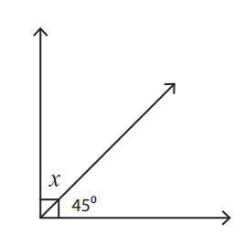
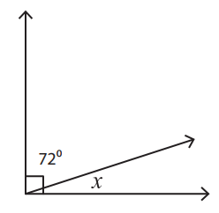
A
1
2

Slide 2
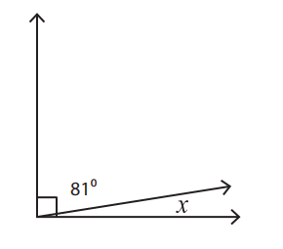
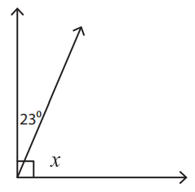
B
1
81
y

Slide 3
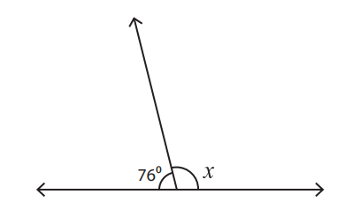
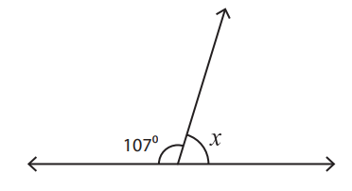
C
1
2

Slide 4
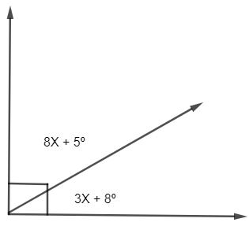
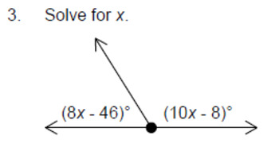
D
1
2

Slide 5
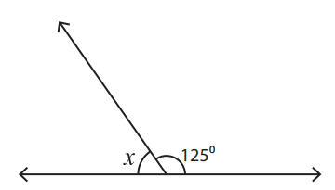
E
1
2
125
76

Slide 6
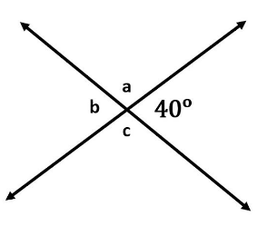
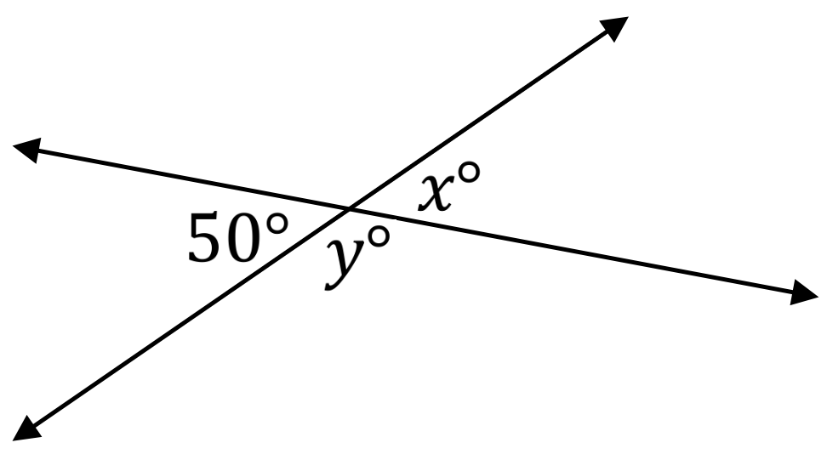
F
1
2
Z

Slide 7
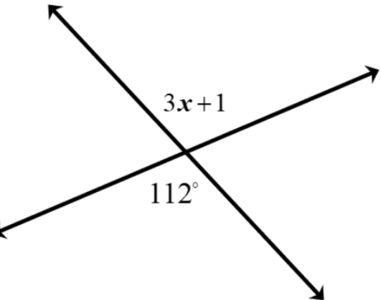
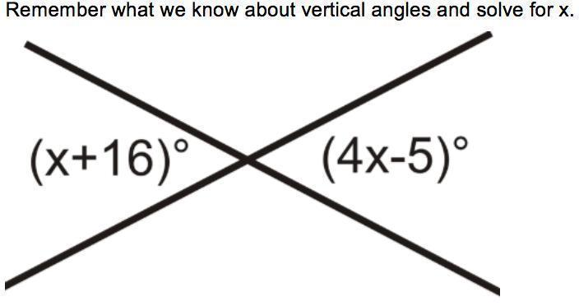
G
1
2

Slide 8
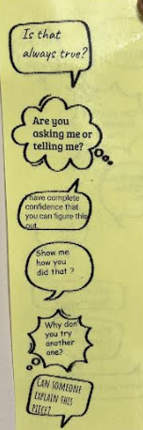
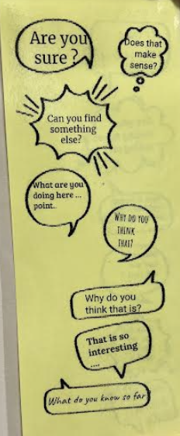
ANSWERS
 | 1 | 2
A | 45 | 18
B | X = 9 | Y = 67
C | 104 | 73
D | x=7, 61, 29 | x=13, 58, 122
E | 104 | 55
F | a=140, b=40, c=140 | x=50, y=130, z=130
G | x=37, others 68 | x=7, 23 and 157

