Slide 1
Factoring Trinomials
Thin Slicing
Notes:
Doc: https://docs.google.com/document/d/1oWTCEu-XDLukRnVW0gX_kGk3Lp9f6cDX0eXV2lmcktw/edit

Slide 2
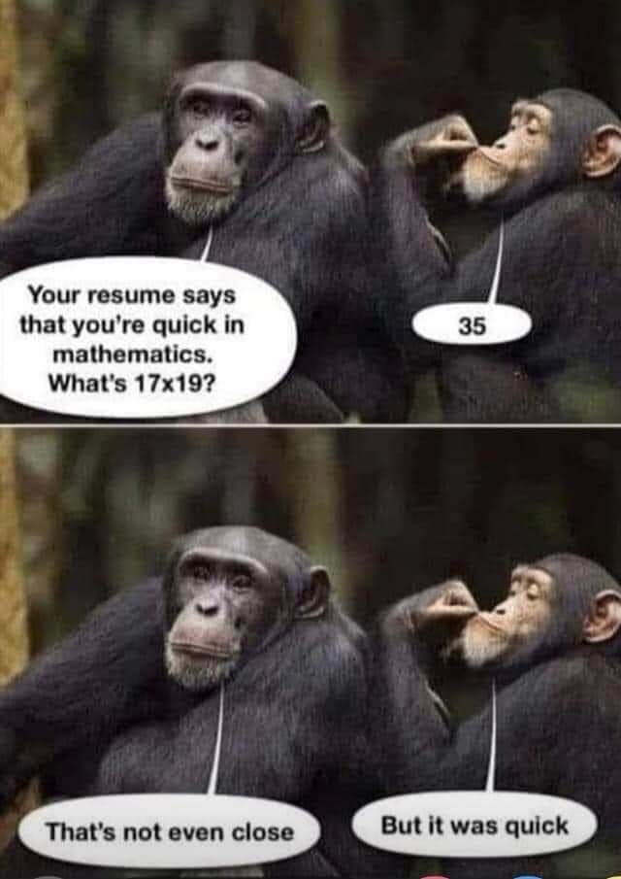
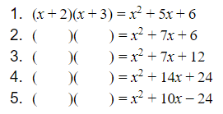
Warm-Up: Multiply
→ Math isn’t about speed.

Slide 4
Set 1: Find the factors of each trinomial.
Notes:
What do we get when we multiply (x+2)(x+3)? [distributive property OR box method]
Your job today is to find the factors of each trinomial.

Slide 5
Set 1: Find the factors of each trinomial.
Notes:
What do we get when we multiply (x+2)(x+3)? [distributive property OR box method]
Your job today is to find the factors of each trinomial.

Slide 6
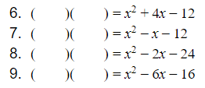
Set 2: Find the factors of each trinomial.

Slide 7
Set 2: Find the factors of each trinomial.

Slide 8
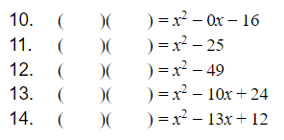
Set 3: Find the factors of each trinomial.

Slide 9
Set 3: Find the factors of each trinomial.

Slide 10
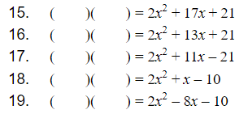
Set 4: Find the factors of each trinomial.

Slide 11
Set 4: Find the factors of each trinomial.

Slide 12
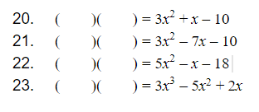
Set 5: Find the factors of each trinomial.

Slide 13
Set 5: Find the factors of each trinomial.

Slide 14
Example(s) Things to Remember
In your notebook:
Write down things that will be helpful for you in a few weeks. Write enough details/information for your future forgetful self.
Factoring Quadratics

