Slide 1
The earliest Heroes

Slide 2
Prometheus and Io (Background)
Prometheus- considered the wisest titan
Was thought to have the gift of prophecy
Son of Iapetus (also father to Epimetheus, Menoetius, Atlas and Clymene)
Io- one of Zeus’ many mistresses
Was changed into a cow after Zeus’ wife became aware of the affair in an attempt to hide it from her
Hera (Zeus’ wife) recognized his plot and asked to keep the cow
Zeus couldn’t refuse without compromising his relationship with Hera
Eventually, she escaped, still in the form of a cow

Slide 3
Prometheus and Io
Prometheus was serving a sentence for providing fire to mankind
This sentence consisted of him being bound to a rock where an eagle would come and pick at his liver which would grow back during the night
One particular day during his sentence, he realized a cow who spoke like a woman
He then recognized her story and soon she too found out who he was
The began to talk and exchanged details of how they came to be

Slide 4
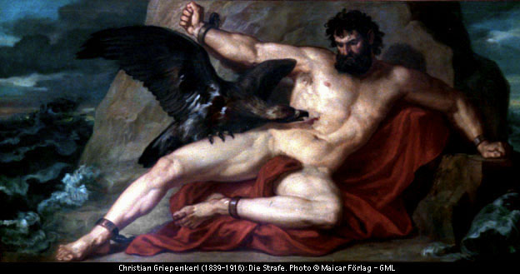
Prometheus’ punishment

Slide 5
Prometheus and Io
Hera, still seeking revenge from Io sends a gad-fly to make her go mad
Prometheus tries to provide comfort, but this renders useless and Io wanders on
She keeps traveling until she reaches the Nile, which freed her from her alternate form
She then returns to Zeus and later bears a child, Hercules
Hercules eventually is the one to free Prometheus of his sentence

Slide 6
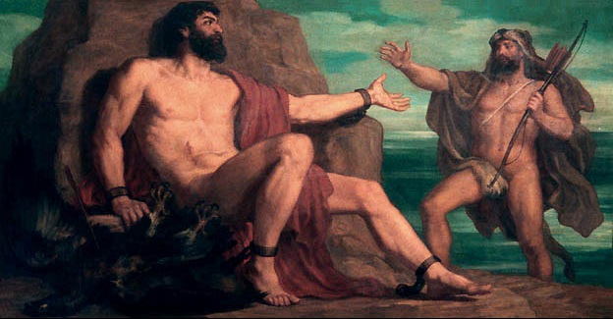
Hercules freeing Prometheus

Slide 7
Europa (Background Info)
Europa - a Phoenician woman of high status
A descendent of Io (just mentioned)
Thought to be the daughter of Agenor, king of Tyre (mentioned in the Illiad
Some argue that she is instead, the daughter of Phoenix

Slide 8
Europa
Zeus, one not know for his faithfulness, sees Europa picking flowers and immediately is attracted to her
In order to come in contact with Europa, Zeus transformed himself into a white bull
He then walked over to her slowly and she was in the process of placing flowers on his neck
Before she finished, he abducted her and headed towards the city of Crete

Slide 9
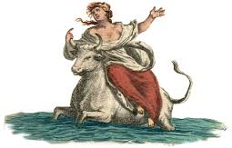
THE ABDUCTION OF Europa

Slide 10
Europa
Upon arriving, Zeus returned to his original form
He then raped her and she bore three sons; King Minos, King Rhadamanthus and Prince Lycia
Europa was the first Queen in all of Crete
Europa then married the King of Crete who adopted her sons as his own
It is said that Zeus still attempts to seduce Europa to this day in the form of a bull, causing for the constellation Taurus

Slide 11
Allusions
The Ionian Sea- the stretch of sea that Io ran along while she was a cow was named after her
Europe- named after Europa
2 of Jupiter’s moons- two of Jupiter’s largest moons are named Io and Europa
Prometheus volcano- On Jupiter’s moon Io, one of the volcanoes is named Prometheus and has in almost always been erupting whenever a picture is taken of Io.

Slide 12
Higher Level Questions
1. How do Io and Europa's experiences compare?
2. Is it fair that Io suffered so greatly because of Zeus' love for her but Europa prospered and was never the focus of Hera's jealousy? Why?
3. Do you believe that Hera's treatment of the girls Zeus falls in love with is justified? Why?

