Slide 1
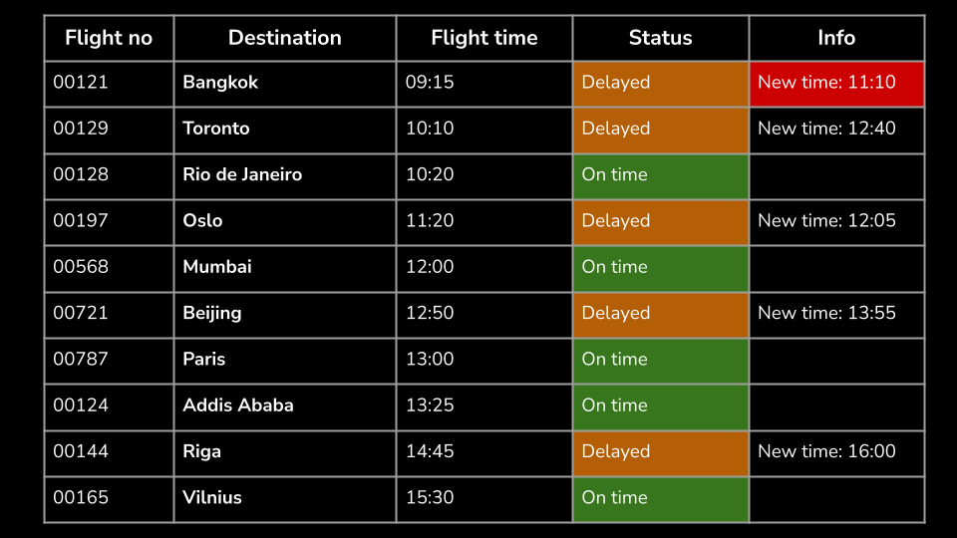
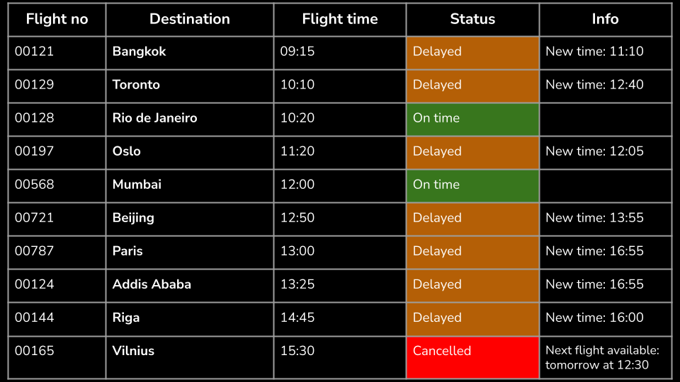
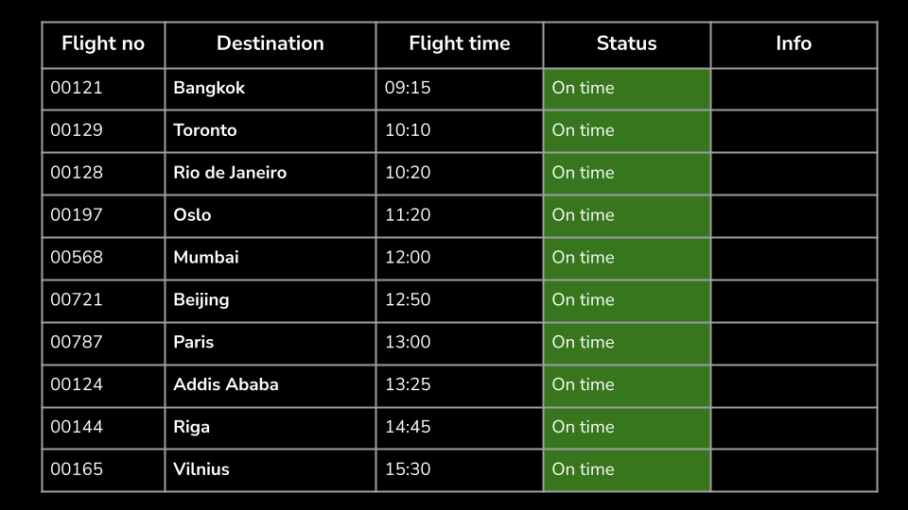
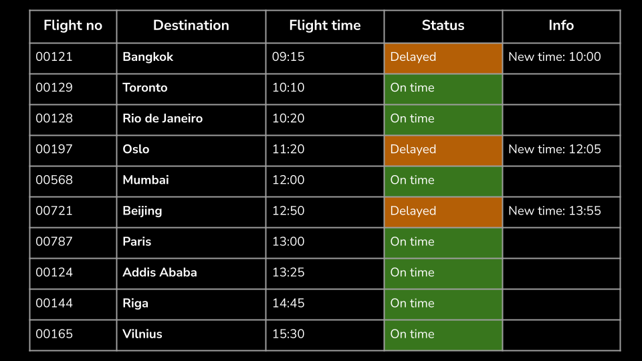
The Departure Lounge

Slide 2
We randomized into groups of 3.
Each group stood at their vertical whiteboard.
The first Departure Lounge flight board was show.
What do you notice and wonder? - Feel free to change the destinations (we used these as they represent lots of home countries in the class)
One member of each group gathered to be the passengers, while the other group members stood at their vertical whiteboard.
The flight board then updated (second slide) - and the passengers were asked to play the role of an angry customer who wants to know how long their delay is.
We spent a few minutes with the passengers visiting various groups, asking about various flights.
A couple of the groups were recording the delays on their whiteboards, so we all had a look and then had some time to organise the whiteboards.
We then rotated the passenger group and updated the board.

Slide 3
Some extension questions that worked well:
“Look at the actual time right now on the class clock…how long will I have to wait in total?”
“The flight time is ____ hours, so when will I arrive in ____”
Consolidation key strategy:
We zoomed in as a whole class on the cancellation.
One student said that they wanted to get to a “new day” first, so she added 8h 30m. Then another 12h 30m to get to 12:30.
Another student added 24 hours, then backed up 3 hours.
I modelled both of these on number lines (making sure that they were lined up vertically) and had them all reflect on how they worked which one they liked best etc.

Slide 4
Flight no | Destination | Flight time | Status | Info
00121 | Bangkok | 09:15 | On time
00129 | Toronto | 10:10 | On time
00128 | Rio de Janeiro | 10:20 | On time
00197 | Oslo | 11:20 | On time
00568 | Mumbai | 12:00 | On time
00721 | Beijing | 12:50 | On time
00787 | Paris | 13:00 | On time
00124 | Addis Ababa | 13:25 | On time
00144 | Riga | 14:45 | On time
00165 | Vilnius | 15:30 | On time

Slide 5
Flight no | Destination | Flight time | Status | Info
00121 | Bangkok | 09:15 | Delayed | New time: 10:00
00129 | Toronto | 10:10 | On time
00128 | Rio de Janeiro | 10:20 | On time
00197 | Oslo | 11:20 | Delayed | New time: 12:05
00568 | Mumbai | 12:00 | On time
00721 | Beijing | 12:50 | Delayed | New time: 13:55
00787 | Paris | 13:00 | On time
00124 | Addis Ababa | 13:25 | On time
00144 | Riga | 14:45 | On time
00165 | Vilnius | 15:30 | On time

Slide 6
Flight no | Destination | Flight time | Status | Info
00121 | Bangkok | 09:15 | Delayed | New time: 11:10
00129 | Toronto | 10:10 | Delayed | New time: 12:40
00128 | Rio de Janeiro | 10:20 | Delayed | New time: 12:35
00197 | Oslo | 11:20 | Delayed | New time: 12:05
00568 | Mumbai | 12:00 | Delayed | New Time: 12:43
00721 | Beijing | 12:50 | Delayed | New time: 13:55
00787 | Paris | 13:00 | Delayed | New Time: 13:56
00124 | Addis Ababa | 13:25 | Delayed | New Time: 13:15
00144 | Riga | 14:45 | Delayed | New time: 16:00
00165 | Vilnius | 15:30 | Delayed | New Time: 16:10

Slide 7
Flight no | Destination | Flight time | Status | Info
00121 | Bangkok | 09:15 | Delayed | New time: 11:10
00129 | Toronto | 10:10 | Delayed | New time: 12:40
00128 | Rio de Janeiro | 10:20 | On time
00197 | Oslo | 11:20 | Delayed | New time: 12:05
00568 | Mumbai | 12:00 | On time
00721 | Beijing | 12:50 | Delayed | New time: 13:55
00787 | Paris | 13:00 | Delayed | New time: 16:55
00124 | Addis Ababa | 13:25 | Delayed | New time: 16:55
00144 | Riga | 14:45 | Delayed | New time: 16:00
00165 | Vilnius | 15:30 | Cancelled | Next flight available: tomorrow at 12:30

Slide 8
Destination | Flight time | Status | Info | Delay
Bangkok | 09:15 | Delayed | New time: 11:10 | 1h 55 minutes
Toronto | 10:10 | Delayed | New time: 12:40 | 2h 30 minutes
Rio de Janeiro | 10:20 | On time |  | 0
Oslo | 11:20 | Delayed | New time: 12:05 | 45 minutes
Mumbai | 12:00 | On time |  | 0
Beijing | 12:50 | Delayed | New time: 13:55 | 1h 5 minutes
Paris | 13:00 | Delayed | New time: 16:55 | 3h 55 minutes
Addis Ababa | 13:25 | Delayed | New time: 16:55 | 3h 30 minutes
Riga | 14:45 | Delayed | New time: 16:00 | 1h 15 minutes
Vilnius | 15:30 | Cancelled | Next flight available: tomorrow at 12:30 | 21 hours

