Slide 1


The Blood

Slide 2
Blood
Blood transports everything that must be carried from one place to another, such as:
  Nutrients from the food we eat, Oxygen
  Wastes Carbon Dioxide gases, urea, uric acid
  Hormones Humoral steroids and thyroid hormones
  Body heat – Blood vessels dilate and contract in response to temperature

Slide 3
Components of Blood
Blood is the only fluid tissue, a type of connective tissue, in the human body
Components of blood
  Formed elements (living cells) makes up 45%
  erythrocytes or Red Blood Cells (RBCs)
    HEMATOCRIT – the percent of erythrocytes to total blood volume
  Leukocytes or White blood Cells (WBCs)
  Platelets – help with blood clotting
  Plasma (nonliving fluid matrix) makes up 55%
  Water makes up 90%
  Salts (electrolytes) Sodium, Potassium, Chloride and Bicarbonate, maintain pH,
  Plasma Proteins (Albumin transports fatty acids and drugs, maintains osmotic pressure, Globulins transport lipids, iron and antibodies, Fibrinogen helps with clotting)
  Nutrients, waste, gases and hormones

Slide 4
Components of Blood
When blood is separated:
  Erythrocytes sink to the bottom (45 percent of blood, a percentage known as the hematocrit – a measure in CBC (Complete Blood Count) blood test)
  Buffy coat contains leukocytes and platelets (less than 1 percent of blood)
    Buffy coat is a thin, whitish layer between the erythrocytes and plasma
  Plasma rises to the top (55 percent of blood) Of that 55%, 90% is H2O

Slide 5
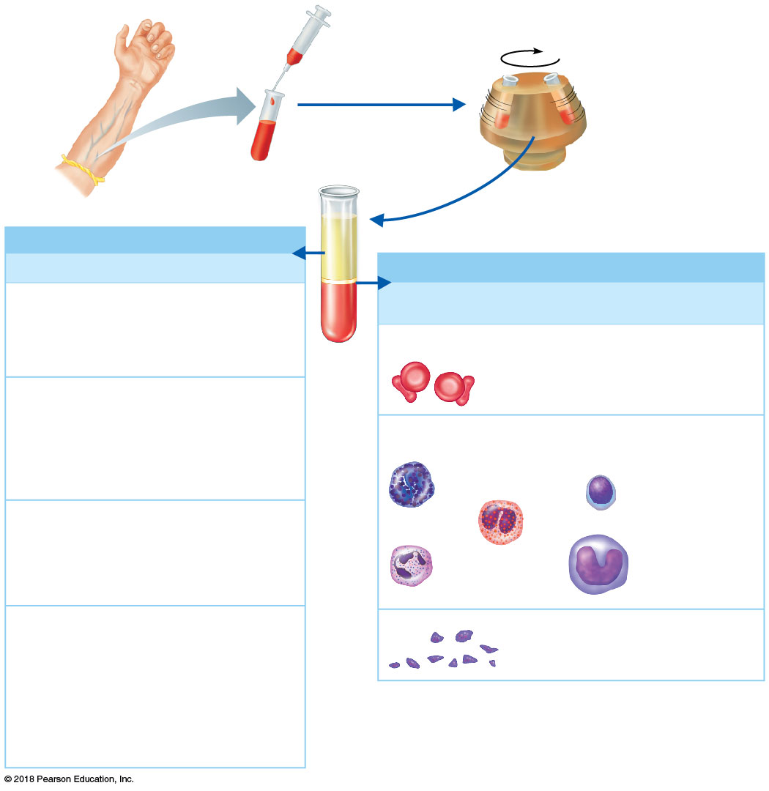
Figure 10.1 The composition of blood.
Plasma 55%
Constituent
Major Functions
Formed elements (cells) 45%
Water
90% of plasma
volume; solvent
for carrying other
substances;
absorbs heat
Cell Type
Number
(per mm³ of blood)
Functions
Erythrocytes
(red blood cells)
4–6 million
Transport oxygen
and help transport
carbon dioxide
Salts (electrolytes)
Osmotic balance,
pH buffering,
regulation of
membrane
permeability
Sodium
Potassium
Leukocytes
(white blood cells)
Calcium
4,800–10,800
Defense and
immunity
Magnesium
Chloride
Bicarbonate
Lymphocyte
Plasma proteins
Osmotic balance,
pH buffering
Basophil
Albumin
Fibrinogen
Clotting of blood
Eosinophil
Globulins
Defense (antibodies)
and lipid transport
Monocyte
Neutrophil
Substances transported by blood
Platelets
Nutrients (glucose, fatty acids, amino
acids, vitamins)
250,000–400,000
Blood clotting
Waste products of metabolism
(urea, uric acid)
Respiratory gases (O₂ and CO₂)
Hormones (steroids and thyroid hormone
are carried by plasma proteins)
© 2018 Pearson Education, Inc.

Slide 6
Physical Characteristics and Volume
Blood characteristics
  Sticky, opaque (like a foggy window) fluid
  Heavier and thicker than water
  Color range ALL BLOOD IS RED! THERE IS NO SUCH THING AS ‘BLUE BLOOD’
    Oxygen-rich blood is scarlet red
    Oxygen-poor blood is dull red or purple (deep purple often mistaken as ‘blue blood’)
  Metallic, salty taste (just in case you are a vampire and would like to know)
  Blood pH is slightly alkaline (basic), between 7.35 and 7.45
  Blood temperature is slightly higher than body temperature, at 38ºC or 100.4ºF (Why do you think body temp is 98.6F?)

Slide 7
Physical Characteristics and Volume
Blood volume
  About 5–6 liters (2.5 to 3 bottles of soda!), or about 6 quarts, of blood are found in a healthy adult
  Blood makes up 8 percent of body weight

