Slide 1
The Apartheid, Soweto Riots, and Nelson Mandela
A fight for justice and equality

Slide 2
What was apartheid?
Apartheid was the government system of legal segregation of whites and non-whites in South Africa between the years 1948-1990
Translation in Afrikaans:
“separateness”

Slide 3
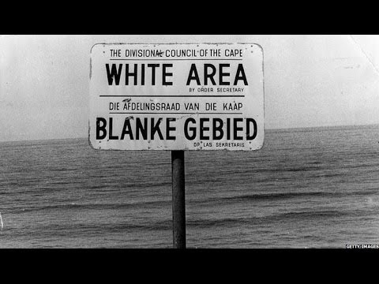
A very brief history of the Apartheid

Slide 4
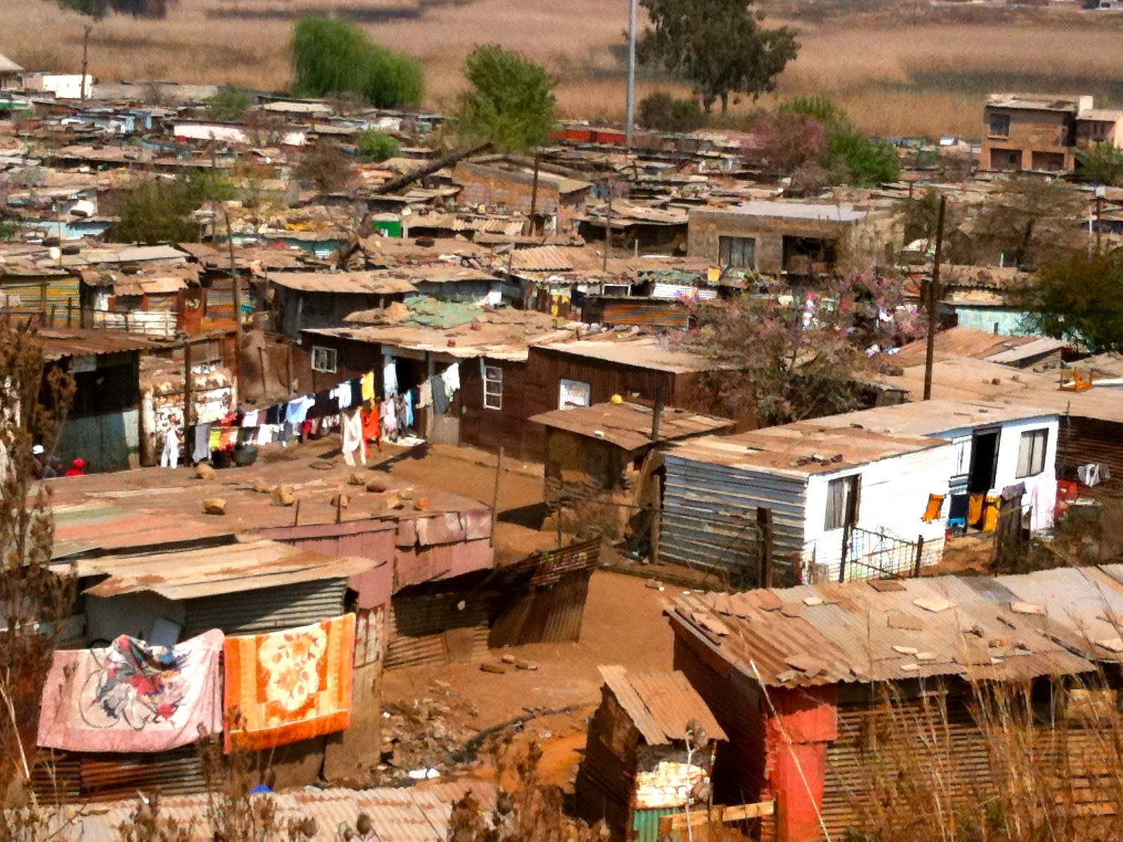
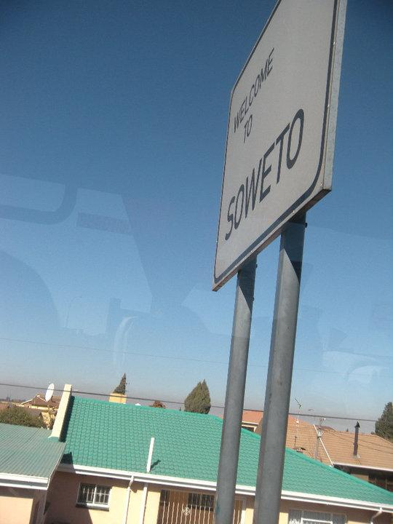
Soweto
Soweto: Stands for South Western Township. It is a shantytown located just outside South Africa’s capital of Johannesburg.
Soweto was established even before apartheid in order to move Black Africans out of the white areas of Johannesburg. It is a shantytown that today is home to over 1.3 million people.
(South African History Online)

Slide 5
Soweto Uprising 1976
The Soweto Uprising in 1976 was in response to apartheid policies in education that forced black South Africans to learn subjects taught in the language of “Afrikaans.” Since Afrikaans was the language of their white, apartheid government, it was seen as the “language of the oppressor”.

Slide 6
June 16th, 1976
Over 10,000 students of Soweto marched to Orlando soccer stadium in a peaceful protest. After failing to push the crowd back, police officers opened fire on the protesters, killing two students Hastings Ndlovu and Hector Pieterson.
(Overcoming Apartheid, Michigan State University)
Soweto Uprising

Slide 7
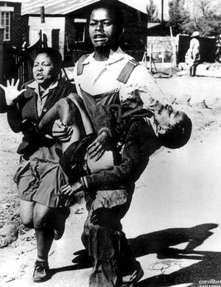
The image of Hector Pieterson’s lifeless body being carried out of the protest has become an iconic photo representing the struggle of Black South Africans during apartheid.
Hector was 12 years old.

Slide 8
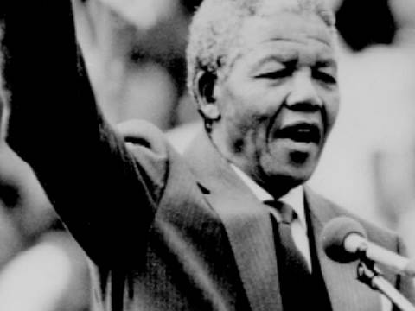
Nelson Mandela and his fight for justice

Slide 9
“Education is the most powerful weapon which you can use to change the world.”
-Nelson Mandela

