Slide 1
Supplemental Guides
Alternative Read-Aloud Texts for the CKLA Knowledge Strand
Downloadable from https://www.coreknowledge.org/curriculum/download-curriculum/
Materials on the Core Knowledge site are CKLA First Edition (where Knowledge was called Listening & Learning), but the content of the read-alouds is virtually identical from First to Second Edition (the Amplify version).

Slide 2
Modified Read-Alouds
“The modified read-alouds in the Supplemental Guide, like the read-alouds in the corresponding [teacher’s guide], are content-rich and designed to build students’ listening comprehension, which is a crucial foundation for their reading comprehension abilities. You may notice that not all of the read-alouds in the [teacher’s guide] appear in the corresponding Supplemental Guide. Some of the read-alouds were omitted to provide ample time for teachers to review read-aloud content and language, and to engage students in extended dialogue about the text. Nonetheless, students who listen to the Supplemental Guide read-alouds will learn the same core content as students who listen to read-alouds from the corresponding [teacher’s guide]. …
Please note that many modified read-alouds ask that you show Flip Book images in a non-sequential order that differs from the order in which the images are arranged in the Flip Book. Furthermore, some modified read-alouds make use of Flip Book images from two or more separate lessons.”
from “Preface to the Supplemental Guide” in all guides

Slide 3
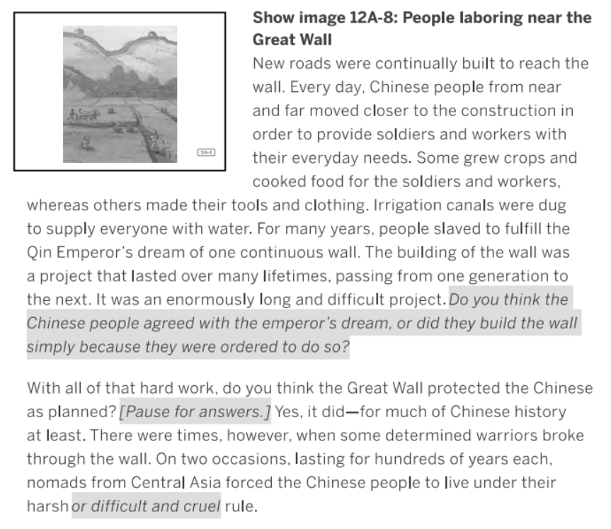
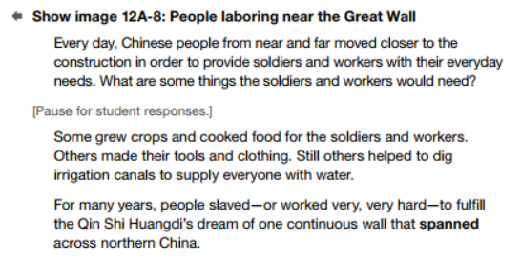
Example Difference in Text
This example from Grade 2, Domain 2, Early Asian Civilizations, Lesson 12
Supplemental Guide Version
Original Version

Slide 4
Application Activities
The Supplemental Guide contains more options for the Application/Extension part of the lesson (Part B). Directions in the Supplemental Guide suggest choosing some of the activities, not all.
For example, see the options for the two versions of Grade 1, Domain 5, Early American Civilizations, Lesson 10:
Original Version | Supplemental Guide Version
Survival in the Andes: The Taclla | Survival in the Andes: The Taclla
Early American Civilizations Chart | Early American Civilizations Chart
 | Multiple Meaning Word Bend
 | Syntactic Awareness: Object Pronoun Us
 | Vocabulary Instructional Activity: Distant

