Slide 1
Supplemental Guides
Alternative Read-Aloud Texts for the CKLA Knowledge Strand (K-2)
Created by Maggie Dillier, 2022
Downloadable from https://www.coreknowledge.org/curriculum/download-curriculum/
Materials on the Core Knowledge site are CKLA First Edition (where Knowledge was called Listening & Learning), but the content of the read-alouds is virtually identical from First to Second Edition (the Amplify version).
On my Drive: bit.ly/CKLAMaterials, then choose a grade, then Knowledge, then First Edition Materials. The Supplemental Guide is a PDF of all the read-alouds.

Slide 2
Modified Read-Alouds
“The modified read-alouds in the Supplemental Guide, like the read-alouds in the corresponding [teacher’s guide], are content-rich and designed to build students’ listening comprehension, which is a crucial foundation for their reading comprehension abilities. You may notice that not all of the read-alouds in the [teacher’s guide] appear in the corresponding Supplemental Guide. Some of the read-alouds were omitted to provide ample time for teachers to review read-aloud content and language, and to engage students in extended dialogue about the text. Nonetheless, students who listen to the Supplemental Guide read-alouds will learn the same core content as students who listen to read-alouds from the corresponding [teacher’s guide]. …
Please note that many modified read-alouds ask that you show Flip Book images in a non-sequential order that differs from the order in which the images are arranged in the Flip Book. Furthermore, some modified read-alouds make use of Flip Book images from two or more separate lessons.”
from “Preface to the Supplemental Guide” in all guides

Slide 3
Supports for English Learners
Four main ways the Supplemental Guide supports learners of English are in
modified text,
greater content review,
vocabulary preview, and
more application of concepts.
Not every read-aloud/lesson has all of these supports, and some lessons are virtually identical across versions.

Slide 4
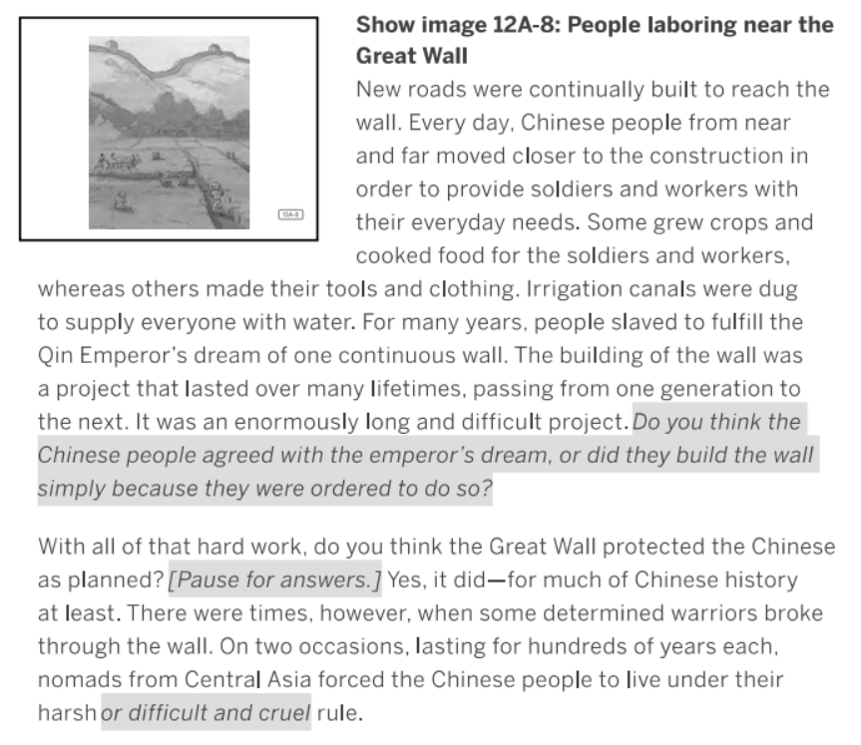
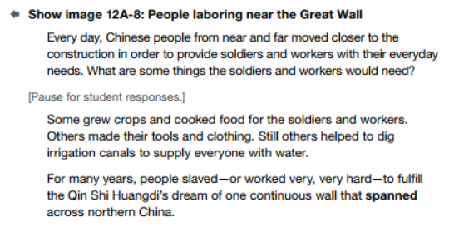
Modified Text
This example is from Grade 2, Domain 2, Early Asian Civilizations, Lesson 12.
Supplemental Guide Version
Original Version

Slide 5
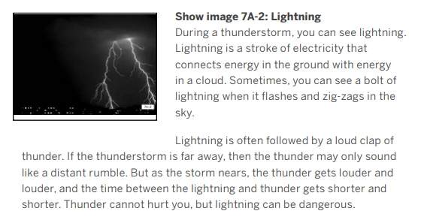
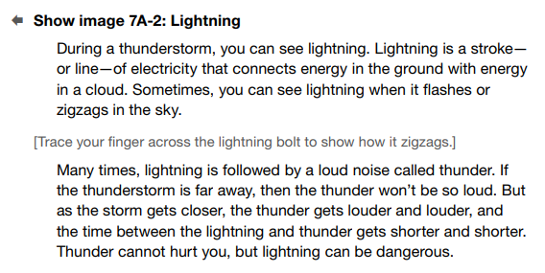
Modified Text
This example is from Kindergarten, Knowledge 8, Seasons and Weather, Lesson 7.
Original Version
Supplemental Guide Version
This text embeds more supports like physical motions (“zigzags”) and defined vocabulary (“a stroke - or line”).
It also uses simpler sentence structure, as in “the thunder won’t be so loud,” versus “the thunder may only sound like a distant rumble.”

Slide 6
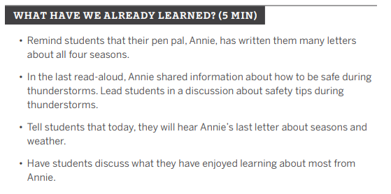
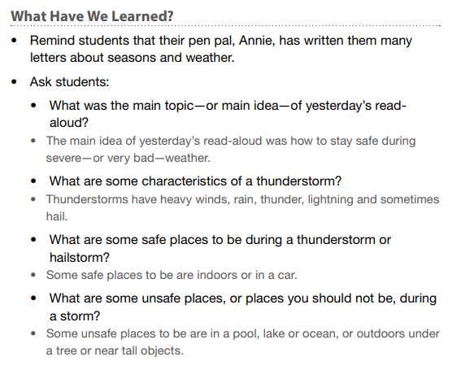
Greater Content Review
The “What Have We Already Learned?” lesson warm-up often contains more/more directed review of concepts in the Supplement Guide.
Original Version
Supplemental Guide Version
Kindergarten, Knowledge 8, Seasons and Weather, Lesson 8

Slide 7
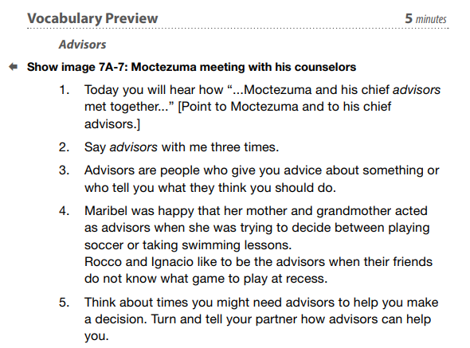
Vocabulary Preview
Vocabulary words are often previewed before the read-aloud - only in the Supplemental Guide.
Supplemental Guide
Grade 1, Knowledge 5, Early American Civilizations, Lesson 7

Slide 8
Application Activities
The Supplemental Guide contains more options for the Application/Extension part of the lesson (Part B). Directions in the Supplemental Guide suggest choosing some of the activities, not all.
For example, see the options for the two versions of Grade 1, Domain 5, Early American Civilizations, Lesson 10:
Original Version | Supplemental Guide Version
Survival in the Andes: The Taclla | Survival in the Andes: The Taclla
Early American Civilizations Chart | Early American Civilizations Chart
 | Multiple Meaning Word Bend
 | Syntactic Awareness: Object Pronoun Us
 | Vocabulary Instructional Activity: Distant

