Slide 1
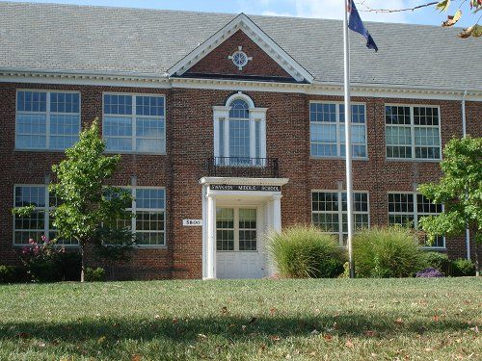

WELCOME ABOARD!
Rising 6th graders and new Swanson
students!

Slide 2

MAROON AND WHITE
SPIRIT
SERVICE
SCHOLARSHIP
HOME OF THE ADMIRALS

Slide 3



Principal
Renee Harber
Assistant Principals
  Antonio Hall
  Eric Underhill
  Laura Porter
Director of Counseling
Rana Luthra
703-228-5535

Slide 4


The School Day
7:50 a.m. – 2:24 p.m.
Breakfast served at 7:20 a.m.
3 minutes between classes
Grade level lunches: 35 minutes
  6th grade: 10:41
  7th grade: 12:15
  8th grade: 11:28
Afterschool Program: Clubs and Sports
  ASP I: 2:30- 3:30pm
  ASP2: 3:30-4:15pm
Late bus: Monday - Thursday at 4:15pm
  Late Bus route numbers are different than regular route numbers

Slide 5

STAR Period
Teacher Advisory or Homeroom Period
  9:28 AM – 9:54 AM every day (between 2nd and 3rd mod)
Team building projects, improving organizational and study habits
Service projects (Team and School-wide)
Distribution of progress reports, report cards, important information, etc.
Teacher help
  Organization and study habits
Completion of projects and assignments
Locker assignments and combinations
Televised school announcements
SQUIRT: Sustained Quiet Uninterrupted Reading Time
  (Mondays and Thursdays)
ATSS: Arlington Tiered System of Support – Math and Reading Interventions

Slide 6

Sixth Grade Core Subjects
6th Grade Teams- Mariners, Sailors, Navigators, Seahawks
Mathematics- Math 6, Pre-Algebra
Social Studies- US History, Civics, and Economics to 1865
Science – Grade 6 Science
English – Grade 6 English
Reading- Reading Comprehension and Note Taking Strategies (full-year or half-year)
Health & PE

Slide 7

Math
Math placement - Based on a set of criteria outlined in the letter that includes teacher recommendation, SOL scores, and additional assessment data.
  The letters of math placement recommendations are delivered at the end of school in June from the elementary schools.
Math Strategies – An elective class for math support (by recommendation).

Slide 8
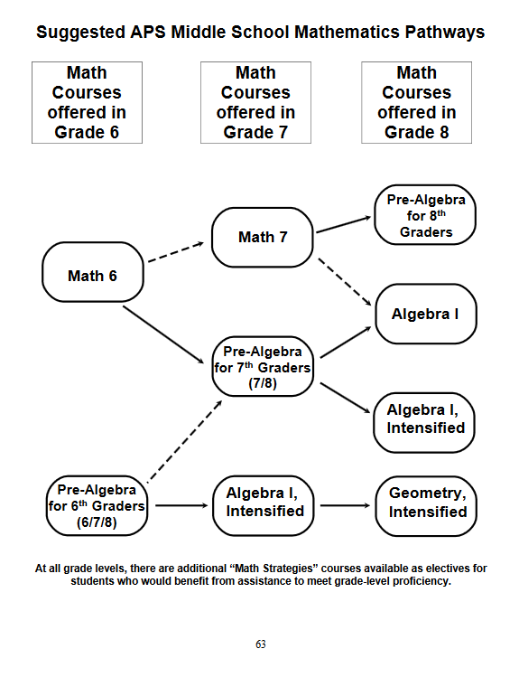
MATH PATHWAYS

Slide 9
Contact Information
Math Coach/Coordinator
Laura Partridge
Laura.Partridge@apsva.us
703-228-2344
Reading Coordinator
Cynthia Chiu
Cynthia.chiu@apsva.us
703-228-5520

Slide 10

Academic Planning
Counselors will take the steps to ensure that each student has an Academic Plan (grades 7 – 12) that reflects student´s interests and talents.
http://www.apsva.us/page/2203
6th graders don’t complete an academic plan form, but will fill out an interest inventory worksheet.

Slide 11




6th Grade Electives
Admiral’s Wheel
Fine Arts – Art, Drama
Practical Arts - Technology Education, Family Consumer Science, and Digital Input Technologies
Language Electives (not for HS credit)
Every other day – paired with half-year reading
Intro to Spanish, French, Latin
Transitional Spanish (Students with 3+ years in APS FLES program)
Intro to Spanish for Fluent Speakers
Music
Beginning Orchestra
Beginning Band
Beginning Chorus

Slide 12
Required Middle School Vaccinations
TDaP: Tetanus, diphtheria, and pertussis
From June 26th-September 1st, turn in the record to Swanson’s clinic
Do NOT wait until the first day of school, as your child will not be admitted to classes until their vaccination record has been processed.
Questions? Contact Christina Cuesta, Swanson’s nurse, at ccuesta@arlingtonva.us or 703-228-5514

Slide 13


After School Clubs
Based on student interest
Best Buddies
Bike Club
Boys to Men Club
Captain’s Crew
GSA (Gender & Sexuality Alliance)
Intramural Sports
Latina Youth Leading at Swanson (LYLAS) Club
Wavelength Literary Magazine
Magic: The Gathering
Math Counts
Nature Club
Swanson Sisterhood
Teen Advisory Board (TAB)
TSA
Video Game Design Club
PTA programs/clubs – will receive information via email
Check out the Activities Fair during the 2nd week of school!

Slide 14





Get Involved!
Want to start a club? Have questions about sports? Contact:
Trevor Holland
Activities Coordinator
703-228-5510

Slide 15
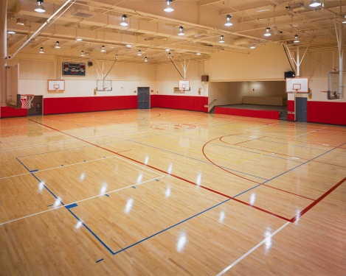
Middle School Interscholastic Sports
Tryouts:
  Boys & Girls Soccer
  Boys & Girls Basketball
  Co-ed Tennis
  Cheerleading
No Tryouts:
  Boys & Girls Swim
  Boys & Girls Dive
  Wrestling
  Co-ed Track
Sports Physical needed
  Needs to be within one calendar year of the season to participate)
  Sports physical form can be found on the Swanson website under “Athletics”

Slide 16
Counseling Services
Individual Counseling
Group Counseling
Lunch Groups
“Second Step” Classroom Lessons
  Bullying
  Emotional Management
  Communication
Naviance - A web based software program to help students research college and career plans.
Scheduling and Course Request Forms
Orientation and Transition Activities
Parent-Teacher Conferences
Academic Planning

Slide 17
Important Dates
Information will be mailed to your residence in mid-August. This information will include your child’s team and first day information.
School supply lists are posted on the Swanson website homepage.
Join us at our Open House on Thursday, August 30th from 11AM to 1PM. Students who are new to APS may take the math placement test on that day at 9:00 AM.
Back to School Night: Thursday, September 20th

Slide 18
New to Arlington?
Need to register your child?
Contact Karla Pineda (Swanson Registrar) at karla.pineda@apsva.us or 703-228-5508
Or you can drop in!
Registration hours:
Mondays, Tuesdays, & Thursdays
9am – 12pm

Slide 19

Questions?
Thank you for coming and have a great summer!

