Slide 1



1
Change
3 ½ to an improper fraction
Change
5 2/7 to an improper fraction
Change
7/3 to a mixed number
Change 4 7/5 to a mixed number
1
Change
3 ½ to an improper fraction
Change
5 2/7 to an improper fraction
Change
7/3 to a mixed number
Change 4 7/5 to a mixed number

Slide 2



2
2

Slide 3




3
3

Slide 4



4
4

Slide 5




5
5

Slide 6




6
6

Slide 7








7
7

Slide 8
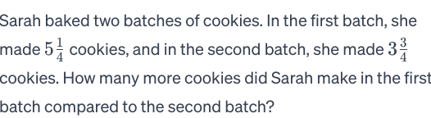
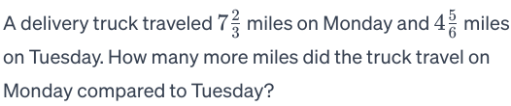

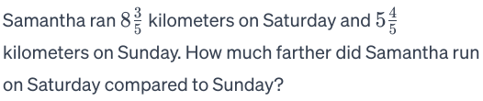
8
8

Slide 9



9
9
Alex completed the problem.
He got the answer
What did Alex do wrong? How could he correct his error?
Alex completed the problem.
He got the answer
What did Alex do wrong? How could he correct his error?
Sally completed the problem.
She got the answer.
What did she do wrong? How could she correct her error?
Sally completed the problem.
She got the answer.
What did she do wrong? How could she correct her error?

Slide 10

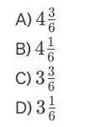
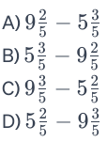


10
10
Mark all that are true for
Mark all that are true for
Which of the following could represent the answer?
Which of the following could represent the answer?

Slide 11

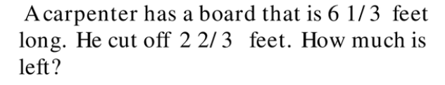
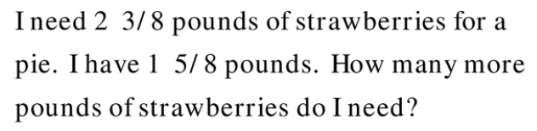
11
11
Prove your reasoning.
Prove your reasoning.
Prove your reasoning.
Prove your reasoning.
Prove your reasoning.
Prove your reasoning.

Slide 12
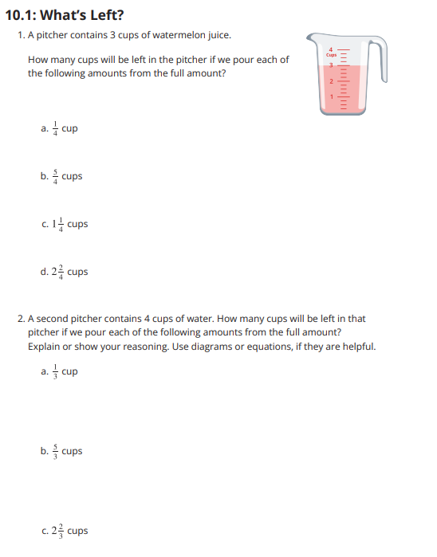
Extension

Slide 13


Exit Ticket
Name: ________________________
Sweet
Spicy
Mild
Sally had 4 feet of wood for a garden. Joe had 2 ⅘ feet of wood for a garden. How much many more feet of wood did Sally have?
Pick one to solve any way you choose.

