Slide 1
Secondary Math Transition
Dec2012

Slide 2
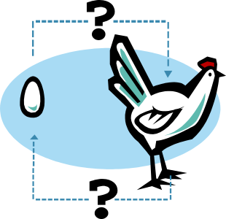

Chicken and Pigs
A farmer sends his daughter and son into the barnyard
to count the number of chickens and pigs. When they return, the son says he counted thirty-eight legs and the daughter says she counted twelve heads. How many chickens and pigs does the farmer have?

Slide 3


Penguins and Reindeer
Brian, the gorilla, was planning a party for his zoo friends. He sent his elves Jamie and Nancy Sue into the North Pole exhibit to count the penguins and reindeer. Jamie said there were 40 legs and Nancy Sue said there were 14 heads. How many penguins and reindeer were in the exhibit?

Slide 4
Major Themes
All students means ALL students
The work is about improving instruction, which requires that teachers collaborate to reach more students more of the time

Slide 5
Underlying Principle
“Everyone is good at mathematics because everyone can think. And mathematics is about thinking.”
  Yeap Ban Har, National Institute of Education, Singapore.
Corollary 1: Strategies that attempt to remove thinking from learning are bound to fail in the long run.
Corollary 2: When learning is effective, “getting the right answer” is but a small piece of the work.
Notes:
So I am going to give you a chance to think.

Slide 6
College and Career Readiness

Slide 7
Rationale for A2E for All
Algebra 1 and Geometry provide insufficient readiness for college and most careers
All students need proficiency in A2E for
  Many careers, with or without college
  Informed citizenship
  Individual empowerment
High school mathematics should open doors
  But adult decisions often close doors for students
  After students complete A2E, they have choices
And again, not your parents’ Algebra 2
Notes:
What counts as A2E should be driven by these goals.

Slide 8
What Is Needed?
Renewed curriculum and instruction
  Across middle and high school toward a rigorous and relevant A2E
“Focal Points” for high school
Support for students are behind
  To help them catch up
Access to more advanced problem solving
The CCSS and the Model Pathways are foundational responses to these needs
Notes:
Teachers stick with the basic skills because they think they’ve been successful (and they see short-term success). For more advanced problem solving, the uncertainty and failure are going to increase initially. Need some coaching.
It’s not like high school students are working very hard right now. Only about 20% of students study more than 10 hours per week.

Slide 9
A Look Inside the
Common Core State Standards

Slide 10
CCSS Principles
Focus
  Identifies key ideas, understandings, and skills for each grade or course
  Stresses deep learning, which means applying concepts and skills within the same grade or course
Coherence
  Articulates a progression of topics across grades and connects to other topics
  Vertical growth that reflects the nature of the discipline

Slide 11
CCSS Mathematical Practices
Make sense of problems and persevere in solving them
Reason abstractly and quantitatively
Construct viable arguments and critique the reasoning of others
Model with mathematics
Use appropriate tools strategically
Attend to precision
Look for and make use of structure
Look for and express regularity in repeated reasoning

Slide 12
CCSS Domain Progression
K |  | 1 | 2 | 3 | 4 | 5 | 6 | 7 | 8 | HS
Counting & Cardinality
Number and Operations in Base Ten |  |  |  |  |  |  | Ratios and Proportional Relationships |  |  | Number & Quantity
 |  |  |  | Number and Operations – Fractions |  |  | The Number System
Operations and Algebraic Thinking |  |  |  |  |  |  | Expressions and Equations |  |  | Algebra
 |  |  |  |  |  |  |  |  | Functions | Functions
Geometry |  |  |  |  |  |  |  |  |  | Geometry
Measurement and Data |  |  |  |  |  |  | Statistics and Probability |  |  | Statistics & Probability
Notes:
This diagram illustrates how the domains are distributed across the Common Core State Standards.
What is not easily seen is how a domain may impact multiple domains in future grades.
An example is K-5 Measurement and Data, which splits into Statistics and Probability and Geometry in grade 6.
Likewise, Operations and Algebraic Thinking in K-5 provides foundation Ratios and Proportional Relationships, The Number System, Expressions and Equations, and Functions in grades 6-8.

Slide 13
K-8 CCSS Changing Content Emphases
Primary focus on number in grades K-5
Fractions as numbers on the number line, beginning with unit fractions
Fluency with standard algorithms, supported by strategies based in place value
Much statistics in grade 6-8
Much algebra and geometry in grades 7-8

Slide 14
High School Mathematics Pathways
CCSS Appendix A, developed by Achieve
Two main pathways:
  Traditional: Two algebra courses and a geometry course, with statistics and probability in each
  Integrated: Three courses, each of which includes algebra, geometry, statistics, and probability
Both pathways:
  Complete the Core in the third year
  Include the same “critical areas”
  Require rethinking high school mathematics
  Prepare students for a menu of fourth-year courses
Typical in U.S.
Typical outside U.S.
Notes:
An Achieve committee organized the high school standards into course sequences.

Slide 15
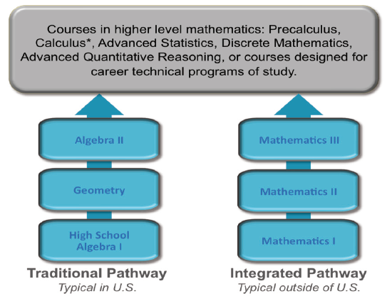
Two Main Pathways
Notes:
Each Pathway prepares students for a menu of fourth-year courses
Precalculus (or AP Calculus)
AP Statistics
Discrete Mathematics
Advanced Quantitative Reasoning
Courses designed for particular career technical pathways
…

Slide 16
CCSSM and Acceleration
The CCSS for Mathematics represent significant curricular acceleration in grades K-8
  Much of Algebra 1 and Geometry are in the middle grades
  Many “accelerated” programs will no longer be ahead
  The CCSS for Grade 8 is a reasonable, internationally benchmarked response to Algebra for all in grade 8
Accelerating large percentages of students much beyond the CCSS for K-8 is probably unwise
The CCSSM for high school include much advanced content and much new content for all students
So we need to rethink mathematics, grades 6-12
Notes:
Emphasize this is aimed at middle grades teachers and mathematics programs in the middle school.

Slide 17
Partnership for College and Career Readiness (PARCC)
PARCC system aims to increase the rates students graduate prepared for success in college and career
PARCC assessment system will feature complex, multipart tasks.
Assessments will occur in grades 3-8 and Math 1, Math 2 and Math 3
Required 2-part summative assessments, a performance-based assessment and an end-of-year assessment
Optional components: A diagnostic assessment and a mid-year formative assessment

Slide 18
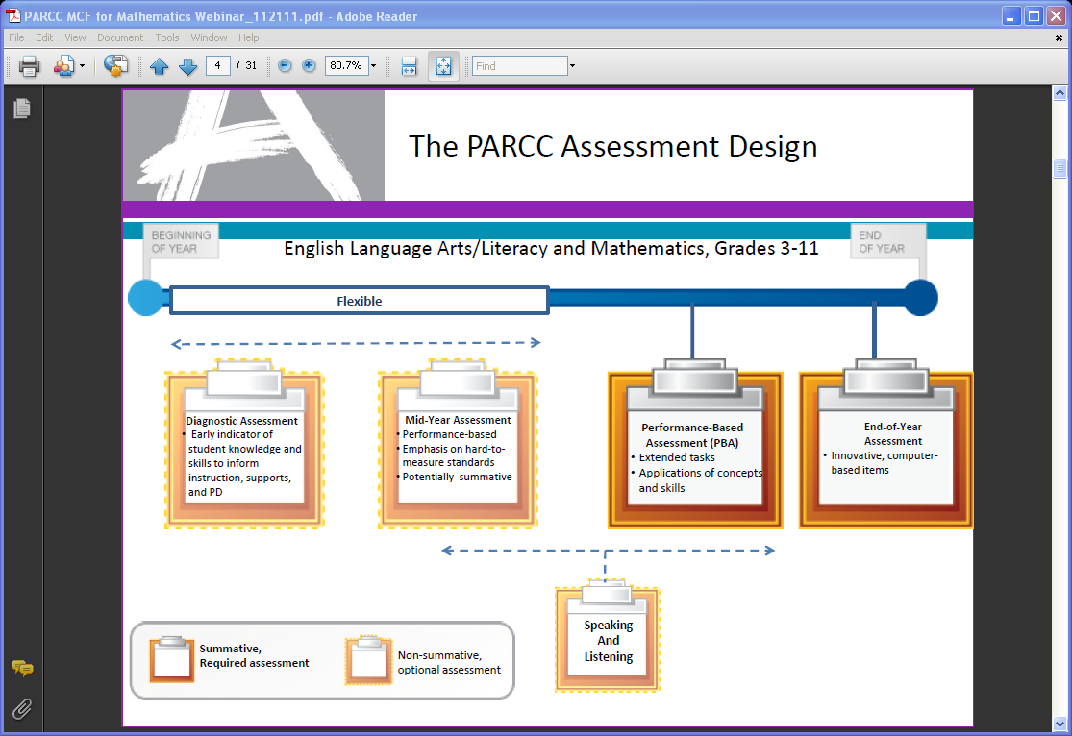
Assessment

Slide 19
Overview of Mathematics Task Types
PARCC mathematics assessments will include three types of tasks.
Task Type | Description of Task Type
I. Tasks assessing concepts, skills and procedures | Balance of conceptual understanding, fluency, and application Can involve any or all mathematical practice standards Machine scorable including innovative, computer-based formats Will appear on the End of Year and Performance Based Assessment components
II. Tasks assessing expressing mathematical reasoning | Each task calls for written arguments / justifications, critique of reasoning, or precision in mathematical statements (MP.3, 6). Can involve other mathematical practice standards May include a mix of machine scored and hand scored responses Included on the Performance Based Assessment component
III. Tasks assessing modeling / applications | Each task calls for modeling/application in a real-world context or scenario (MP.4) Can involve other mathematical practice standards. May include a mix of machine scored and hand scored responses Included on the Performance Based Assessment component
For more information see PARCC Item Development ITN Appendix D.

Slide 20
Worthington’s path to implementation of the
Common Core
State Standards for Mathematics

Slide 21
Worthington decision making process
All secondary math staff including intervention specialists met with Dr Brad Findell Common Core Consultant
September 2011 Develop understanding of the
content of the standards and the intent of the standards-the mathematical practices
January 2012 Studied each of the courses in each high school pathway to determine best fit for us
Recommended integrated pathway
April 2012 Reviewed proposed scope and sequence for the integrated pathway
Fall 2012 Develop courses for grades 7-12

Slide 22
Implementation Suggestions, Challenges, and Resources

Slide 23
Challenges and Responses
Current courses are not aligned to the CCSSM
  Effort to focus instruction which reduces repetition in content
    Create a course progression which is a is adjusted to meet overall curricular requirements during the transition to total implementation of CCSSM
  Use of Comparative Analysis documents and proposed scope and sequence to create a transition progression to the new standards
  Units for CCSSM are being created from current textbooks both hardcopy and online
    Not all units can use the current resources
    Textbook companies are in development of new resources expected in 2014
Intervention options for students who have weaknesses
Communication of new course progression to students and parents
Notes:
Emphasize deep alignment rather than cursory alignment.
Emphasize looking forward rather than back.
Response to Intervention (RtI) is not about sorting students and it is not a package. RtI begins with high-quality Tier 1 instruction for all students. Then some students receive additional support.
Data can help teachers, schools, and districts know where to focus their attention. But learning will not improve without improvements in instruction.

Slide 24
Challenges and Responses
Formative assessment
  Formative assessment must provide insight into student thinking
Professional development
  Implementation of rich mathematical tasks
  Develop strategies for content-based professional learning communities
Local control and limited resources
  Share and borrow materials
  Leverage resources
  Take advantage of the assessment consortia PARCC
Notes:
Formative assessment is sometimes called “formative instruction” in order to emphasize that the point is making instructional decisions on the basis of what students understand (and misunderstand) so far.
Generic professional development rarely helps teachers learn how to use the new strategies to advance the learning of particular content.

Slide 25
Closing Thought
“These Standards are not intended to be new names for old ways of doing business. They are a call to take the next step. It is time for states to work together to build on lessons learned from two decades of standards based reforms. It is time to recognize that standards are not just promises to our children, but promises we intend to keep.”
  (CCSS, 2010, p. 5)
Notes:
Let’s deliver on these promises.

