Slide 1
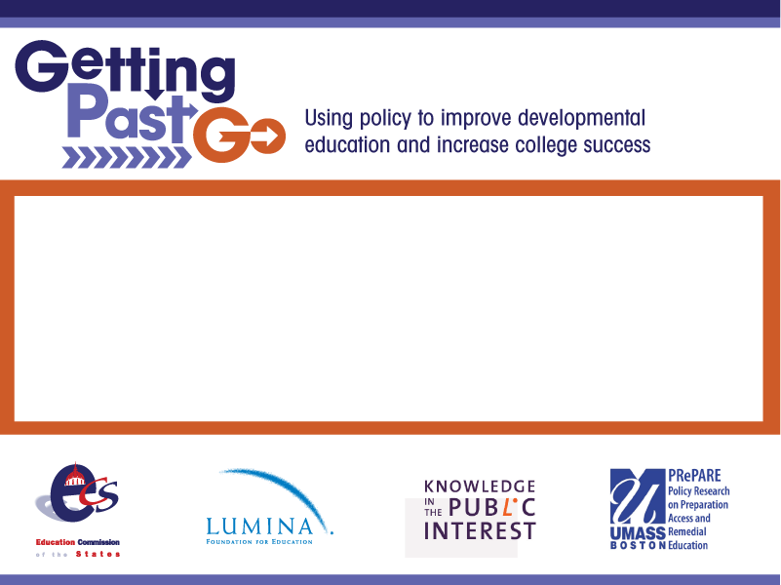
Developmental Education Instructional Strategies
Bruce Vandal, Education Commission of the States
September 1, 2011

Slide 2
Developing a Game Plan
The Layup
Just short of the cut score
The Three Pointer
1-2 levels below college-level
The Half-Court Shot
3 or more levels below college-level
The Bench
High school students below college-level

Slide 3
The Layup: Just below college level
Austin Peay’s Structured Assistance Model
Community College of Baltimore County’s Accelerated Learning Program

Slide 4
Austin Peay Structured Assistance
• Active learning
• Small group teaching
• Individualized help
• Meaningful feedback
• Monitor Student success

Slide 5
Traditional Model
Complete 3-6 hours non-university level courses before enrolling in Core Mathematics course
MATH1010
Mathematical Thought and Practice
43.5% earned a D or higher
DSPM 0800
Elementary Algebra
ACT 15-16
53.1%
Completed course with a grade of C or higher
DSPM 0850
Intermediate Algebra
ACT 17-18; or
Completed DSPM 0800
51.2% completed course with a grade of C or higher
Math 1530
Fundamentals of Statistics
28.8% earned a D or higher

Slide 6
Structured Assistance Redesign
Professor: Classroom
Core course content
Grade determination
Guidance
Feedback
SLA Leader: Workshop
Prerequisite competencies
Reinforce key course concepts
Test review

Slide 7
Student and Faculty Time
Students
Meet in class for 2x50 minute sessions
Attend math lab for at least 1 hour
Faculty
Number of classroom meetings remains unchanged
Office hours now in math lab

Slide 8
Structured Assistance Results
 | Traditional- DSPM 0800 | Traditional – DSPM 0850 | Traditional College Ready | Redesign
Math 1010 | 11.6% | 43.5% | 85% | 76.3%
Math 1530 | 7.5% | 28.8% | 56.2% | 61.2%

Slide 9
CC of Baltimore County Accelerated Learning Project
Students co-enroll in college English and highest level developmental English.
Developmental students enrolled with traditional students in college English
Developmental students pulled out into developmental English
Uses learning community approach for instruction
Developmental course reinforces and supports instruction in college English

Slide 10



Traditional Model
ENG 052
ENG 101
semester 1
semester 2

Slide 11


ALP Model
ENG 101
ENG 052
semester 1
semester 1

Slide 12
Accelerated Learning Project Results
students who took traditional developmental writing in fall 06
took 052
fall 06
1023
S in 052
604
59%
took 101
383
37%
A, B, or C
in 101
279
27%
students who took ALP in
fall 07,
spring 08,
fall 08,
spring 09
took 052
2007-09
227
S in 052
175
77%
took 101
227
100%
A, B, or C
in 101
142
63%

Slide 13
Three Pointer: Modularization
Jackson State SMART Math
Cleveland State and Chattanooga State “U Do the Math”

Slide 14
Jackson St. SMART Math
Modularization & Multi-Exit Options
12 modules replaced 3 traditional courses
Prerequisite modules were identified for success in:
  general education math courses
  other college level courses
  programs not requiring college level math
Changes in Developmental Math Requirements approved by Curriculum Committee
Procedures set up to advise students of their multi-exit options based on their career choices

Slide 15
Academic Program Readiness
Jackson State’s Module Distribution
Modules | 1, 2, 3 | 4, 5, 6, 7 | 8, 9, 10, 11, 12
Traditional | Basic Mathematics | Elementary Algebra | Intermediate Algebra
Module Requirements by Academic Program
Programs Requiring 12 Modules | 7 | 20.3%
Programs Requiring 8 or less Modules | 41 | 79.7%

Slide 16
Mastery Learning
New student begins with Pre-Test on Module 1
  80% mastery moves student to next module, If less than 80%,
    Student studies work text book : and does homework assignment s for Module 1 in MyMathLab + (80% Mastery)
    After homework is completed student works and turns in Notebook problems found in MML+ (100% Mastery).
    Student takes Practice Test in MyMathLab+ (80% Mastery)
    Student takes Post Test in MyMathLab+ (75% Mastery)
    Student , moves to Module 2 and so on

Slide 17
SMART Math Results
Course | Term | Percent Course Completion | Percent “C” or Better
Traditional | Spring 2008 | 74% | 41%
Redesign | Spring 2008 | 72% | 54%
SMART Math | Fall 2008 | 75% | 57%
SMART Math | Spring 2009 | 83% | 59%
SMART Math | Fall 2009 | 84% | 60%

Slide 18
Cleveland State Emporium Model
3 Developmental Math Classes
  Basic Math, Elementary Algebra, Intermediate Algebra
  Emporium Model, Mastery Learning 1+2 Format
7 College Math Classes
  College Algebra, Finite Math, Statistics (1 + 2)
  Precalculus I & II, Applied Trig, Business Calculus (2 + 1)
2 Computer Labs, 4 Computer Classrooms
  60 computer lab on main campus in Cleveland
  35 computer classroom/lab on campus in Athens

Slide 19
The Cleveland State Model
Course Layout
  Each course consists of 10 – 12 mini-modules
  1 hour class meeting each week – students work in class
  2 hours work outside class each week – at least 1 hour in lab
  Students expected to complete one module each week
Course Grade
  10% Attendance Grade - class & lab attendance, module finished
  30% Homework Sets – 2 to 5 sections per module
  60% Quiz and Exam Grades – 1 quiz each module, 2 exams
Course Standards
  Students must complete every homework set (70 or better)
  Students must pass every module quiz and exam (70 or better)
  Students must pass attendance grade (70 or better)
  Students may take each quiz and exam multiple times

Slide 20
Cleveland State Results
  Initial Results
  Developmental Math Completion 54% to 72%
  College Math Completion from 72% to 74%
  35% Growth in Math Enrollments
  20% Savings Sustained
TBR Study Logistical Regression (Schutz & Tingle)
Strong positive effect on course success
  Strong positive effect on next course success, including both dev math and college math
  Gender and Race were not factors in predicting course success - achievement gaps were closed

Slide 21
The Half Court Shot:
Multiple Levels Below College Level
Washington I-BEST Model
California Acceleration Project

Slide 22
Washington I-BEST Model
Integrated Learning Outcomes
Compile Resources
Create Integrated Learning Outcomes
Match Available Standards to Integrated Learning Outcomes
Assess, Review and Revise Integrated Learning Outcomes
Integrated Teaching
Both instructors work as a collaborative team to design and deliver the program.
They are both present in the classroom
The adult basic education instructor ensures that basic skills are within the context of the workforce education content and gauge student progress.
The workforce education instructor focuses on the delivery of the workforce content.

Slide 23
I-BEST Results
I-BEST students were more likely to:
continue into credit-bearing courses
earn credits toward a credential
earn a certificate
improve their basic skills.
Probability of credential 50% greater for I-BEST Students

Slide 24
California Acceleration Project English/Reading
Chabot College English 102:
Reading, Reasoning, and Writing (Accelerated)
A one-semester 4-unit developmental English course leading directly to English 1A
An alternative to two-semester, 8-unit sequence
No minimum placement score, students self-place in either the accelerated or two-semester path
Developed with “backwards design” from college English:
  Students engage in the same kinds of reading, thinking, and writing of college English, with more scaffolding and support
College has expanded accelerated offerings in last decade:
  Course now constitutes more than 66% of entry-level sections

Slide 25
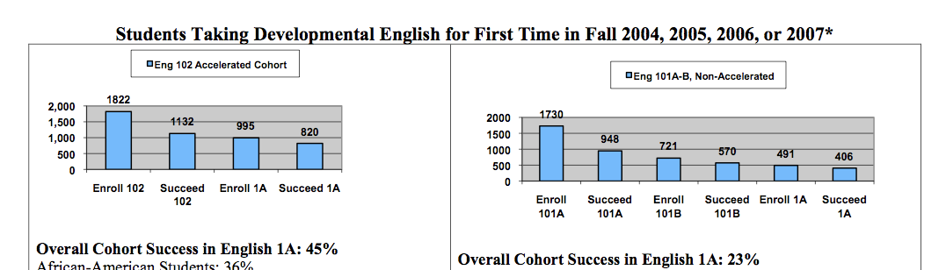
Success in College-Level English Doubles

Slide 26
California Acceleration Project
Math
Statpath, Los Medanos College
A new one-semester developmental Math course with no minimum placement score:
Bypasses the standard 4-course sequence leading to Calculus
Developed through “backwards design” from college statistics:
Includes only those elements of algebra and arithmetic sequence that are directly relevant to statistics
Provided with “just-in-time remediation” as students engage in statistical analysis
Offered as experimental course 2009-2011, recently approved as permanent course

Slide 27
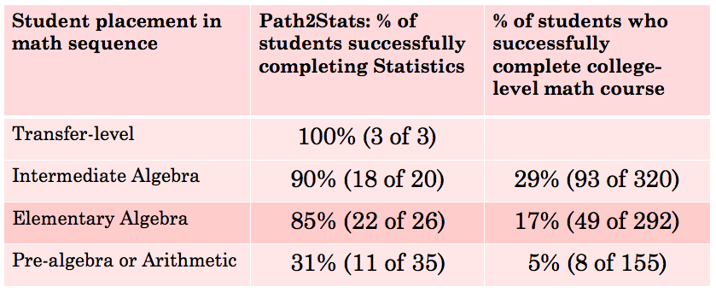
Greater Success for All Students

Slide 28
The Bench: Early Assessment
Florida’s Postsecondary Education Readiness Test
Arkansas Early Assessment/Early Intervention Model

Slide 29
Florida: Early Assessment and Intervention
Florida Postsecondary Education Readiness Test (PERT) used for placement at community colleges, early assessment in high schools.
Developed competencies for upper/lower level math, English and reading.
New diagnostic assessments pinpoint deficiencies
High schools and community colleges develop early intervention courses.
Student exit exam in early intervention courses equal college readiness.

Slide 30
Arkansas
Early Assessment/Intervention Programs
Students can take placement test as early as 8th grade at no cost to student.
Requires the use of “college readiness assessments” in the development of college and career planning at Arkansas public schools.
Students scoring below cut score shall receive instruction to address remediation their senior year.
Identify eligible students for local programs through the use of the college readiness assessments.
High school students who score above the stated cut score are eligible to enroll in postsecondary courses.

Slide 31
For More Information
Bruce Vandal
bvandal@ecs.org
http://GettingPastGo.org

