Slide 1
Human Resources Update
Q3 FY2018

Slide 2
Agenda
Key Leadership Hires
Hiring statistics & actions plans
Leave statistics & action plans
Organizational transformation
KPI Update
Compensation

Slide 3
Key Leadership Hires – On Track
Title | New Hire | Internal Promotion
Chief Procurement and Contract Administration Officer | Jeff Cook
AGM of Human Resources | Bonnie Haase
Chief Customer Officer | To Be Announced
Program Manager for AFC 2.0 | David Sikorski
CFO Operations Finance & Control | Kashif Qadeer
Chief Engineering Officer |  | Erik Stoothoff
Chief of Transit Services |  | Todd Johnson
Chief Transformation and Business Process Redesign Officer |  | Nick Easley
Open Roles | Status
EHS Officer | Screening resumes & interviewing candidates
Deputy Chief Real Estate | Posted; Screening resumes; need additional candidates
General Counsel | Open, sourcing candidates
Red/Orange Capital Program Mgr. | Open & Interviewing
Sr Dir of Warehouse & Inventory Mgmt. | Offer in progress
Executive Director of Commuter Rail | Open & reviewing resumes
Policy, Innovation & Transformation Officer | Open
Sr. Dir of Engineering & Maintenance | Open
Sr. Dir of Infrastructure Engineering & Planning | Open
Rhythm in place to drive results

Slide 4
Hiring Results
Q1
44 days to fill Posted Positions vs.
  113 days to fill Program hires
99 Posted hires vs.
97 hires Program hires
Immediate focus on Program hiring process
GOAL - 45 Days
4

Slide 5
Improving All Hiring Processes
Process Improvement |  | Process mapping ‘types’ of hiring, identifying delays & opportunities
Recruiter Alignment |  | Align recruiters to areas of expertise
Partner with Hiring Managers |  | Set clearer expectations/timelines
Identifying tools to simplify |  | Adding LinkedIn recruiter seat
Broaden Outreach Efforts |  | Identify passive candidates & solicit executive referrals
5

Slide 6
Programmed Hiring
Current State
Considering Options
Lottery System managed by Merriman $135K |  | Bring in-house, use ATS that integrates seamlessly with PeopleSoft 9.2
50% of our applicants do not show up for testing |  | Use online application and aptitude assessment tool to determine eligibility, improving our candidate base
20-30% of applicants fail driving records check |  | Move driving record screen up in process then BOSS tested if qualified
Testing 4x year calling in up to 3,000 lottery participants, added expense of a hall, police & recruiting team time |  | More frequent, smaller groups tested, maybe administer in house with staff
Only 2 applicants lost using the Workforce Assessments in the past fiscal year |  | Rethink Workforce Assessment process.
1098 passed the BOSS test, but 870 still need to obtain a CDL Permit to be eligible |  | Reach out early to help obtain a CDL permit, piloting a class to coach & prepare for the test.
Game Plan in place July 1, 2018
6

Slide 7
Establish FMLA Control
Automated Processes |  | Created tools & identified software - launched 2017
Created Workflow |  | Ensure FMLA regulations are applied - Audit identified errors
Scrutinize Frequency & Duration |  | Monitored alignment of absence use. Provide ongoing education to ensure compliance
Implemented a Certification Review Process to adhere to regulation |  | Verified compliance with regulations - launched Q2 2018
Instituted a Clarification, Authentication, Pattern Absence Review |  | Identified patterns & abuse - Launched Q2 2018
Implemented a Return to Work process |  | Established process to verify, track & monitor
Implement the Alternative Job Search Program |  | Implemented AJS program for employees who migrated from FMLA to ADA
Launched… Needs Improvements
7

Slide 8
Number of Employees Approved FMLA & ADA
Bus operations represent 42% of all FMLA leaves
Intermittent leaves represent over 90% of all leaves… the most challenging to manage employee availability
Top 3 Health Conditions for intermittent Leave:
Diseases of the Musculoskeletal System (Neck & Back)
Diseases of the Nervous System
Mental and behavioral disorders
96% Intermittent
97% Intermittent
97% Intermittent
8

Slide 9
Managing the FMLA Caseload- FY 2018
Top Three Reasons For Denials
No documentation provided
Ineligible
Exhausted
Top Three Areas For Approvals
Bus Maint & Transportation
Light Rail
Heavy Rail
Opportunities:
Time Wasted on Denials
LT - address health issues
ID Trends
9

Slide 10
Organizational Transformation
In Transition:
On Deck
Finance & Administration
Procurement and Contract Admin
Capital Programs
Operations:
  Chief Engineering Office
  RIDE
HR
Major Projects:
  AFC 2.0
Customer Experience
Communications
Operations:
  Ferry
  Service Planning and Strategy
Real Estate
EHS
Legal
Revenue
Major Projects:
  R/O Line

Slide 11
Executive KPI For FY 19
Compensation… Reboot
Rolled out to Executive/non-Affiliates 6/4
Tied to MBTA/GM organizational goals
Cascading through senior staff to departments and to individual employee level
Driving transparency and performance feedback
Survey from May 2017
• Organizational changes occurred
• Job Titles inaccurate
• Spotty data matches
• Title Cleanup | Done
• Complete internal comparisons and review with LMR/staff | July
• Re-benchmark with industry and local markets | FY Q2
• Re-evaluate salary grade structure | FY Q2
Overall Observations:
Need to apply some disciplines to deep dive points of pain for customers, Authority & Board
Focus on Transparency of Key Priorities of Authority/GM and build culture of accountability and performance

Slide 12
Appendix
Q3 FY2018

Slide 13
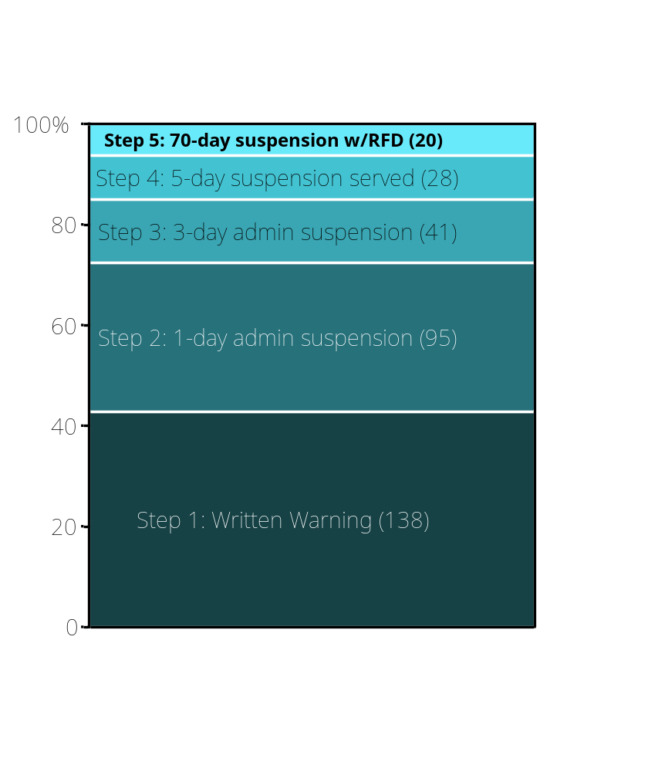
Terminations & Discipline for Violations of Attendance Policy
Progressive Discipline Track
in FY2018-Q3: 322
Terminations in
FY2018-Q3: 32
12

