Slide 1
Measures of Center
Mean, Median, Mode
Presented by Mr. Laws
6th Grade Math

Slide 2
NC Standard
S-SID.2 – Use statistics appropriate to the shape of the data distribution to compare center(mean, median)…

Slide 3
Key Vocabulary Words:
average, data, mean, median, measure of center, mode

Slide 4
Essential Question
How can you use measures of center to describe data set?

Slide 5
Target Statement
How can you use measures of center to describe data set?

Slide 6
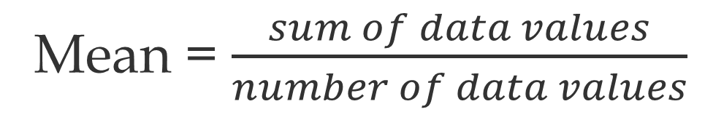
What is Measure of Center?
A measure of center is a single number used to describe a set of numeric data.
The mean is one measure of center, that helps find the average of a data set by adding the sum of the data values, and dividing the number of data values in the set.
Mean = $\frac{sum of data values}{number of data values}$

Slide 7
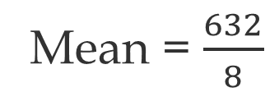
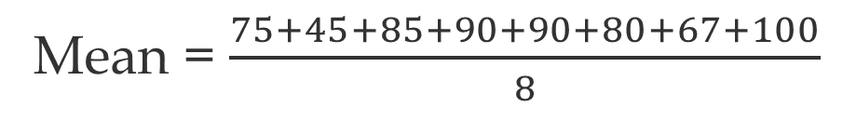
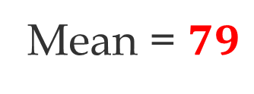
How Do I Find the Mean?
Example#1 Several students’ scores on a math test are shown below. Find the mean score of the test results.
Math Test Scores
75 | 45 | 85 | 90 | 90 | 80 | 67 | 100
Step 1: Find the mean (average) by adding the sum of data values, and dividing it by the number of data values.
Mean = $\frac{75+45+85+90+90+80+67+100}{8}$
Mean = $\frac{632}{8}$
Mean = $79$

Slide 8
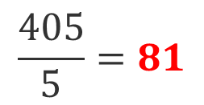
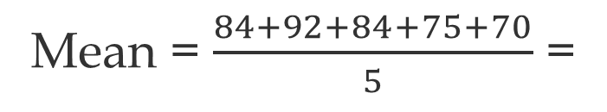
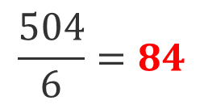
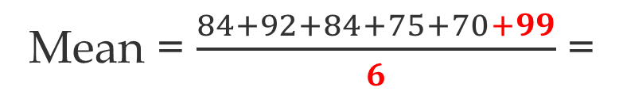
How do I solve a word problem by finding the mean?
Example#2: Katherine earned 84, 92, 84, 75, and 70 on her first 5 tests. What is the minimum grade Katherine needs to earn on her next test to have a mean of 84?
a. 81 b. 84 c. 95 d. 99
Step 1: Find the mean (average) of the 5 tests by adding the sum of data values, and dividing it by the number of data values.
Mean = $\frac{84+92+84+75+70}{5}$ =
$$\frac{405}{5}=81$$
Step 2: Since her 5 test mean is 81%, she will have to score above that average to reach a mean of 84%
Mean = $\frac{84+92+84+75+70+99}{6}$ =
$$\frac{504}{6}=84$$
Step 3: Find the mean by picking and adding the highest score to the data set and divide it by 6 to represent 6 tests taken.
The answer is d. – Katherine will have to score a 99% on her next test to have a mean of 84.

Slide 9
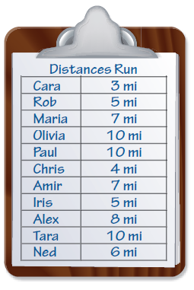
How Do I Find The Median?
3. Another center of measures is called the median, The median represents the middle value of an ordered data set.
Example # 3: A high school coach recorded the following distances that a cross-country team ran last week. Find the median.
Step 1: Write the data values in order from least to greatest
3 4 5 5 6 7 7 8 10 10 10
Step 2: Equal the number of values on either side of the data.
3 4 5 5 6 7 7 8 10 10 10
Median is 7

Slide 10
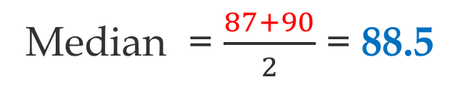
How Do I Find The Median?
Example # 4: Find the median of these test scores: 87, 90, 77, 83, 99, 94, 93, 90, 85, 83.
Step 1: Write the data values in order from least to greatest.
77, 83, 83, 85, 87, 90, 90, 93, 94, 99
Step 2: Equal the number of values on either side of the data.
77, 83, 83, 85, 87, 90, 90, 93, 94, 99
Median = $\frac{87+90}{2}$ = 88.5
Step 3: If the data set has two middle numbers, average the two values.

Slide 11
How do I find the Mode?
4. Another center of measures is called the mode. The mode represents the value that occurs most frequently in a given data set
Example # 5 Find the mode for the following set of data.
Step 1: Find the number that repeats the most.
3 4 5 5 6 7 7 8 10 10 10
Step 2: Since 10 is the most frequent number, the mode for the data set is 10.
Note: data does not need to be in order to find the mode.

Slide 12
Summary
What are some key things to remember about this lesson?
Do you have any more questions or concerns about this lesson?
Did you highlight or circle key vocabulary words, underline key concepts, write level 1 or level 2 questions, and write a summary.

