Slide 1


Pamlico County
State Of The County Health (SOTCH) Report 2010

Slide 2
State of the County Health Report
In between Community Health Assessments, the SOTCH helps us:
  Promote a broader understanding of the health of the community
  Measure local progress in improving the health of the community through collaboration measures with community partners

Slide 3
Community Health Assessment (CHA)
The Pamlico County Health Department provides leadership to conduct, produce and distribute a comprehensive CHA in conjunction with Healthy Carolinians of Craven & Pamlico Counties.
Determines the major health concerns in the county.
Gives statistical data on how the county ranks compared to North Carolina’s rates and national rates.

Slide 4
Community Assessment
Completed the Community Health Assessment in 2007
Next assessment to be completed in 2011
Part of the Healthy Carolinians recertification process, which is conducted under the guidance of the Office of Healthy Carolinians/Health Education and the State Center for Health Statistics of the NC Department of Health and Human Services.
An important component of the Pamlico County Health Department’s Strategic planning process.
A benchmark for community collaboration measured through the NC Public Health Department Accreditation process.
Notes:
To join the CHA Advisory Committee, call Tamara. She will be happy to have you!

Slide 5
Community Health Assessment Priorities
Access To Healthcare
Obesity
Substance Abuse
Notes:
These priorities were selected as a result of the most recent community health assessment.

Slide 6
Demographics
Pamlico County’s 2009 population estimate was 12,892 with a growth of -.41%. 50.3% are males and 49.7% are females. Minorities accounted for 22.7% of the total population.
The population is spread out with 19% ≤ 19, 6% from 20 to 24, 23% from 25 to 44, 29% from 45 to 64, and 23% who were 65 years of age or older.
NC Office of State Budget & Management
Notes:
Pamlico County is ranked 92nd in population as well as the fastest growing county. In 2008, minorities accounted for 25% of the population.
The population is spread out with 21% under the age of 18, 6% from 18 to 24, 26% from 25 to 44, 28% from 45 to 64, and 19% who were 65 years of age or older.

Slide 7
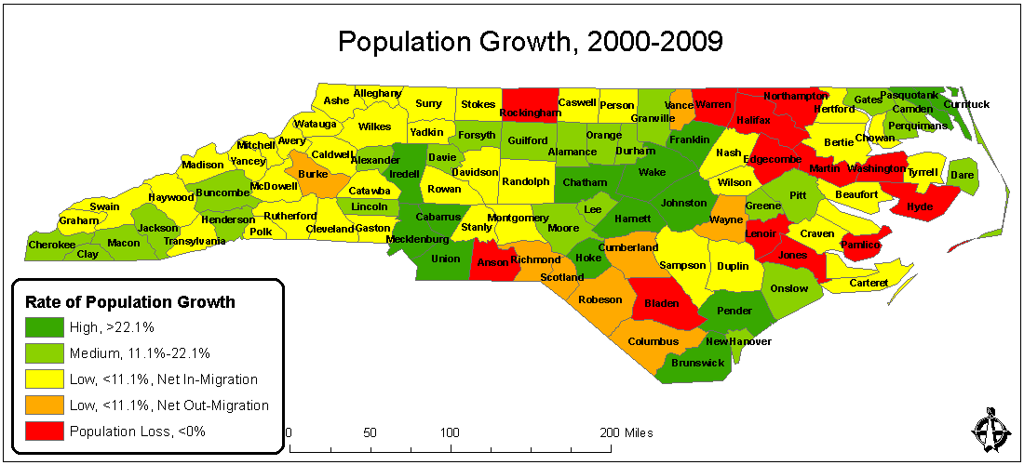
NC Office of State Budget & Management
Notes:
This slide was provided to me from the NC Office of State Budget & Management.

Slide 8
Pamlico County Pregnancies
Reports from the NC State Center for Health Statistics indicate that from 2008 to 2009:
  Induced abortion increased by 53%
  Live births slightly decreased by .8%
  The number of fetal deaths remained at 0.

Slide 9
Pregnancy Outcomes
23 induced abortions
  52.1% or 12 induced white abortions
  43.% or 10 induced minority abortions
111 live births
  83% or 92 white live births
  17% or 19 minority live births
134 pregnancies
Notes:
White abortions decreased from 80% in 2008 to 52% in 2009; however, the number of black induced abortions tripled. From 2008 to 2009, white births increased and minority births decreased. Of the 111 kids born in 2009. 54.5% were born to married moms—57.6% of white mom were married, 36.8% of minority moms.

Slide 10
Resident Live Birth Rates Per 1,000 Population, 2005-2009
 | Total | White | Minority
NC | 14.1 | 13.6 | 15.5
Pamlico County | 8.5 | 9.2 | 6.5
NC State Center for Health Statistics

Slide 11
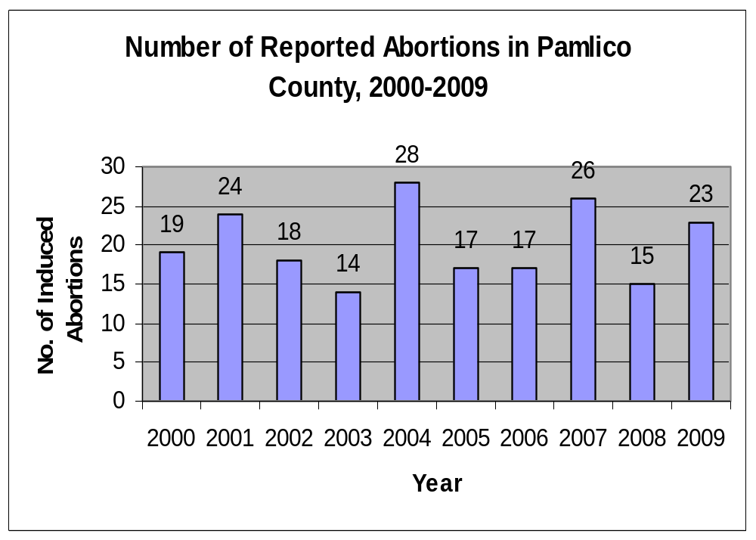

Slide 12
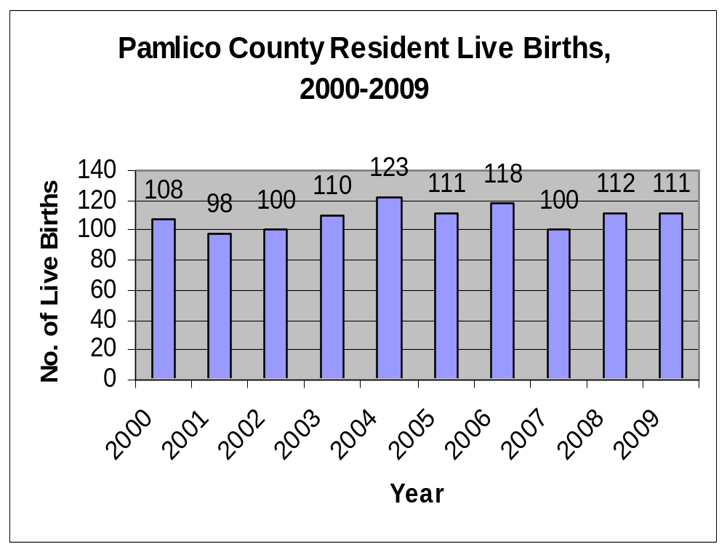
Notes:
Of the 111 babies born in 2009, 54.5% (60 babies) were born to married moms. 57.6% (53 moms) of white moms were married; 36.8% (7) minority moms were married. 69% (76) of these moms did not smoke; 31% (34) did smoke.

Slide 13
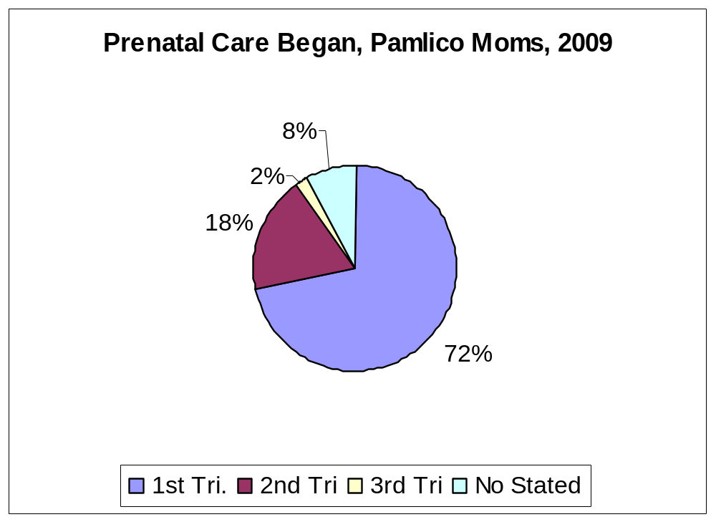

Slide 14
Pamlico County
Teenage Pregnancy Outcomes, 2009
Current reports from the NC State Center for Health Statistics indicate that from 2008 to 2009:
  The number of teenage induced abortions increased by 350% or 7 abortions.
  The number of teenage live births decreased 48.1% or 13 births.
  The number of teenage pregnancies decreased by 20.6% or 6 pregnancies.
Notes:
It’s safe to say that induced abortion is on the rise. There were 2 abortions in 2008--both incidents were white moms. In 2009, there were 9 induced abortions. 33% from white moms; 55% from Minority moms. Minority teenage pregnancies has increased slightly. Pamlico’s teen pregnancy rate (40.6) is higher than the state (33.6)
Teenage is aged 15-17 years old. Minority teenage pregnancy rates in the county (37.8) are lower than the state (46.1).

Slide 15
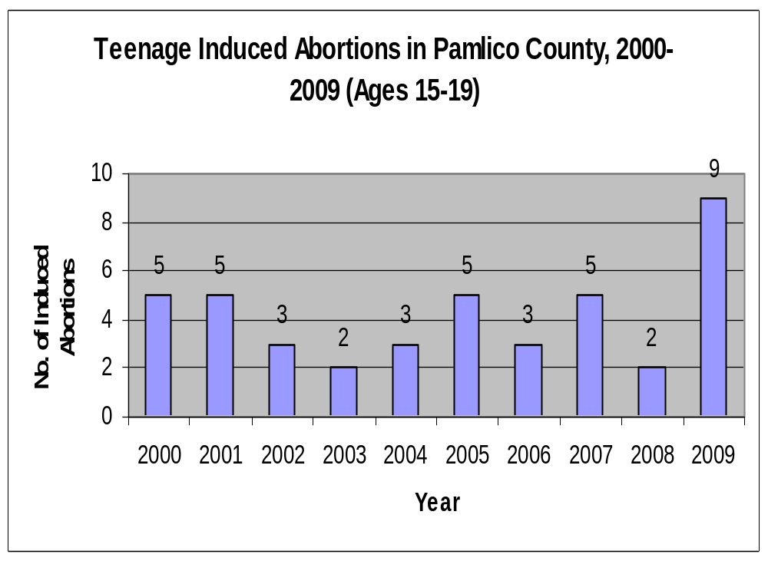
Notes:
Teenage abortions increased by 350% or 7 abortions. The number of white teen mom performing abortions increased by 50%, only 1; however, minority teenage induced abortions SOARED. Minority statistics went from 0 in 2008 to 5 in 2009.

Slide 16
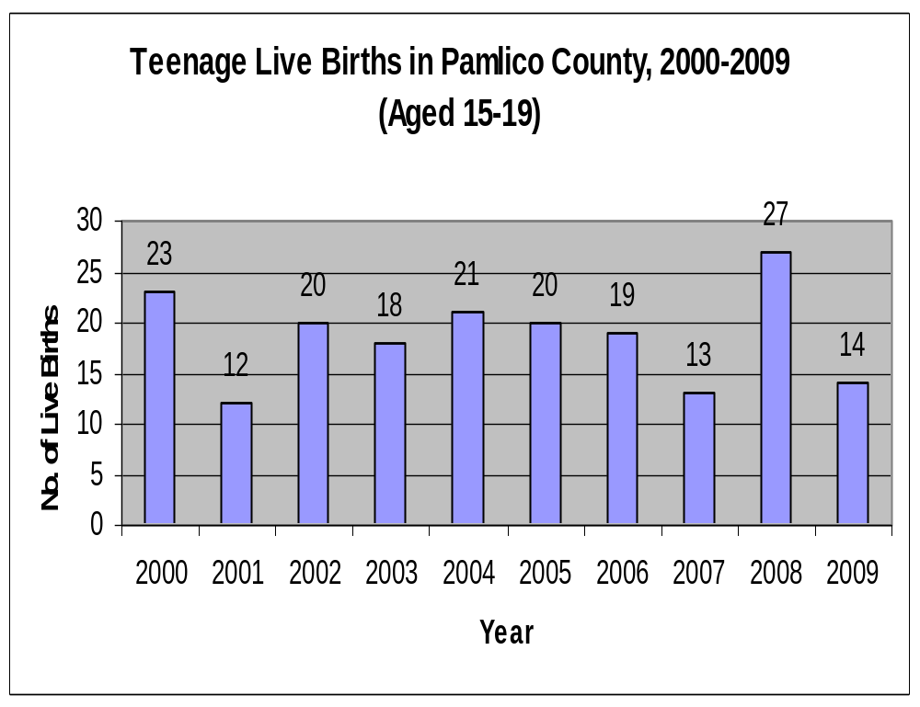
Notes:
White deliveries, or live births, dropped nearly 48% from 2008 to 2009. Minorities live births dropped by half, from 6 to 3.

Slide 17

Notes:
There was a slight increase of minority teenage pregnancies from 2008 to 2009, from 6 to 8.

Slide 18
Pamlico County Death Rates, 2009
In 2009, Pamlico County had a death rate of 1090.5 which is higher than the NC rate of 820.1.
Current reports from the NC State Center for Health Statistics indicate that from 2008 to 2009:
  The number of deaths decreased by 4.7% or 7 deaths.
  There were 140 deaths in 2009.
Notes:
The death rate in Pamlico County (1090.5) is higher than the state’s (820.1)

Slide 19
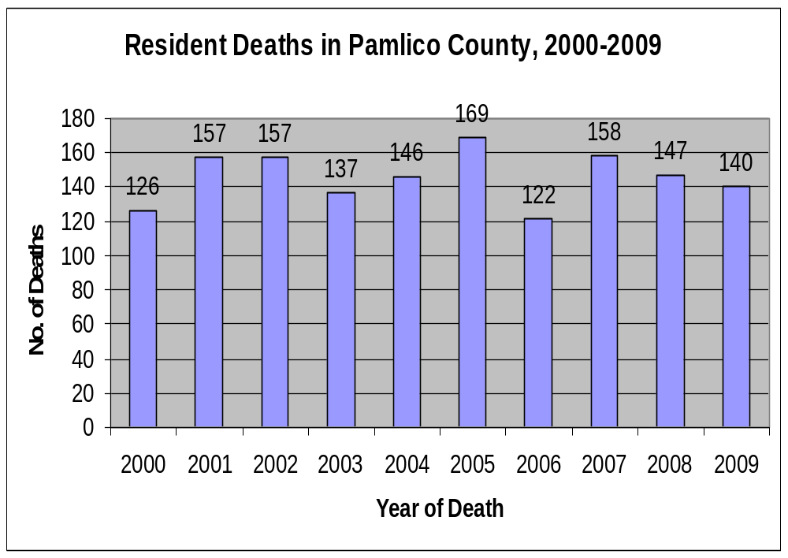

Slide 20
Leading Causes of Death in NC, 2009
Pamlico County had higher death rate of heart disease, cerebrovascular disease, cancer, septicemia, chronic liver disease, unintentional motor vehicles injuries, all other unintentional injuries, suicide, homicide and Alzheimer’s Disease than NC.
Pamlico County had a lower death rate of HIV, diabetes, pneumonia and influenza, chronic lower respiratory disease and nephritis than the NC.
Notes:
Heart disease death rates in Pamlico County are higher than the sta

Slide 21
Leading Causes of Death in NC, 2009
1 | Cancer
2 | Diseases of the heart
3 | Cerebrovascular disease
4 | Chronic lower respiratory diseases
5 | Other unintentional injuries
6 | Alzheimer’s disease
7 | Diabetes
8 | Nephritis, nephritic syndrome
9 | Influenza & Pneumonia
10 | Motor vehicle injuries

Slide 22
Pamlico County
Leading Causes of Death, 2009
Rank | Cause | Number
 | TOTAL DEATHS—All Causes | 140
1 | Diseases of the heart | 40
2 | Cancer | 30
3 | Cerebrovascular disease | 7
3 | Other unintentional injuries | 7
5 | Chronic lower respiratory diseases | 5
5 | Chronic liver disease & cirrhosis | 5
5 | Motor vehicle injuries | 5
8 | Alzheimer’s disease | 4
8 | Suicide | 4
10 | Septicemia | 3
 | *Others | 30
Notes:
In 2008, the leading cause of death in Pamlico County was cancer, resulting in 25% of the death followed by diseases of the heart, 18% of all deaths in 2008. There were 30 other causes of deaths, too.

Slide 23
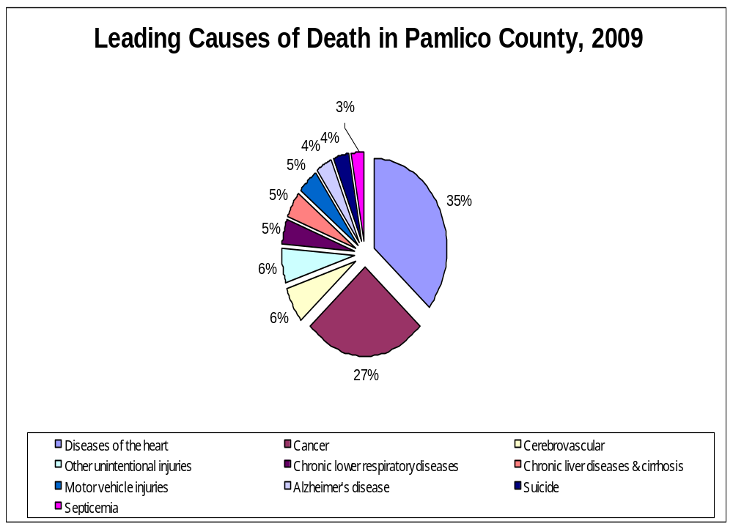

Slide 24
Infant Deaths
For the year 2009, Pamlico County had a rate of 18.0 infant deaths per 1,000 live births, which is higher than the NC rate of 7.9.
In 2009, there were 2 infant deaths in Pamlico County.
NC State Center for Health Statistics

Slide 25
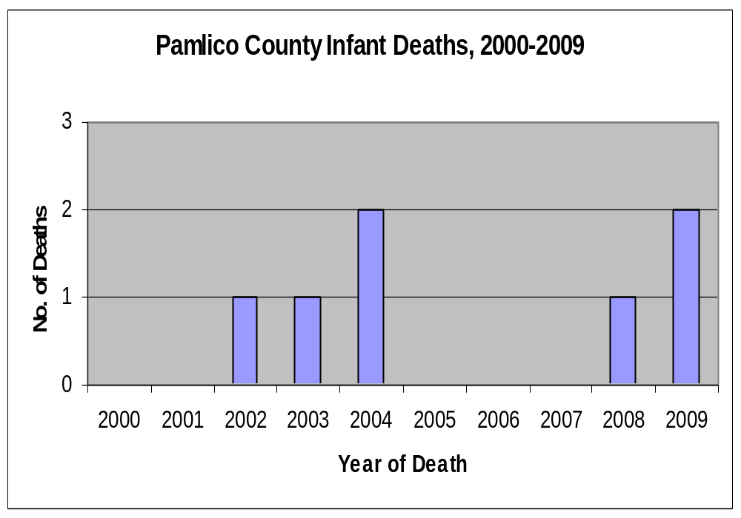

Slide 26
Child Deaths
From 2008 to 2009, child death numbers has remained the same.
In 2009, there were 2 child deaths in Pamlico County
  A drowning
  A suicide

Slide 27
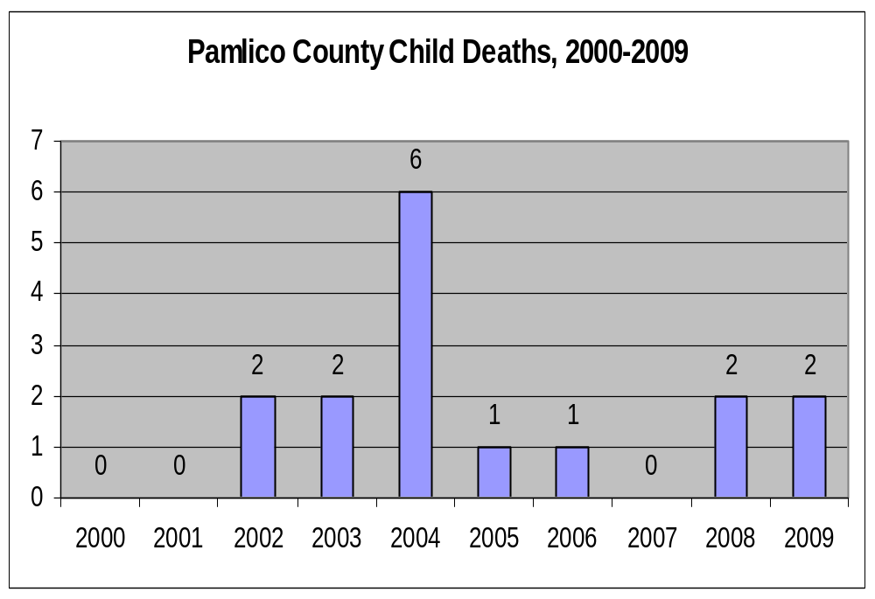

Slide 28
Obesity
According to the 2009, Behavioral Risk Factor Surveillance Survey, 69.6% of respondents in eastern NC report that they are overweight or obese. 65.0% of respondents across NC report that they are overweight or obese.

Slide 29
Hospital Discharges - Asthma
In 2009,Pamlico County had a discharge rate of 194.7 per 100,000 which is higher than the NC rate of 117.1.
There were 25 hospital discharges with a primary diagnosis of asthma.
In 2009, Pamlico County had a rate of 224.8 per 100,000 which is higher than the NC rate of 175.0 for children ages 0-14.
There were 4 hospital discharges with a primary diagnosis of asthma.

Slide 30
Pamlico County Sexually Transmitted Infections
Reports from the NC Department of Health & Human Services, Epidemiology Branch indicate that from 2008 to 2009:
  Chlamydia has decreased by 5.4% or 2 cases.
  Gonorrhea has increased by 66.6% or 2 cases.
  HIV diseases has remained at 0.
Notes:
Syphilis cases are reported by stage of infection, which is determined through a combination of laboratory testing and patient interviews.

Slide 31
Current Pamlico STI Reports
Reports from the NC Department of Health & Human Services, Epidemiology Branch indicate that from January-September 2010, there were:
  31 Chlamydia cases;
  10 Gonorrhea cases;
  1 Primary & secondary syphilis cases;
  0 Early latent syphilis cases;
  1 HIV case

Slide 32
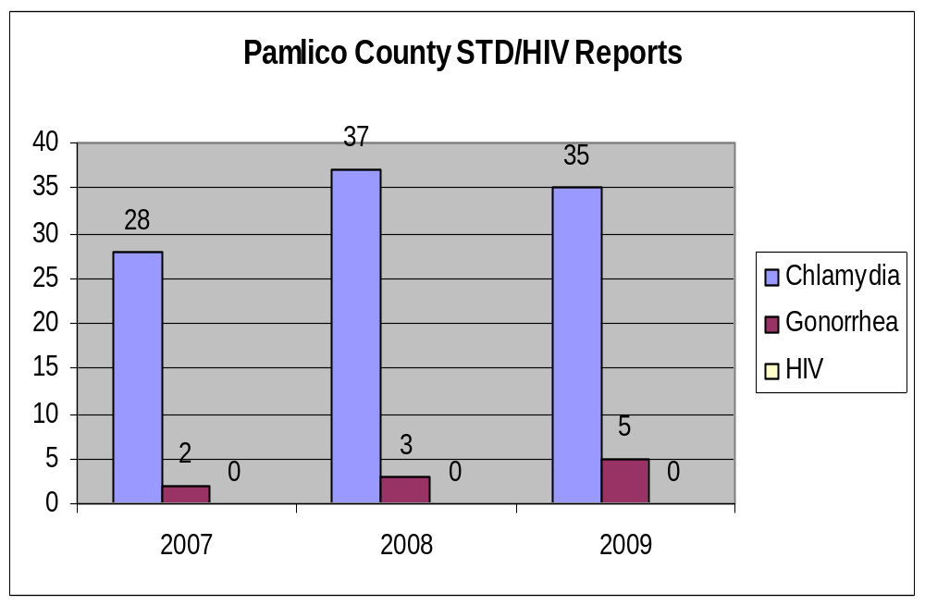

Slide 33
Un-Insured and/or Under-insured
HOPE patients earn less than two times the federal poverty level, but earn too much to qualify for Medicaid. They are too young for Medicare and can not afford insurance to take care of their chronic conditions
In 2008, HOPE Clinic helped 740 people, in 2009, they helped 875. In 2010, HOPE Clinic will help almost 1,000 people.

Slide 34
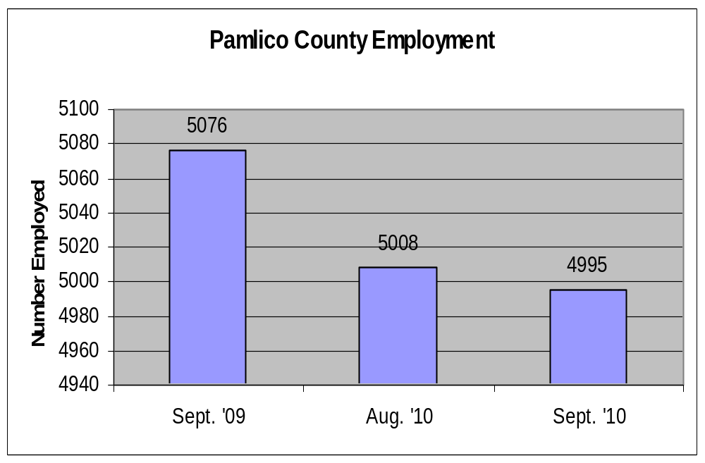
Employment Security Commission of NC

Slide 35
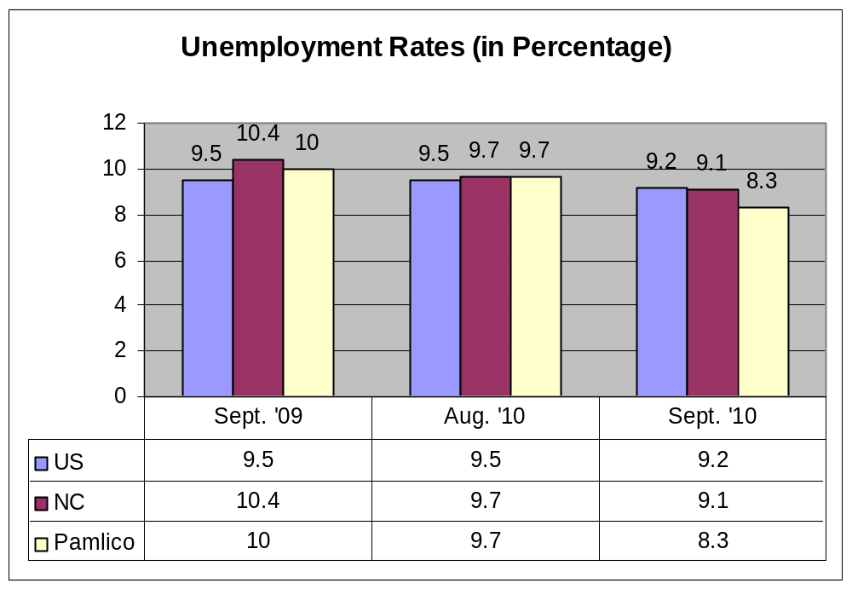
Notes:
The average weeks of duration of UI benefits remained nearly the same in Pamlico County, from September 2009 to September 2010, 17.9 to 17.8 weeks. The number of average weeks in NC increased, from 16.0 weeks in September 2009 to 18.2 weeks in 2010.

Slide 36
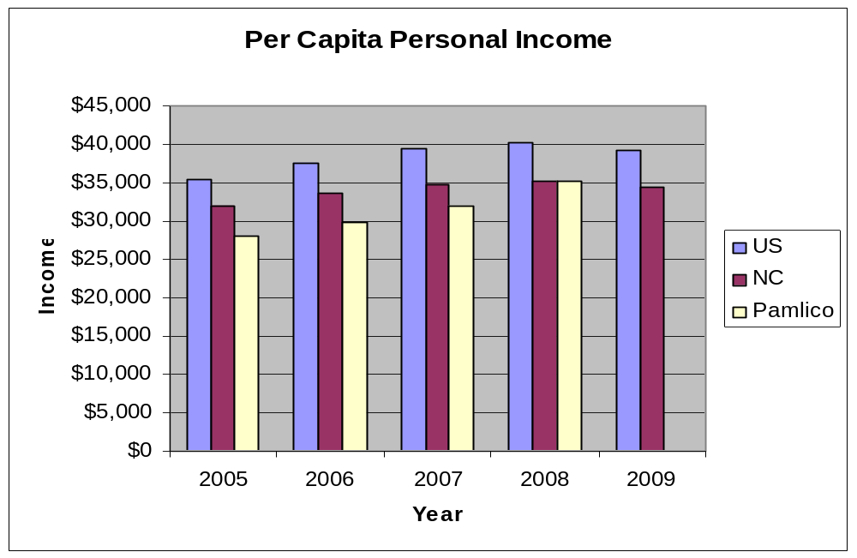
*2009 income data for Pamlico Co. was unavailable

Slide 37
Top Employers in Pamlico County (9/2010)
Pamlico County Board of Education
State of NC Dept of Correction
County of Pamlico
Pamlico Community College
Food Lion, LLC
All Safe Industrial Services, Incs.
YMCA
Britthaven
Arapahoe Charter School
Eastern Carolina Home Healthcare
Employment Security Commission of NC
Notes:
The YMCA dropped from number 4 in 2008 to being number 7 this year. In 2008 the top employers were: The Board of Education, State of NC, County of Pamlico, YMCA, PCC, Food Lion, Arapahoe Charter School, Britthaven, Pamlico Packing, Home Life Care, Inc.

Slide 38
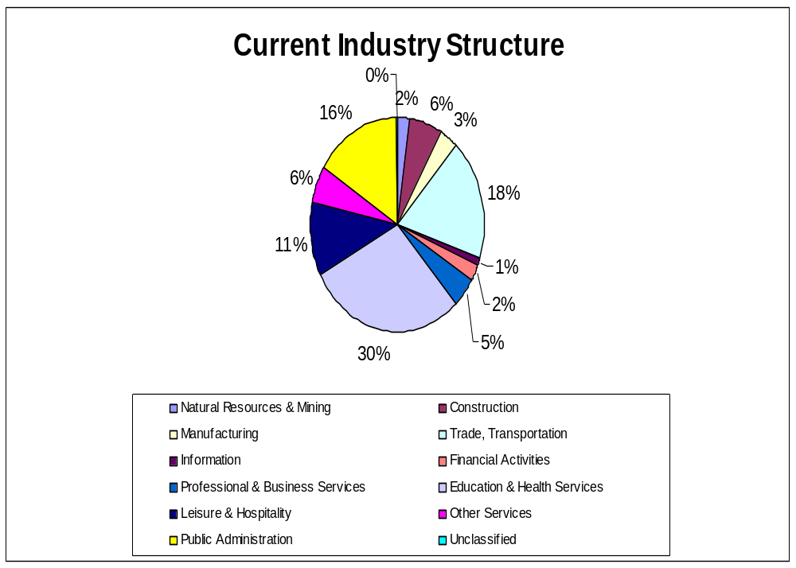
Notes:
Most residents are taking or choosing jobs in Education & Health Services; Trade, Transportation & Utilities or Public Administration. This information was updated in September 2010. Source is the NAICS Employment & Wages, Quarterly Census of Employment of Wages

Slide 39
Commuting Patterns (11/2008)
Residents Commuting out of and into Pamlico County
  Total Workers Commuting Out of Pamlico County: 2,276
  Total Workers Commuting Into Pamlico County: 1,155
  1,553 Pamlico County Residents live and work in Pamlico County
Employment Security Commission of NC

Slide 40
Substance Abuse
The Pamlico County Substance Abuse Task Force is working with the SADD Club, at Pamlico County High School, to get students involved with initiatives to prevent underage drinking, reduce prescription drugs use, as well as tobacco prevention efforts.
Pamlico County Substance Abuse Task Force & the Pamlico Youth Empowerment Substance Abuse Prevention Helps Everyone (SAPHE) presented for our Town Hall Meeting a program called “Drugs Uncovered”, a free presentation for parents to educate themselves on the current drug trends facing their youth aged kids.
Pamlico County Substance Abuse Task

Slide 41
Substance Abuse
Coastal Coalition for Substance Abuse Prevention (CCSAP) was awarded the United for Health Grant to conduct a GIS survey of responsible alcohol consumption in the 5 county region:
  Pamlico
  Craven
  Carteret
  Jones
  Onslow
Coastal Coalition for Substance Abuse

Slide 42
Access To Healthcare
A workshop, A Framework for Understanding Poverty, was held for community leaders in February.
In 2010, HOPE Clinic will help almost 1,000 people by providing basic medical and dental care, medications, health education, counseling and referrals to specialist.
Pamlico County Health Department and Pamlico Pediatrics has been working closely with CareShare Health Alliance to establish a committee to address indigent care.

Slide 43
Access To Healthcare
For Public Health Month (April), the health department hosted 4 blood pressure and BMI screening clinics in the community.

Slide 44
Obesity
A Take 10! training was held at Pamlico County Primary School in January. A Train the Trainer portion as well as a Teacher’s training was taught.
Girls on the Run is active again this year at Fred A. Anderson Elementary School. The program has expanded into Pamlico County Middle School.
Health department staff were encouraged to participate in the Eat Smart, Move More, Maintain, Don’t Gain Holiday Challenge.
Child Nutrition provides healthy snacks for the School Health Advisory Council.

Slide 45
Emerging Issues
Chlamydia
Gonorrhea

Slide 46
For more information:
Contact:
  Tamara Jones
  Health Educator
  Pamlico County Health Department
  Post Office Box 306
  Bayboro, NC 28515
  : 252-745-5111
  : 252-745-7684
  : tamara.jones@pamlicocounty.org

