Slide 1
What Is Statistics?
Statistics is the science concerned with developing and studying methods for collecting, analyzing, interpreting and presenting empirical data.

Slide 2
Variability in Data
Data is everywhere. It’s in our newspapers, it’s in our science classes, it shows up in economics, medicine and anywhere else that variability occurs.
Variability gives you a way to describe how much data sets vary. The tools of statistics are designed to explain this variability.

Slide 3
The following types of variability can change the uniformity of a data set:
Observational or Measurement Variability
Variability that is introduced due to either our measuring instruments not being precise enough or differences in how two people read the measurement.
What are some examples:
Reaction time when recording time with a stopwatch
Differences in scales

Slide 4
The following types of variability can change the uniformity of a data set:
Natural or Sampling Variability
Variability that accounts for the fact that members of a population are simply different.
What are some examples:
Two people work out the same number of hours/week but lose different amounts of weight
Two plants get the same amount of water and sunlight but grow at different rates

Slide 5
The following types of variability can change the uniformity of a data set:
Induced Variability
Variability that occurs because we have assigned our population or sample to two or more treatment groups and then observe the differences between the groups
What are some examples:
Two groups are tested for memory with different amount of sleep
Two groups are tested for the effects of a drug with one group getting a placebo

Slide 6
Collecting Data for Studies
There are a few standard ways of collecting data:
use existing data
survey a sampling of the population
design an experiment
use a census
and

Slide 7
use a simulation
- a model (computer) to replicate the conditions of a process or situation.

Slide 8
Observational Studies
There are two major types of studies:
An observational study observes individuals and measures variables without controlling the individuals or their environment.
Example: Randomly choose 50 women who smoked a pack of cigarettes for the last 10 years and 50 women who have not smoked at all. Measure their lung capacity. Analyze, interpret, and draw conclusions based on the data.

Slide 9
Observational Studies include surveys
Example: An organization wants to know if drinking caffeinated coffee causes hyperactivity in college students. To test their research question, they select a sample of college students and give them a survey concerning their intake of caffeinated coffee and their hyperactivity levels.
These are observational studies because the researchers are not making any manipulations.

Slide 10
Experimental Studies
An experimental study imposes a treatment on individuals in order to collect data on their response to the treatment.
Example: Another organization also wants to know if drinking caffeinated coffee causes hyperactivity in college students. They design a different study. They select a random sample of college students and randomly assign them to drink coffee with or without caffeine. The researchers observe the students' behaviors.
This is an experimental study because a treatment is being imposed. The researchers are manipulating the treatment that each participant receives.

Slide 11
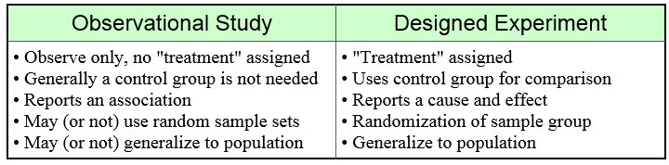
Observation VS. Experiment

Slide 12
Collecting Data for Studies
There are many different situations in which we collect data. They have important differences and all of them depend on randomization.
Randomization is used primarily to eliminate variability caused by some type of bias.

Slide 13
Randomization
In a randomized comparative experiment, individuals are randomly assigned to the control group or the treatment group.
A control group is a group of individuals that do not receive treatment by the researchers and is then used as a benchmark.
The treatment group consists of participants who receive the experimental treatment whose effect is being studied.
In the end, the responses of those in the treatment group are compared with the responses from the control group to look for differences that are statistically significant (unlikely to have occurred just by chance).
The comparison of the control group and the treatment group makes it possible to determine any effects of the treatment.
Randomization minimizes bias and produces groups of individuals that are theoretically similar in all ways before the treatment is applied.

Slide 14
Conclusions of an Observational Study
An observational study can identify correlation between variables, but not causality.
Variables other than what is being measured may be affecting the results. (a vigorous exercise in older people correlates with longer life, but comparing groups only on exercise and lifespan ignores other factors, such as that people who are unhealthy to begin with may not be able to exercise vigorously.

Slide 15
Conclusions of an Experimental Study
A rigorous randomized comparative experiment, by eliminating sources of variation other than the controlled variable, can make valid cause-and-effect conclusions possible.

Slide 16
Survey Questions
Poorly designed questions may not accurately reflect the opinions or actions of those being surveyed.
Biased questions--questions that are flawed in a way that leads to inaccurate results.
Example: Taking a survey about soda outside a health food store

Slide 17
Identify the population and the sample. Is the sample biased?
A journalist for “The Maroon” wants to know if students think the food in the cafeteria has enough healthy options. They ask the students during “B” lunch to answer questions on a survey.
Population: New Paltz High School
Sample: Students who have “B” lunch
Biased? No, the sample is random.

Slide 18
Identify the population and the sample. Is the sample biased?
Planet Fitness wants to see if their members are satisfied with the ease of use of the equipment? They ask members getting off the equipment to rate their experience.
Population: Planet Fitness members
Sample: Members getting off equipment
Biased? Yes, members may be staying home because of dissatisfaction.

Slide 19
Biased Questions
Questions may be biased in the following ways:
The wording of the question may encourage or pressure the respondent to answer in a particular way.
The question may be perceived as too sensitive to answer truthfully.
The questions may not provide the respondent with enough information to give an accurate opinion.

Slide 20
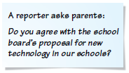
Tell why the question may be biased or otherwise introduce bias into the survey.
Describe a way to correct the flaw.
This question assumes that the respondent is familiar with the proposal. To get accurate results that lead to valid conclusions, state the proposal clearly using neutral language before asking the question.

Slide 21
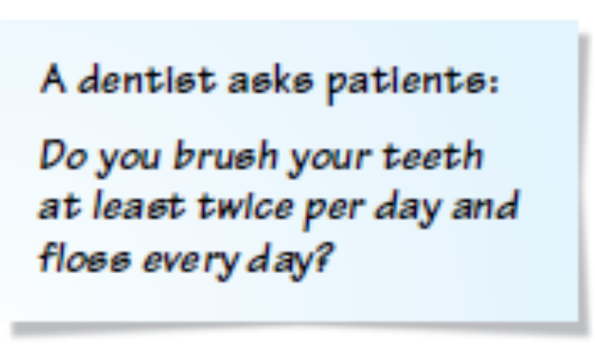
Tell why the question may be biased or otherwise introduce bias into the survey.
Describe a way to correct the flaw.
Patients who brush less than twice per day or do not floss daily may be afraid to admit this since the dentist is asking the question.
One improvement would be to have patients answer questions about dental hygiene on paper and put the paper anonymously into a box.

Slide 22
Determine whether each situation is an example of an experiment or an observational study. Explain.
A researcher asks college students how many hours of sleep they get on an average night and examines whether
the number of hours of sleep affects students’ grades.
The researcher gathers data without controlling the individuals or applying a treatment. The situation is an observational study.

Slide 23
Determine whether each situation is an example of an experiment or an observational study. Explain.
A Parks Department employee wants to know if latex paint is more durable than non-latex paint. She has 50 park benches painted with latex paint and has 50 park benches painted with non-latex paint.
A treatment (painting benches with latex paint) is applied to some of the individuals (benches) in the study. The situation is an experiment.

Slide 24

Determine whether each situation is an example of an experiment or an observational study. Explain.
Experiment: a treatment (use of a new Web site) is imposed on some individuals (Web site users).

Slide 25
Controlled Experiment
In a controlled experiment, two groups are studied under identical conditions with the exception of a variable.
Control group—a group under ordinary conditions.
Treatment group—a group that is subjected to the treatment.

Slide 26
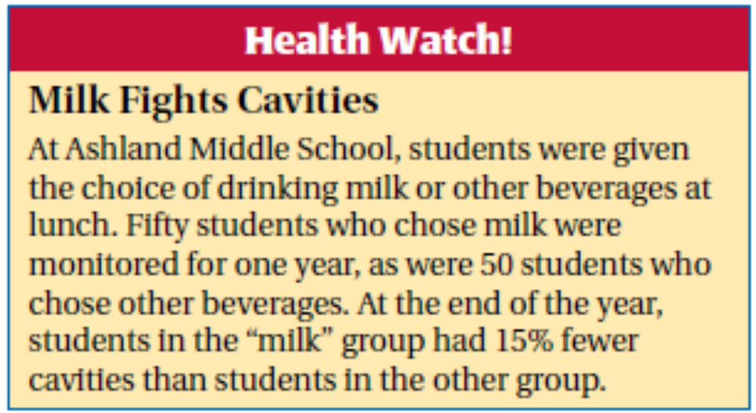
Determine whether the study described in the health bulletin below is a randomized comparative experiment. If it is, describe the treatment, the treatment group, and the control group. If it is not, explain why not and discuss whether the conclusions drawn from the study are valid.

Slide 27
SOLUTION
The study is not a randomized comparative experiment because the individuals were not randomly assigned to a control group and a treatment group. (In fact, the study is an observational study, not an experiment, since no treatment is imposed.)
The study’s conclusion that milk fights cavities may or may not be valid. There may be other reasons why students who chose milk had fewer cavities. For example, students who voluntarily choose milk at lunch may be more likely to have other healthy eating or dental care habits that could affect the number of cavities they have.

Slide 28
Determine whether the study described in the research summary discussed brfore is a randomized comparative experiment. If it is, describe the treatment, the treatment group, and the control group. If it is not, explain why not and discuss whether the conclusions drawn from the study are valid.

Slide 29
SOUTION
The study is a randomized comparative experiment; treatment is use of a new Web site; treatment group is individuals using the new Web site; control group is individuals using old Web site.

Slide 30
Explain whether the following research topic is best investigated through an experiment or an observational study. Then explain how you would design the experiment or observational study.
You want to know if listening to music using earphones for more than one hour per day affects a person’s hearing.
SOLUTION
The treatment (listening to music using earphones for more than one hour a day) may affect an individual’s hearing, so it is not ethical to assign individuals to a control or treatment group. Use an observational study.

Slide 31

SOLUTION
Randomly choose one group of individuals who already listen to music using earphones for more than one hour per day.
Randomly choose one group of individuals who do not listen to music using earphones for more than one hour per day.
Monitor the hearing of the individuals in both groups at regular intervals.

Slide 32
Practice:
Determine if the below situations are observational studies or experiments—and why.
Over a 4‐month period, among 30 people with bipolar disorder, patients who were given a high dose (10g/day) of omega‐3 fats from fish oil improved more than those given a placebo. (Archives of General Psychiatry 56 [1999]: 407)
Experimental: treatments were imposed
2 treatments: 1 high dose, 1 placebo-control group

Slide 33
2) The leg muscles of men aged 60 to 75 were 50% to 80% stronger after they participated in a 16‐week, high‐intensity resistance‐training program twice a week. (Journal of Gerontology 55A [2000}: B336)
Experimental: treatments were imposed
1 treatment, no control group

Slide 34
3) Among a group of disabled women aged 65 and older who were tracked for several years, those who had a vitamin B12 deficiency were twice as likely to suffer severe depression as those who did not. (American Journal of Psychology 157 [2000]: 715)
Observational: researchers studying traits that already exist

