Slide 1
Analyzing One-Variable Data
1
Lesson 1.6
Measuring Center

Slide 2

Measuring Center
Find and interpret the median of a distribution of quantitative data.
Calculate the mean of a distribution of quantitative data.
Compare the mean and median of a distribution, and choose the more appropriate measure of center in a given setting.

Slide 3
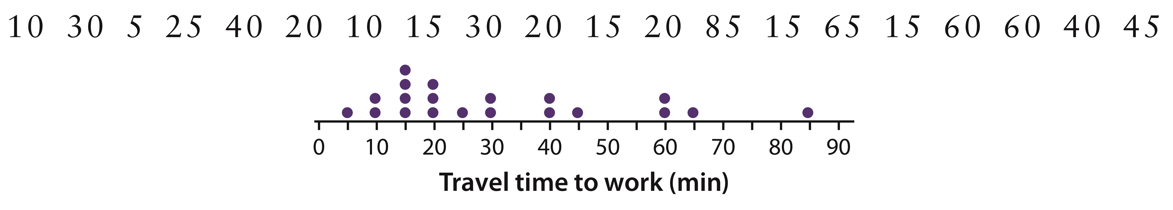
Measuring Center
Here are the travel times in minutes of 20 randomly chosen New York workers, along with a dotplot of the data:
The distribution is right-skewed and single-peaked. The longest travel time (85 minutes) appears to be an outlier.
How should we describe where this (or some other) distribution of quantitative data is centered?
The two most common ways to measure center are the median and the mean.

Slide 4
Measuring Center
We could report the value in the “middle” of a distribution as its center. That’s the idea of the median.
Median
The median is the midpoint of a distribution, the number such that about half the observations are smaller and about half are larger.
To find the median, arrange the data values from smallest to largest.
  If the number n of data values is odd, the median is the middle value in the ordered list.
  If the number n of data values is even, the median is the average of the two middle values in the ordered list.

Slide 5

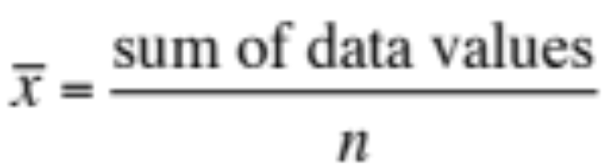
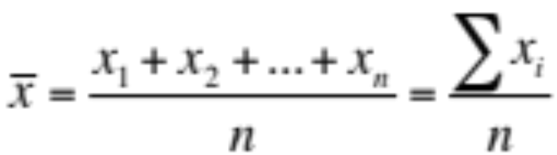
Measuring Center
The most common measure of center is the mean.
Mean
The mean (pronounced “x-bar”) of a quantitative set of data is the average of all n data values.
To find the mean, add all the values and divide by n. That is,
In mathematics, the capital Greek letter sigma, Σ, is short for “add them all up.” Therefore, the formula for the mean can be written in more compact notation:

Slide 6

Measuring Center
Which measure—the mean or the median—should we report as the center of a distribution? That depends on both the shape of the distribution and whether there are any outliers.
Resistant
A measure of center (or variability) is resistant if it isn’t influenced by unusually large or unusually small values in a distribution.
  The mean is not resistant to outliers.
  The median is resistant to outliers.

Slide 7
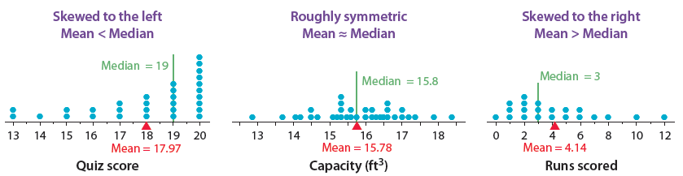
Measuring Center
Choosing a Measure of Center
If a distribution of quantitative data is roughly symmetric and has no outliers, use the mean to measure center.
If the distribution is strongly skewed or has outliers, use the median to measure center.

Slide 8
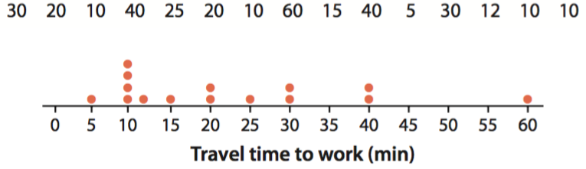
LESSON APP 1.6
Is the pace of life slower in smaller cities?
Does it take less time to get to work in smaller cities? Here are the travel times in minutes for 15 workers in North Carolina, chosen at random by the Census Bureau, along with a dotplot of the data.
Find the median. Interpret this value in context.
Calculate the mean travel time. Show your work.
Which measure of center—the median or the mean— better describes a typical travel time to work for this sample of workers in North Carolina? Justify your answer.

Slide 9
Measuring Center
Find and interpret the median of a distribution of quantitative data.
Calculate the mean of a distribution of quantitative data.
Compare the mean and median of a distribution, and choose the more appropriate measure of center in a given setting.

