Slide 1
Chapter 2
Tools of Environmental science

Slide 2
2.1 Scientific Method
2.2 Statistics and Models
2.3 Making Informed Decisions

Slide 3
2.1 Scientific Method

Slide 4
Objectives
List and describe the steps of the experimental method.
Describe why a good hypothesis is not simply a guess.
Describe the two essential parts of a good experiment.
Describe how scientists study subjects in which experiments are not possible.
Explain the importance of curiosity and imagination in science.

Slide 5
The Experimental Method
Scientists make most of their discoveries using the experimental method.
This method consists of a series of steps that scientists worldwide use to identify and answer questions.

Slide 6
Observing
Observation is the process of obtaining information by using the senses as well as the information obtained by using the senses.
Observing is the first step of the experimental method.
Observations can take many forms, including descriptions, drawings, photographs, and measurements.

Slide 7
Hypothesizing and Predicting
A hypothesis is a theory or explanation that is based on observations and that can be tested.
Forming a hypothesis is the second step of the experimental method.
A hypothesis is not merely a guess.
A good hypothesis should make logical sense and follow from what you already know about the situation.

Slide 8
Hypothesizing and Predicting
Predictions are statements made in advance that express the results that will be obtained from testing a hypothesis if the hypothesis is supported.
A prediction is used to test a hypothesis.

Slide 9
Hypothesizing and Predicting
It is important that any hypothesis can be disproved.
Every time a hypothesis is disproved, the number of possible explanations for an observation is reduced.
By eliminating possible explanations a scientist can zero in on the best explanation.

Slide 10
Experimenting
Experiments are procedures that are carried out under controlled conditions to discover, demonstrate, or test a fact, theory, or general truth.
An experiment is performed when questions that arise from observations cannot be answered with additional observations.
Experiments should be designed to pinpoint cause-and-effect relationships.

Slide 11
Experimenting
Good experiments have two essential characteristics: a single variable is tested, and a control is used.
The variable is the factor that changes in an experiment in order to test a hypothesis.
To test for one variable, scientists usually study two groups or situations at one time, with the variable being the only difference between the two groups.

Slide 12
Experimenting
The experimental group is the group in the experiment that is identical to the control group except for one factor and is compared with controls group.
The control group is the group in the experiment that serves as a standards of comparison with another group to which the control group is identical except for one factor.

Slide 13
Organizing and Analyzing Data
Data is any pieces of information acquired through observation or experimentation.
Organizing data into tables and graphic illustrations helps scientists analyze the data and explain the data clearly to others.
Graphs are often used by scientists to display relationships or trends in the data.

Slide 14
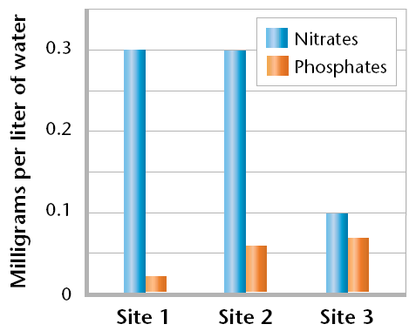
Organizing and Analyzing Data
Bar graphs are useful for comparing the data for several things in one graph.

Slide 15
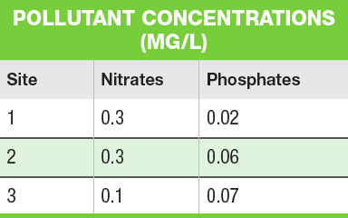
Organizing and Analyzing Data
Graphing the information makes the trends presented in tables easier to see.

Slide 16
Drawing Conclusions
Scientists determine the results of their experiment by analyzing their data and comparing the outcome of their experiments with their prediction.
Ideally, this comparison provides the scientist with an obvious conclusion.

Slide 17
Drawing Conclusions
But, often the conclusion is not obvious.
In these cases, scientists often use mathematical tools to help them determine whether the differences are meaningful or are just a coincidence.

Slide 18
Repeating Experiments
Scientists often repeat their experiments.
The more often an experiment can be repeated with the same results, in different places and by different people, the more sure scientists become about the reliability of their conclusions.
Scientists look for a large amount of supporting evidence before they accept a hypothesis.

Slide 19
Communicating Results
Scientists publish their results, sometimes in scientific articles, to share what they have learned with other scientists.
Scientific articles include the question the scientist explored, the reasons why the question is important, background information, a precise description of how the work was done, the data collected, and the scientist’s interpretation of the data.

Slide 20
The Correlation Method
When the use of experiments to answer questions is impossible or unethical, scientists test predictions by examining correlations.
Correlation is the linear dependence between two variables.

Slide 21
The Correlation Method
An example is the relative width of a ring on a tree trunk is a good indicator of the amount of rainfall the tree received in a given year.
Trees produce wide rings in rainy years and narrow rings in dry years.
This method was used to help scientists investigate why the settlers at Roanake Island all died and why many died at the Jamestown Colony.

Slide 22
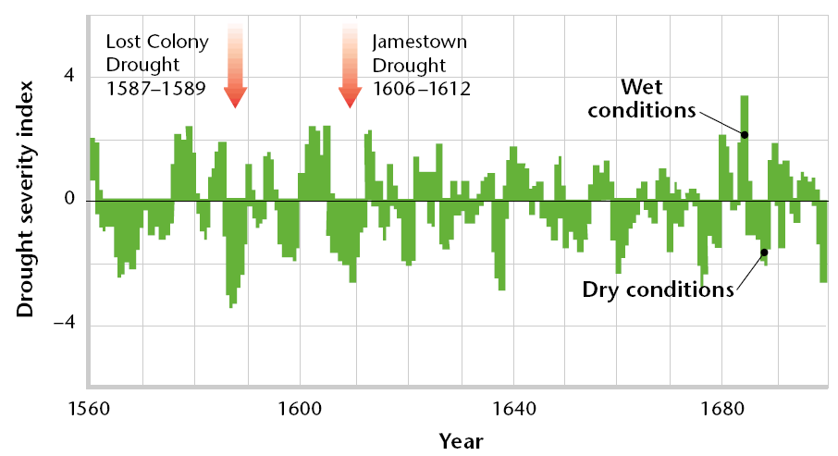
The Correlation Method
The Scientists concluded that the settlers may have been the victims of unfortunate timing.

Slide 23
The Correlation Method
Although correlation studies are useful, they do not necessarily prove cause-and-effect relationships between two variables.
Scientists become more sure about their conclusions only if they find the same correlation in different places and as they continue to eliminate other possible explanations.

Slide 24
Scientific Habits of Mind
Good scientists tend to share several key habits of mind, or ways of approaching and thinking about things.
The first habit of mind is curiosity. Good scientists are endlessly curious which drives them to observe and experiment.
The second habit of mind is skepticism. This means that good scientists don’t believe everything that they are told.

Slide 25
Scientific Habits of Mind
The third habit of mind is openness to new ideas. Good scientists keep an open mind to how the world works.
Another habit of mind is intellectual honesty. A good scientist is willing to recognize the results of an experiment even though it may mean that his or her hypothesis was wrong.

Slide 26
Scientific Habits of Mind
Lastly, good scientists share imagination and creativity.
They are not only open to new ideas, but able to conceive new ideas themselves.
They have the ability to see patterns where others do not or can imagine things that others cannot.
This allows for good scientists to expand the boundaries we know.

Slide 27
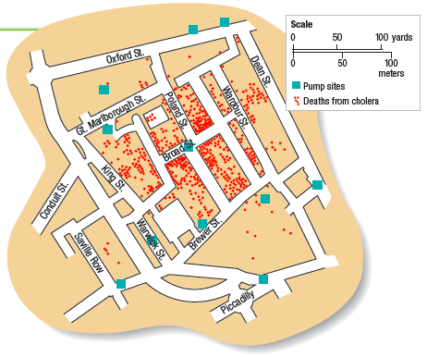
Imagination and Creativity
An example being when John Snow created a spot map which effectively pinpointed the source of a Cholera epidemic in 1854.

Slide 28
Section 2.1 Review Questions
Describe the steps of the experimental method.
Name three scientific habits of mind and explain their importance.
Explain why a hypothesis is not just a guess.
Explain how scientists try to answer questions that cannot be tested with experiments.
Describe two essential parts of a good experiment, and explain their importance.

Slide 29
2.2 Statistics and models

Slide 30
Objectives
Explain how scientists use statistics.
Explain why the size of statistical sample is important.
Describe three types of models commonly used by scientists.
Explain the relationship between probability and risk.
Explain the importance of conceptual and mathematical models.

Slide 31
How Scientists use Statistics
Statistics is the collection and classification of data that are in the form of numbers.
Scientists rely on and use statistics to summarize, characterize, analyze, and compare data.
Statistics is actually a branch of mathematics that provides scientists with important tools for analyzing and understanding their data.

Slide 32
Statistics Works with Populations
Scientists use statistics to describe statistical populations.
A statistical population is a group of similar things that a scientist is interested in learning about.

Slide 33
What is the Average?
Statistical populations are composed of similar individuals, but these individuals often have different characteristics.
A mean is the number obtained by adding up the data for a given characteristic and dividing this sum by the number of individuals.
The mean provides a single numerical measure for a population and allows for easy comparison.

Slide 34
Distribution
Distribution is the relative arrangement of the members of a statistical population, and is usually shown in a graph.
The graphs of many characteristics of populations, such as the heights of people, form bell-shaped curves.
A bell shaped curve indicates a normal distribution where the data is grouped symmetrically around the mean.

Slide 35
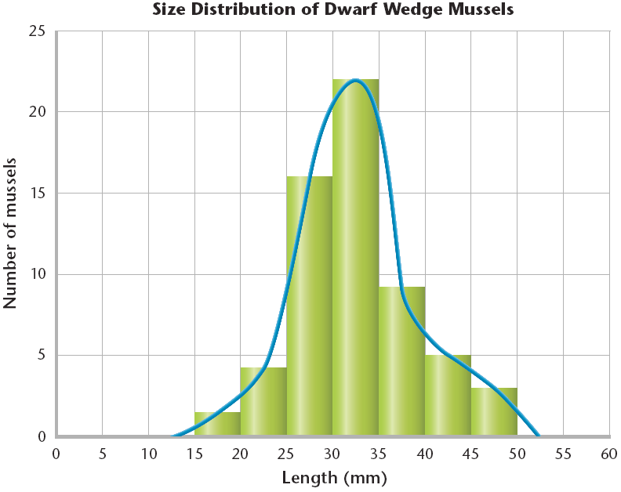
Distribution

Slide 36
What is the Probability?
Probability is the likelihood that a possible future event will occur in any given instance of the event.
Probability is usually expressed as a number between 0 and 1 and written as a decimal rather than as a fraction.
However, there must be a large enough sample size in order to obtain accurate results.

Slide 37
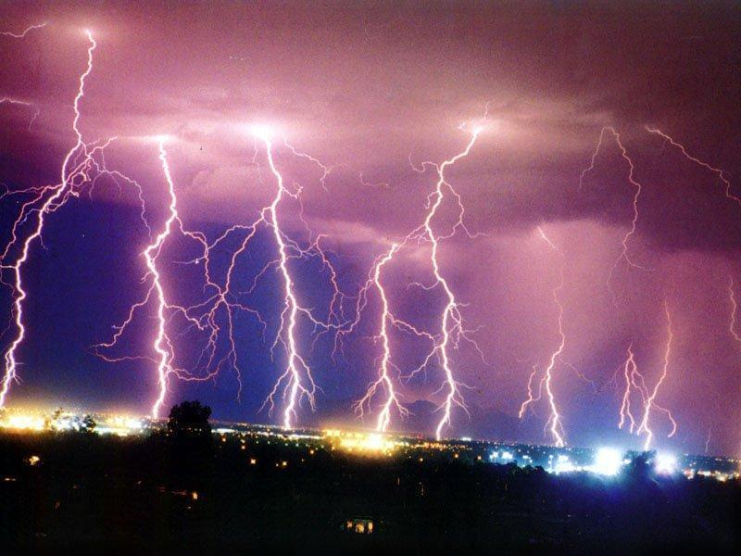

Slide 38
Understanding the News
The news contains statistics every day. For example, a reporter might say, “A study shows that forest fires increased air pollution in the city last year.”
This could lead you to gather and then graph data on the pollution levels for last 20 years, and looking to see if this year’s seem unusually high.
Paying attention to statistics will make you a better consumer of information.

Slide 39
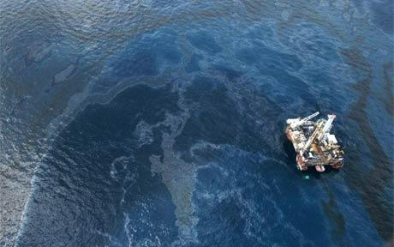
BP Oil Spill

Slide 40
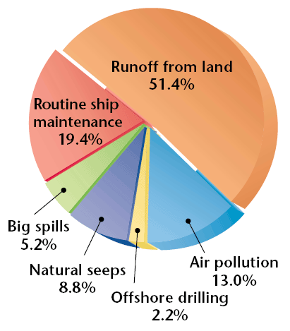
Thinking About Risk
Risk is the probability of an unwanted outcome.
People often worry about big oil spills, but as the pie chart shows, there is a much greater risk of oil pollution from everyday sources.

Slide 41
Thinking About Risk
The most important risk we consider is the risk of death.
Most people overestimate the risk of dying from sensational causes, such as plane crashes, but underestimate the risk from common causes, such as smoking.
Likewise, most citizens overestimate the risk of sensational environmental problems and underestimate the risk of ordinary ones.

Slide 42
Models
Models are patterns, plans, representations, or descriptions designed to show the structure or workings of an object, system or concept.
Scientists use several different types of models to help them learn about our environment.

Slide 43
Physical Models
Physical models are three-dimensional models you can touch.
Their most important feature is that they closely resemble the object or system they represent, although they may be larger or smaller.
The most useful models teach scientists something new and help to further other discoveries.

Slide 44
Physical Models
One of the most famous physical models was used to discover the structure of DNA.
The structural model was built based on the size, shape, and bonding qualities of DNA.
The pieces of the model put together helped the scientist figure out the potential structure of DNA.
Discovering the structure led the understanding of DNA replication.

Slide 45
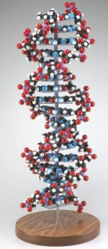
Model of DNA

Slide 46
Graphical Models
Maps and charts are the most common examples of graphical models.
Scientists use graphical models to show things such as the position of the stars, the amount of forest cover in a given area, and the depth of the water in a river or along a coast.

Slide 47
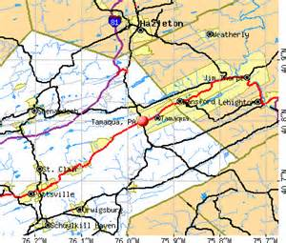
Map-Graphical Model

Slide 48
Conceptual Models
Conceptual models are verbal or graphical explanations for how a system works or is organized.
A flow-chart diagram is an example of a conceptual model.
A flow-chart uses boxes linked by arrows to illustrate what a system contains, how those contents are organized, and how they affect one another.

Slide 49
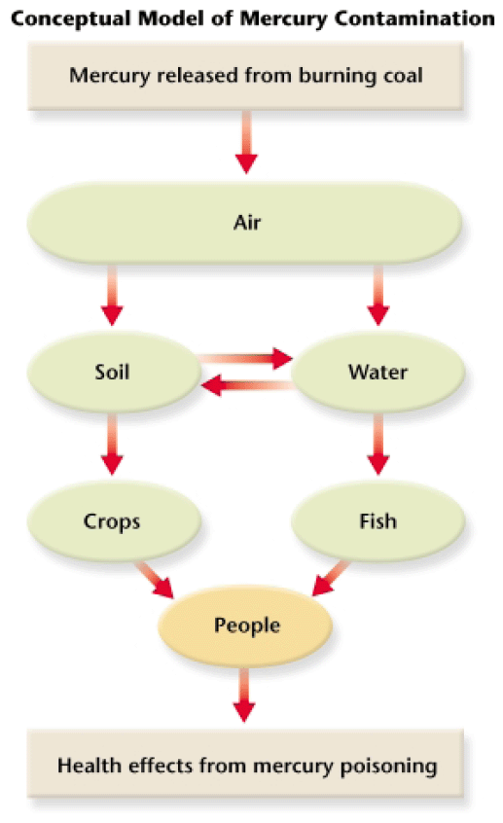
Conceptual Models

Slide 50
Conceptual Models
Conceptual models can also be verbal descriptions or even drawings.
For example, one conceptual model of the structure of an atom describes the atom as one large ball being circled by several smaller balls.
This illustrates another point, that a model can be more than one type. An atomic model made using plastic balls is both a conceptual and physical model.

Slide 51
Mathematical Models
Mathematical models are one or more equations that represent the way system or process works.
Mathematical models are especially useful in cases with many variables, such as the many things that affect the weather.

Slide 52
Mathematical Models
Although mathematical models use number and equations, they are not always right.
People are the ones who interpret the data and write the equations. So, if the data or the equations are wrong, the model will not be realistic and will provide incorrect information.
Like all models, mathematical models are only as good as the data that went into building them.

Slide 53
Mathematical Models
Scientists use mathematical models to create amazing, as well as useful images.
“False color” satellite images are created using mathematical models.
Scientists use the models to relate the amount of energy reflected from objects to the objects’ physical condition.

Slide 54
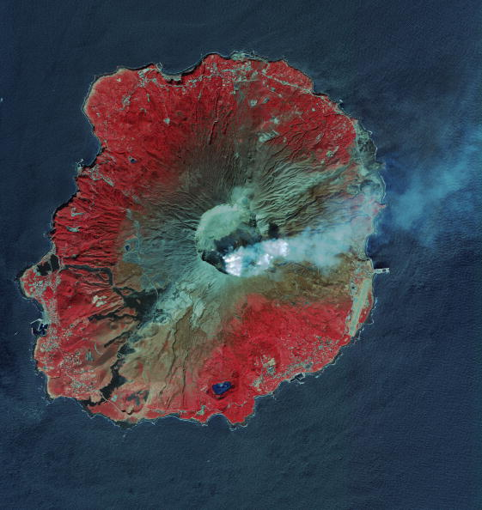

Slide 55
2.2 Section Review Questions
Explain why sample size is important in determining probability.
Explain what “the mean number of weeds in three plots of land” means.
Describe three types of models used by scientists.
Explain the relationship between probability and risk.

Slide 56
2.3 Making Informed Decisions

Slide 57
Objectives
Describe three values that people consider when making decisions about the environment.
Describe the four steps in a simple environmental decision-making mode.
Compare the short-term and long-term consequences of two decisions regarding a hypothetical environmental issue.

Slide 58
Values and the Environment
Scientific research is an essential first step in solving environmental problems.
However, before research can begin, an examination of values is usually needed.
Values are principles or standards that an individual considers to be important.
There are many values that affect environmental decision making.

Slide 59
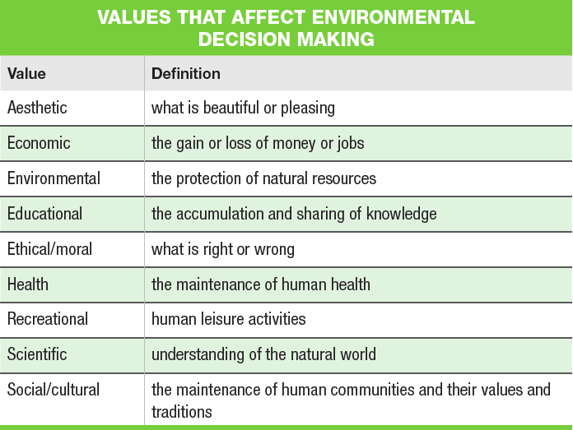
Values that Affect Environmental Decision Making

Slide 60
An Environmental Decision-Making Model
A decision-making model is a conceptual model that provides a systematic process for making decisions.
Decision-making models can be used to help you make decisions about environmental issues which can be very difficult.

Slide 61
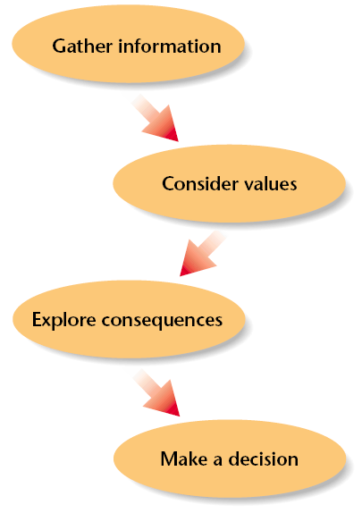
Decision-Making Model

Slide 62
A Decision-Making Model
The first step in the model is to gather information. This includes things such as watching news reports, and talking to experts.
Second, consider which values apply to the issue.
Next, explore the consequences of each option.
Finally, evaluate all of the information and make a decision.

Slide 63
A Hypothetical Situation
The golden-cheeked warbler population is declining in Valley County.
The town of Pleasanton, in Valley County, is growing rapidly, and much of the new development is occurring outside the city limits.
Biologists who have been studying the warbler warn county officials that if they do not take action, the state fish and wildlife service may list the bird as an endangered species.

Slide 64
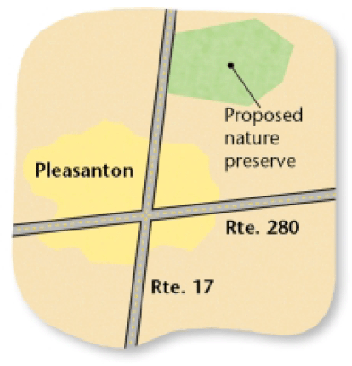
A Hypothetical Situation
Several groups join together to propose that the county buy several hundred acres of land where the birds are known to breed and save the land as a nature preserve.

Slide 65
A Hypothetical Situation
The group also proposes limiting development on land surrounding the preserve.
The group obtains enough petitions to put the issue to a vote, and the public begins to discuss the proposal.

Slide 66
A Hypothetical Situation
People who own property within the proposed preserve oppose the plan.
These property owners have an economic interest in the situation. They believe that they will lose money if they are forced to sell their land to the county instead of developing it.
Other residents do not like the idea of more government regulations on how private property can be used.

Slide 67
A Hypothetical Situation
Other landowners support the plan and fear that without the preserve the warbler will be listed as an endangered species. Once listed as endangered, the state will impose a plan to protect the bird that will require even stricter limits on land development.
People who have land near the preserve think that their land will increase in value.
Many residents also look forward to hiking and camping in the preserve.

Slide 68
How to Use the Decision-Making Model
The hypothetical situation in Pleasanton can be used to illustrate how to use the decision-making model.
Michael Price is a voter in Valley County who will vote on whether the county should create the nature preserve.
The steps Michael took to make his decision follow.

Slide 69
Gather Information
Michael studied the warbler issue thoroughly by watching local news reports, reading the newspaper, learning more about the golden-cheeked warblers from various Websites, and attended forums where the issue was discussed.
Several of the arguments on both sides made sense to him.

Slide 70
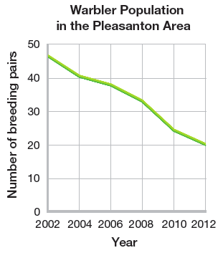
Gather Information
Michael also gathered scientific information that included graphs of the decline of the warbler population.

Slide 71
Consider Values
Michael made a table to help him clarify his thoughts and values.
Michael considered the environmental, economic, and recreational values of the preserve.
He believed these to be important, but someone else might have thought other values were more important to consider.

Slide 72
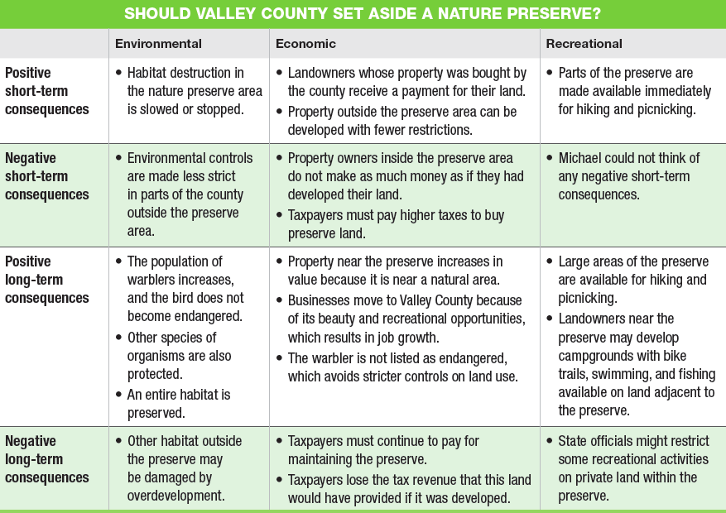
Should the Valley County Set Aside a Nature Preserve?

Slide 73
Explore Consequences
Michael decides that in the short term, the positive and negative consequences listed in his table were almost equally balanced.
For example, some people would suffer financially from the plan, but others would benefit.
Also, taxpayers would have to pay for the preserve, yet all residents would have access the previously private property.

Slide 74
Explore Consequences
It was the long term consequences that allowed Michael to make his decision.
Michael realized that the environmental values were an important factor in his decision.
The thought of the warbler becoming extinct distressed him, and protecting the habitat now would be less costly that protecting it later under a state imposed plan.

Slide 75
Explore Consequences
Michael considered that there were long term benefits as well.
He had read that property values were rising rapidly in counties where land was preserved for recreation.
He also found that people would pay more to live in counties that have open spaces.

Slide 76
Explore Consequences
Because the county contained little preserved land, Michael thought that creating the preserve would bring the county long-term economic benefits.
He also highly valued the aesthetic and recreational benefits of the preserve, such as walking trails.

Slide 77
Make a Decision
Michael chose to vote in favor of the nature preserve.
However, someone else who looked at the same table of pros and cons might have voted differently.
If you lived in Valley County, how would you have voted?

Slide 78
Make a Decision
As you learn about issues affecting the environments, use this decision-making model as a starting point to making your decisions.
Be sure to consider your values, weigh the pros and cons, and keep in mind both the short-term and long-term consequences of your decision.

Slide 79
2.3 Section Review Questions
Explain the importance of each of the four steps in a simple decision-making model.
List and define three possible values to consider when making environmental decisions.
Describe in a short paragraph examples of two situations in which environmental values come into conflict with other values.

