Slide 1
Operation Enduring Freedom (OEF), Iraqi Freedom (OIF) , and New Dawn (OND) Era Veterans and the VA System
Amy Boyles, LCSW
OEF/OIF/OND Program Manager
VA Pittsburgh Healthcare System

Slide 2
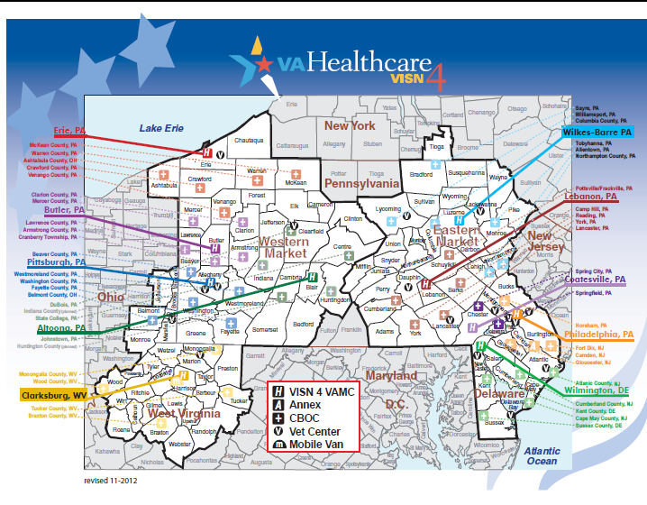
Map of VISN 4

Slide 3
Statistics
Over 2 million veterans have served in Iraq or Afghanistan since the wars began over a decade ago
Since 9/11, only 1% of Americans have served in the Iraq and Afghanistan wars
Of the over 2 million veterans who have served in Iraq or Afghanistan, over 800,000 have been deployed more than once
Above statistics taken from J. Bautista’s 2011 article in northjersey.com

Slide 4
Statistics (continued)
In May 2012, the overall unemployment rate for Iraq and Afghanistan war veterans was 12.7%, compared to the national rate of 8.2%
  For Iraq and Afghanistan war veterans age 18-24, the unemployment rate was nearly 30%
Nearly 20% of OEF/OIF veterans screen positive for PTSD or depression
10-20% of OEF/OIF veterans are suffering some level of a traumatic brain injury
There is evidence of a 21 percent excess of suicides through 2007 among OEF/OIF Veterans when their mortality was compared to that of the US general population, with adjustment for age, sex, race, and calendar year (VA Office of Environmental Epidemiology)
Veterans are more likely than the general population to use firearms as a means for suicide (National Violent Death Reporting System)
  Unless otherwise noted, above statistics are from the Iraq and Afghanistan Veterans of America (www.IAVA.org).

Slide 5
Statistics (continued)
Relationship/family problems
  A 2009 study done by Sayers, Farrow, Ross, & Oslin of 199 OEF/OIF veterans showed that 75% of the married/cohabitating veterans reported some type of family problem within the last week:
    Feeling like a guest in their own household
    Feeling their children had acted afraid of them or were not warm toward them
    Feeling unsure about their family role
  In the same study, nearly 54% of those veterans who were currently or recently separated from their partners reported conflicts involved “shouting, pushing, or shoving.”
Housing problems and homelessness
  In 2008 the foreclosure rate in military towns was increasing at 4 times the national average
  By 2009, over 2,000 OEF/OIF veterans had sought assistance through the VA homeless programs (doesn’t include those not receiving or seeking VA care)
  Unless otherwise noted, above statistics are from the Iraq and Afghanistan Veterans of America (www.IAVA.org).

Slide 6

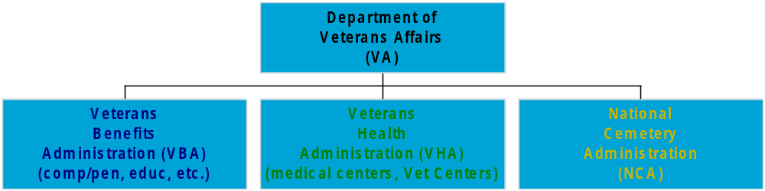
Department of Veterans Affairs (VA)

Slide 7
National Cemetery Administration (NCA)
Burial and Memorial Benefits
1-800-827-1000

Slide 8
Veterans Benefits Administration (VBA)
Compensation / Pension
Education (GI Bill)
Vocational Rehabilitation & Employment (VR&E)
Life Insurance
Home Loan Guaranty

Slide 9
Veterans Benefits Administration (VBA)
- Regional Office: 1000 Liberty Ave., Pittsburgh, PA
1-800-827-1000
www.va.gov
- eBenefits www.ebenefits.va.gov
  Access to DOD and VA records
  Monitoring open claims for benefits
  Applications for housing grants and other benefits

Slide 10
Veterans Health Administration (VHA)
Basic Eligibility Requirements
Returning Combat Veterans
  5 years eligibility post-discharge (see next slide for additional information)
Service time requirements
  Active Duty: 2 yrs with honorable discharge
  Reserve: Activated for duty orders
Special Considerations
  Vietnam Campaign Medal

Slide 11
Veterans Health Administration (VHA)
Basic Eligibility Requirements (continued)
Income Guidelines
  Veteran only: $39,435
  Veteran +1: $45,100
  Deductions
    Deduct unreimbursed medical expenses from your total gross household income.

Slide 12
Veterans Health Administration (VHA)
Eligibility/Enrollment for OEF/OIF/OND Veterans
  During the 5 years following military discharge, Veterans may receive treatment at VA Medical Centers (VAMC) for issues related to their time in service at no cost. For non-service related issues, veterans may be charged a co-payment based on their income. After five years, there may be a co-payment based on Veteran's income for all care/treatment UNLESS the Veteran is being treated for a service-connected illness, injury, or disability.

Slide 13
VHA Pittsburgh Locations
VA Pittsburgh Medical Centers
University Drive Heinz Division
(Oakland) (Aspinwall/ Fox Chapel area)
Community Based Outpatient Clinics
Greensburg, PA Monaca, PA Uniontown, PA
Washington, PA St. Clairsville, OH
Vet Centers (readjustment counseling)
Pittsburgh, PA McKeesport, PA Wheeling, WV
(Greentree) (White Oak)

Slide 14
How to get enrolled in VHA for medical care:
Seek assistance from staff in the OEF/OIF/OND program at 412-822-2362
Present to any of the VAPHS site locations and go to eligibility (Please bring a copy of your DD-214 and a photo ID.)
  University Drive: located on the first floor near the main entrance
  Heinz Division: located on the first floor of the Ambulatory Care Building (building 71)
Call 1-877-222-8387 for assistance with eligibility and getting enrolled in VA healthcare.
Online – You can navigate the website at www.va.gov or go directly to www.va.gov/healtheligibility to complete the eligibility form and submit.
* Enroll for VA care as soon as possible after discharge, and make an initial appointment after you are enrolled
to establish your care at your local VAMC.

Slide 15
Once enrolled in VHA, some of the services veterans can access:
    Screening Services (Depression, Substance Abuse, PTSD, Military Sexual Trauma, TBI)
    Preventive Services
    Primary Care
    Counseling
    Dental Care*
    Behavioral Health Services (Inpatient and Outpatient Services)
    Women’s Health
    Physical Therapy
    Prosthetics
    Prescriptions
    Substance Abuse Treatment
    Sexual Trauma Counseling
    Stress Management
    Urgent Care
    *Please see next slide for specifics on dental care

Slide 16
Dental Care
Cost-free, one-time treatment of dental conditions for recently separated Veterans who:
  served for 90 days or more
  apply within 180 days of separation
  Have no indication on DD-214 that necessary dental care was provided within 90 days of release or discharge

Slide 17
VHA OEF/OIF/OND Programs
Teams or representatives at each VA medical center devoted to helping OEF/OIF/OND Veterans transition to civilian life and coordinate their VA care.
Each returning service member has access to a care manager who can assist navigating the VA healthcare system and assisting with coordination of care.
Care managers offer returning service members individualized care and confidential, professional guidance as well as access to VA services and resources.

Slide 18
VA Pittsburgh OEF/OIF/OND Clinic
Primary Care
Behavioral health
Social work care management
Multi-disciplinary team meetings/efforts

Slide 19
OEF/OIF/OND Transition Patient Advocate
The Transition Patient Advocate serves as facilitator,
communicator, advocate, and problem solver for
severely injured Veterans.

Slide 20
VHA Programming and Services (VA Pittsburgh)
Primary Care Services
  Patient Aligned Care Team (PACT) model/multidisciplinary team (primary care provider; RN case manager; clerk; social worker; dietician; etc.)
  Referrals to specialty clinics and services
Behavioral Health Services
  Individual/group therapy
  Walk-in services
  Intensive Outpatient Program
  Post-Traumatic Stress Disorder (PTSD) Program
Specialty Medical Services/Clinics (e.g. Orthopedics, Pain management, Pulmonary, Physical therapy, etc.)

Slide 21
Healthcare for Homeless Veterans (HCHV)
Eligibility
Programs
  Domiciliary
  Hud- VASH- Veterans Affairs Supportive Housing
  Transitional Housing
Walk in services
National Call Center for Homeless Veterans:
1-877-4AID VET (1-877-424-3838)

Slide 22
Veterans Justice Outreach and
Healthcare for Re-entry Veterans Programs
For eligible veterans who are currently involved with the justice system
Veterans court (Allegheny County) – treatment in lieu of incarceration
Assistance and coordination of care for veterans being released from jail/prison (i.e. services, include assistance with housing, employment, medical, mental health, and substance abuse treatment)
**Please be aware that these programs do not provide legal services to Veterans, nor do they address whether a Veteran is competent to stand trial.

Slide 23
Recovery Programming
Center for Treatment of Addictive Disorders (CTAD)
Psychosocial Residential Rehabilitation Treatment Program (PRRTP)
Community Transition Center (CTC)
Vocational Services

Slide 24
Specialty Care Services
  Spinal Cord Injury Program
  Healthy Women’s Center
  Polytrauma Services
  Interdisciplinary Pain Rehab Program
  Visually Impaired Service Team

Slide 25
Women Veterans Programs
Women Veterans may receive
  full continuum of medical benefits package
  women’s family planning and birth control, gender-specific health care, e.g. hormone replacement therapy, breast and GYN care, maternity, limited infertility
  Special considerations
    Each facility has a Women Veterans Program Manager
    Women’s Trauma Recovery Program (Palo Alto) inpatient post traumatic stress disorder (PTSD) and military sexual trauma (MST) treatment
    VA researchers also conduct studies on women's health
    Women’s Benefits Coordinator available for disability benefits

Slide 26
Veterans Crisis Line/Suicide Prevention Program
The Veterans Crisis Line connects Veterans in crisis
or their families and friends with qualified, caring
Department of Veterans Affairs responders through a confidential toll-free hotline, online chat, or text.
Veterans and their loved ones can call 1-800-273
8255 and Press 1, chat online, or send a text message to 838255 to receive confidential support 24 hours a day, 7 days a week, 365 days a year.
http://veteranscrisisline.net

Slide 27
Caregiver Support Program
Who Is Eligible?
Veterans who sustained a serious injury – including traumatic brain injury, psychological trauma or other mental disorder – incurred or aggravated in the line of duty, on or after September 11, 2001.
Must also be in need of personal care services because of an inability to perform one or more activities of daily living and/or need supervision or protection based on symptoms or residuals of neurological impairment or injury.
Veterans must first be enrolled for VA health services, if not enrolled previously.
Services Available to Family Caregivers through this Program
Monthly stipend
Travel expenses (including lodging and per diem while accompanying Veterans undergoing care)
Access to health care insurance (if the Caregiver is not already entitled to care or services under a health care plan)
Mental health services and counseling
Comprehensive VA Caregiver training provided by Easter Seals
Respite care (not less than 30 days per year)

Slide 28
Caregiver Support Program cont.
General Caregiver Support
Caregiver Support Coordinators (CSC) – Located at each VAMC, these providers serve as clinical experts on caregiver issues including VA and non VA resources. Available to support caregivers to navigate through the VA system and provide general support and resources.
Building Better Caregivers – A Stanford University Workshop to help Caregivers take better care of themselves: a joint collaboration between the VA and the National Council on Aging.
The VA National Caregiver Support Line (CSL)- 1-855-260-3274 A confidential support line to provide emotional support and resources to family caregivers.
Support Groups – In addition to monthly support calls facilitated by the CSL, local VAMCs also offer a variety of support groups for caregivers.
Respite – 30 days of respite is provided to Veterans of all eras to support the family caregiver at home. Respite can be provided in the home setting or in a VA or VA contracted facility.
Website - www.caregiver.va.gov Provides information on available VA services and supports available to caregivers.

Slide 29
Home-Based Services
Home-Based Primary Care
Tele-health
Homemaker Home Health Aide
Community Support/Mental Health Intensive Case Management

Slide 30
QUESTIONS?
?
?
Thank you!

