Slide 1
Science and Math at Newton South High School
8th Grade Parent Night - March 2020

Slide 2
Welcome to our information session
Gerard Gagnon (Science Department Head) - gagnong@newton.k12.ma.us
Divya Shannon (Math Department Head) - shannond@newton.k12.ma.us

Slide 3
Science, Tech Ed and Engineering
Gerard Gagnon- Science Department Head

Slide 4
Why Physics First?
Intuitive
Analytical
Preparation for continued success in Science

Slide 5
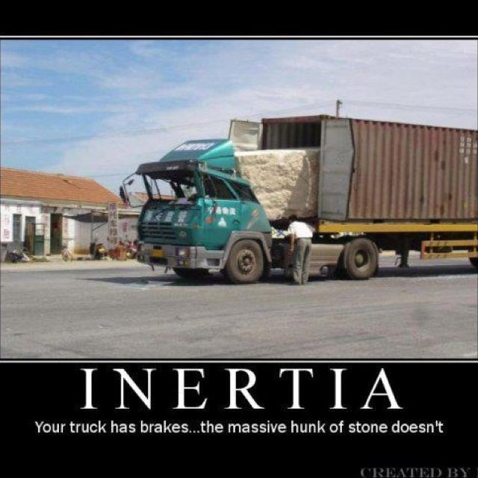

Slide 6
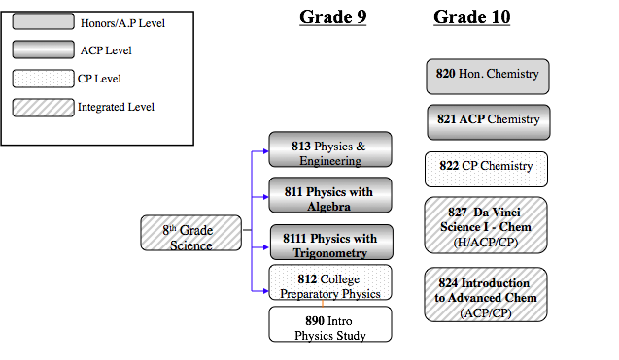

Slide 7
Clarifying the options for Freshmen
812 - College Prep
- structures in place to make work more incremental and to
explicitly build students’ toolkit for future success
811 -ACP with Algebra
- majority of students take physics in this setting problem solving uses algebra
8111 -ACP with Trigonometry - for students for whom math IS truth
813 - Physics with Engineering - Learn and Build, Tinker, two settings
with projects that reinforce physics

Slide 8
MCAS
June of 2021
At NSHS, >99% pass the first time each year
Supports in place for students identified at risk
Many steps we take to support students to satisfy the state requirement

Slide 9
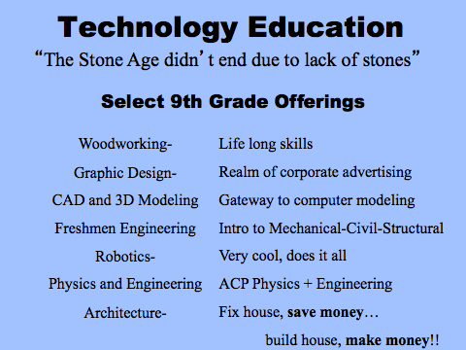
Add Engineering/Tech Slides?

Slide 10
Mathematics and Computer Science
Divya Shannon - Mathematics Department Head

Slide 11
Mathematicians
Persist through challenging problems
Communicate their ideas as effectively as possible
Don’t always get the answer, and learn from their mistakes
Are creative and try several approaches to a problems

Slide 12
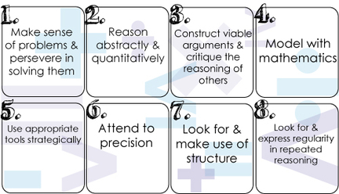
8 Mathematical Practice

Slide 13
Pathways Within The Math Department
College Prep (CP)
Once at South, there is a process to move between pathways that involves teacher recommendation
Advanced College Prep (ACP)
Accelerated Advanced College Prep (AccACP)
Honors/AP
AP Level courses are taken by junior and senior students with the appropriate prerequisite coursework

Slide 14
The Traditional Math Pathways
9th Grade
12th Grade Options
Math 1 Honors
AP Calculus BC or AP Calculus AB
Introduction to Calculus
AP Statistics
Math 1 Accelerated
Precalculus Accelerated or Precalculus/Statistics
Math 1 ACP
Precalculus ACP
Math 1 620
Algebra 1
Functions/Trigonometry
Intro. to Precalculus
Math 630
Foundations of Mathematics
Integrated Curriculum: Math 1 and Math 2 are a combination of Algebra and Geometry Concepts

Slide 15
Graduation Requirements (Math)
May 2022 (Sophomore Year)
At NSHS, >99% pass the first time each year
Supports in place during sophomore year for students identified at risk
Minimum 10 credits (2 full years) of math required ot graduate

Slide 16
Computer Programming
Introduction to Object Oriented Programming
(Unleveled Course)
Introduction to Programming and Computer Science
(Honors)
Advanced Programming with Swift OR
Introduction to IOS Programming
(Both are Honors)
Starting in 9th grade or later
Starting in 10th grade or later

Slide 17
The daVinci STEAM Program
Open to 10th, 11th and 12th graders
  10th Grade - Multi-level math and science classes, encouraged to take art
  11th Grade - Multi-level math, science and engineering courses
  12th Grade - STEAM project course
Project and Problem-Based Learning
Group work and collaboration
Small learning community

Slide 18
Resources at South
J block
After School Program
Math Center
Science Help Center

Slide 19
Who to contact if you have questions
Your student’s current math or science teacher or counselor
Gerard Gagnon (Science Department Head) - gagnong@newton.k12.ma.us
Divya Shannon (Math Department Head) - shannond@newton.k12.ma.us

