Slide 1
Standard Deviation and the Normal Model
Part 1
Reshifting Data, Rescaling Data, Z-score

Slide 2
Standard Deviation as a ruler
Standard deviation is a measure of how wide spread data values are in a distribution.
Since standard deviation tells us how a collection of values differ, it can be used as a ruler to measure different collections of groups of data.
As the most common measure of variation, the standard deviation plays a crucial role in how we look at data.

Slide 3
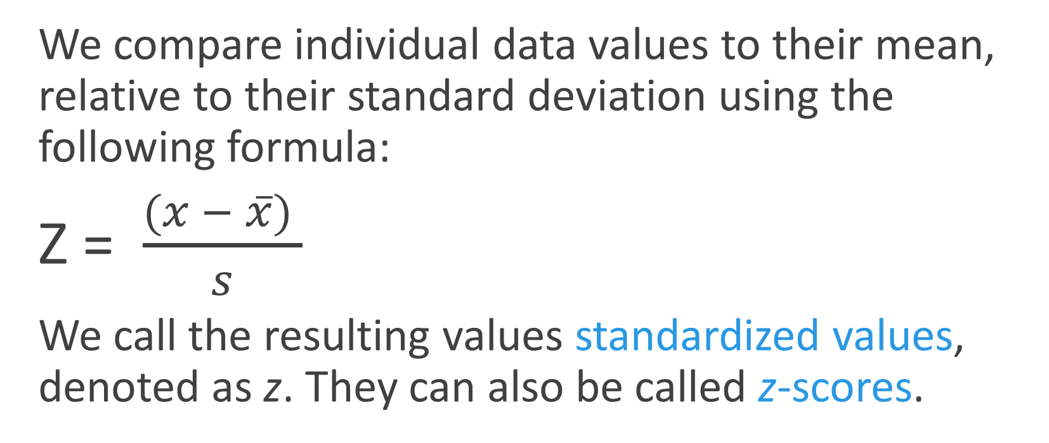
Standardizing with z-scores
We compare individual data values to their mean, relative to their standard deviation using the following formula:
Z = $\frac{(x − \overline{x}) }{s}$
We call the resulting values standardized values, denoted as z. They can also be called z-scores.

Slide 4
Z-Scores
Data values below the mean have a negative z – score.
Data values above the mean have a positive z – score.

Slide 5
Z score Example
Two Olympic Heptathlon athletes have different scores in different events. How could we compare whether their scores and choose a winner for several events?
 | Actual | Mean | Standard Deviation | Z-score
Athlete 1 800 m | 129.08 | 137 | 5
Athlete 1 Long Jump | 5.84 m | 5.98 m | .32m
Athlete 2 800 m | 130.32 | 137 | 5
Athlete 2 Long Jump | 6.59 m | 5.98 m | .23 m

Slide 6
Shifting Data – adding or subtracting
When Adding or Subtracting a constant to each value, all measures of position (center, percentiles, min, max) will increase (or decrease) by the same constant
When Adding or Subtracting a constant to every data value the measures of spread (IQR, Range, Standard Deviation) are unchanged.

Slide 7
Shifting Data – multiplying or dividing
When we multiply (or divide) all the data values by any constant, all measures of position (mean, median, and percentiles) and measures of spread ( range, IQR, and standard deviation) are multiplied or divided y that same constant.

Slide 8
Example - hams
A specialty food company sells “gourmet hams” by mail order. The hams vary in size from 4.15 to 7.45 pounds, with a mean weight of 6 pounds and standard deviation of 0.65 pounds. The quartiles and median weights are 5.6, 6.2 and 6.55 pounds.
Find the range and the IQR of the weights
Do you think the distribution of the weights is symmetric or skewed? Why?
If these weights were expressed in ounces what would the mean, standard deviation, quartiles, median, IQR and range be?
When the company ships these hams, the box and packing materials add 30 ounces. What are the mean, standard deviation, quartiles, median, IQR, and range of weights of boxes shipped (in ounces)?

Slide 9
Example: SAT to ACT Scores
Suppose you took the SAT and scored 1850 on the SAT test when the mean on the test was 1500 with a standard deviation of 250. What would an SAT score of 1850 be on the ACT test if during the same time frame the mean ACT test score was 20.8 with a standard deviation of 4.8?

Slide 10
Standard Deviation and the Normal Model
Part 2
Normal Distribution and Empirical Rule

Slide 11
Back to z-scores
Standardizing data into z-scores shifts the data by subtracting the mean and rescales the values by dividing by their standard deviation.
  Standardizing into z-scores does not change the shape of the distribution.
  Standardizing into z-scores changes the center by making the mean 0.
  Standardizing into z-scores changes the spread by making the standard deviation 1.

Slide 12
When Is a z-score Big? (cont.)
There is no universal standard for z-scores, but there is a model that shows up over and over in Statistics.
This model is called the Normal model (You may have heard of “bell-shaped curves.”).
Normal models are appropriate for distributions whose shapes are unimodal and roughly symmetric.
These distributions provide a measure of how extreme a z-score is.

Slide 13
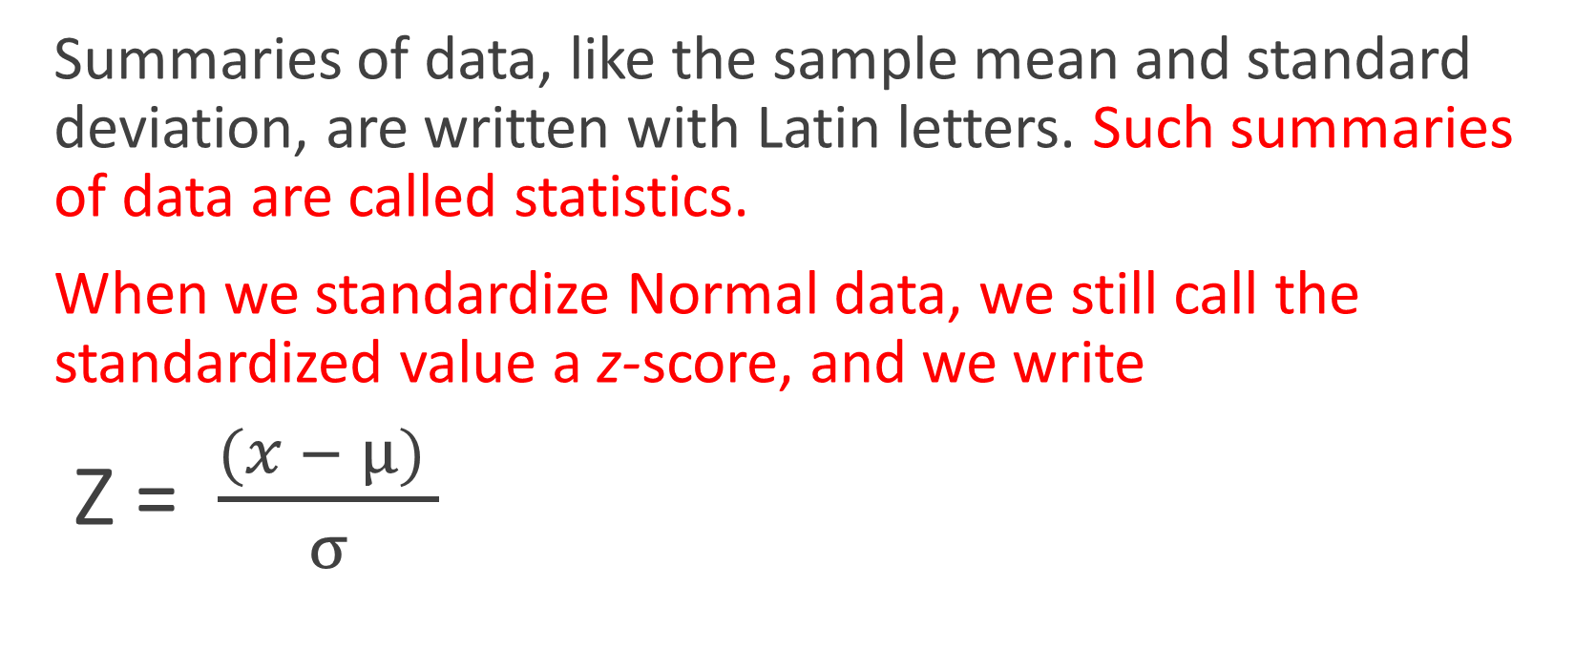
When Is a z-score Big? (cont.)
Summaries of data, like the sample mean and standard deviation, are written with Latin letters. Such summaries of data are called statistics.
When we standardize Normal data, we still call the standardized value a z-score, and we write
Z = $\frac{(x − μ) }{σ}$

Slide 14
When Is a z-score Big? (cont.)
Once we have standardized, we need only one model:
  The N(0,1) model is called the standard Normal model (or the standard Normal distribution).
Be careful—don’t use a Normal model for just any data set, since standardizing does not change the shape of the distribution.

Slide 15
The 68-95-99.7 Rule (cont.)
It turns out that in a Normal model:
  about 68% of the values fall within one standard deviation of the mean;
  about 95% of the values fall within two standard deviations of the mean; and,
  about 99.7% (almost all!) of the values fall within three standard deviations of the mean.

Slide 16
When Is a z-score Big? (cont.)
When we use the Normal model, we are assuming the distribution is Normal.
We cannot check this assumption in practice, so we check the following condition:
  Nearly Normal Condition: The shape of the data’s distribution is unimodal and symmetric.
  This condition can be checked with a histogram or a Normal probability plot (to be explained later).

Slide 17
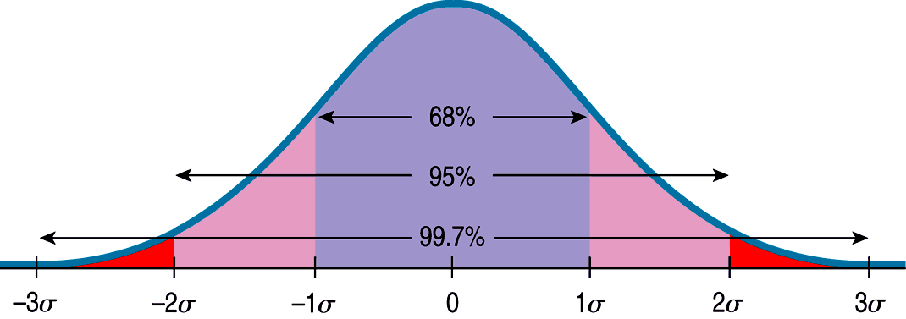
The 68-95-99.7 Rule (cont.)
The following shows what the 68-95-99.7 Rule tells us:

Slide 18
Example – driving times
Suppose it takes you 20 minutes, on average to get to school, with a standard deviation of 2 minutes. Suppose a Normal model is appropriate for the distribution of driving times.
A) How often will you arrive at school in less than 22 minutes?
B) how often will it take you more than 24 minutes?

Slide 19
Example SAT Scores
The SAT reasoning test has three parts: Writing, Math, and Critical Reading. Each part has a distribution that is roughly unimodal and symmetric and is designed to have an overall mean off 500 and a standard deviation of 100. Suppose you earned a 600 on one part of the SAT. Where do you stand among all students?
What proportion of students scored between 450 and 600, given N(500, 100)?

Slide 20
SAT scores
A college says it admits only people with SAT Verbal test scores among the top 10 %. How high a score does it take to be eligible? N(500, 100).

Slide 21
Standard Deviation and the Normal Model
Part 3
Normal Probability Plot

Slide 22
Normal Probability Plot
Enter data into a spreadsheet
Create a plot using Normal Probability Plot under plot type
Example:
Shoe Sizes {9, 8 ,9.5, 10, 12, 7, 8.5, 9, 8, 7.5, 9, 6.5, 10, 11, 9.5, 12, 8.5, 9, 8, 9, 9.5, 8.5}
*The straighter the line, the closer the shape of the distribution is to being uniform and symmetric*
If the line is curved, create a histogram to examine the shape

Slide 23
What not to do
Don’t use the Normal model when the distribution is not unimodal and symmetric
Don’t use the mean and standard deviation when outliers are present
Don’t round off too soon
Don’t round your results in the middle of a calculation
Don’t worry about minor differences in results

Slide 24
Example – cereal boxes
A cereal manufacturer has a machine that fills the boxes. Boxes are labeled “16 ounces,” so the company wants to have that much cereal in each box, but since no packaging process is perfect, there will be minor variations. If the machine is set at exactly 16 ounces and the Normal model applies (or at least the distribution is roughly symmetric), then about half of the boxes will be underweight, making consumers unhappy and exposing the company to bad publicity and possible lawsuits. To prevent underweight boxes, the manufacturer has to set the mean a little higher than 16.0 ounces.
Based on their experience with the packaging machine, the company believes that the amount of cereal in the boxes fits a Normal model with a standard deviation of 0.2 ounces. The manufacturer decides to set the machine to put an average of 16.3 ounces in each box. Let’s use that model to answer a series of questions about these cereal boxes.

Slide 25
Questions
What proportion of boxes weigh less than 16 ounces? N(16.3, 0.2)
The company's lawyers say that 6.7% is too high. They insist that no more than 4% of the boxes can be underweight. So the company needs to set the machine to put a little more cereal in each box. What mean setting do they need?
The company president vetoes that plan, saying the company should give away less free cereal, not more. Her goal is to set the machine no higher than 16.2 ounces and still have only 4% underweight boxes. The only way to accomplish this is to reduce the standard deviation. What standard deviation must the company achieve, and what does that mean about the machine?

