Slide 1
SSHS Panther Media Center
Internet Safety and Acceptable Use of Technology Training
For Students

Slide 2
Technology Policy
Lee County Schools Technology Policy
It is the intent of the Lee County Board of Education to provide its students,
with the technology, software, supportive resources, and professional development
that will help prepare them for our ever-changing technological society now and
into the 21st Century.
All students must accept responsibility for proper use of these resources. Every
individual using these resources will comply with all system policies and procedures
as well as local, state, and federal laws and/or guidelines governing the usage of
technology and its components.
Each individual will also use the system’s technology resources in an efficient
manner so as not to waste or abuse them. Technology users should adhere to rules
of protocol so as to do no harm to individuals, institutions, or companies.

Slide 3
Technology Guidelines
Technology General Guidelines #1
BE PREPARED to be held accountable for your actions.
Users must NOT harm the computers or network in any way.
Must NOT attempt to modify technology resources and configurations, change the restrictions associated with their accounts, or attempt to breach any technology resource security system with or even without malicious intent
Computer or Internet should not be used to view, sent, or display obscene, lewd, profane, vulgar, disrespectful, rude, threatening, or inflammatory language, messages, or pictures.
The posting of electronic chain letters or other useless information is a violation of system policy.
Illegal copies of software may not be created or used on school equipment.

Slide 4
Technology Guidelines
Technology General Guidelines #2
Unauthorized installation of software or downloading of files, games, programs, or other electronic media is strictly prohibited.
Accessing any work, folders, or files which are not assigned to you under your computer password is forbidden.
Individuals are not authorized to make copies of any software or data.
Do not share you computer password with another person.
Do not use the computer or Internet to reveal anyone’s personal address or phone number.

Slide 5
Internet Usage - Lee County Policy
Internet Usage – Lee County Policy
The intent of the Lee County Schools is to provide free and equal access to resources
available via the Internet with the understanding that students will access and use
information that is appropriate for instructional and educational purposes.
Internet access is a privilege, not a right!!
ALL Lee County Schools guidelines for appropriate technology usage shall apply to usage of the Internet. Internet communications are often public in nature, so all users should be careful to maintain appropriate and responsible communications.
The Lee County Schools Guidelines Regarding the Legal and Ethical Use of the
Internet and Technology Resources for Students and for Employees is located
in all student handbooks and on the Lee County Web Page {www.lee.k12.al.us} under Technology. Violators of this policy will be handled in a manner consistent with comparable situations requiring disciplinary action, including, but not limited to: (1) Loss of access
(2) Additional disciplinary action to be determined in line with existing
practice regarding inappropriate language or behavior
(3) Legal action, when applicable.

Slide 6

Lee County Student Email Guidelines
Lee County Student Email
Lee County Schools provides its students student email address for communication
between students and teachers, so that assignments and group projects may be
completed and turned in electronically as well as to provide a means of
communications about schoolwork.
Lee County Student Email login is located at http://mail.students.lee.k12.al.us
There is also a Student Email icon on students’ desktop.

Slide 7
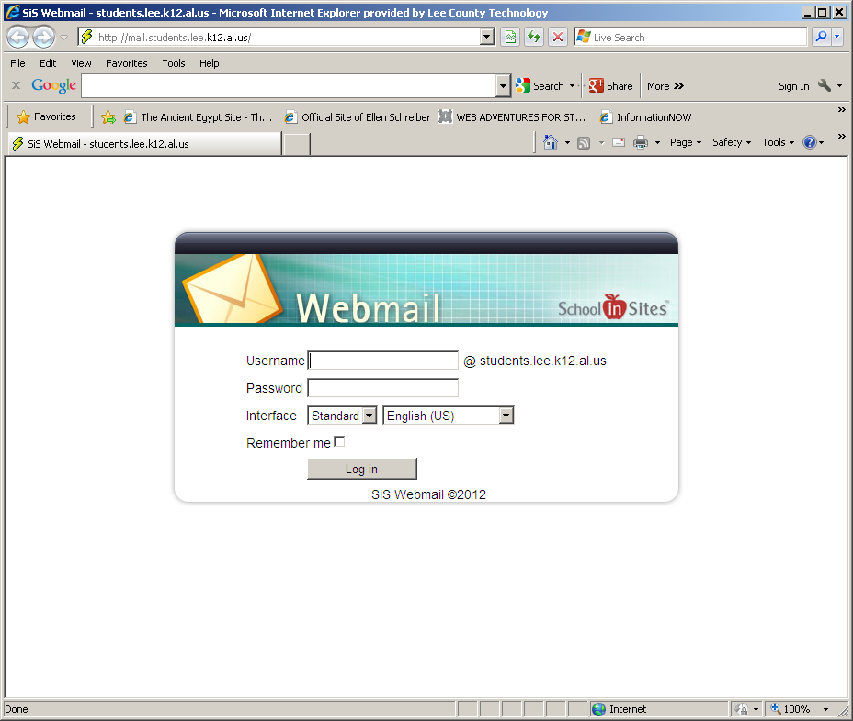
Lee County Student Email Guidelines
Lee County Student Email
Lee County Student Email login screen looks like the image below:
To log into the Lee County Student Email, you enter the SAME Username and
password that you log into the computer with.
IMPORTANT THINGS TO REMEMBER:
(1) This email address should be used ONLY for school purposes
(2) Any information in these emails are property of Lee County
(3) These emails can NOT be deleted.
(4) In the event of an investigation, school or criminal, these emails can be
and will be subpoenaed for evidence.
THINK CAREFULLY BEFORE YOU EMAIL!!

Slide 8
Cybersafety Issues
Cybersafety Issues

Slide 9
Social Networks
Cybersafety Issues:
Social Networks

Slide 10
Social Networks
Social Networks
Online places are where people can chat and post personal news, pictures,
and make comments on topics and other people are called social networks
which are the most popular use of the internet among students.
The most popular social networking websites are:
Facebook (2) MySpace (3) Twitter (4) Instagram {the latest}
Contrary to popular belief, your online presence and postings are NEVER
private!!
In fact, many different people can and will access and view your Facebook
and MySpace websites. People who may and often will view your social
network pages are future employers, college admission officers, law
enforcement officers, and unfortunately, online predators.

Slide 11
Social Networks
Social Networks
There are steps you can take to protect yourself from unwanted intrusion
in your social network website.
Limit access to your social network webpages to ONLY people that you ACTUALLY know in real life.
(2) NEVER give out any personal information that can identify you or
where you live, go to school, or locations (like stores) you frequent.
(3) NEVER post pictures or information about your friends or family without their permission.
(4) Check posted comments REGULARLY!!

Slide 12



Social Networks
Social Networks
ALWAYS THINK BEFORE POSTING MESSAGES OR PICTURES ON YOUR SOCIAL NETWORK PAGE!!
NEVER POST ANYTHING YOU WOULD NOT SAY
“FACE TO FACE” OR OFF-LINE!!
NEVER POST PICTURES THAT MAY
NEGATIVELY IMPACT YOUR FUTURE!!
Remember that any picture you upload to the internet
or writings you post to the internet can be downloaded by
anyone and be copied and re-posted online FOREVER!

Slide 13
Online Predators
Cybersafety Issues:
Online Predators

Slide 14
Online Predators
Online Predators
Unfortunately, there are persons who inhabit cyberspace who seek to find
other people, and especially teenagers, to send inappropriate pictures and
messages to or engage conversations that are inappropriate. They may also
seek to entice a person to meet them in real life in order to harm them.
These people are called ONLINE PREDATORS.
You should become wary if a person begins to ask you for very personal
information or to ask where your computer is and can you view the
computer privately. They may offer you a job, money, or may even threaten
you with physical harm or the release of embarrassing pictures or
information if you do not send them inappropriate pictures of yourself or
more information.
They may even want you to meet them somewhere by yourself.

Slide 15
Online Predators
Online Predators
How should you handle online predators? If the online conversation
becomes too personal or too inappropriate or threatening, you should:
Simply logoff without responding to the online predator
(2) Tell a trusted adult – {Parent, Teacher, School Resource Officer}
(3) Contact your internet service provider
If an online stranger wants to meet with you in real life,
DON’T BE FLATTERED….
BE SUSPICIOUS!!

Slide 16
Cyberbullying
Cybersafety Issues:
Cyberbullying

Slide 17
Cyberbullying
Cyberbullying
Cyberbullying occurs when a person uses the Internet or cell phones to
harass or intimidate another person. The following are examples of
cyberbullying:
(1) Mean, vulgar, or threatening email
(2) Humiliating text sent via cell phone
(3) Website mocking others
(4) Posting embarrassing photos or videos
(5) Impersonating someone online/cellphone to spread rumors
(6) Posting or sending sensitive, private information about another person
Handle Cyberbullying By:
(1) Talking to a trusted adult by the incident
(2) Do NOT respond to any harassing messages
(3) Save messages and internet postings for evidence
(4) Contact law enforcement with your evidence from Step #3.

Slide 18
Sexting
Cybersafety Issues:
Sexting

Slide 19
Sexting
Sexting
Sexting is when a person sends sexually explicit message or a nude/semi-
nude picture of themselves or another person electronically via
the following:
Cell Phone {Main form of distribution}
E-mail
Facebook
Sexting should NEVER be done. It is not considered a joke or just a
teenage prank.
It is considered a felony crime with serious consequences for the person
who either sends or recieves messages or images that are considered
“sexting”! If the person in the image is under the age of 18, sexting
becomes child pornography.

Slide 20
Sexting
Sexting
For both sender and possessor of image/message, consequences to be
faced for sexting include: humiliation of self and family, loss of
extracurricular activities and sports, expulsion from college, loss of
scholarships , and loss of employment. There are legal consequences as
well, including jail time and being required to register as a sex offender.
If you receive a sext from someone, even a friend, you should do the
following {otherwise you put yourself in danger of being charged with
a crime}:
(1)Report any nude image or sexually explicit message you receive on
your cell phone to an adult you trust.
(2) Do NOT delete the image or message from your phone. Take the
phone to an adult you trust.
(3) Do not attempt to handle this situation on your own.

Slide 21
Phishing
Cybersafety Issues:
Phishing

Slide 22
Phishing
Phishing
Phishing is a new type of web scam in which websites and emails are used
to deceive the reader into revealing personal and financial information
{passwords, financial records, Social Security #}, so that the reader’s
information can be accessed and used in identity theft and bank theft or
fraud.
NEVER open an e-mail or click on a web link where it asks you to update
or reveal personal information!!
Legitimate business and banks will NEVER ask for your personal or
financial information in this manner.

Slide 23
Passwords
Cybersafety Issues:
Passwords

Slide 24
Passwords
Passwords
Cybersafety also includes protecting your online information that can
include personal, school, financial, and even medical details that should
remain anonymous and protected. To protect any confidential information
or to prevent any tampering with a personal website, creating passwords
and not sharing them is EXTREMELY IMPORTANT!!
To create excellent passwords, Use a combination of upper and lowercase
letters and include numbers within the password as well.
NEVER use initials, nicknames, important dates, family or pet names or
anything that could be easily figured out by people who know you, even
they who casually know you!
Once created, NEVER divulge your password to ANYONE,
especially “friends”!! {The only exception to this would be giving it to
a trusted adult for emergency uses.}

Slide 25
Internet Safety
The SSHS Panther Media Center hopes that you will apply the
information presented to your use of technology be it a cell
phone or computer, so that each of you will use the internet
and technology safely and ethically.
Thank you for your attention to this presentation!

