Slide 1
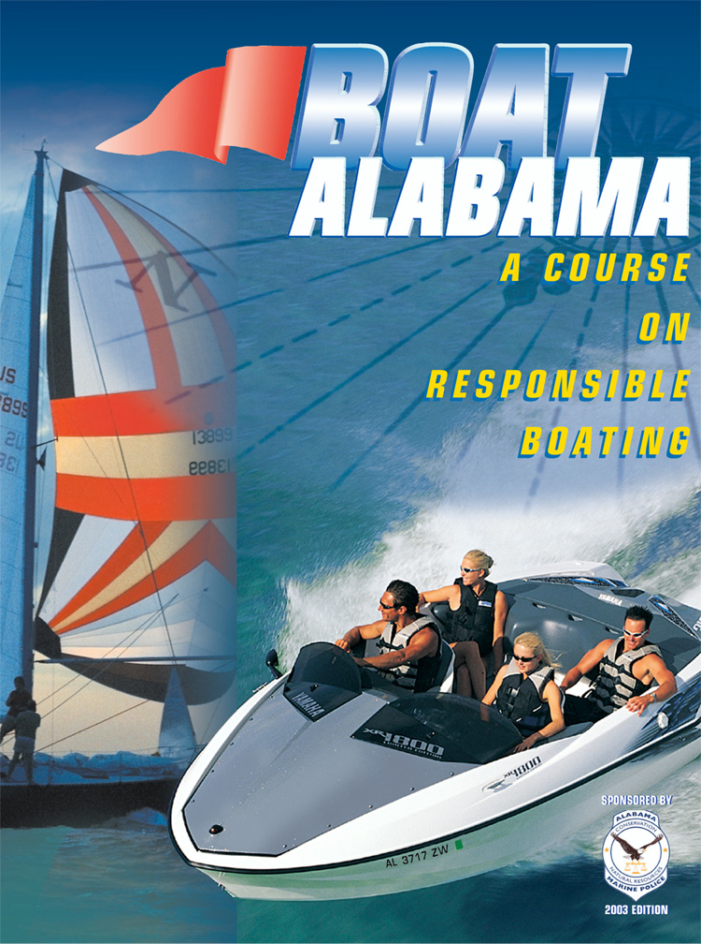

Slide 2
Class Plan
Lesson One: KNOW YOUR BOAT
Lesson Two: BEFORE YOU GET UNDERWAY
Lesson Three: OPERATING YOUR BOAT SAFELY
Lesson Four: LEGAL REQUIREMENTS OF BOATING
Lesson Five: BOATING EMERGENCIES
Lesson Six: ENJOYING WATER SPORTS

Slide 3
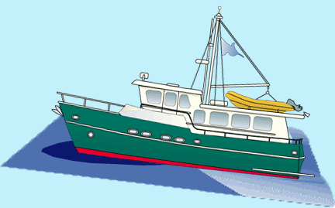
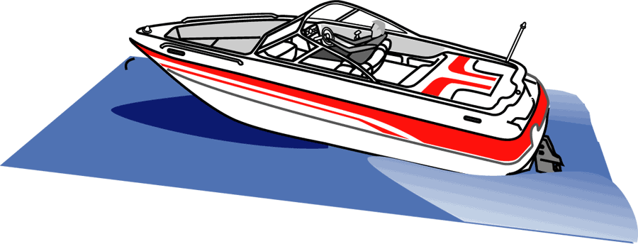
Lesson One: Know Your Boat
Hull Types and Shapes
Displacement hulls are designed to cut through water
Planing hulls rise up and glide on top of water

Slide 4


Lesson One: Know Your Boat
Hull Shapes and Types (cont.)
There are four basic hull shapes
Hull Shapes Advantages Disadvantages
Flat Bottom Hull Planing hull with shallow Rides roughly in
draft; good for fishing in choppy waters
small lakes and rivers
Deep Vee Hull Planing hull gives Takes more power
smoother ride in rough to move than a flat
water bottom hull; may
roll or bank in sharp turns

Slide 5


Lesson One: Know Your Boat
Hull Shapes and Types (cont.)
Hull Shapes Advantages Disadvantages
Round Bottom Hull Typical displacement hull Has a tendency to roll
that moves easily through unless it has a deep water even at slow speeds keel or stabilizers
Multi-Hull Another displacement Needs large area
hull; has greater stability when turning
because of wide beam

Slide 6
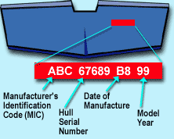
Lesson Four: Legal Requirements
Hull Identification Number
Hull Identification Number (HIN) is a unique, 12-digit number, assigned by manufacturer, to vessels built after November 1, 1972

Slide 7
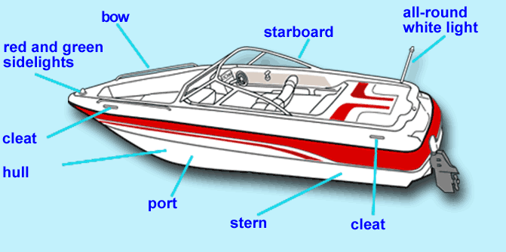
Lesson One: Know Your Boat
Vessel Terminology

Slide 8
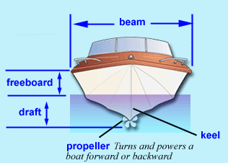
Lesson One: Know Your Boat
Vessel Terminology (cont.)
Additional term:
Transom: Vertical surface at the back of the hull

Slide 9
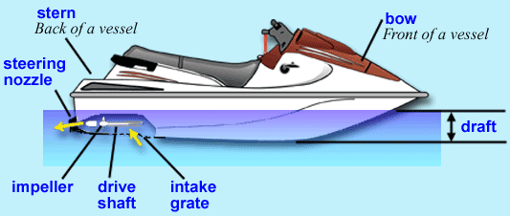
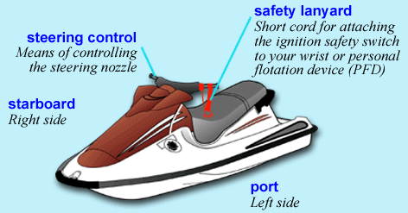
Lesson One: Know Your Boat
Personal Watercraft

Slide 10
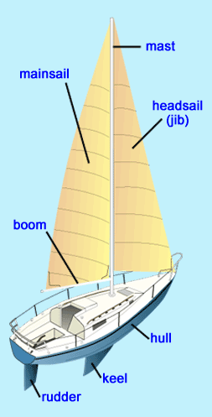
Lesson One: Know Your Boat
Sailboats
Sailboats range in size and
complexity, but basically consist of four components:
Hull carries passengers and supports rigging
Rigging includes lines, sails, boom and masts

Slide 11
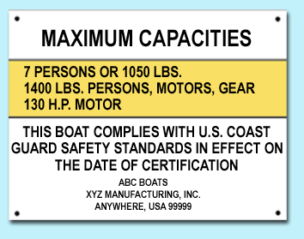
Lesson Two: Before You Get Underway
Capacity
Never take a vessel on the water with too many people
or too much gear onboard. Vessels loaded beyond capacity will more easily swamp or capsize
Capacity plate is located
near the operator’s position
or on the transom

Slide 12
Lesson Two: Before You Get Underway
Capacity (cont.)
Indicates maximum weight
capacity (including passengers,
gear and motors) or maximum
number of people vessel can
safely carry
Federal law requires single-hull
vessels have capacity plate if
less than 20 feet in length

Slide 13
Lesson Six:
Responsibilities
Operators are responsible for ensuring that their passengers understand basic safety practices and laws:
Use a pre-departure checklist to ensure you’ve taken necessary safety precautions then discuss with your passengers

Slide 14
Lesson Four: Legal Requirements
Who May Operate A Vessel
Robertson/Archer Act of 1994 requires every person who operates a motorized vessel (including PWC) on Alabama waters must first obtain a boater safety certification. Does not apply to operators of sailboats, rowboats or canoes

Slide 15
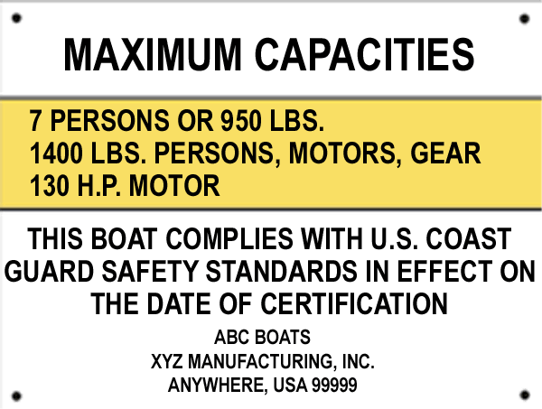
Lesson Four: Legal Requirements
Unlawful and Dangerous Operation (cont.)
Overloading or Overpowering is loading vessel with passengers or gear beyond recommended capacity (taking into consideration weather and other operating conditions) or powering vessel beyond recommended horsepower. It is illegal to operate or allow others to
operate a vessel without a
permanent capacity plate

Slide 16
Lesson Four: Legal Requirements
Visual Distress Signals
Visual Distress Signals (VDSs) allow vessel operators to signal for help in the event of an emergency
VDSs must be in serviceable condition, readily accessible and certified as complying with USCG requirements
VDSs are classified as: VDSs are either:
Day signals (visible in bright sunlight) Pyrotechnic (smoke and flames)
Night signals (visible at night) Non-pyrotechnic (non-combustible)
Both day and night signals

Slide 17




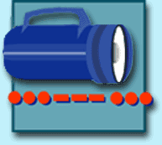
Lesson Four: Legal Requirements
Visual Distress Signals (cont.)
Pyrotechnic Visual Distress Signals
Orange Smoke Red Meteor Red Flare
Day Signal Day and Night Signal Day and Night Signal
Non-Pyrotechnic Visual Distress Signals
Electric Light Orange Flag Night Signal Day Signal

Slide 18
Lesson Three: Operating Your Boat Safely!
Docking
Docking basics:
Approach into wind if possible and move slowly
Bring vessel to stop by using reverse gear
Never try to stop with your arms or legs

Slide 19
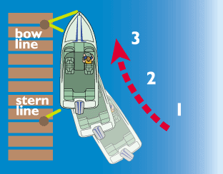
Lesson Three: Operating Your Boat Safely!
Docking (cont.)
If there is no wind or current:
Approach dock at a narrow
angle (10° to 20°)
When close enough, secure
bow line
Swing stern in, secure it, then shut off engine

Slide 20
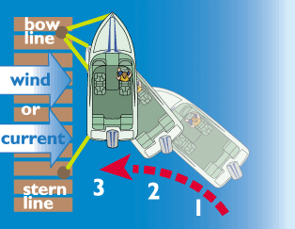
Lesson Three: Operating Your Boat Safely!
Docking (cont.)
If wind or current is pushing you away from dock:
Point bow toward dock at
40° to 50° angle; approach
dock and secure bow line
Use reverse to swing in stern
Secure stern line

Slide 21
Lesson Three: Operating Your Boat Safely!
Docking (cont.)
If the wind or current is pushing you toward the dock:
Approach parallel to dock
Allow wind and current to push you to dock
Secure bow and stern lines

Slide 22
Lesson Four: Legal Requirements
Personal Flotation Devices (PFDs)
All vessels must be equipped with USCG-approved life jackets called personal flotation devices (PFDs)
Quantity and type depends on:
  Length of vessel
  Number of people onboard and/or being towed

Slide 23
Lesson Four: Legal Requirements
PFD Requirements
All vessels must carry one Type I, II, III or V USCG-approved PFD for each person onboard or being towed. If Type V is used, must be approved for activity at hand
Vessels 16 ft. or longer must also have one Type IV USCG-approved PFD onboard
Each person onboard PWC must wear a properly secured USCG-approved PFD
Each person being towed behind a vessel must wear a properly secured USCG-approved PFD
Children under 8 must wear a properly secured USCG-approved PFD at all times while onboard any vessel, except when in an enclosed cabin

Slide 24
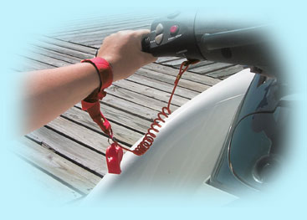
Lesson Three: Operating Your Boat Safely!
Ignition Safety Switches
Emergency ignition safety switch has lanyard which attaches operator to switch
If lanyard is removed from switch, the engine will shut off

Slide 25
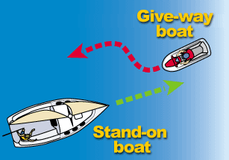
Lesson Three: Operating Your Boat Safely!
Navigation Rules (cont.)
There are two terms to help explain what to do when encountering other vessels
Give-way boat – vessel which
is required to take early and
substantial action to keep
well away from other vessels
by stopping, slowing down
or changing course

Slide 26
Lesson Three: Operating Your Boat Safely!
Navigation Rules (cont.)
Stand-on boat - vessel which should maintain its course and speed unless it becomes apparent that give-way boat is not taking appropriate action

Slide 27
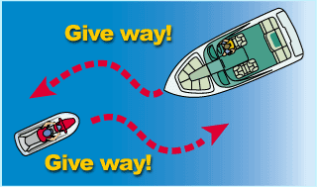
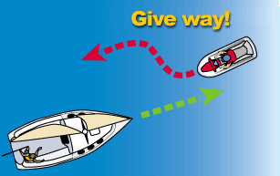
Lesson Three: Operating Your Boat Safely!
Navigation Rules (cont.)
When meeting another vessel head-on:
Power vs. Power : Neither vessel is stand-on boat -- both vessels should keep to starboard (right)
Power vs. Sail: Powerboat is give-way boat

Slide 28
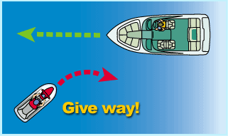
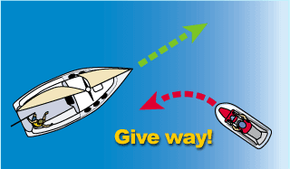
Lesson Three: Operating Your Boat Safely!
Navigation Rules (cont.)
When meeting another vessel in a crossing situation:
Power vs. Power: Vessel on port (left) is give-way boat
Power vs. Sail: Powerboat is give-way boat

Slide 29
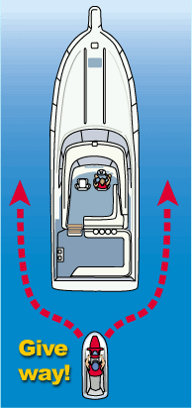
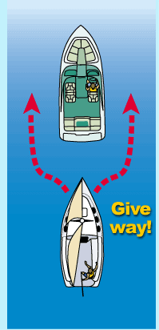
Lesson Three: Operating Your Boat Safely!
Navigation Rules (cont.)
When overtaking another vessel:
Power vs. Power: Vessel which is overtaking another vessel is give-way boat
Power vs. Sail: Vessel which is overtaking another vessel is give-way boat

Slide 30
Carbon Monoxide
Dangerous because its colorless, odorless, and tasteless
  Fatal

Slide 31
Lesson Five: Boating Emergencies
Boating Accidents (cont.)
If someone falls overboard, immediately:
Reduce speed and throw victim a PFD
Turn vessel around and carefully pull alongside victim
Stop the engine. Pull victim onboard over the stern keeping weight in the vessel balanced

Slide 32
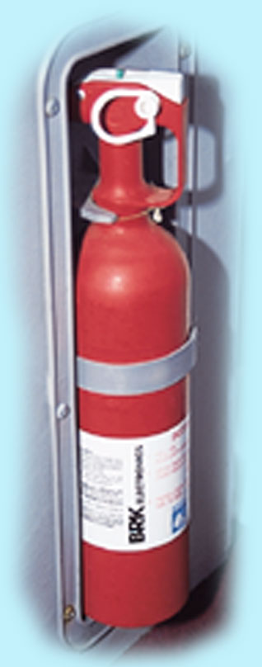
Lesson Four: Legal Requirements
Fire Extinguishers
Extinguishers are classified by a letter and number symbol
Number indicates the relative size of the extinguisher
Letter indicates type of fire it will extinguish:
  Type A: fires of combustible solids like wood
  Type B: fires of flammable liquids like gasoline or oil
  Type C: electrical fires
Approved fire extinguishers identified by “Marine Type USCG-approved” on the label, followed by size and type symbols and approval number
Extinguishers should be placed in accessible area – not near the engine or in a compartment. Be sure you know how to operate them Check all extinguishers annually to make sure fully charged. Extinguishers should be serviced at least every two years.

Slide 33
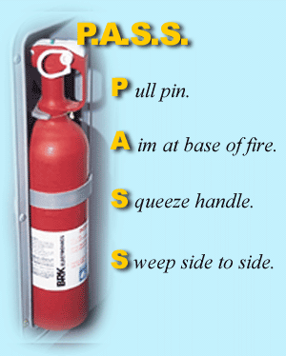
Lesson Five: Boating Emergencies
Boating Accidents (cont.)
Aim extinguisher at base of flames, and sweep back and forth
Never use water on gasoline, oil, grease or electrical fire

Slide 34
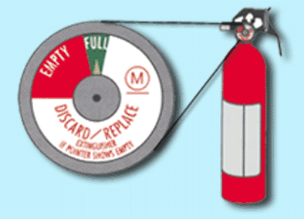
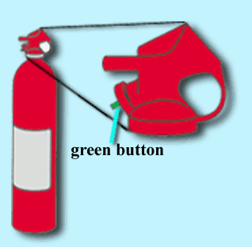
Lesson Five: Boating Emergencies
Boating Accidents (cont.)
Check the charge level of your fire extinguisher annually to make sure it is charged
To check this style, depress green button; if fully charged, button should pop back out immediately
On this style, needle
indicator should be in “full” range

Slide 35
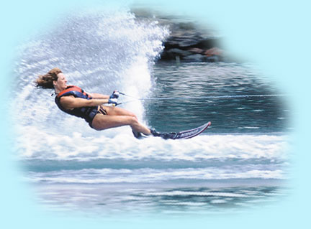
Lesson Six: Enjoying Water Sports
Water skiing
Before towing a water skier vessel operator should:
Safety: can only tow 1 hour
before sunrise and 1 hour after sunset

Slide 36
Lesson Six: Enjoying Water Sports
Water skiing
Before towing a water skier vessel operator should:
Have second person onboard
to act as observer
Review hand signals with
skier for proper
communication
Make sure skier is wearing
USGC approved PFD
Be familiar with skiing area
and any water hazards

Slide 37
Skipper Responsibilities
Keep a proper lookout to avoid collisions
Travel at safe speeds for water & weather conditions
  Visibility

Slide 38
Lesson Three: Operating Your Boat Safely!
Sound Signals
Sound signals are composed of short and long blasts:
Short blast is about one second in duration
Prolonged blast is 4-6 seconds in duration

Slide 39
Lesson Three: Operating Your Boat Safely!
Sound Signals (cont.)
Vessel operators use sound signals to communicate change in direction to other boaters:
One short blast (TOOT) tells other boaters “I intend to turn to my right”
Two short blasts (TOOT TOOT) tells other boaters “I intend to turn to my left”
Three short blasts tells other boaters “I am backing up”

Slide 40
Lesson Three: Operating Your Boat Safely!
Sound Signals (cont.)
Sound signals let other boaters know where you are during periods of restricted visibility:
One prolonged blast at intervals of no more than two minutes is the signal used by powerboats when underway
One prolonged plus two short blasts at intervals of no more than two minutes is the signal used by sailboats under sail alone

Slide 41
Lesson Three: Operating Your Boat Safely!
Sound Signals (cont.)
Sound signals are used to warn other boaters or alert them to danger:
One prolonged blast is a warning signal
Five (or more) short, rapid blasts are used to signal danger or to signal that you do not understand or disagree with the other boater’s intentions

Slide 42
Lesson Five: Boating Emergencies
Weather Emergencies (cont.)
If caught in foul weather:
Put on PFDs and make sure they are properly secured
Keep sharp lookout for other vessels and floating debris
If there is fog, sound your fog horn
Head for nearest shore that is safe to approach

Slide 43
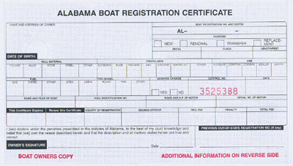
Lesson Four: Legal Requirements
Registration and Decals
You must have an Alabama Certificate of Number and validation decals to legally operate your vessel on public waters in Alabama

Slide 44
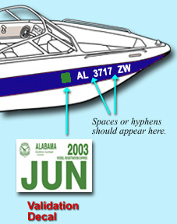
Lesson Four: Legal Requirements
Registration and Decals (cont.)
Display number and decals as follows:
Number must be painted, decaled or otherwise affixed to both sides of bow
Number must read from left to right on both sides of bow
Number must be at least 3 inches high in BLOCK letters

Slide 45
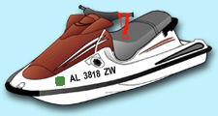
Lesson Four: Legal Requirements
Registration and Decals (cont.)
Number’s color must contrast with its background
Letters must be separated from the numbers by spaces or hyphens
No other numbers may be displayed on either side of bow
Decals must be affixed on each
side of vessel, within 6 inches
before or after, and in line with
registration number

Slide 46
Lesson Four: Legal Requirements
Who May Operate A Vessel (cont.)
Boater Safety Certification Requirements for Alabama Residents
If you are under 12 years of age as of January 1, 2002: may obtain boater safety certification after you turn 12 but may operate a vessel only if person 21 or more with a valid certification is onboard and in position to take immediate physical control of the vessel
After you turn 14 you may legally operate vessel without supervision

Slide 47
Lesson Four: Legal Requirements
Personal Flotation Devices (cont.)
Each PFD must be:
  In good condition
  Proper size for the intended wearer (based upon body weight and chest size)
  Readily available
Vessel operators should ask everyone to wear PFD

Slide 48
Lesson Five: Boating Emergencies
Weather Emergencies
To avoid being caught in foul weather:
Tune a portable radio to local station that gives weather updates
Be alert to weather you can see and check barometer
Watch for wind shifts, dark clouds and lightning. Look out for rough water
Watch weather to the west, the direction from which most bad weather arrives
Watch for fog as it creates problems especially in inlets and bays

Slide 49
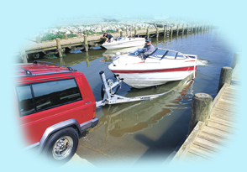
Lesson Two: Before You Get Underway
Trailering Your Vessel
Have the right trailer for your vessel:
Width and length of vessel determine width and length of trailer
Weight of vessel, engine
and gear should not
exceed 90% of trailer’s
recommended load
capacity

Slide 50

Lesson Four: Legal Requirements
Protecting the Environment
To prevent spreading aquatic pests:
Inspect vessel and trailer, removing any plants and animals you see before leaving the waterbody
Drain motor, live well, and bilge
on land before leaving the
waterbody

Slide 51
Alcohol

Slide 52



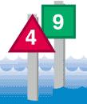
Lesson Three: Operating Your Boat Safely!
U. S. Aids To Navigation System (ATON)
U. S. Aids to Navigation System uses nuns, cans, and daymarks as lateral navigation markers:
Nuns and Cans – red triangular-shaped (nuns) or green cylindrical-shaped (cans)
Lighted Buoys – marked with Lateral System
Daymarks – red triangles or green squares attached permanently to structures; can be lighted

Slide 53


Lesson Three: Operating Your Boat Safely!
U. S. Aids To Navigation System (cont.)
Lateral Markers
Colors and numbers mean the same thing regardless of kind of buoy or marker:
Red colors, red lights, and even numbers indicate right side of channel as boater enters from open sea or heads upstream
Green colors, green lights and
odd numbers indicate left side of channel as boater enters from open sea or heads upstream

Slide 54
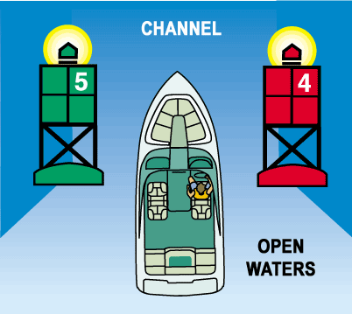
Lesson Three: Operating Your Boat Safely!
U. S. Aids To Navigation System (cont.)
Use this phrase as a reminder of the correct course when returning from open waters or heading upstream:
“Red Right Returning”

Slide 55
Lesson Six: Enjoying Water Sports
Water skiing
Before towing a water skier vessel operator should:
Have second person onboard
to act as observer/ wide angle mirror
Review hand signals with
skier for proper
communication
Make sure skier is wearing
USGC approved PFD
Be familiar with skiing area
and any water hazards

Slide 56
Lesson Four: Legal Requirements
Accidents and Casualties
Vessel operator involved in an accident must submit written report to AMPD if as a result:
  Person dies or disappears or…
  Person is injured and remains incapacitated for more than 72 hours or…
  Damage to vessel and other property exceeds $2000.00
  Give assistance to anyone injured in the accident

Slide 57
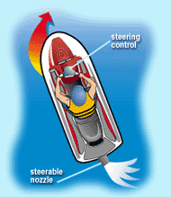
Lesson Three: Operating Your Boat Safely!
Personal Watercraft (PWC)
Steering and stopping a PWC:
PWC are steered by water being forced through steering nozzle at back of unit
Remember you must always
have power in order to maintain steering control
Always allow plenty of room for stopping

Slide 58
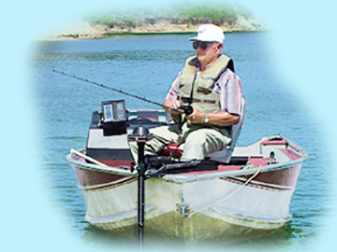
Lesson Six: Enjoying Water Sports
Fishing
Anglers using a vessel to fish should:
Know and follow all safe boating laws and requirements
Pay attention to capacity plate
and don’t overload vessel
Wear PFD especially when the
water is cold or when fishing
alone or in remote areas
Recycle or toss used fishing line
into receptacles onshore and not
into waters or onto shorelines

Slide 59
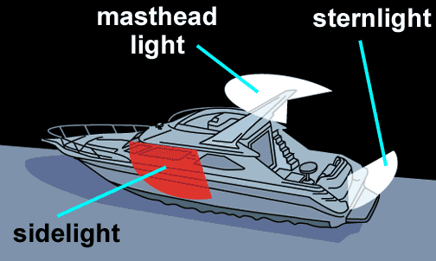
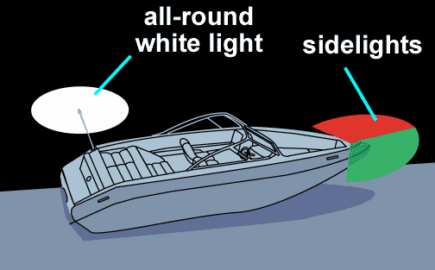
Lesson Three: Operating Your Boat Safely!
Navigation Lights (cont.)
Sidelights – red and green lights (also called combination lights) visible from side or head-on
red light indicates vessel’s port (left) side
green light indicates vessel’s starboard (right) side

Slide 60
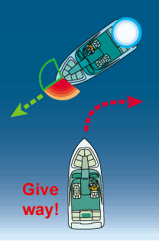
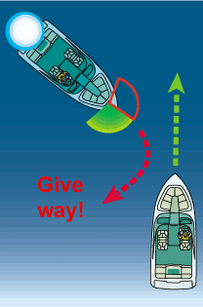
Lesson Three: Operating Your Boat Safely!
Night Navigation (cont.)
When you see red and white lights you must
give-way to other vessel
When you see white and green lights you are the stand-on boat; but, stay alert

Slide 61
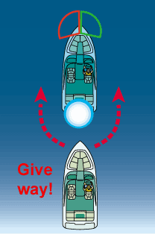
Lesson Three: Operating Your Boat Safely!
Night Navigation (cont.)
When you see only a white light, you are overtaking another vessel or it is anchored and it is the stand-on boat

Slide 62
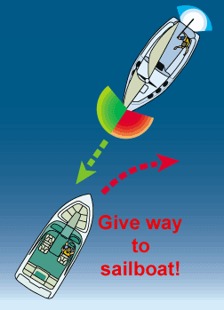
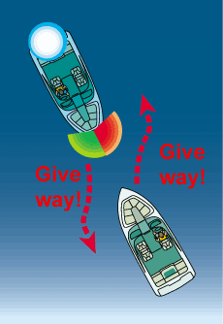
Lesson Three: Operating Your Boat Safely!
Night Navigation (cont.)
When you see red, green and white lights, you are approaching another powerboat head-on and so both boats must give-way
When you see only red and green lights, you are approaching sailboat under sail head-on and you must give-way

Slide 63
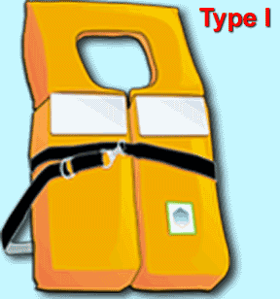
Lesson Four: Legal Requirements
Personal Flotation Devices (cont.)
Type I: Offshore Life Jackets
For rough or remote waters where rescue may take awhile
Excellent for flotation -- will turn most unconscious persons face up in water

Slide 64
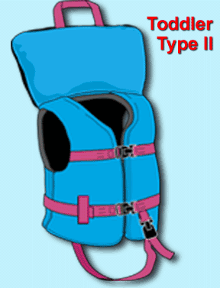
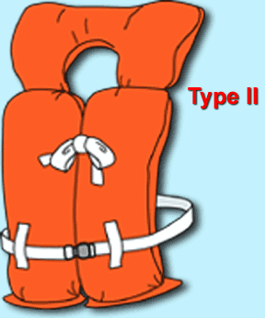
Lesson Four: Legal Requirements
Personal Flotation Devices (cont.)
Type II: Near-Shore Vests
Good for calm waters and fast
rescues
May lack capacity to turn
unconscious wearers face up

Slide 65
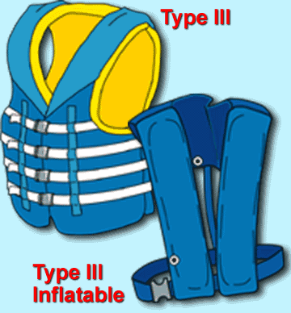
Lesson Four: Legal Requirements
Personal Flotation Devices (cont.)
Type III: Flotation Aids
Good for calm waters and fast rescues
Will not turn a person face up
Some designed to inflate when you enter water

Slide 66
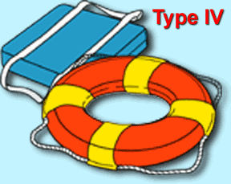
Lesson Four: Legal Requirements
Personal Flotation Devices (cont.)
Type IV: Throwable Devices
Cushions or ring buoys designed to be thrown to someone in trouble
Not for long hours in rough waters, non-swimmers or the unconscious

Slide 67
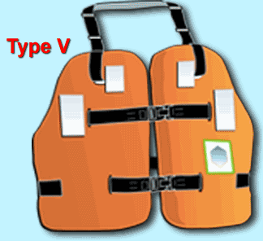
Lesson Four: Legal Requirements
Personal Flotation Devices (cont.)
Type V: Special-Use Devices
Designed for specific activities such as kayaking or water skiing
Some designed to inflate when you enter water
To be acceptable, Type V PFDs must be used in accordance with their label

Slide 68
Lesson Two: Before You Get Underway
Boating Accessories
Carry spare parts and extra fuel and oil
Carry emergency equipment and supplies
  Bailer
  Anchor
  Paddles
  Flashlight
Tool kit
Throw rope
Visual distress signals
required on high seas and coastal waters

Slide 69
Lesson Two: Before You Get Underway
Boating Accessories (cont.)
Carry compass, maps and a radio or mobile phone
Carry personal supplies and extra clothing
  First aid kit
  Sun block lotion
  Sun glasses
  T-shirt
  Drinking water
Cap
Gloves
Shoes
Wet suit

Slide 70
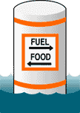
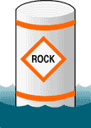
Lesson Three: Operating Your Boat Safely!
U. S. Aids To Navigation System (cont.)
Non-Lateral Markers
Most common are regulatory markers which use orange markings and black lettering, found on lakes and rivers:
Squares provide information indicating directions, distances, places, food and supplies, repairs, etc.
Diamonds warn of dangers such as rocks, dams, shoals, construction or stumps

Slide 71

Lesson Three: Operating Your Boat Safely!
Casting Off
If the wind or current is holding the vessel to the dock:
Cast off stern line. Move
and secure bow line to
mid-vessel position on dock
Put vessel slowly into forward
gear and steer bow into dock
After stern swings away from
dock, cast off bow line, and
back away

Slide 72

Lesson Three: Operating Your Boat Safely!
Casting Off (cont.)
If the wind or current is pushing the vessel away from the dock:
Cast off all lines
Push vessel away from dock
(for your vessel to be able to
turn, stern must be free to
move)
Shift to forward and slowly
leave area

Slide 73
Lesson Three: Operating Your Boat Safely!
Navigation Rules- Exceptions
If operating a power boat, you must give-way to:
Vessel not under command, such as anchored or disabled vessel
Vessel restricted in ability to maneuver or a vessel constrained by its draft such as large ship in channel
Vessel engaged in commercial fishing
Sailboat under sail unless it is overtaking

Slide 74
Lesson Five: Boating Emergencies
Boating Accidents (cont.)
If vessel sinks or floats away, don’t panic
If you are wearing a PFD, make sure it is securely fastened, remain calm, and wait for help
If you aren’t wearing a PFD, look for one floating in the water or other buoyant items to use as a flotation device
Make sure others are wearing PFDs or have a buoyant item
If there is no other means of support, you may have to tread water or simply float
In cold water, float rather than tread to reduce hypothermia

Slide 75

Lesson Five: Boating Emergencies
Boating Accidents (cont.)
Knowing your boating environment
Become familiar with locations of shallow water and submerged
objects before you go out
Learn to read chart to determine
your position and depth
Stop the engine and lift outdrive
Shift weight in the vessel to the area furthest away from the point of impact

Slide 76
Lesson Four: Legal Requirements
Who May Operate A Vessel (cont.)
Boater Safety Certification Requirements for Alabama Residents
If you are under 12 years of age as of January 1, 2002: may obtain boater safety certification after you turn 12 but may operate a vessel only if person 21 or more with a valid certification is onboard and in position to take immediate physical control of the vessel
After you turn 14 you may legally operate vessel without supervision

Slide 77
Lesson Three: Operating Your Boat Safely!
Personal Watercraft (PWC)
Steering and stopping a PWC:
14 y.o. to operate alone
MUST have a vessel license
Operate sunrise to sunset

Slide 78
Lesson Five: Boating Emergencies
Risk Management (cont.)
Minimize risk of drownings by wearing PFDs
Almost all drowning victims aren’t wearing a PFD or are wearing an inadequate one. PFDs:
Must be readily accessible
Are of proper size for intended wearer
Are in good condition

Slide 79

Lesson Three: Operating Your Boat Safely!
Anchoring
Most commonly used anchors are:
Plow style anchor good for most vessels; holds by digging itself into bottom sediments
Fluke style anchor (Danforth®) similar to plow style, but more lightweight
Mushroom anchor shouldn’t be used to anchor vessel larger than small canoe, rowboat, sailboat or inflatable since it has little holding power; never use to hold vessel in rough water or weather

Slide 80
Lesson Three: Operating Your Boat Safely!
Anchoring (cont.)
Follow these guidelines when anchoring your vessel:
Attach 7-8 feet of galvanized chain to anchor to help prevent abrasion of anchor line from sand or rock on bottom
Select area of little or no current, protected from weather
Lower anchor over the bow to bottom, then slowly back
away downwind or down current
Never anchor from stern as this can make vessel unstable

Slide 81

Lesson Three: Operating Your Boat Safely!
Anchoring (cont.)
Let out 7-10 times as much line as depth of the water
Tie off line around a bow cleat, and pull on anchor to make sure it is secure
Anchor
Chain
Line

Slide 82
Lesson Three: Operating Your Boat Safely!
Anchoring (cont.)
Guidelines for retrieving anchor:
Always retrieve anchor into vessel before leaving area
Move vessel over anchor; pulling straight up on line should break it free
When anchor breaks free, stop vessel and retrieve it
Never drag the anchor behind vessel

Slide 83
Lesson Three: Operating Your Boat Safely!
Compasses and Charts
Nautical charts are helpful when boating in bays or in large lakes; charts give:
Water depths
Locations of channels, sand bars, rocks and vegetation
Most direct courses possible

Slide 84

Lesson Three: Operating Your Boat Safely!
Compasses and Charts (cont.)

Slide 85
Lesson Four: Legal Requirements
Sound Producing Devices
Sound producing device is necessary in periods of reduced visibility or whenever vessel operator needs to signal intentions or position
On Alabama state waters, requirements for sound producing devices are:
Vessels less than 16 ft. not required but strongly recommended they carry horn or whistle
Vessels 16 ft. to 26 ft. required to carry a whistle or horn or some other means to make efficient sound signal audible for at least on-half mile
Vessels 26 ft. to 40 ft. required to carry whistle or horn or some other means to make efficient sound signal audible for at least one mile

Slide 86

Lesson Four: Legal Requirements
Backfire Flame Arrestors
All powerboats (except outboards) fueled with gasoline must have an approved backfire flame arrestor on each carburetor
Backfire flame arrestors
are designed to prevent
ignition of gasoline
vapors in case of
engine backfire

Slide 87

Lesson Five: Boating Emergencies
Risk Management
Nearly all accidents are preventable. Boating fatalities are most often characterized by:
PFDs are onboard but not in use
Good weather conditions
Involvement of small, open
vessels with a fiberglass hull
Age of the operator between
26 to 50 years

Slide 88

Lesson Four: Legal Requirements
Other Equipment and Regulations
Diver Down Flag Federal and state law requires scuba divers and snorkelers display diver down flag to mark diving area. Alabama law requires vessel operators stay at least 100 ft. from displayed flag.
A rectangular red flag, at least 12 x 12 inches, with a white diagonal stripe used to indicate presence of submerged diver in the area. Alabama law requires divers prominently display this flag and stay within 50 ft. radius of the flag

Slide 89

Lesson Five: Boating Emergencies
Boating Accidents
Capsizing is when a vessel turns on its side or completely over. Swamping is when vessel fills with water. To reduce the risk, follow these rules:

Slide 90
Lesson Five: Boating Emergencies
Boating Accidents (cont.)
Do not overload your vessel
Turning vessel at controlled speeds
Secure anchor line to bow of vessel
Don’t boat in rough water or bad weather

Slide 91
Lesson Five: Boating Emergencies
Boating Accidents (cont.)
If your vessel should capsize or swamp, or if you have fallen out and can’t get back in, stay with the vessel:
Take a headcount. Reach, throw, row or go to anyone in distress
If vessel remains afloat, try to re-board. If vessel is overturned or swamped, hang onto it. Try to get as much of your body as possible out of cold water

Slide 92

Lesson Six: Enjoying Water Sports
Responsibilities (cont.)
Boaters have a responsibility to the environment:
Keep waters clean and disease-free by properly disposing of waste and litter
Practice the three “R’s”-- Reduce, Reuse and Recycle

