Slide 1

Spring Into Reading
Literacy Night
Presented by:
Britney Calton - Reading Intervention Teacher
Sandy Armstrong - Instructional Partner

Slide 2

College and Career Readiness Standards
Standards were developed in the following Language Arts areas:
- Reading
- Writing
- Speaking and Listening
- Language
The standards define what students should understand and be able to do by the end of each grade.
Notes:
These standards drive the instruction in the classroom and Title I programs. We want to make sure our students meet the minimum requirements so they will be ready to advance to the next grade and be successful.

Slide 3

Five Components of Reading
Phonemic Awareness
Phonics
Vocabulary
Fluency
Comprehension

Slide 4

Kindergarten Expectations
Recognize and name all uppercase and lowercase letters of the alphabet.
Print many uppercase and lowercase letters
Blend simple three to four letter words
Count, pronounce, blend, and segment syllables in spoken words. Ex: elephant—3 syllables
Isolate and identify initial, medial, and final sounds in CVC words. Ex: /m/ /a/ /t/

Slide 5

Kindergarten Expectations
Name author and illustrator and what they do
Add or take away sounds in simple, one-syllable words to make new words Ex: mat --change /m/ to /c/ to make new word cat.
Capitalize the first word in a sentence and the pronoun I.
Recognize and produce rhyming words.

Slide 6
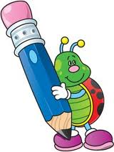
Kindergarten Expectations
Read high-frequency words (A.K.A.– Sight Words/Popcorn Words)
can
I
the
we
see
a
like
to
and
said
want
my
are
you
little
was
they
have
here
me
this
what
me
do
go
she
he
with
is
for
of

Slide 7
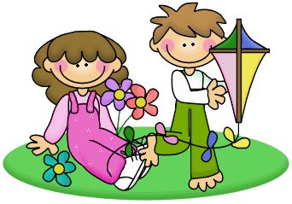
First Grade Expectations
Reading Standards
Recognize the distinguishing features of a sentence (e.g., first word, capitalization, ending punctuation).
Distinguish long from short vowel sounds in spoken single-syllable words.
Orally produce single-syllable words by blending sounds (phonemes), including consonant blends.
Isolate and pronounce initial, medial vowel, and final sounds (phonemes) in spoken single-syllable words.
Segment spoken single-syllable words into their complete sequence of individual sounds (phonemes).

Slide 8
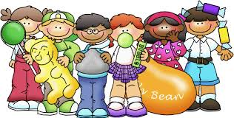
First Grade Expectations Continued
Know the spelling-sound correspondences for common consonant digraphs.
Decode regularly spelled one-syllable words.
Know final -e and common vowel team conventions for representing long vowel sounds

Slide 9
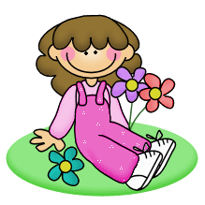
What can I do at home?
Read EVERY single day!!!!
Blend small CVC words such as bat, top, wax, dig, etc.
Read and write high-frequency words such as with and this.
Write words with letter combination patterns such as words with the silent e or “magic e”
Write complete sentences with correct capitalization and punctuation
Read aloud first-grade books with accuracy and understanding
Quickly answer addition and subtraction facts for sums up to 20

Slide 10
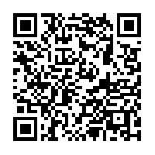
First Grade Sight Words
Scan this QR Code to get a list of 1st grade sight words!

Slide 11
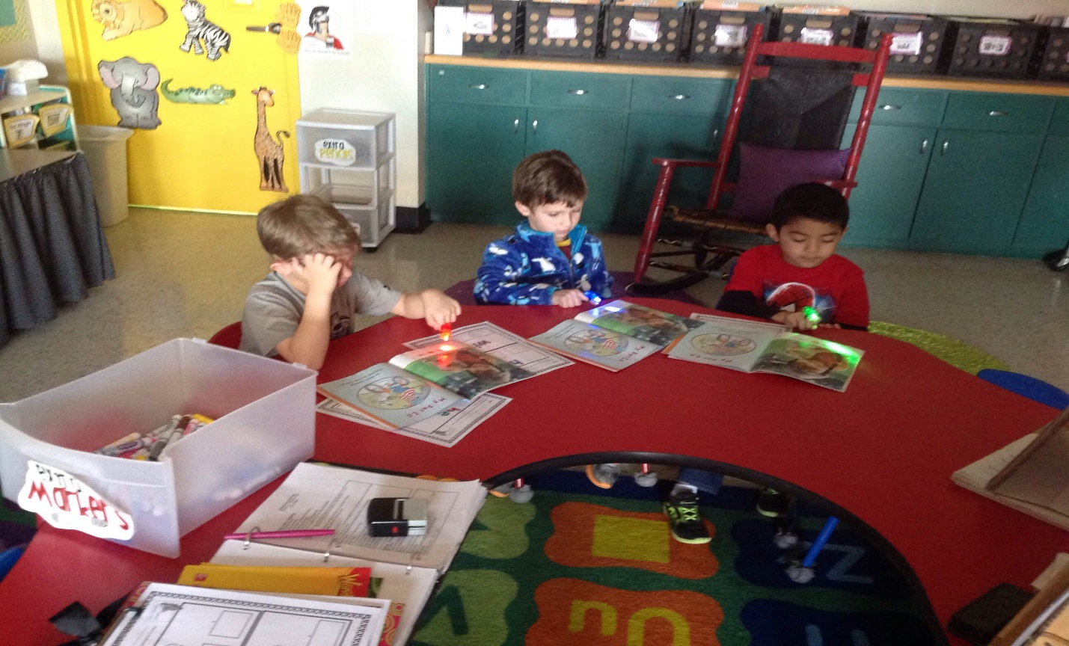
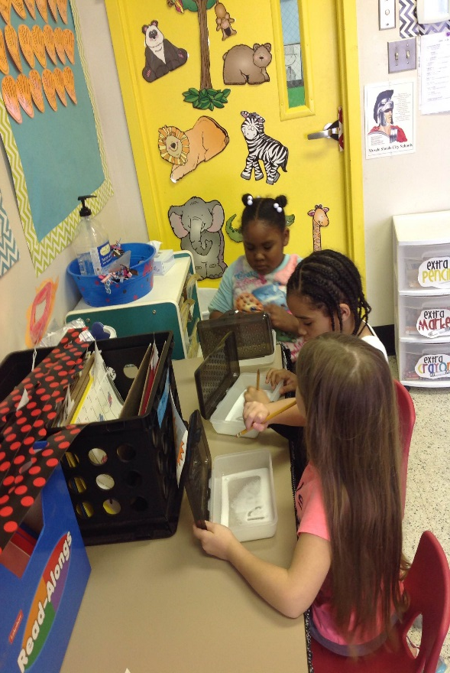
Students Reading with Finger Lights
https://drive.google.com/open?id=0Bxi0SDYbO9poc0NiOXFtM2JSTUk

Slide 12
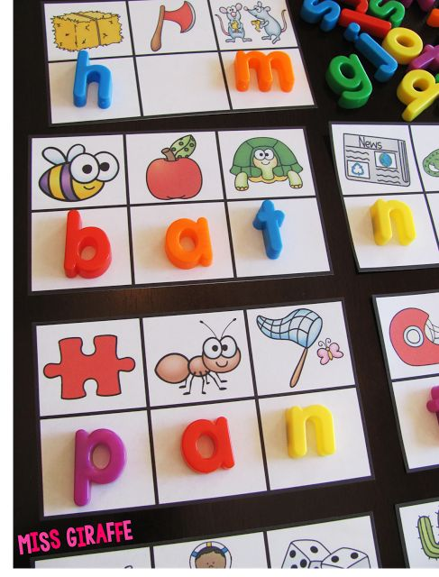
Summer Fun Ideas

Slide 13
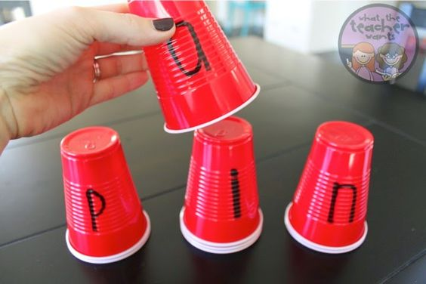
Summer Fun Ideas

Slide 14
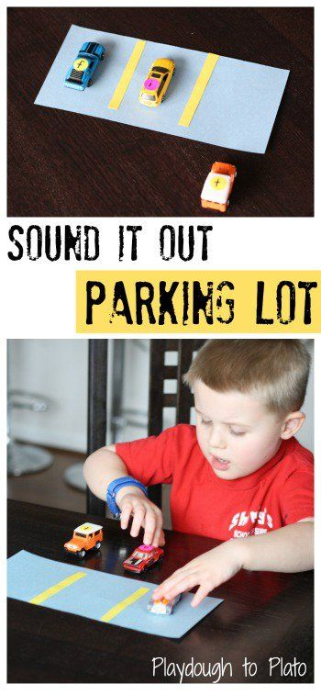
Summer Fun Ideas

Slide 15
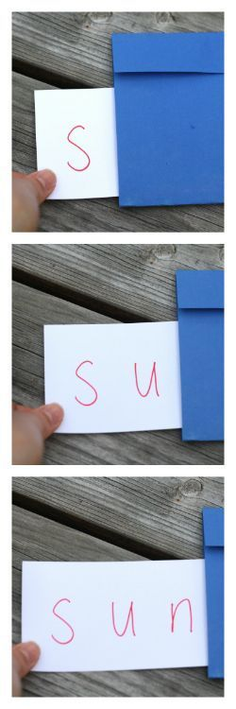
Summer Fun Ideas

Slide 16
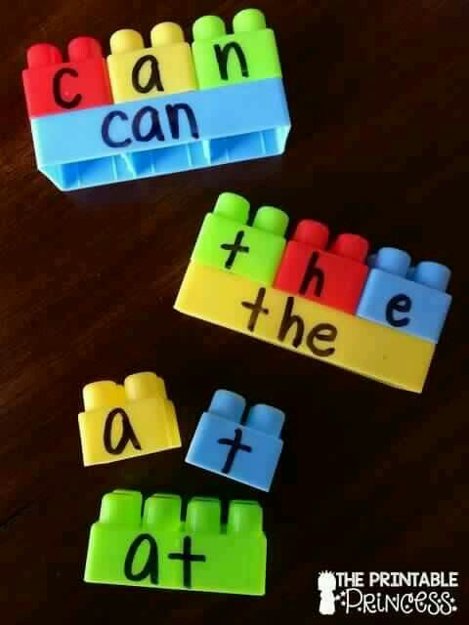
Summer Fun Ideas

Slide 17
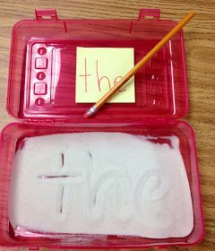
Summer Fun Ideas

Slide 18
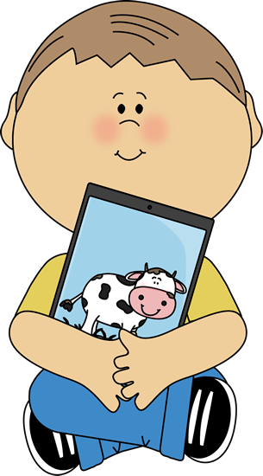
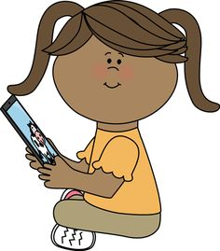
Technology
(Sandy Armstrong)

Slide 19
Questions/Concerns?
Thank you so much for coming!
If you need me at anytime please feel free to contact me! bcalton@mscs.k12.al.us

