Slide 1
Colonial Hills Literacy Night
2014-15

Slide 2
Thank you for coming!
Tonight’s Presenters:
Primary Reading: Abby Miller
Primary Writing: Sam Fell
Intermediate Reading: Rosemary Sartor
Intermediate Writing: Jan Verhoff
ELL: Yehong Liao & Deidre Rieppel
Next Generation Assessments and Technology: Martha Mickey & Julie Payne

Slide 3
Next Generation Assessments and Technology Resources
Julie Payne and Martha Mickey

Slide 4
Common Core Standards Mission Statement
“The standards are designed to be robust and relevant to the real world, reflecting the knowledge and skills that our young people need for success in college and careers.”

Slide 5
Common Core Shifts for ELA/Literacy
Complexity: The standards require regular practice with complex text and its academic language
Evidence: The standards emphasize reading and writing grounded in evidence from text, both literary and informational
Knowledge: The standards require building knowledge through content rich non-fiction

Slide 6

AIR
OCBA
American Institute for Research
Ohio Computer Based Assessments
Notes:
By way of example, let’s turn briefly to he PARCC assessment. Share what PARCC stands for. Also share what AIR stands for: American Institutes for Research and also called OCBA- Ohio Computer Based Assessments. AIR is the vendor for the science and social studies tests, similar to how PARCC is the vendor for the reading and math tests.

Slide 7

How Will PARCC Be Different?
For students:
Test quality will mirror high-quality coursework
Is computer-based, interactive, engaging
Measures the skills and knowledge students need to succeed in college and careers
Produces timely information, allowing teachers to tailor instruction to students’ needs
Includes embedded supports for English language learners, students with disabilities
*From: http://parcconline.org/for-parents

Slide 8
Round 1 – Performance Based Assessments
 | Focus of the Assessments | Performance Based Components | Expectations
Performance Based Assessments (PBA) (administered after approximately 75% of the school year) | Writing effectively when analyzing text | Literary Analysis | For each task, students will be asked to read one or more texts, answer several short comprehension and vocabulary questions. Students will write an essay that requires them to draw evidence from the text(s).
 |  | Research Simulation
 |  | Narrative
*Students are given 60-90 minutes to take each assessment.

Slide 9
Round 2 – End-of-Year Summative Assessment
 | Focus of the Assessments | Performance Based Components | Expectations
End-of-Year Summative Assessment (EOY) (administered after approximately 90% of the school year) | Reading comprehension | Session1 | The ELA/Literacy EOYs at each grade level will include 4-5 texts, both literary and informational (including social science/historical, scientific, and technical texts at grades 6-11). A number of short-answer comprehension and vocabulary questions will also be associated with each text.
 |  | Session 2
*Students will be given 75 minutes to complete each assessment.

Slide 10
Three Response Types
EBSR = Evidence Based Selected Response
  Two part multiple choice question that allows students to not only answer, but then select from a part B to show WHY they chose the answer in part A.
TECR = Technology Enhanced Constructed Response
  An item on the test uses some kind of tech to help with the answer - like drag and drop, and interactive graph, etc.
PCR= Prose Constructed Response
  Opportunities for students to write an essay - this only occurs on the English Language Arts/Literacy Performance based Assessment
http://parcconline.org/sites/parcc/files/PARCCGlossary07-01-13.pdf

Slide 11
Evidence Based Selected Response
Part A Question: | Part B Question:
In the excerpt from Brian’s Winter, Brian comes to a major realization at the end of the passage. . Which statement best describes his realization? a. He needs to avoid confronting wild animals. b. He needs to prepare for the perils of winter. * c. He needs to create a better way to store food. d. He needs to find a new, safer shelter. RL 8.3 | Which detail best supports the answer in Part A? a. “The bear...turned back to ransacking the camp, looking for where that delicious smell had come from.” (paragraph 15) b. “He would have to find some way to protect himself, some weapon.” (paragraph 19) c. “He kept putting wood on the fire, half afraid the bear would come ack.” (paragraph 20) d. “...he had missed the warnings that summer was ending...and what was coming would be the most dangerous thing he had faced...” (paragraph 21)* RL 8.1

Slide 12
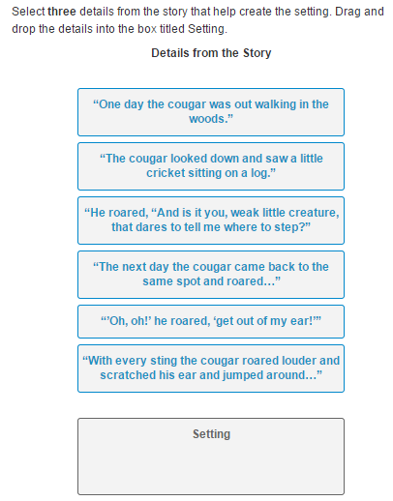
Technology Enhanced Constructed Response

Slide 13
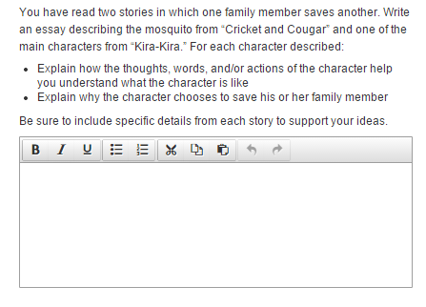
Prose Constructed Response

Slide 14
Timeline
Now- Teachers have been embedding higher-level thinking questions into instruction. Mrs. Mickey has started the tutorial with students in grades 3-6.
Coming Soon- Students will take practice tests to become familiar with test format on the computer. Curriculum based daily practice will prepare students for the level of thinking necessary.
Assessment Time-
  Performance Based Assessment- mid-February to beginning of March
  End of Year- mid- April to mid-May

Slide 15
Next Generation Learners
What are the kinds of thinking our students are being asked to do? (for PARCC but also for life)
How can WE prepare students for that thinking?
How can we communicate that testing is not an event?
  It is an on-going process.
How can we ensure the focus is on their KNOWLEDGE and not their technical skills.

Slide 16
PARCC Tutorial
PARCC Test Tutorial
  Tutorial (20 minutes): shows technology skills needed for test and sample questions
Third through sixth graders have started this at school.
Notes:
Have parents navigate to Colonial Hills site via phone or chrome book. Martha will have them use the three main tabs to see where everything is located on site.

Slide 17
Getting to Know the Test
Parcc Online- Parent Resources
http://parcconline.org/for-parents
PARCC Sample Items-
http://parcc.pearson.com/sample-items/
Tech Skill Practice-
nextgen.apps.sparcc.org/home
nextgen.nwoca.org
infohio-skills-online-testing

Slide 18
At Home
Purposeful Keyboarding practice-
  Hands on “home row”, posture and improving technique
On Colonial Hill’s School Website- Go to:
  “Library”
  Then choose “Keyboarding Skills Website”
Learning.com- Complete lessons assigned by Mrs. Mickey
Goal- Spend 15 minutes a day on Purposeful Keyboarding Practice

Slide 19
Web Resources Colonial Hills Website
Library
Keyboarding Skills Websites
Academics
Graded Course of Study
Common Core State Standards
Literacy Resources
Next Generation Assessments

Slide 20
Questions
See the PARCC website
Email -
Julie Payne- jpayne@wscloud.org
Carly McVey- carlyjmcvey@gmail.com

Slide 21
Colonial Hill’s Literacy Night
November 13th, 2014
Sessions: 6:45-7:10, 7:15-7:40
Primary Sessions Writing: Mrs. Fell (Library-Rm 16) Reading: Mrs. Miller (Mrs. Lanier’s Room-Rm 15) | Intermediate Sessions Writing: Mrs. Verhoff (Mr. Bisca’s Room- Rm 5) Reading: Mrs. Sartor (Computer Lab-Rm 16)
First Session- ELL Session: Mrs. Rieppel and Mrs. Liao (Mrs. Thornton ‘s Room-Rm. 4)

Slide 22
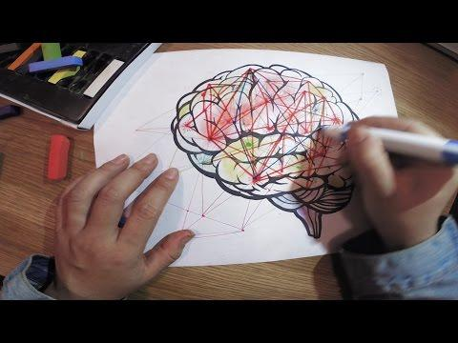
You can do anything!

Slide 23
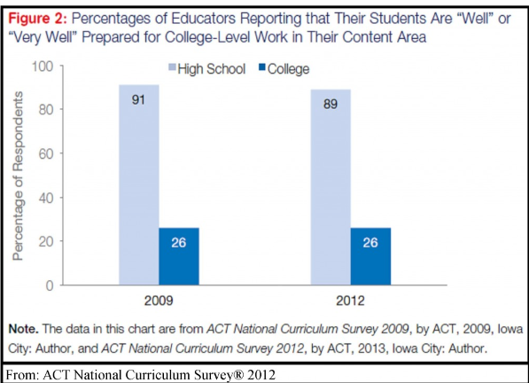
The Gap

Slide 24

How Will PARCC Be Different?
For teachers and schools:
Computer-based testing will boost student engagement and access
More efficient than pencil-and-paper tests
Timely data during the year will aid instruction, professional development
Tests will assess the full range of student performance, not just students in the middle
Tests will measure student growth at all levels as well as focusing on proficiency
From: http://parcconline.org/for-parents

