Slide 1
Defining Economics
Objective:
Define economics and discuss how the economy relates to our lives

Slide 2
Agenda
1. Announcements
2. In The News
3. Diagnostic
4. Defining Economics Activity
5. Notes – What is Economics
6. Exit Ticket: How do you fit into the economy.

Slide 3
In the News
DOW, S&P, NASDAQ
Gas near $1 per gallon
Sanders & Trump big winners in New Hampshire
  Surprise 2nd by Kasich
Americans don’t live as long !
  Drug poisoning, Car Crashes, Guns, Infant Mortality, Smoking…
Jobs
Good news: American companies are hiring, despite all the concern surrounding the U.S. economy. The number of job openings now is almost three times the 2.1 million during July 2009, just after the recession ended that June.
Bad news: The number of job openings could be a reflection of companies not finding the right candidates. Many Americans don't have the skills that those available jobs require. It's called the job skills gap, and it has become a serious problem in the U.S.
  Truck drivers, electricians & plumbers

Slide 4
Activity Instructions:
Split into 7 groups of 3 or 4
Each group stand by a poster
Each poster represents a part of the definition of economics
Brainstorm what your phrase means and how it relates to what you already know about economics (5 minutes)
Rotate
Class discussion

Slide 5

Social Science
“Hard sciences” – i.e. physics, chemistry
  Deal with structure and behavior of inanimate objects
“Soft sciences” – i.e. sociology, economics
  Involve the observation of humans
Notes:
Economics is a soft science that can be paired with a certain set of values to advance a particular political viewpoint

Slide 6

Concerned with the way society chooses
Economics does not operate by natural forces
People make choices in how the economy operates
Who are these people???
Notes:
Economics doesn’t operate by natural forces like weather (hurricanes, earthquakes etc…) but it can be affected by natural forces
What does it mean to make choices?
Who makes the choices? Consumers politicians business banks government officials

Slide 7
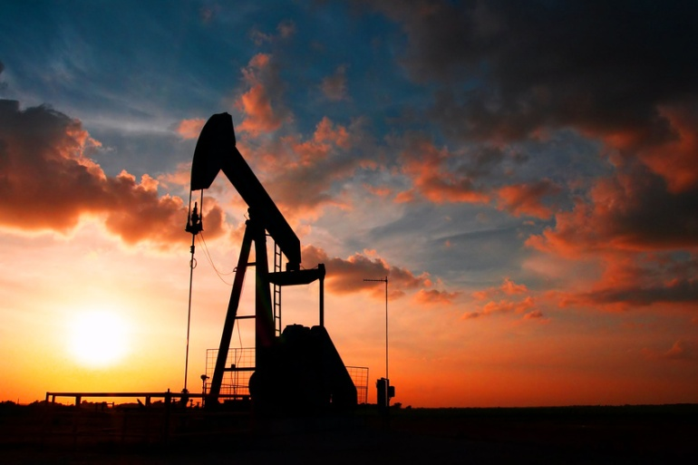

To employ its limited resources
Name some resources
Are people a resource???
Notes:
Resources: coal oil water trees
Labor: all people with their knowledge and skills – this is an important resource!!!
Unemployment in DC metro area approx 6.2% -- are we effectively using our resources???
National average is approx 9%

Slide 8
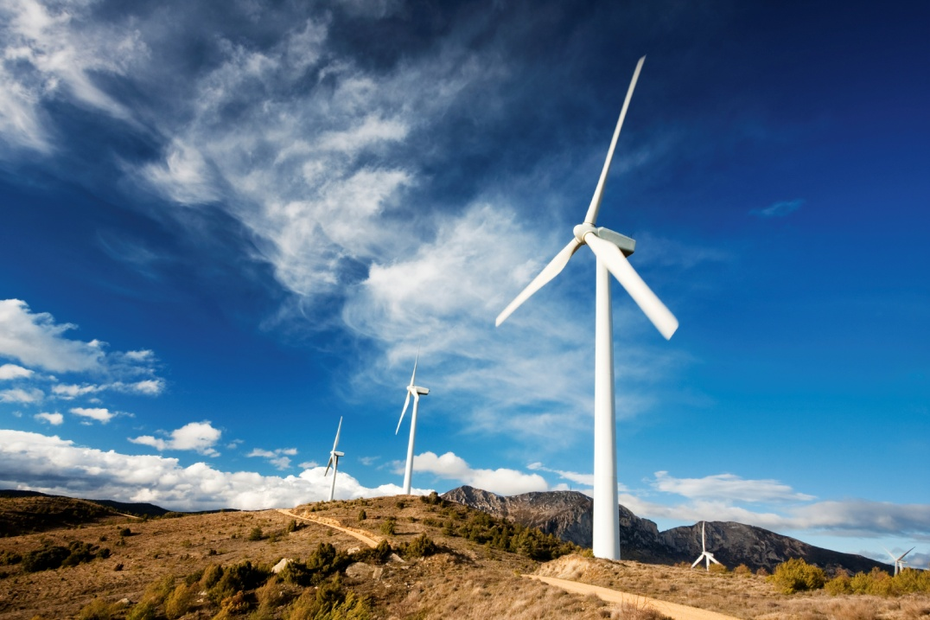
Which have alternative uses
How do we use resources wisely?
How do we use resources unwisely?
Notes:
Clear-cutting vs. selective cutting of trees
Throwing away paper vs recycling
Turning off the water when you brush your teeth

Slide 9
To produce goods and services
List some goods:
List some services:
Notes:
Goods: clothes, shoes, cars, electronics, houses, food, phones
Services: doctors, insurance agents, relators, airlines, waiters/waitresses, lawyers etc…

Slide 10
For present and future
How can we continue to use resources to produce goods and services we need now and still plan wisely for the future?

Slide 11
consumption
Consumer – a person that uses products or services, especially for personal needs
How do you consume???
Level of consumption is one indicator of how the economy is functioning
What people are consuming is also an indicator
Notes:
What does it mean to consume? – to use, to devour or absorb, to waste, to spend, to destroy
What is a consumer
How do you consume??? buy clothes & shoes to wear, Buy food, Put gas in our cars
Why is economics concerned with consumers???
Level of consumption is one indicator of how the economy is functioning
What people are consuming is also an indicator

Slide 12
Defining Economics
Economics is the social science that is concerned with the way society chooses to employ its limited resources which have alternative uses to produce goods and services for present and future consumption.
Now put it in your own words…

Slide 13
Exit Ticket:
How do you fit into the economy?
Name 4 things you know about economics
How does economics relate to your life? How does it affect your family?
What role do you and your family play in the economy?
How does the economy affect your neighborhood?

