Slide 2
The Skeletal System
Parts of the skeletal system
  Bones (skeleton)
  Joints
  Cartilages
  Ligaments
Two subdivisions of the skeleton
  Axial skeleton
  Appendicular skeleton

Slide 3
Functions of the Bones
Support the body
Protect soft organs
  Skull and vertebrae protect brain and spinal cord
  Rib cage protects thoracic cavity organs
Attached skeletal muscles allow movement
Store minerals and fats
  Calcium and phosphorus
  Fat in the internal marrow cavity
Blood cell formation (hematopoiesis)

Slide 4
Classification of Bones
The adult skeleton has 206 bones
Two basic types of osseous (bone) tissue
  Compact bone
    Dense, smooth, and homogeneous
  Spongy bone
    Small needlelike pieces of bone
    Many open spaces

Slide 5
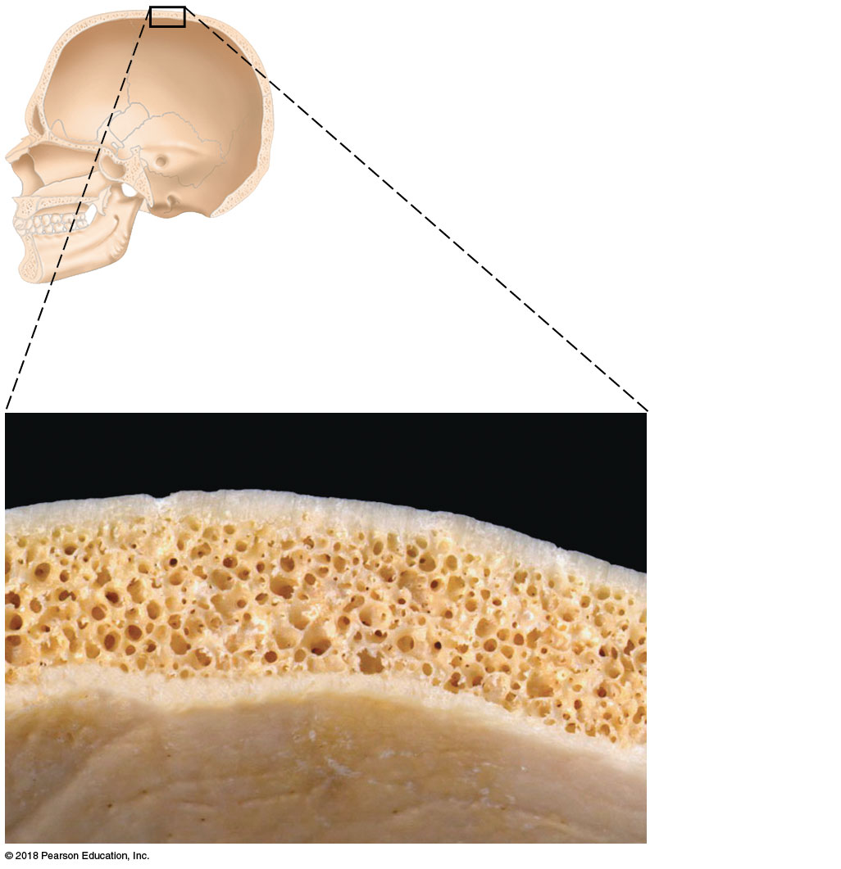
Figure 5.1 Flat bones consist of a layer of spongy bone sandwiched between two thin layers of compact bone.
Spongy
bone
Compact
bone
© 2018 Pearson Education, Inc.

