Slide 1
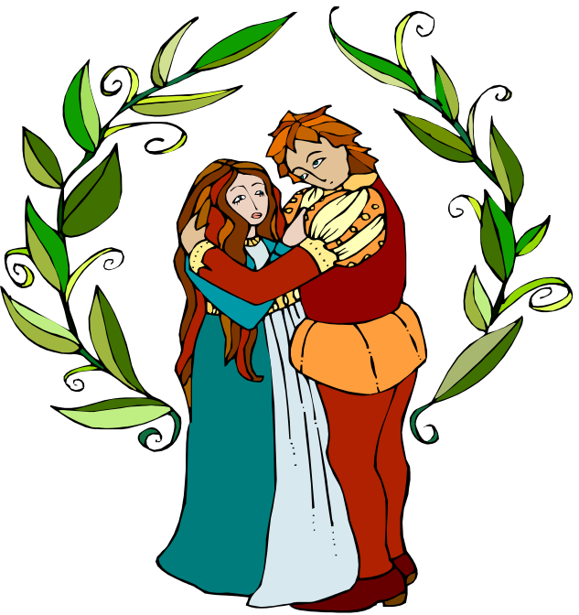
Silent Discussion: Romeo and Juliet pre-reading

Slide 2
Silent discussion directions
Take out a lined piece of paper and put an MLA header on the top left side of the paper.
As I click through this presentation, you will view many statements and respond to them with your honest and school appropriate opinion.
After you respond to each statement write your name (DO NOT INITIAL—NO CURSIVE).
You will then pass your paper and take a few minutes to read what the person in front of you wrote.
You will then respond to either what they wrote,the current question,or a mixture of the 2. When finished--again write your name.
We will repeat this process until we read all of the statements and at the very end you will find your original paper with your MLA header at the top.

Slide 3
To get full credit for this assignment…
You WILL turn in the paper at the end of class
I WILL be reading them entirely
To receive an “A” you must provide detailed, thoughtful answers/responses to most of the questions.
Write agree or disagree and WHY
The more writing, the better. Use the entire time to respond to each question
Don’t forget to write your name EVERY TIME you respond. You will receive points for each response. If you forget, you lose the point.

Slide 4
#1
It is worth sacrificing your family to be with the one you love.

Slide 5
#2
A person can be in love at age 15

Slide 6
#3
Love at first sight is possible.

Slide 7
#4
Hatred is a feeling that is taught.

Slide 8
#5
Sometimes there are valid reasons for grudges.

Slide 9
#6
There is no valid justification in killing someone.

Slide 10
#7
One should always resolve disputes (disagreements).

Slide 11
#8
Tragedies in life are always a bad thing.

Slide 12
#9
Love should be blind to family differences.

Slide 13
#10
When it comes to matters of love, trust your feelings.

Slide 14
#11
Revenge is justifiable – “An eye for an eye.”

Slide 15
#12
Men should be ruled by their passions.

Slide 16
#13
It is okay to be dishonest if the result is good.

Slide 17
#14
Parents should have some say about whom their children marry.

Slide 18
#15
The ideal age to marry is _________ because ______.

Slide 19
#16
Is there only one true love for each of us “soul mate”, or could we be happy with many different people.

Slide 20

THE END
Deliver the paper you currently have to the person whose name is at the top left of the page in MLA format.
When you get your paper back, read through the discussion that took place today amongst your peers.
On your way out of class today submit your papers to the class bin ☺

