Slide 1
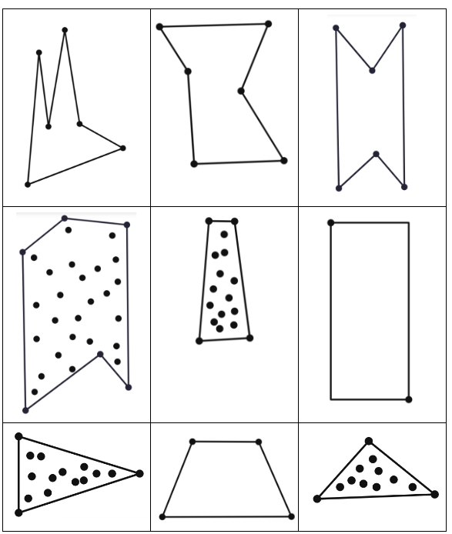
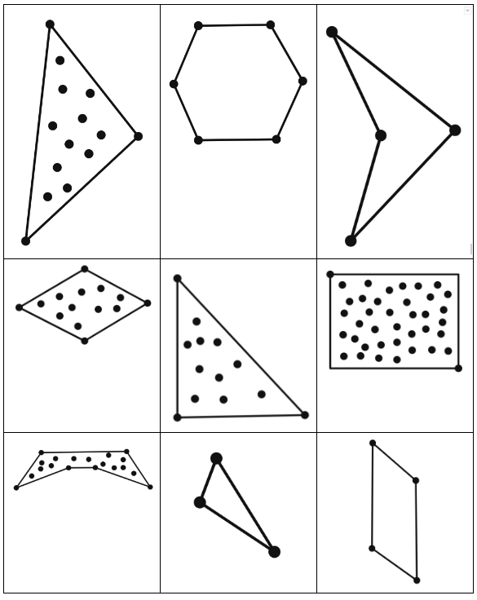
Notes:
Go to next slide for task: Printable shapes: https://docs.google.com/document/d/1io9qvdQdMGqbcudP0iWrLZ_guyPHnsImgDEt7RctvUo/edit

Slide 2
Task:
Sort shapes into groups you decide on.
Label each group.
Draw two more shapes into each group you’ve created.
Finish the sentence:
All shapes in this group ___________________________________.

