Slide 1

Entertainment History & The Economy
What role does marketing play in entertainment?
Written by: Memory Reed
Georgia CTAE Resource Network 2010

Slide 2
Intro to S&E Marketing Standard
MKT-SEM-4. Students will analyze the field of marketing as it relates to the elements of the entertainment industry: television, radio, music, movie, theater, and fine arts.
    a. Examine the history of each element and its relationship to the economy.
    b. Develop a timeline for each element.
    c. Examine the current economic impact of each element within the local, national, and international markets.
    d. Compare and contrast the current marketing trends of the elements.

Slide 3

Essential Question
Why is it important to understand how entertainment marketing affects the economy?

Slide 4
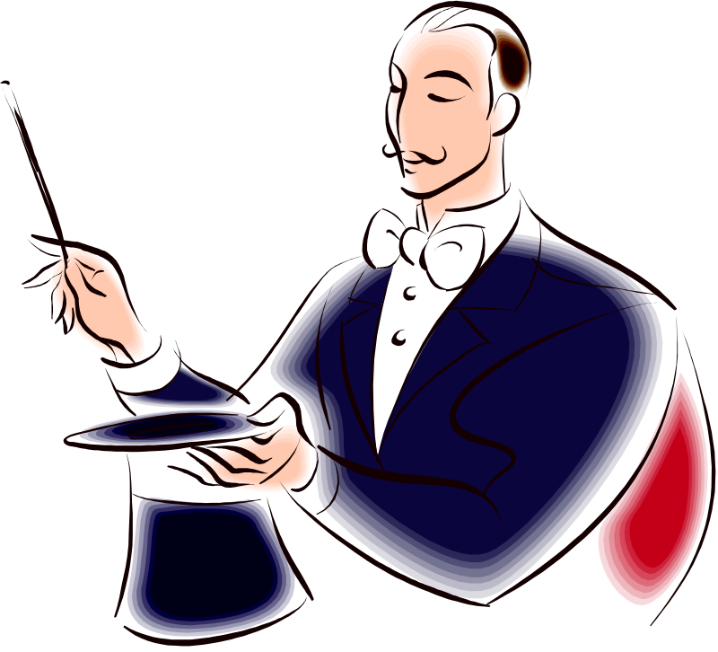
What is Entertainment?
Entertainment is whatever people are willing to spend their money and spare time viewing rather than participating in. This includes sports and the arts, and can be viewed in person, broadcast, or recorded form.

Slide 5
History of Entertainment
As long as there have been people, there has been entertainment.
Early forms of entertainment included minstrels, plays, gladiators, singing (concerts), circuses, theater, animal fights, various sporting events, and even feeding Christians to lions!
People will find ways to entertain themselves!

Slide 6
American Entertainment History
Early American entertainment included such things as:
  Minstrel shows
  Circus acts
  Musical shows
  Poetry readings
  Plays
  Wild West Shows

Slide 7
American Entertainment Cont.
Dime Shows
Medicine Shows
Burlesque Shows
Variety Shows/Vaudeville Shows
Freak Shows

Slide 8
Early Marketing of Entertainment
Marketing was mainly posters and word of mouth.
In order to enjoy entertainment, people usually had to travel, which was difficult.
Distribution was a problem since most entertainment was performing arts.

Slide 9
Theater
Theater has always had a place in human history.
People have always put on plays for others.
Though we have movies, HDTV, etc., many people still enjoy going to live theater to see performances.
Theater no longer has a major impact on our economy, but there is a place for it in the entertainment business.

Slide 10
Musical Entertainment History & Impact
Music has been a part of human history since the beginning of time. People have made instruments and sang to entertain others.
In the 1400’s during the Renaissance, the importance of secular music increased.
During the late 1500’s to early 1600’s musical drama began - opera.

Slide 11
Musical Entertainment History
Opera & ballet combined to create entertainment, and females began to become involved both in composition and on-stage.
1600’s-1700’s The Baroque period: opera, ballet, violin, musical comedy all expand and become popular.

Slide 12
Musical Entertainment
During the classical period (1750’s - ), symphonies began to take place.
Music starts changing rapidly in the U.S. as blues & jazz influences start taking place in the mid-1800’s.
1877 Edison invents sound recording and the influence of music on our culture mushrooms.

Slide 13
Musical History & Impact
Late 1800’s many cities open theaters for their local orchestras, opera houses, etc.
1930’s the swing era and the big band era begins.
1950’s Rock ‘n’ Roll begins, taking its roots from R&B.
1956 Elvis Presley emerges as one of the first rock stars.

Slide 14
Music History & Impact
The economic impact of music went from small concerts, to large concerts, record & album sales, radio success after the advent of TV was based on music, the stars brought in a lot of money with their licensed merchandise.
Musical delivery from records to iPods has transformed entertainment and the economic impact it has.

Slide 15
Short History of Film
In 1895 the Lumiere brothers were the first to present a projected movie to paying customers in a café in Paris.
The first movie with sound was The Jazz Singer which opened in the United States in 1927.
Mickey Mouse arrived in 1928 in Walt Disney’s Steamboat Willie.
10 years later Snow White and the Seven
Dwarfs became the first full length
animated film.

Slide 16
A New Form of Entertainment
July 1955 Disney opened Disneyland in Anaheim California.
With the opening of Disneyland a totally new form of entertainment was born – the theme park!
Once started, technologies of all sorts changed marketing, advertising, and distribution forever.
A current trend is to name sports arenas
for corporate sponsors.

Slide 17
History of Radio Entertainment
The beginnings of radio transmitters began in the late 1800’s, but it wasn’t until around 1922 that commercial radio began.
Entertainment radio began slowly in the 1920’s as companies started stations and began broadcasting throughout the U.S., starting in the northeast.
The first radio commercial was $100 for a10 minute message promoting the sale of apartments on Long Island.

Slide 18
Commercial Radio History
At first radio was only on for certain hours of certain days.
By 1940 programming shifted from music and local talk programs to drama and news.
There were many popular shows that were the precursors of TV shows to come.
In 1935, 2/3 of all homes had radio sets and 4 national and 20 regional networks provided programs everywhere in America
24 hours a day.

Slide 19
Impact of Radio
Radio advertising reached a high of $203 million in 1949.
Radio was a victim of its phenomenal growth, the more stations, the greater division of revenue. So, even though there was a lot of money, there wasn’t much per company.
By 1950, 94% of all households owned at least 1 radio set.

Slide 20
Television and Marketing
TV provided sports and entertainment marketers with a wide-open distribution channel into the billfolds of consumers. The market grew quickly and continues to advance throughout much of the world.
October 1945: 25,000+ people came to Gimble’s Department Store to see the first demonstration of TV.
9 TV stations and fewer than 7,000 working TV sets existed in the US when WWII ended.

Slide 21
Television’s Increasing Influence
The pricing of television commercial time is tied to the number of viewers the programming attracts.
9 TV stations in 1945 grew to 98 stations by 1949.
In 1996 there were more than 223 million TV sets with many homes having at least two.
Advertisers spent almost 42.5 billion in 1996.

Slide 22
Marketing & TV
In 1945 The American Association of Advertising encouraged the start of television advertising
Television changed the marketing of entertainment in a profound way. TV advertising hooked the imagination of the consumer
In 1946 the Gillette Company staged the first television sports spectacular – a heavy weight boxing match. There was an estimated audience of 150,000 on 5,000 sets!

Slide 23
Marketing Has to Keep Up
The marketing of entertainment is evolving faster and faster with daily changes in technology.
Products that were innovative yesterday are out-of-date today.
Information managers and promoters must be creative and forward thinking in order to anticipate the wants of the buying public.

Slide 24
References
http://articles.famouswhy.com/england_history___entertainment_and_sport_in_middle_ages/
http://www.historylearningsite.co.uk/roman_entertainment.htm
http://people.virginia.edu/~jwf8f/507.html
http://www.history.com/encyclopedia.do?articleId=216967
www.infoplease.com
http://history.sandiego.edu/GEN/recording/radio.html

