Slide 1

6/24
Do Now:
Stow your phone & earbuds in your backpack!
Collect your “Do Now!
Do the “ I + numbers” page.
Class Activities:
Students will engage in doing first day activities.
Amir introduce herself! Students will ask questions of the instructor.
Student will do there own “I am numbers”
We generate our Norms!
Student will get a card that show them their groups number!
Student will works on “ Groups Problem”
Student will present their work!
Write “Mienful Note “
Check-your-Understanding
Mild
Spicy
Ms. Amirshekari,
msoleimani@crec.org
Expectations for Success:
Be mentally present.
Ensure a safe environment for all through words and actions.
Plan on completing assignments and actively participating in the group.
Learning Targets:
Students will take the first step in collaboration by working in randomly assigned groups and taking notes.

Slide 2
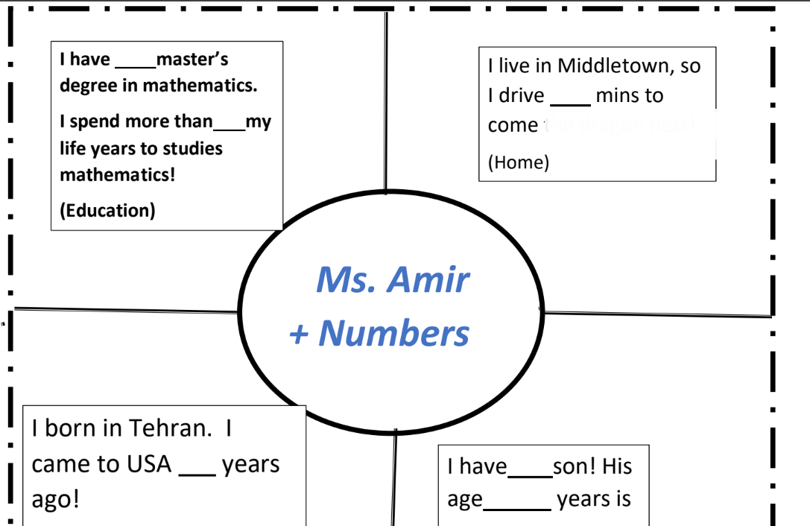
Generate your numbers!
Numbers will Introduce Amir!

Slide 3
Generating Classroom Norms
MATH +FUN in Amir Class!

Slide 4
What are norms?
Norms are a standard or patern, especialy of social behavior, that is typical or expected of a group.

Slide 5
Classroom Norms
SLANT
Respect one another's space & stuff
One “mic”- One person at a time speaking in class or within groups
Listening with the intent of understanding, learn and grow
Show that you are listening by looking at speaker (eyes on the speaker)
Body language-facing speaker, head up…
Be open to different perspectives, we may disagree with the idea, but not with the person
Be prepared for class (ex: pencil, eraser, something to take notes, focus,mindset-engage in learning

Slide 6
Sentences guide you to discussion with your partners.
2. Asking a partner about their work
How did you find your solution?
Will you explain how you got your answer?
I agree with your answer because ________
I disagree with your answer because ________
This does not make sense because ______.
Have you thought about ______________.
1. Justifying your own work.
My answer is ______. I got this by _______.
I believe the first step would be to_________.
Let me explain my thinking ___________.
I noticed that_______, so I __________.
Here is how I show my thinking __________.
Important information needed to solve this problem is ______________________.
First I thought _____________________________, but then I realized ______________

